Slide 1
JavaScript Session 5 Queue
Carol, SAP
Sep 26, 2017

Slide 2
Definition
Definition
Queue
using Array
Radix Sort
Using queue

Slide 3
Definition of Queue

Slide 4
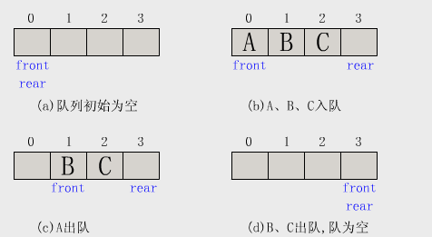
Definition
Queue : First-In-First-Out

Slide 5
Queue
Using Array

Slide 6
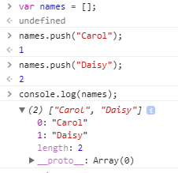
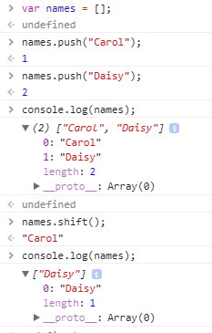
Queue with array
var names = [ ];
names.push(“Carol”);
names.push(“Daisy”);
console.log(names);
var names = [ ];
names.push(“Carol”);
names.push(“Daisy”);
console.log(names);
names.shift();
console.log(names);

Slide 7
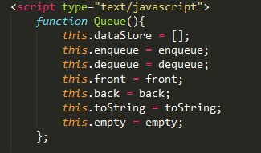
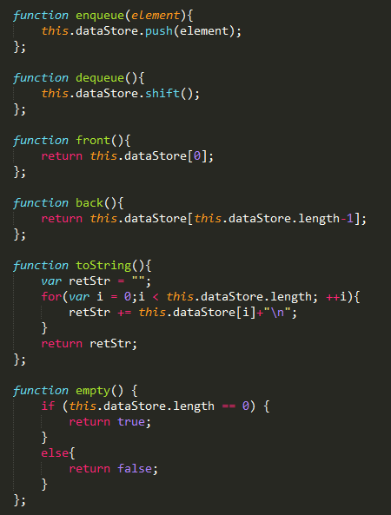
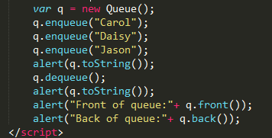
Queue with array
this指的就是new出来的这个instance, 即q
Part 2
Instance
实例化
Part 1
Constructor
构造函数
Part 2
Function
方法

Slide 8
Radix Sort
Using Queue

Slide 9
Radix Sort
91, 46, 85,15,92,35,31,22
Bin 0:
Bin 1:
Bin 2:
Bin 3:
Bin 4:
Bin 5:
Bin 6:
Bin 7:
Bin 8:
Bin 9:
91,31
22,92
85,15,35
46
Bin 0:
Bin 1:
Bin 2:
Bin 3:
Bin 4:
Bin 5:
Bin 6:
Bin 7:
Bin 8:
Bin 9:
15
22
31,35
46
85
91,92
91, 31,92,22,85,15,35,46
15,22,31,35,46,85,91,92

Slide 10
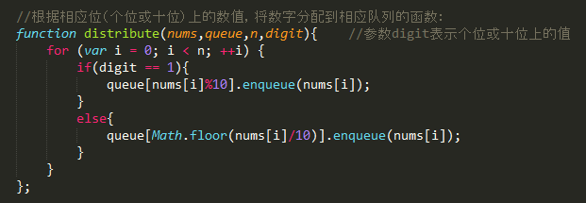
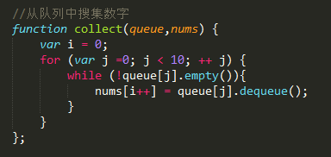
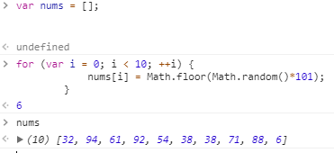


Key method
10 queues
Function1- single/ tens digit sort
Function2- collection
Random digit
Function1
Function2
Random digit
10 queues

Slide 11
Thank you.
Contact information:
Carol Shi

