Slide 1

NGS RNA-Seq Data as Relative Abundances:
Implications for quality control and analysis
Bonnie LaFleur, Dominic LaRoche*, Kurt Michels, Shripad Sinari, and Dean Billheimer
(16 May 2016)
*dlaroche@email.arizona.edu
Notes:
Good morning. I will be presenting our poster on: NGS RNA-Seq Data as Relative Abundances: Implications for quality control and analysis. Our poster highlights some of the advantages of understanding the relative frequency nature of NGS RNA-Seq data.

Slide 2
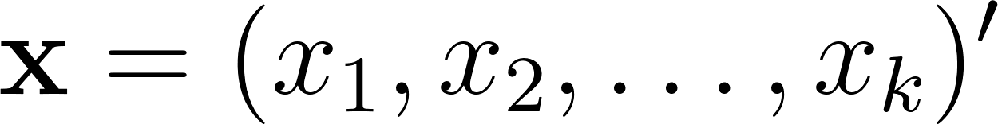
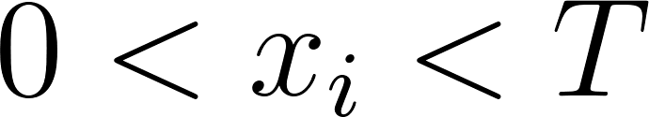
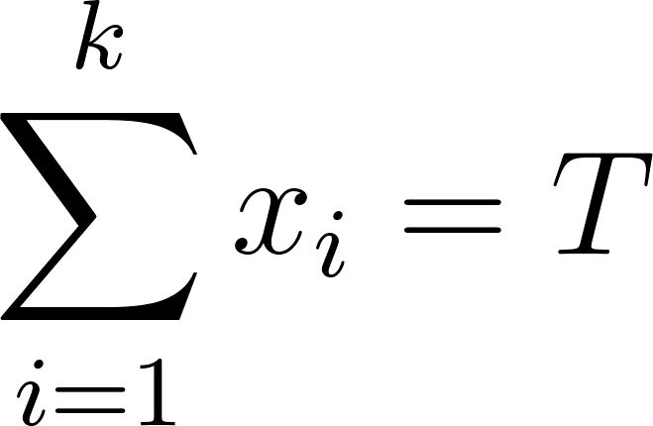
Compositional Data
vector of proportions
all components positive
sum to a constant
(often T=1)
Positivity and summation constraint complicate analysis
Complicated covariance structure (Aitchison, 1982)
As one component increases some other(s) must decrease
“Spurious correlation” (Pearson, 1897) - “fraught with difficulty and danger”
Notes:
I will begin with a brief background on relative frequency measurements, commonly referred to as compositions. A composition is a vector of proportions, which necessarily means that all the components are positive, and which all the components sum to a constant. The positivity and summation constraint have important consequences for analyses of compositions. John Aitchison identified some of the difficulties of interpretation of the covariance structure of a composition, such as the negative bias problem; and, as far back as 1897 Karl Pearson identified a spurious correlation problem. Clearly, compositions require special care in the analysis.

Slide 3
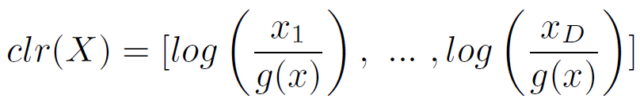
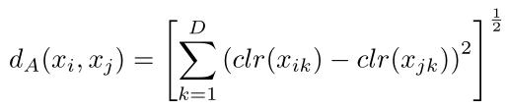
RNA-Seq Data is Compositional
RNA-Seq data from next-generation sequencing is compositional
Data is positive ☑
Sum constraint from limited number of available reads ☑
Methods exist for analysis of compositions (Aitchison 1985)
Log-ratio transformation:
Compositional distance:
Notes:
We propose that RNA-seq data are compositions. The data are always positive and, most importantly, arise as proportions of some limited number of available reads. Although large, the number of reads available in a sequencing run is finite, which imposes a sum constraint. If more reads are allocated to 1 transcript, fewer reads are then available for the other transcripts. As one goes up, the others must come down. This is the signature of a composition. Fortunately, there is already a substantial body of literature on the analysis of compositions so there are already methods for dealing with this type of data. Specifically, we highlight two methods, the clr and the Aitchison distance. These two methods allow us to perform many typical analyses on compositional data.

Slide 4
Summary of Poster
Features in RNA-Seq (targeted and de novo) can be viewed as compositions of totals
Mathematical properties of compositional data are well established
CPM transformation is a type of compositional transformation
Quality control metrics can be derived from properties of a composition
Outlier and influential sample features can be identified using well-established normal theory on transformed data
Compositional geometry enhances multivariate feature evaluation
Aitchison distance is equivalent to Euclidean distance when using clr transformation
Notes:
In our poster we outline how the features in RNA-Seq data can be viewed as compositions and we provide a brief introduction to some of the mathematical properties. We highlight how some operations already in use for RNA-Seq data, like the CPM transformation, are compositional operations. We also describe how the specific geometry of compositions can be used to identify problematic samples and enhance multivariate feature evaluation. If you want to learn more, or if you have any questions about our approach, please come see me during the poster session.

Slide 5
Contact Information
Session Info
Session 375
10:30am -12:20pm
Contact Info
dlaroche@htgmolecular.com

