Slide 1

Relative frequency measurements: Metrics for sample quality, sequencing integrity, and batch effects in targeted NGS
Bonnie LaFleur, Dominic LaRoche, Kurt Michels, Shripad Sinari, and Dean Billheimer
(16 May 2016)

Slide 2
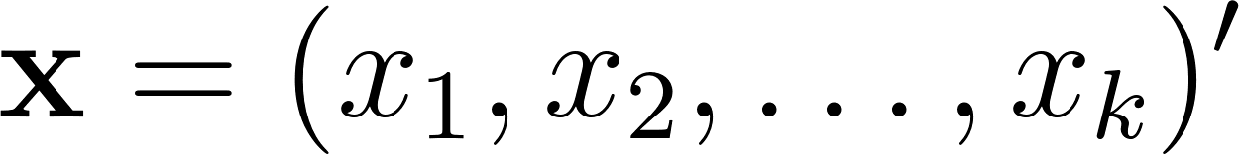
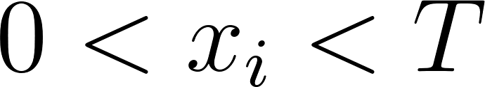
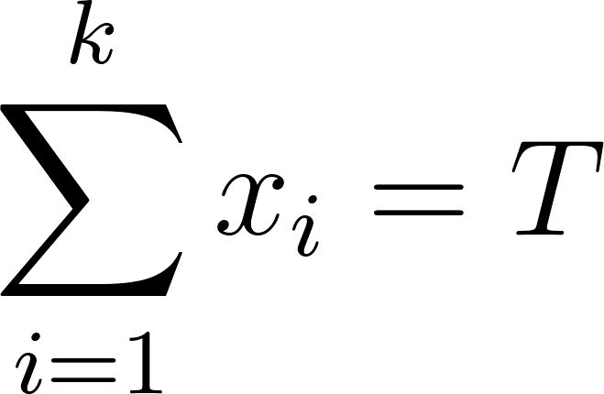
Compositional Data
vector of proportions
all components positive
sum to a constant
(often T=1)
Positivity and summation constraint complicate analysis
Complicated covariance structure (Aitchison, 1982)
As one component increases some other(s) must decrease
“Spurious correlation” (Pearson, 1897) - “fraught with difficulty and danger”

Slide 3
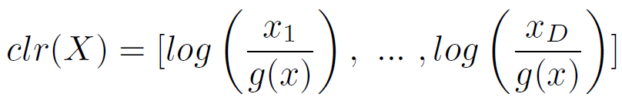
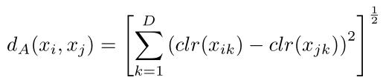
RNA-Seq Data is Compositional
RNA-Seq data from next-generation sequencing is compositional
Data is positive ☑
Sum constraint from limited number of available reads ☑
Methods exist for analysis of compositions (Aitchison 1985)
Log-ratio transformation:
Compositional distance:

Slide 4
Summary of Poster
Evaluation of features in RNASeq (targeted and de novo) can be viewed as compositions of totals
Mathematical properties of compositional data are well established
CPM transformation is a type of compositional transformation without some of the geometric benefits
Quality control metrics can be viewed as detection of unexpected data features
Outlier and influential sample features can be identified using well-established metrics on transformed data
Compositional geometry enhances multivariate feature evaluation
Aitchison distance is equivalent to Euclidean distance when using clr transformation

