Slide 1
Malaria Prevention: Are high-risk households receiving treatments?
Dominic D. LaRoche

Slide 2
Introduction
Malaria is a dangerous infectious disease transmitted by mosquitoes

Slide 3
Introduction
Malaria is a dangerous infectious disease transmitted by mosquitoes
Mosquito exposure prevention can be an effective mechanism for malaria control
Bed Nets
Aerial Spraying

Slide 4
Introduction
Not all households have the same risk from malaria exposure

Slide 5
Introduction
Not all households have the same risk from malaria exposure
Some households have a greater risk of poor outcomes
Children under 5 or adults over 65

Slide 6
Introduction
Not all households have the same risk from malaria exposure
Some households have a greater risk of poor outcomes
Children under 5 or adults over 65
Some households have greater risk of mosquito exposure

Slide 7
Introduction
Need to target exposure abatement treatments to those in the population most at risk
Both bed nets and aerial spraying are administered to households
Households with vulnerable individuals
Households with high risk for mosquito exposure

Slide 8
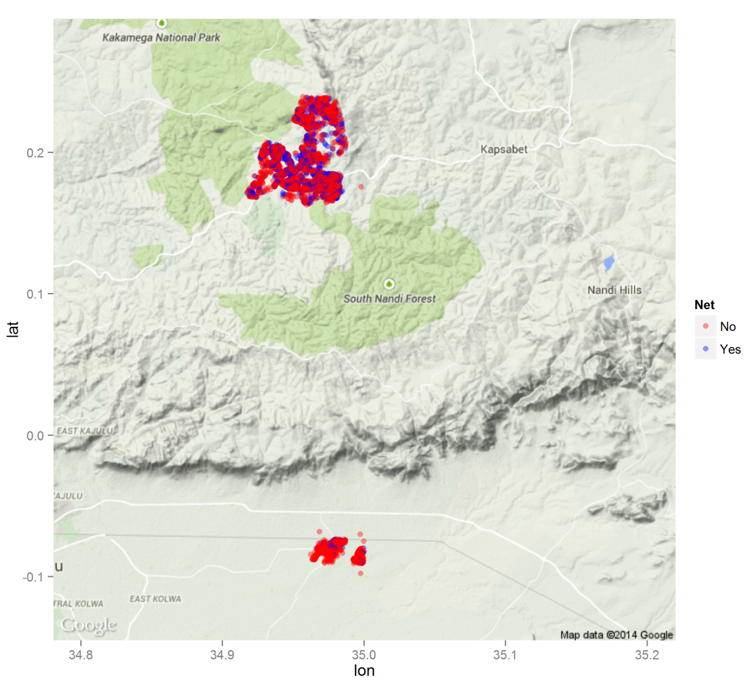
Data
Personal survey of
17,823 members of
3,924 households at
2 sites in Kenya
Collected a variety of information from each member e.g.
Age, sex, net use, past aerial spraying, etc.

Slide 9
Objectives
Determine if high risk households in the study area are preferentially receiving malaria abatement treatments.
High risk households defined as those with both individual age-based risk and mosquito exposure risk
Examine age-based and mosquito-based risk separately

Slide 10
Methods: Age-Based Risk
Aggregated individual data into household data and derived 5 variables
Number of members under 1
Number of members older than 1 and under 5
Number of members over 65
Bed net use (yes if any member reports use)
Aerial spraying (yes if any member reports spraying)

Slide 11
Methods: Age-Based Risk
Household age-risk calculation:
Risk Score= (2 * # under 1) + # under 5 + # over 65
Weighted infants twice as much as other at-risk household members based on literature

Slide 12
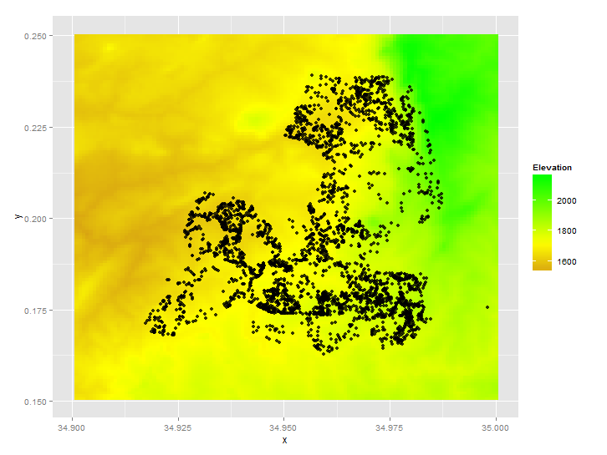
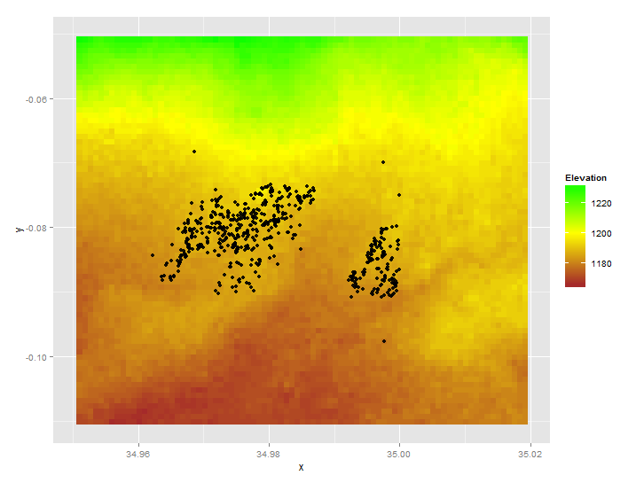
Methods: Mosquito Risk
Digital elevation models (DEM) of each site from the Shuttle Radar Topography Mission (SRTM) provided by NASA
High Elevation Site
Low Elevation Site

Slide 13
Methods: Mosquito Risk
Used SRTM elevation data to determine areas with a high likelihood of breeding mosquitoes.

Slide 14
Methods: Mosquito Risk
Used SRTM elevation data to determine areas with a high likelihood of breeding mosquitoes.
Used Topographic Wetness Index (TWI) to determine areas likely to hold standing water

Slide 15
Methods: Mosquito Risk
Used SRTM elevation data to determine areas with a high likelihood of breeding mosquitoes.
Used Topographic Wetness Index (TWI) to determine areas likely to hold standing water
Applied a Gaussian filter to the TWI surface as a weighted moving average of mosquito risk

Slide 16
Methods: Combined Risk Score
Calculated total risk for a household by combining age-based risk and mosquito based risk
Log-transformed and then scaled each risk score before combining

Slide 17
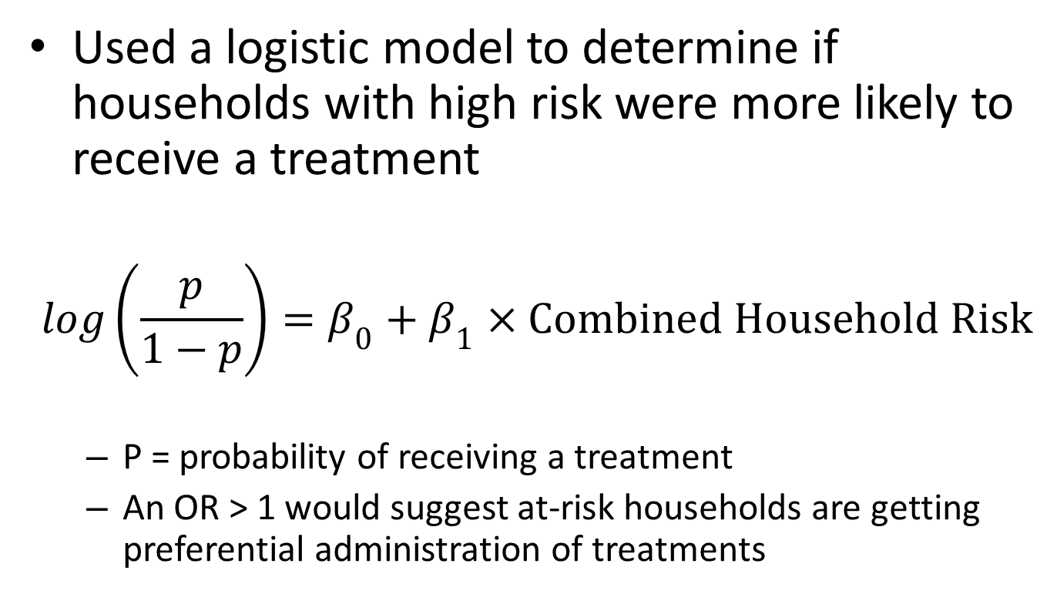
Methods: Risk vs Treatment
Used a logistic model to determine if households with high risk were more likely to receive a treatment
$$log\left(\frac{p}{1−p}\right)=β_{0}+β_{1}×Combined Household Risk$$
P = probability of receiving a treatment
An OR > 1 would suggest at-risk households are getting preferential administration of treatments

Slide 18
Methods: Sensitivity Analysis
Age Risk
Calculate individual risk without including elderly household members
Mosquito Risk
Use a restricted TWI algorithm to isolate areas with very low out-flow potential

Slide 19
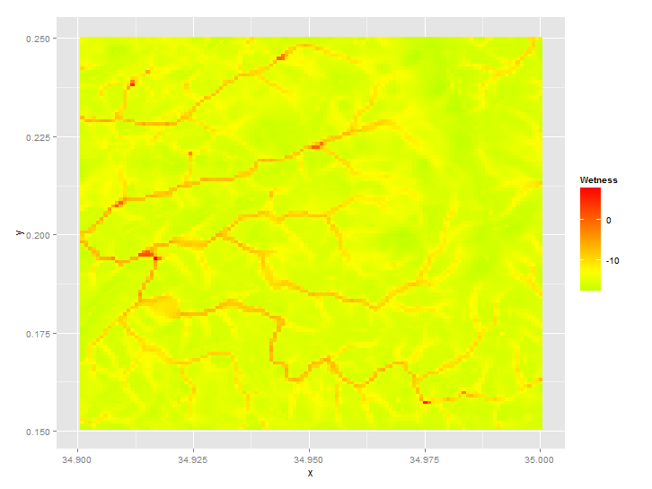
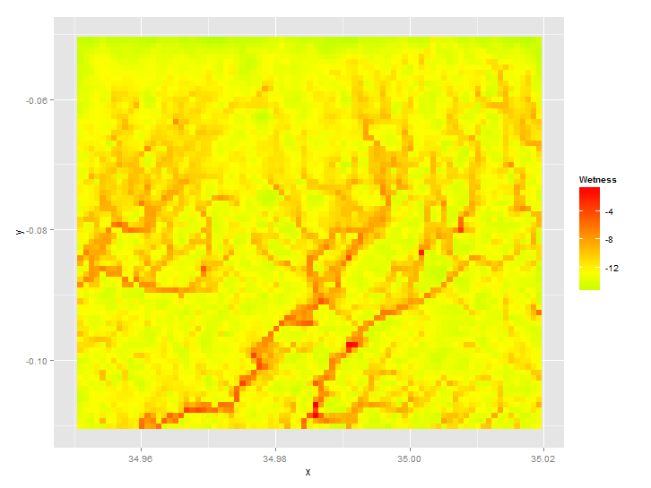
Results: TWI
High site calculated TWI
Low site calculated TWI

Slide 20
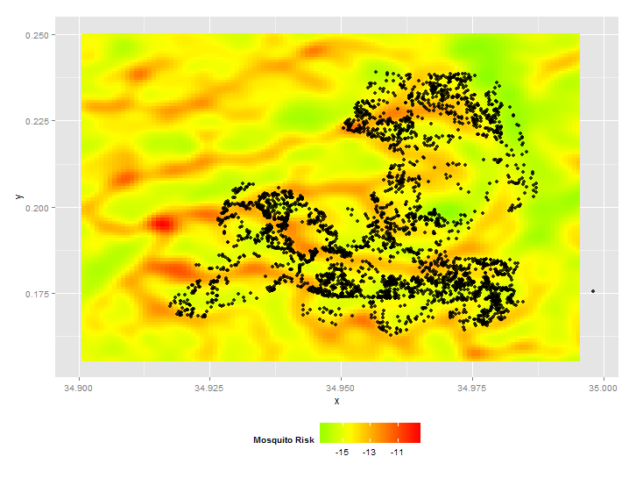
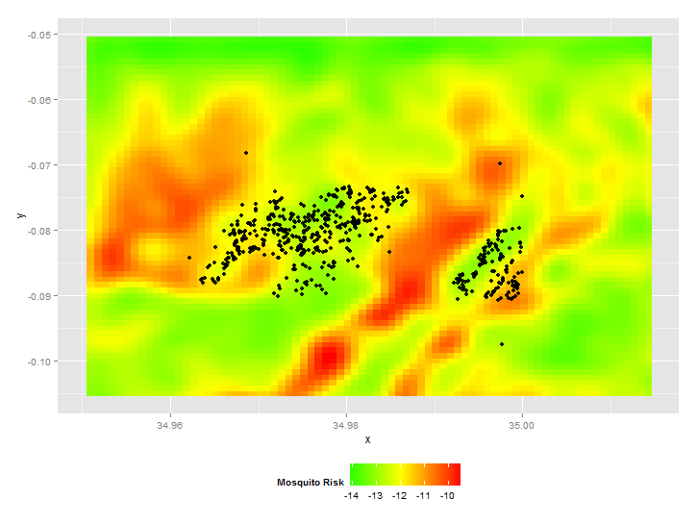
Results: TWI to Risk
High site calculated mosquito risk
Low site calculated mosquito risk

Slide 21
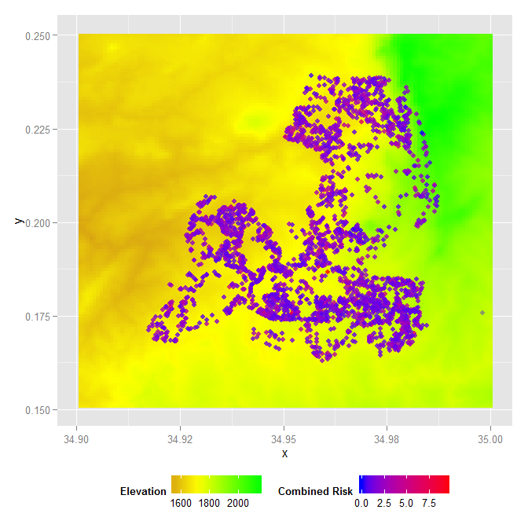
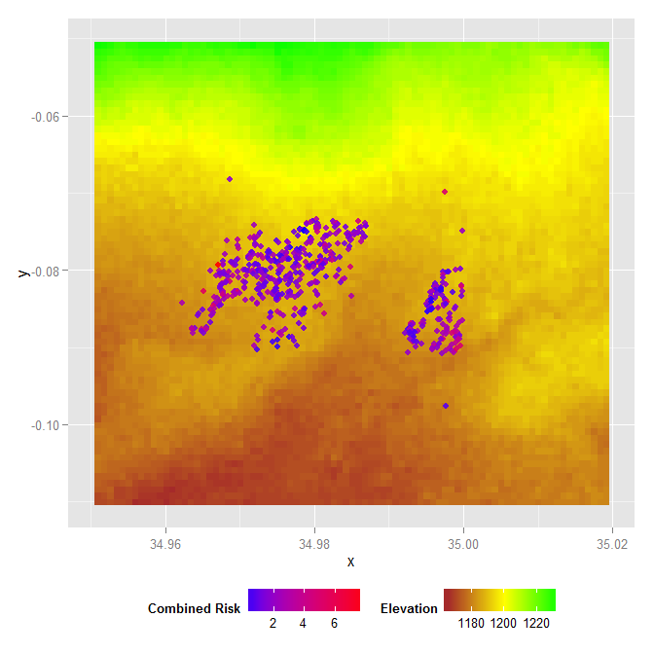
Results: Combined Risk
Combined risk at high site
Combined risk at low site

Slide 22
Results: Treatment vs Combined Risk
Site | Treatment | OR | Lower 95% CI | Upper 95% CI
High | Net | 1.27 | 1.18 | 1.35
 | Spray | 1.15 | 1.03 | 1.29
Low | Net | 0.95 | 0.73 | 1.24
 | Spray | 0.98 | 0.64 | 1.5
High risk households are more likely to receive treatments at the high site but not the low site.

Slide 23
Results: Treatment vs Separate Risk
Site | Treatment | Age Risk |  |  | Mosquito Risk
 |  | OR | Lower 95% CI | Upper 95% CI | OR | Lower 95% CI | Upper 95% CI
High | Net | 1.27 | 1.18 | 1.36 | 1.01 | 0.93 | 1.1
 | Spray | 1.11 | 0.99 | 1.25 | 1.32 | 1.14 | 1.53
Low | Net | 1.05 | 0.8 | 1.38 | 0.58 | 0.31 | 1.1
 | Spray | 1.22 | 0.73 | 2.05 | 0.34 | 0.15 | 0.79

Slide 24
Results: Treatment vs Separate Risk
Site | Treatment | Age Risk |  |  | Mosquito Risk
 |  | OR | Lower 95% CI | Upper 95% CI | OR | Lower 95% CI | Upper 95% CI
High | Net | 1.27 | 1.18 | 1.36 | 1.01 | 0.93 | 1.1
 | Spray | 1.11 | 0.99 | 1.25 | 1.32 | 1.14 | 1.53
Low | Net | 1.05 | 0.8 | 1.38 | 0.58 | 0.31 | 1.1
 | Spray | 1.22 | 0.73 | 2.05 | 0.34 | 0.15 | 0.79
At the high site, aerial spraying is more likely at houses with high mosquito risk whereas bed nets are more likely at houses with high age risk.

Slide 25
Results: Treatment vs Separate Risk
Site | Treatment | Age Risk |  |  | Mosquito Risk
 |  | OR | Lower 95% CI | Upper 95% CI | OR | Lower 95% CI | Upper 95% CI
High | Net | 1.27 | 1.18 | 1.36 | 1.01 | 0.93 | 1.1
 | Spray | 1.11 | 0.99 | 1.25 | 1.32 | 1.14 | 1.53
Low | Net | 1.05 | 0.8 | 1.38 | 0.58 | 0.31 | 1.1
 | Spray | 1.22 | 0.73 | 2.05 | 0.34 | 0.15 | 0.79
At the low site, households with high mosquito risk are less likely to receive aerial spraying.

Slide 26
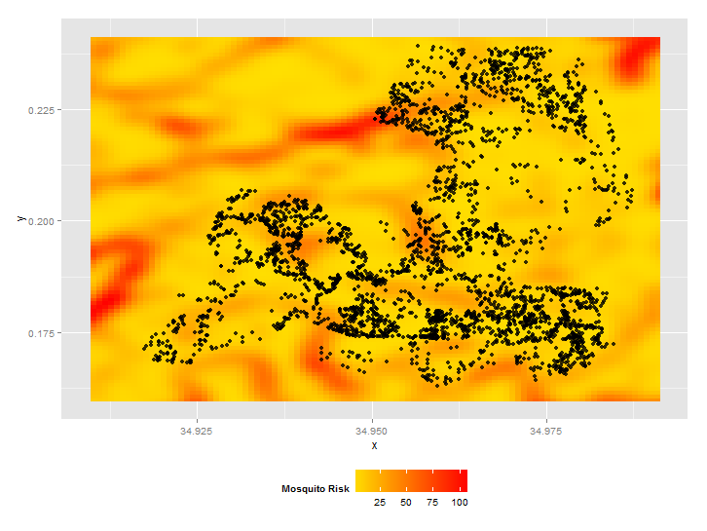
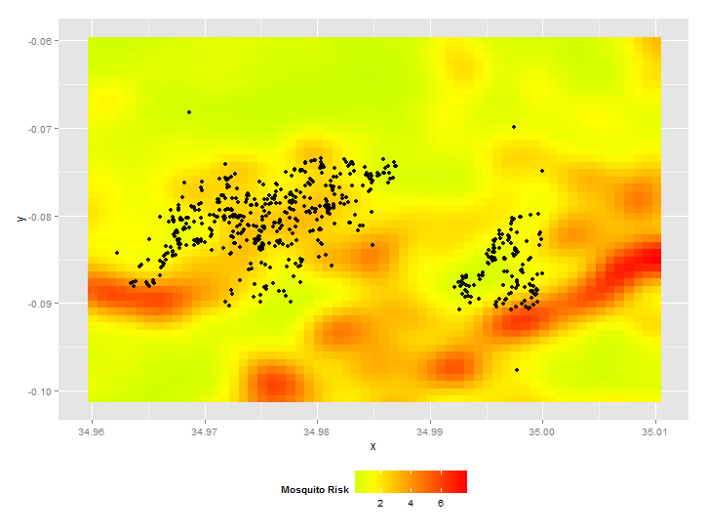
Sensitivity Analysis: Restricted TWI
Tighter restrictions on water outflow to isolate areas of standing water

Slide 27
Sensitivity Analysis: Restricted TWI
 |  | General TWI Based Mosquito Risk |  |  | Restricted TWI Based Mosquito Risk
Site | Treatment | OR | Lower 95% CI | Upper 95% CI | OR | Lower 95% CI | Upper 95% CI
High | Net | 1.27 | 1.18 | 1.35 | 1.34 | 1.22 | 1.48
 | Spray | 1.15 | 1.03 | 1.29 | 1.33 | 1.12 | 1.57
Low | Net | 0.95 | 0.73 | 1.24 | 1.07 | 0.69 | 1.64
 | Spray | 0.98 | 0.64 | 1.5 | 1.31 | 0.63 | 2.7
The restricted TWI suggests better treatment targeting at both the high site and low site.

Slide 28
Sensitivity Analysis: No Elderly at Risk
Site | Treatment | Age Risk (<5 or >65) |  |  | Age Risk (<5)
 |  | OR | Lower 95% CI | Upper 95% CI | OR | Lower 95% CI | Upper 95% CI
High | Net | 1.27 | 1.18 | 1.36 | 1.36 | 1.27 | 1.45
 | Spray | 1.11 | 0.99 | 1.25 | 1.08 | 0.96 | 1.22
Low | Net | 1.05 | 0.8 | 1.38 | 1.21 | 0.94 | 1.55
 | Spray | 1.22 | 0.73 | 2.05 | 1.08 | 0.67 | 1.74
Including only children in the age-based risk suggests better targeting of bed nets to at-risk households.

Slide 29
Discussion
Existing protocols for administration of mosquito abatement treatments need improvement at the low site.

Slide 30
Discussion
Existing protocols for administration of mosquito abatement treatments need improvement at the low site
Aerial spraying is more likely at households with high mosquito risk and bed nets are more likely at households with high age risk.

Slide 31
Discussion
Existing protocols for administration of mosquito abatement treatments need improvement at the low site
Aerial spraying is more likely at households with high mosquito risk and bed nets are more likely at households with high age risk.
Elderly individuals do not appear to be accounted for in current risk assessments

Slide 32
Future Research
Validate TWI as a measure of mosquito exposure risk
Determine health risk of elderly household members

Slide 33
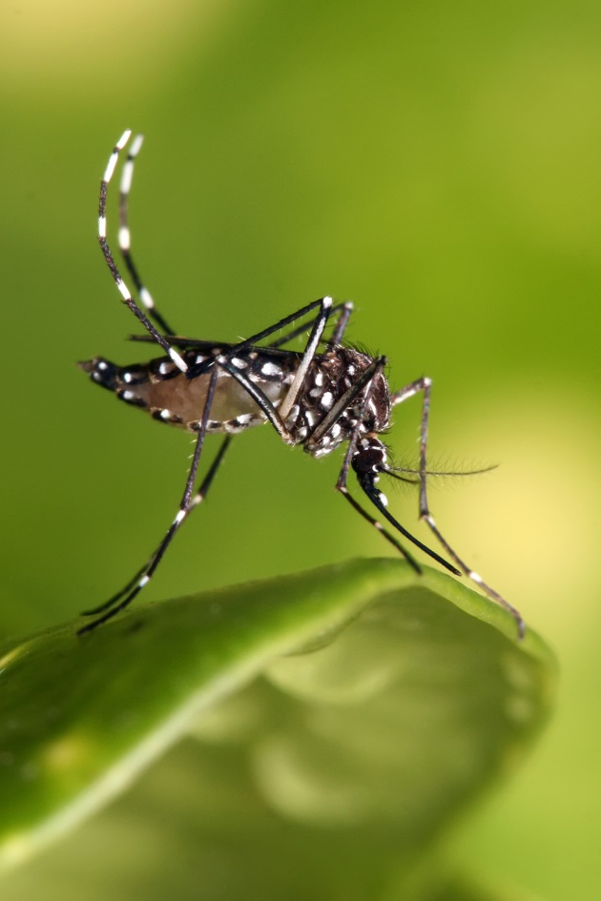
Questions?
???
Aedes aegypti, photo by Dar es Salaam, Tanzania

Slide 34
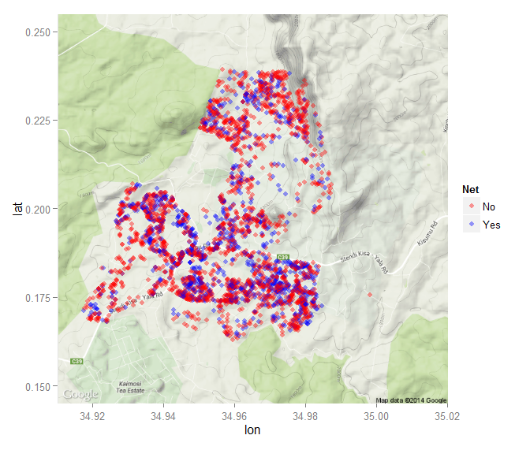
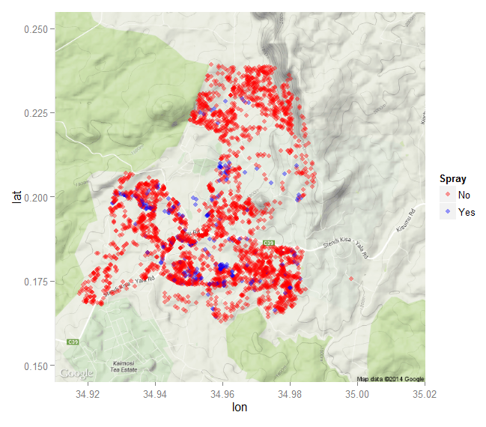
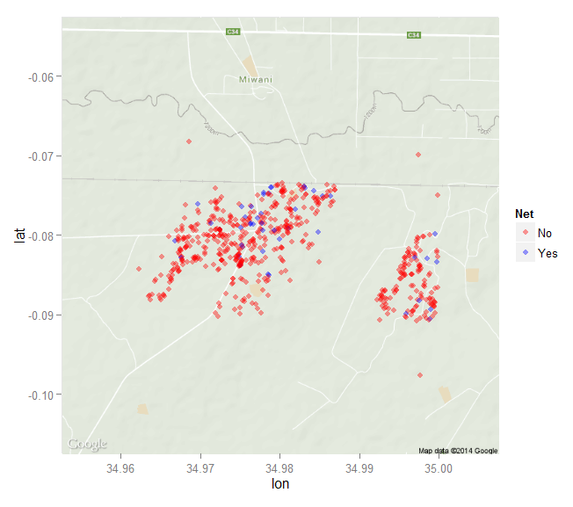
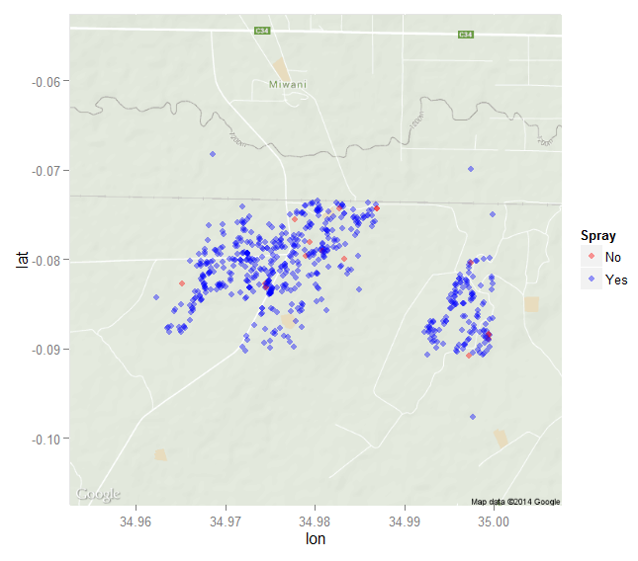
Net Use
Aerial Spraying

Slide 35
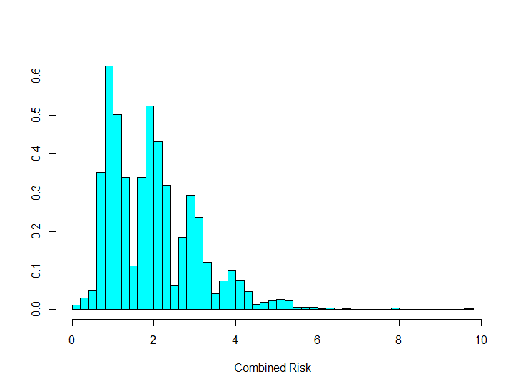
Results: Combined Risk
Combined risk ranged from 0 to 9.74

