Slide 1
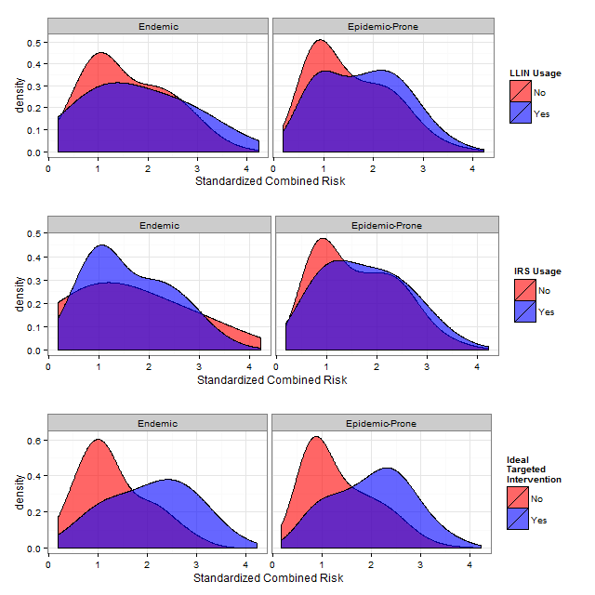
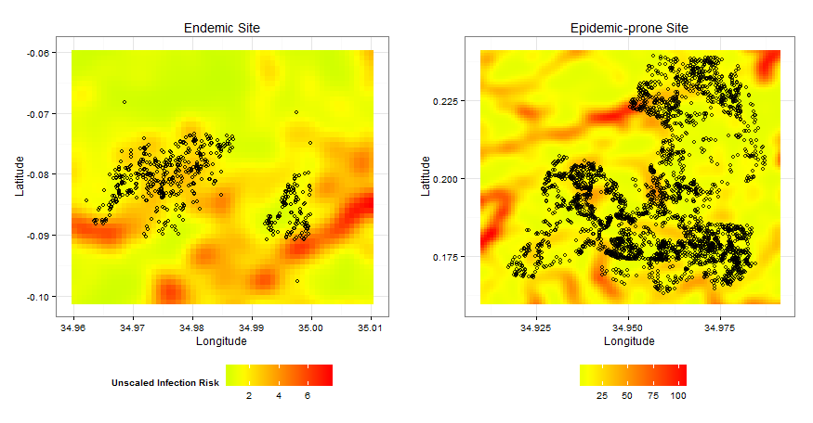
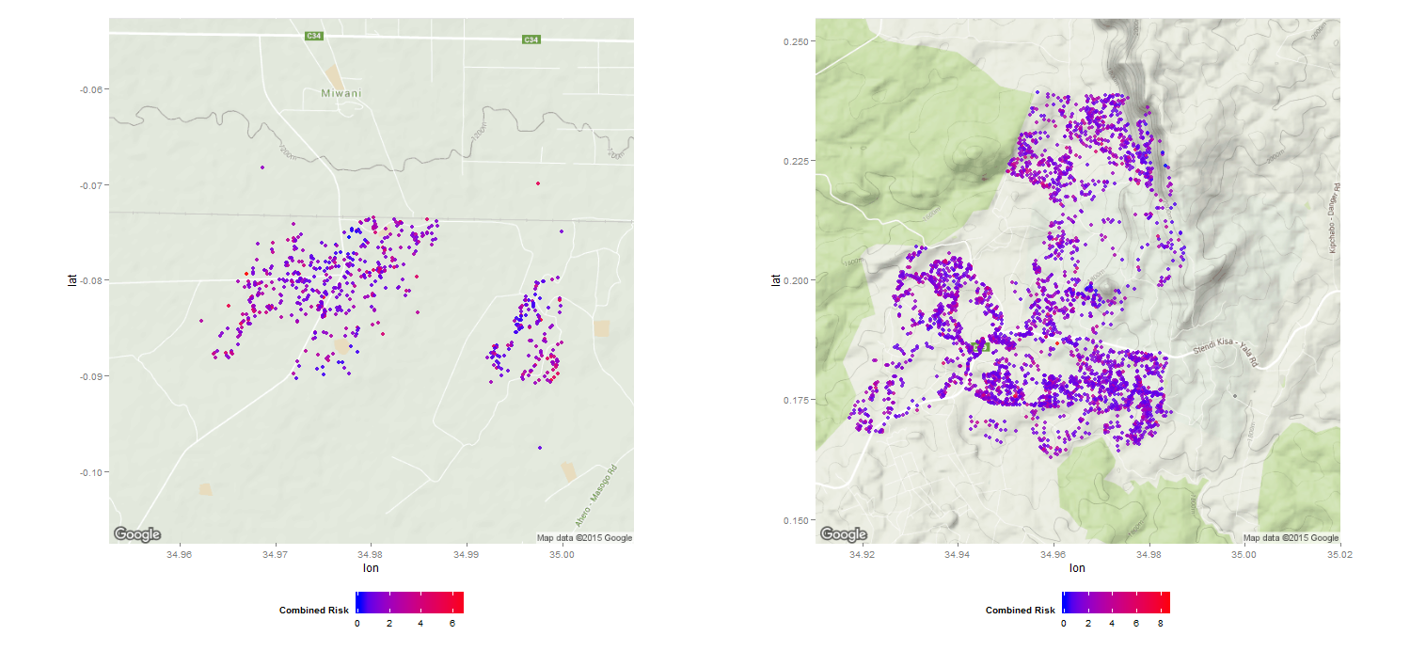

Malaria Prevention: Are high-risk households in Kenya receiving treatments?
Dominic D. LaRoche^{*1}, Melanie L. Bell¹, and Kacey C. Ernst¹
¹Mel & Enid Zuckerman College of Public Health, University of Arizona, *104 BSE University of Arizona, Tucson, AZ 85721, 520-626-8293, dlaroche@email.arizona.edu
Abstract
Malaria is a significant threat to public health in countries where the disease is either endemic or epidemic. Concerted efforts have been made in the past decade to reduce and in some cases eliminate malaria with the use of prophylactic interventions. The World Health Organization recommends preferential administration of interventions to pregnant women and infants because of the high disease burden borne by this group. However, previous research has identified the benefit of additionally targeting interventions at those with the highest risk of infections. We use a topographic wetness index, combined with a household census of intervention use, at two sites in Kenya to assess intervention administration. We find preferential administration of interventions at the high-elevation epidemic-prone site but not at the low-elevation endemic site. Our results have important implications for assessing the administration of interventions in the battle against malaria.
Combined Risk
To determine if current administration protocols targeted households with both high infection risk and high health risk we standardized each risk measure and added them to create a combined risk score (measured in standard deviations from the sample population). We used a logistic model to evaluate whether households with high risk were more likely to receive an intervention. We also modelled each risk separately to determine if existing protocols of intervention administration were adequately addressing either risk.
Figure 3. The distributions of combined risk of each household at the endemic and epidemic-prone sites by LLIN and IRS usage. Combined risk is the combination of infection risk and age-based risk and is standardized within a site so that the unit is in standard deviations. Interventions targeted at high-risk households would result in good separation between the two densities as we simulated in the bottom panel. The epidemic-prone site shows better targeting of interventions than the endemic site for both interventions.
Results
 |  | Long lasting insecticidal nets | Indoor residual spraying
Site | Risk Measure | Odds Ratio (95% CI) | Odds Ratio (95% CI)
Endemic | Combined Risk | 1.33 (0.93, 1.90) | 1.10 (0.59, 2.03)
N*=604 | Infection Risk | 0.58 (0.31, 1.10) | 0.34 (0.15, 0.79)
 | Age-based Risk | 1.21 (0.94, 1.55) | 1.08 (0.67, 1.74)
Epidemic-prone | Combined Risk | 1.45 (1.33, 1.59) | 1.22 (1.05, 1.42)
N*=3380 | Infection Risk | 1.01 (0.93, 1.10) | 1.32 (1.14, 1.53)
 | Age-based Risk | 1.36 (1.27, 1.45) | 1.08 (0.96, 1.22)
Methods
Age-based risk
We used census data from two sites in Kenya which represent the western highland (hereafter “epidemic-prone”, N=3380) and lowland (hereafter “endemic”, N=604) populations. Both sites have had partial treatment with both Long-Lasting Insecticide Treated Nets (LLINs) and Indoor Residual Spraying (IRS). Research was approved by the University of Arizona and the Kenyan Medical Research Institute. For each unique house we calculated the number of individuals under 1, and the number of individuals over 1 and under 5. We assigned an age-based health risk score (age-based risk hereafter) to each household with the following formula:
Risk Score=(2×Children≤1)+(1<Children≤5)
Exposure-based Risk
We assigned each household a risk for exposure to mosquitoes (infection risk) by deriving a continuous risk surface over the study area. We used a Topographical Wetness Index (TWI) derived from the digital elevation data to determine areas likely to provide breeding habitat for mosquitoes. The TWI combines the total basin area (the area from which water will flow to a particular point) with the slope at that point to determine the amount of water likely to accumulate and provide breeding habitat for mosquitoes. We assumed the infection risk of a household was inversely related to the distance to one or more of these high-wetness areas. Therefore, we applied a Gaussian filter with σ=10 to create a weighted average of mosquito risk for each cell in the study area. We then assigned each house the risk score of the cell in which it was located.
Summary
Remotely sensed elevation data from satellites can be used to predict mosquito occurrence
Combining remote-sensed data with household surveys provides valuable information for targeting mosquito interventions
Current strategies for distributing mosquito interventions in Kenya do not effectively target the highest risk households at an endemic malaria site.
Figure1. Gaussian smoothed (σ=10) infection risk at the endemic and epidemic-prone sites. Dots represent household locations within each site.
Figure 2. Combined risk of households for both the endemic and epidemic-prone sites
Discussion
We found significant evidence of targeted interventions at the epidemic-prone site but not at the endemic site. This likely reflects the differential administration of interventions at these two sites. A mass distribution campaign took place at the endemic site 1 year prior to our survey. Despite this, roughly half of the un-sprayed households had higher than average risk with half of these in the upper-most quartile of risk (Figure 2). Incorporating a targeted administration of interventions could have potentially left only very low-risk households without an intervention. Given the additional benefit achieved by targeting interventions to households with the highest risk, and the widespread availability of elevation data provided by the USGS, we believe the incorporation of TWI for identifying households with high infection risk can be used in conjunction with on-the-ground assessments to evaluate and improve current protocols of intervention administration.

