Slide 1


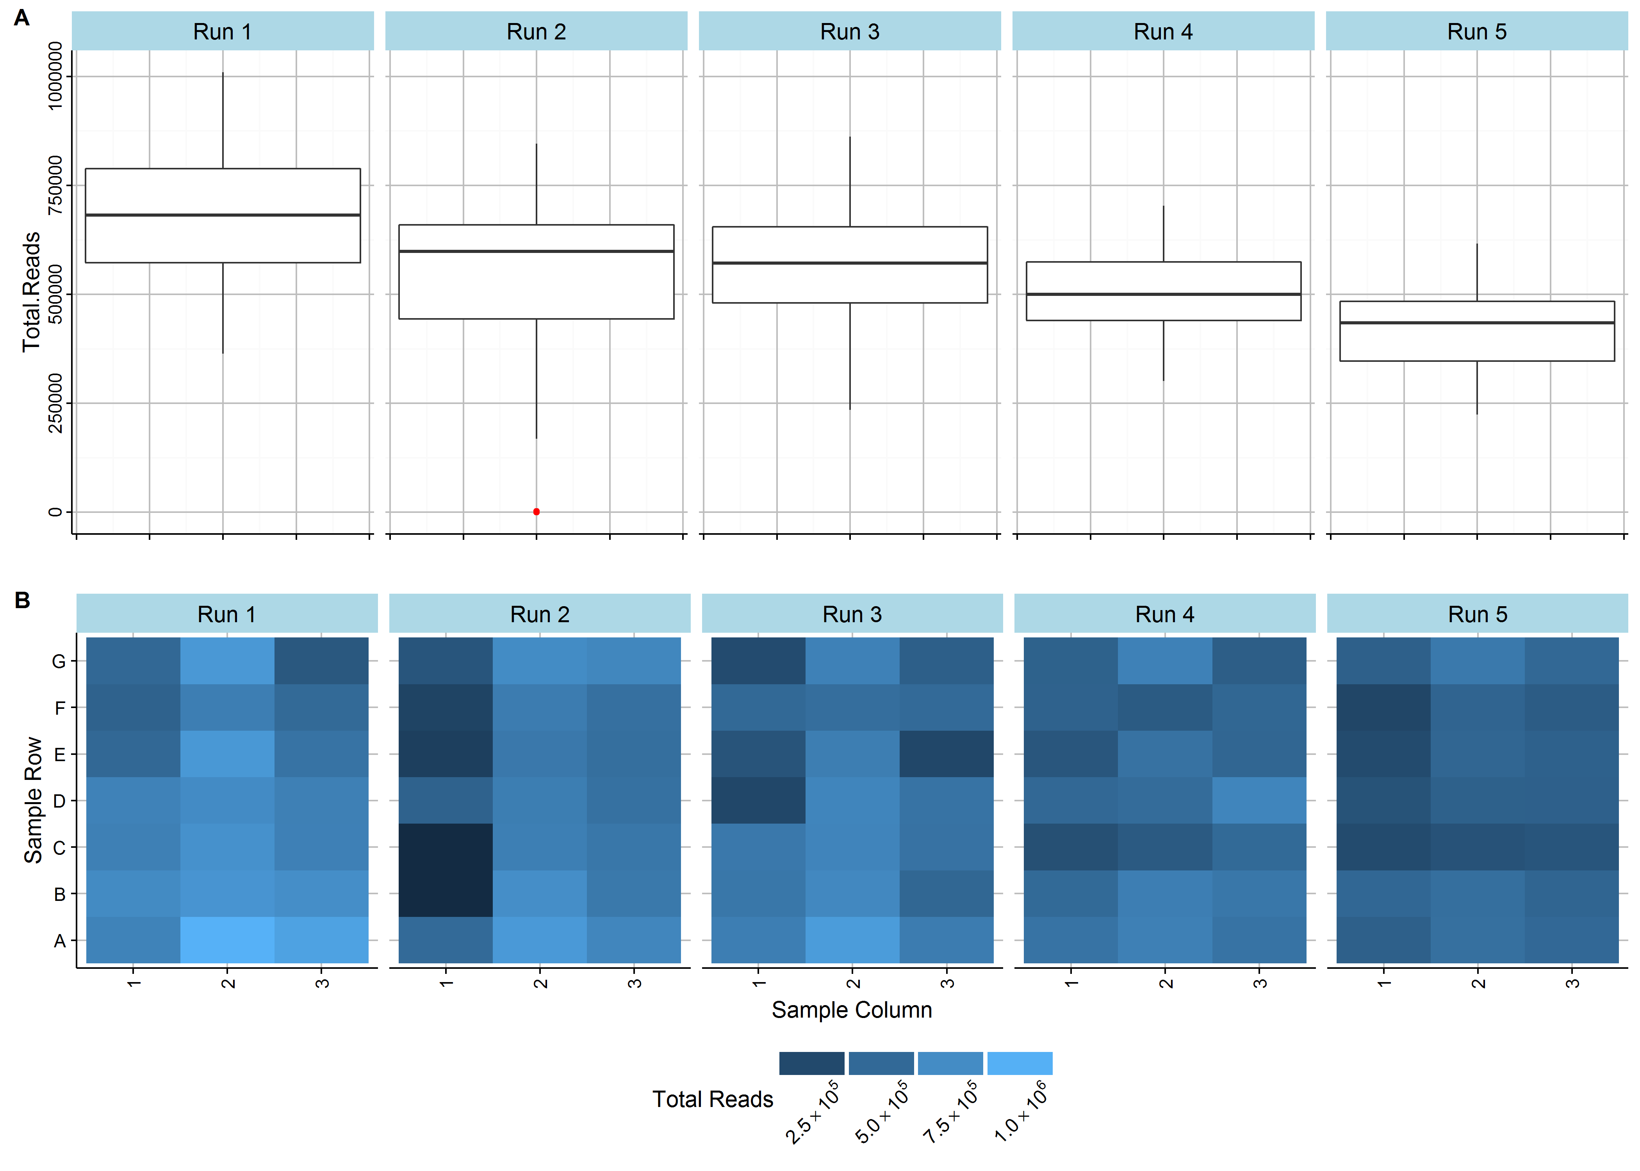
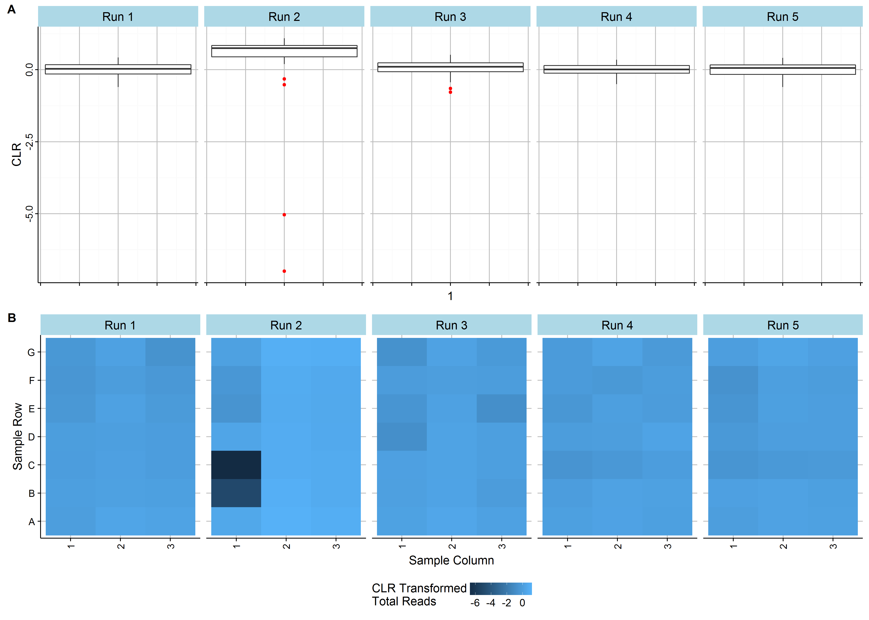


Quality control metrics for extraction-free targeted RNA-Seq:
methods afforded by a compositional framework.
Dominic LaRoche^{1,2*}, Dean Billheimer¹, Shripad Sinari¹, Kurt Michels², and Bonnie LaFleur²
Extraction-free Targeted (EFT) RNA-Seq
Compositional Framework
Fractional Allocation of Aligned Reads to Samples
EFT RNA-Seq offers several benefits over traditional RNA-Seq for clinical use:
Elimination of amplification bias
Reduced sequencing cost
Use of very small sample inputs.
Simplified bioinformatics workflow (alignment)
EFT RNA-Seq creates the need for pos-sequencing quality control metrics.
No extraction step for discovering biological samples with little or degraded RNA
No genome alignment for sequence quality assessment
We develop quality control diagnostics for EFT RNA-Seq by recognizing the compositional nature of RNA-Seq and utilizing the existing body of work on compositional data.
Both EFT RNA-Seq and traditional RNA-Seq measure the relative abundances of RNA transcripts in a sample.
Finite number of transcript reads (counts)
Hierarchical partitioning of sequence reads
Total reads in a sequencing run divided among samples
Total reads in a sample divided among probes
Statistical procedures must account for the special geometry induced by the total sum constraint, particularly with respect to covariance matrices and distances.
Work in ratios of components with centered log ratio transformation
$CLR\left(x_{i}\right)=log \left(\frac{x_{i}}{g(x)}\right)$,
where $g(x)$ is the geometric mean of $x.$
Account for geometry when measuring distance
$$Dist\left(x, y\right)={ \left[\sum_{i=1}^{D}{{\left(log\left(\frac{x_{i}}{g(x)}\right)−log\left(\frac{y_{i}}{g(y)}\right)\right)}^{2}}\right]}^{1/2}$$
Problems with sample quality, library preparation, or sequencing may result in a low number of reads allocated to a sample.
We expect the number of reads allocated to each sample in a sequencing run to arise from the same general data generating mechanism, deviations from this expectation may indicate a sample problem.
Method:
Use the CLR to transform the total number of reads allocated to each sample.
Apply outlier detection method to identify poor samples
Definition: $x_{i}$is a quality control sample failure if $x_{i}$ < lower-quartile - 1.5 × IQR or $x_{i}$ > upper-quartile + 1.5 × IQR, where IQR is the interquartile range of $x$.
Figure 1. The raw (left) and CLR transformed (right) total counts for 120 mRNA samples sequenced in 5 runs. The CLR transformation substantially improves the detection of low total count outlying samples.
Testing for Compositional Invariance
Batch Effects and Normalization
Discussion

