Slide 1


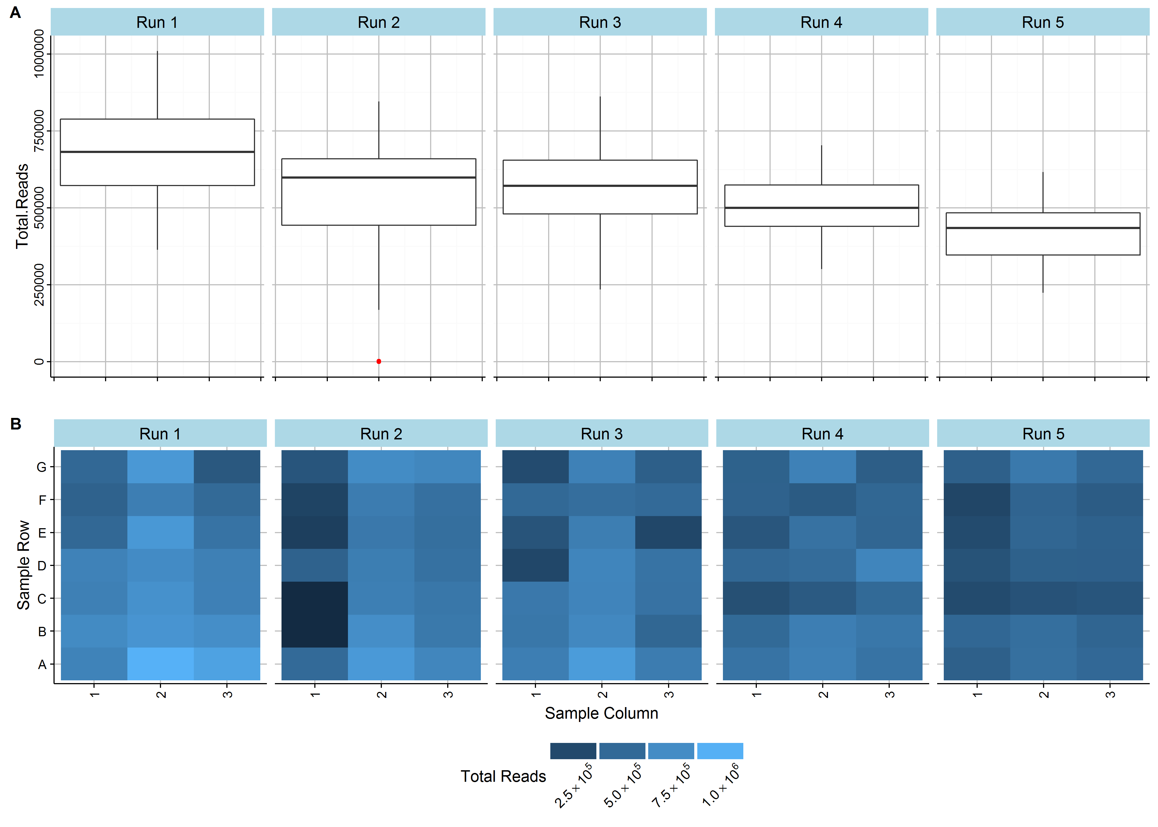
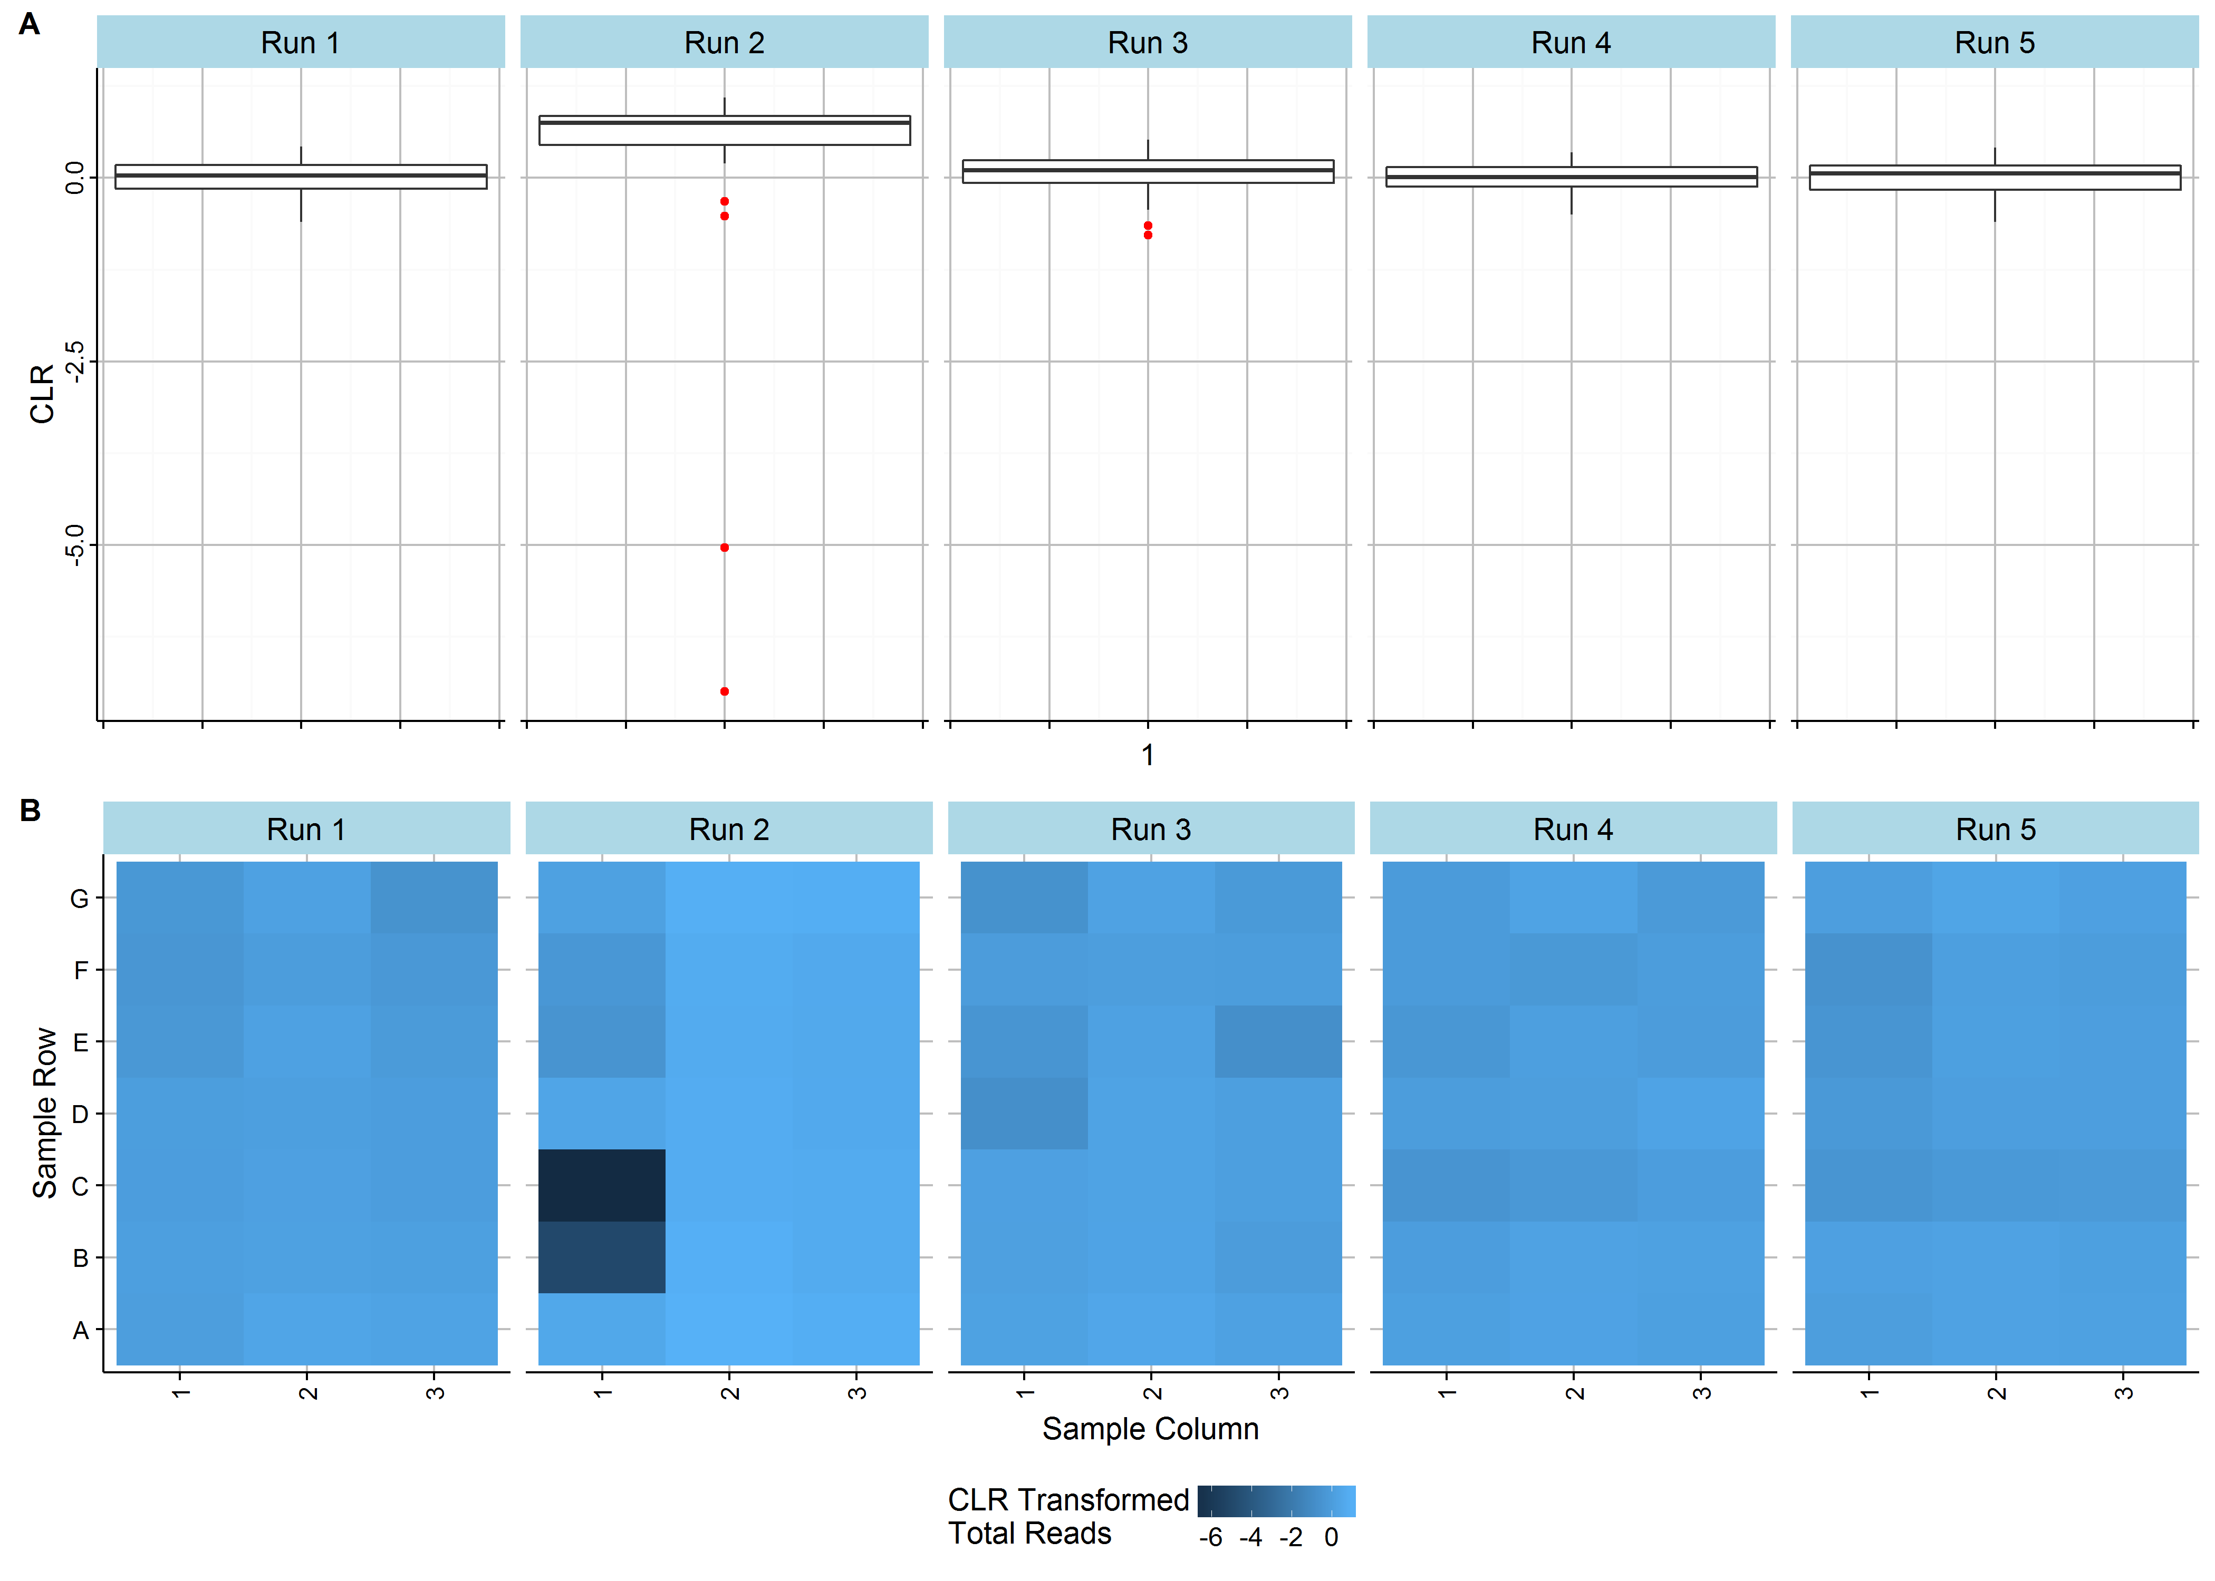
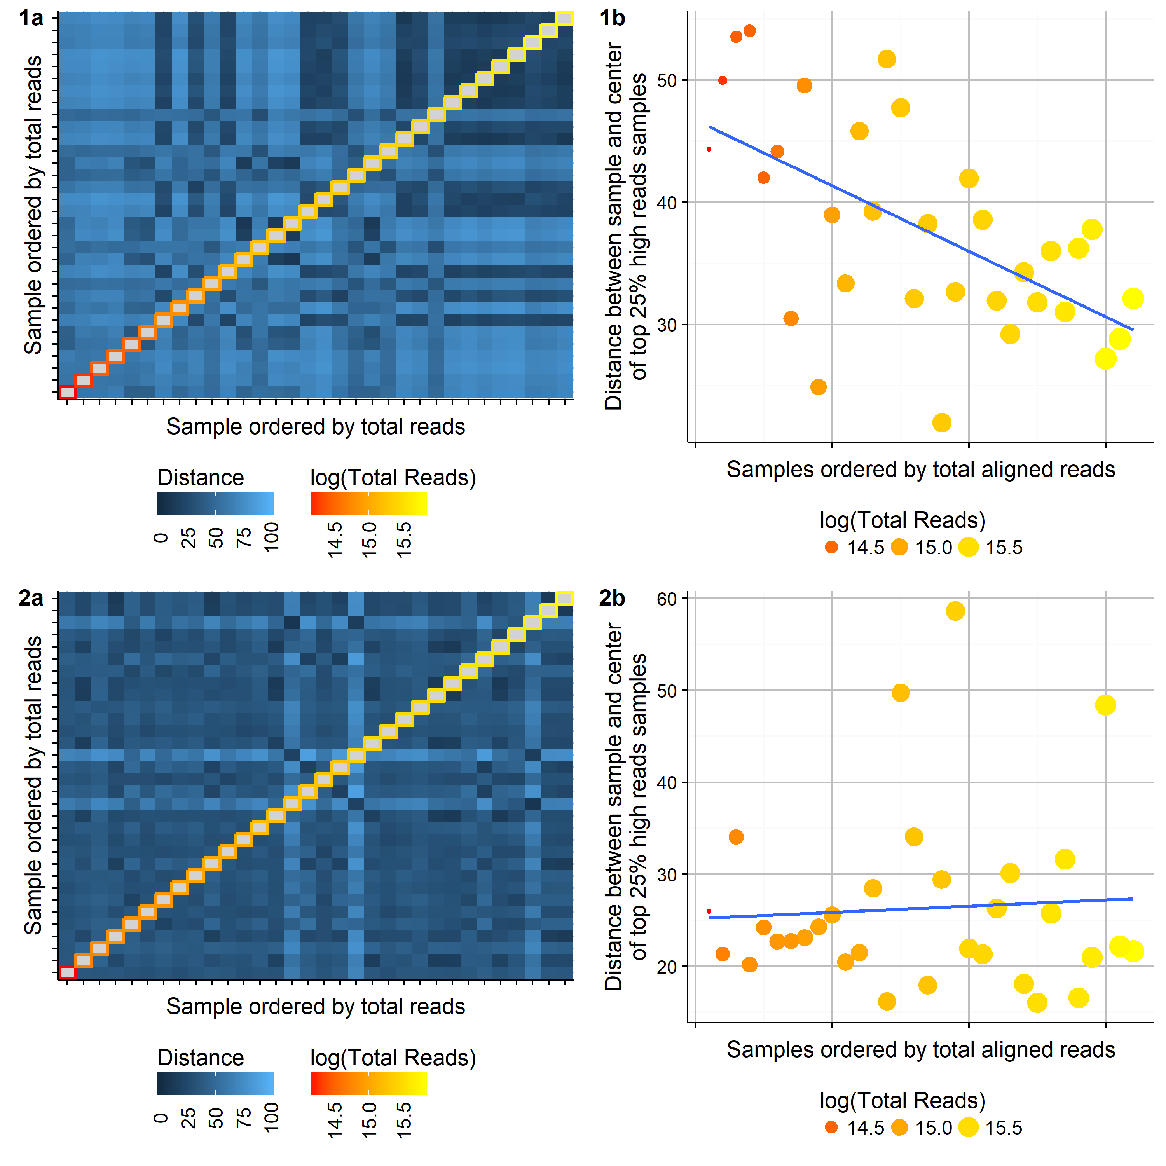


Quality control metrics for extraction-free targeted RNA-Seq:
methods afforded by a compositional framework.
Dominic LaRoche^{1,2*}, Dean Billheimer¹, Shripad Sinari¹, Kurt Michels², and Bonnie LaFleur²
Extraction-free Targeted (EFT) RNA-Seq
Compositional Framework
Fractional Allocation of Aligned Reads to Samples
EFT RNA-Seq offers several benefits over traditional RNA-Seq for clinical use:
Elimination of amplification bias
Reduced sequencing cost
Use of very small sample inputs.
Simplified bioinformatics workflow (alignment)
EFT RNA-Seq creates the need for pos-sequencing quality control metrics.
No extraction step for discovering biological samples with little or degraded RNA
No genome alignment for sequence quality assessment
We develop quality control diagnostics for EFT RNA-Seq by recognizing the compositional nature of RNA-Seq and utilizing the existing body of work on compositional data.
Both EFT RNA-Seq and traditional RNA-Seq measure the relative abundances of RNA transcripts in a sample.
Finite number of transcript reads (counts)
Hierarchical partitioning of sequence reads
Total reads in a sequencing run divided among samples
Total reads in a sample divided among probes
Statistical procedures must account for the special geometry induced by the total sum constraint, particularly with respect to covariance matrices and distances.
Work in ratios of components with centered log ratio transformation
$CLR\left(x_{i}\right)=log \left(\frac{x_{i}}{g(x)}\right)$,
where $g(x)$ is the geometric mean of $x.$
Account for geometry when measuring distance, Aitchison distance
$$Dist\left(x, y\right)={ \left[\sum_{i=1}^{D}{{\left(log\left(\frac{x_{i}}{g(x)}\right)−log\left(\frac{y_{i}}{g(y)}\right)\right)}^{2}}\right]}^{1/2}$$
Problems with sample quality, library preparation, or sequencing may result in a low number of reads allocated to a sample.
We expect the number of reads allocated to each sample in a sequencing run to arise from the same general data generating mechanism, deviations from this expectation may indicate a sample problem.
Method:
Use the CLR to transform the total number of reads allocated to each sample.
Apply outlier detection method to identify poor samples
Definition: $x_{i}$is a quality control sample failure if $x_{i}$ < lower-quartile - 1.5 × IQR or $x_{i}$ > upper-quartile + 1.5 × IQR, where IQR is the interquartile range of $x$.
Figure 1. The raw (left) and CLR transformed (right) total counts for 120 mRNA samples sequenced in 5 runs. The CLR transformation substantially improves the detection of low total count outlying samples.
Testing for Compositional Invariance
Batch Effects and Normalization
Discussion
Analytical methods for RNA-Seq assume that the total number of reads assigned to a sample is independent of the relative abundance of probes in the sample, this is referred to as Compositional Invariance (CI). However, insufficient availability of probes may lead to violations of CI. We provide a visualization for evaluating CI in a sequencing run.
Method:
Calculate all pairwise distances using Aitchison Distance
Create heatmap of distances with samples ordered by total reads
Plot multi-variate distance between each sample and the center of the top 25% of samples with respect to total reads
Identifying and controlling for batch effects is a critical step in the transition of RNA-Seq from the lab to the clinic.
Identify sample groups related to batch with a hierarchical clustering (HC) or principal components analysis (PCA) on CLR transformed counts.
CLR transformation has several
Figure 2. Distances between samples should be independent of the total reads assigned to each sample. Violations of compositional invariance can be visualized through the ordering samples by total aligned reads.

