Slide 1

Relative frequency measurements: Metrics for sample quality, sequencing integrity, and batch effects in targeted NGS
Bonnie LaFleur, Dominic LaRoche, Kurt Michels, Shripad Sinari, and Dean Billheimer
(16 May 2016)

Slide 2
Outline and Strategy
Introduction to RNASeq and HTG workflow
Description of two target assays
Framework for data evaluation through a series of propositions
Each proposition is demonstrated through a series of examples
Mathematical development is referenced when possible
Recommendations
Future directions
“Signal to noise” assessment
Rethink differential expression in terms of distribution of relative abundance across

Slide 3
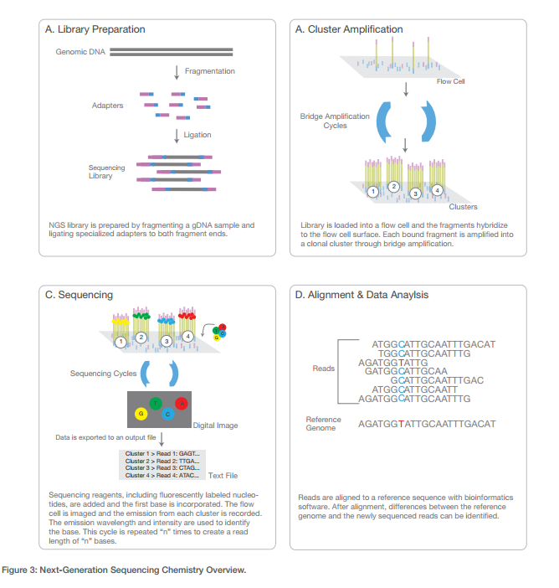
NGS Workflow
Source: http://www.illumina.com/content/dam/illumina-marketing/documents/products/illumina_sequencing_introduction.pdf

Slide 4
Workflow Synergy | HTG and NGS
HTG’s Edge chemistry is optimized for NGS workflow automation

Slide 5
HTG EdgeSeq | Immuno-Oncology Assay
Immuno-Oncology drug response and immune response
549 genes, 10 major groups and pathways

Slide 6

HTG EdgeSeq miRNA Whole Transcriptome Assay
Noncoding RNA
2,083 human miRNA transcripts
Sample Type | HTG EdgeSeq chemistry
FFPE Tissue | 0.8-10 mm² area - Single 5 µm section
Frozen Tissue | 10 µg
Cell Lines | 250-5,000 cells
Plasma/Serum | 15 µl
PAXgene | 32 µl
Purified RNA | 1.5-10 ng

Slide 7
HTG Reproducibility Studies
HTG EdgeSeq assays used as examples
Sequencing plates for reproducibility studies
 | Day 1 | Day 2 | Day 3
Processor 1 | Plate 1 | Plate 4 | Plate 5
Processor 2 | Plate 2
Processor 3 | Plate 3
HTG miRNA WTA
HTG EdgeSeq Immuno-Oncology
Study Design
Multiple sample types and technical replicates are processed on five (5) quarter plates and then individually tagged, cleaned and quantitated to form five (5), 24-sample libraries sequenced on the Illumina MiSeq
Samples
3 sample types: plasma, FFPE & Brain RNA
1 biological samples per sample type
8 technical replicates per sample plate
24 total wells per plate randomized across quadrant 1
Study Design
Single technical replicate of uRNA lysates over (5) quarter plates are tagged, cleaned as a pool, and quantitated to form five (5), 24-sample libraries sequenced on the Illumina MiSeq
Samples
24 total wells of uRNA lysate per plate randomized across quadrant 1

Slide 8
Proposition 1
Data that arise as measurements of relative frequency can be evaluated as compositions of totals
Example: qRT-PCR
Introduction to compositions

Slide 9
Relative Abundance: Example qRT-PCR
Study measuring gene expression measured by qRT-PCR of four genes associated with immune response in infants
Genes of interest: AID, pol η (eta), pol ι (iota), pol ζ (zeta)
Houskeeper: GAPDH
Sample of PBMCs from cord blood in 8 infants and 12 healthy adult volunteers
PBMC samples were transfected/stimulated with antigen receptor that should induce an immune reaction
The samples were incubated for 0, 2, 4, 6, 8, 10, 12, and 24 hours
Question: are infants able to produce a somatic immune response similar to those of adults when exposed to microbial pathogens? Does this response change over time of exposure?
Source: Bowen A.L., Tian C., LaFleur BJ, Crowe Jr JE (2006). Transcriptional Control of Activation-Induced Cytidine Deaminase and Error-Prone DNA Polymerases Is Functionally Mature in the B Cells of Infants at Birth, Human Immunology, 67:43-46

Slide 10
Expression Relative to GAPDH
Let C_{tT} represent the cycle number for a qRT-PCR reaction for the transcript of interest (AID, eta, zeta, iota) and C_{tGAPDH} as the cycle number for the GAPDH reference gene
Each PCR cycle represents an approximate doubling of the amount of transcript
The final cycle number is determined by the depletion of resultant doubling of product
The ΔCt is the difference between the C_{tT} and C_{tGAPDH} values. In this form, transcript expression is expressed as a relative amount to GAPDH (amount of transcript is often expressed on an anti-log2 scale, 2^{[CtT - CtGAPDH]} This assumes that the reaction is an actual doubling, coined, the efficiency of the reaction

Slide 11
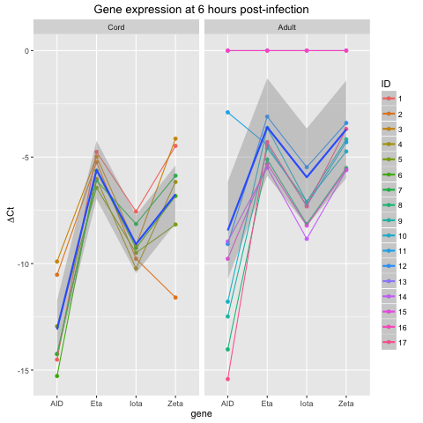
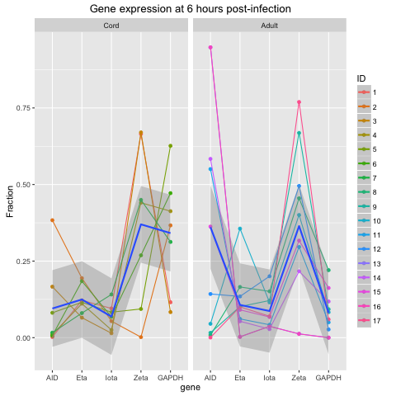
Transcript Expression Levels
Probe expression relative to GAPDH (ΔC_{t} scale)
Expression as relative proportion to total

Slide 12
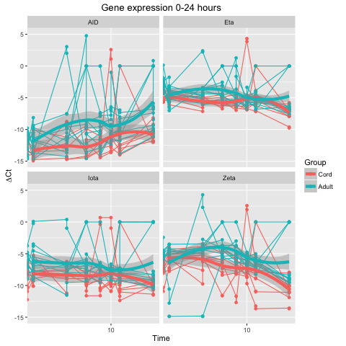
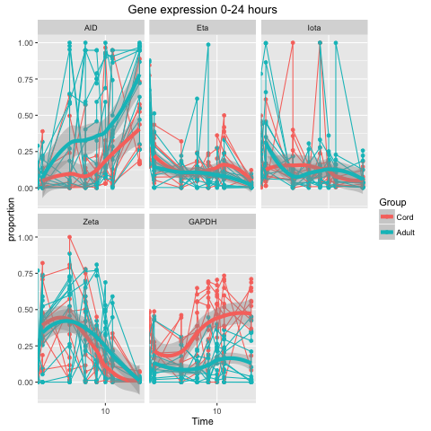
Expression as Time Series
Probe differences compared to GAPDH (ΔC_{t} scale)
Expression as relative proportion to total

Slide 13
Results and Discussion
There were little gene expression, measuring immune response, between infants and adults over time in the eta, zeta, and iota pol genes
There was an increasing difference over time in the AID gene between the infants and adults
Importantly:
There was considerable treatment impact (stimulation by antigen) to the GAPDH gene over time. This calls into question the utility of GAPDH as a reference gene
Application of a compositional framework improve the interpretation – it allows us to evaluate “relative frequency”

Slide 14
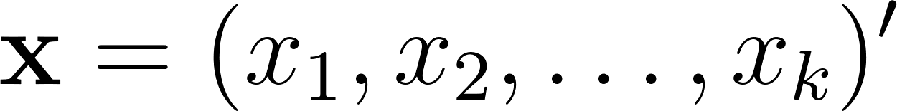

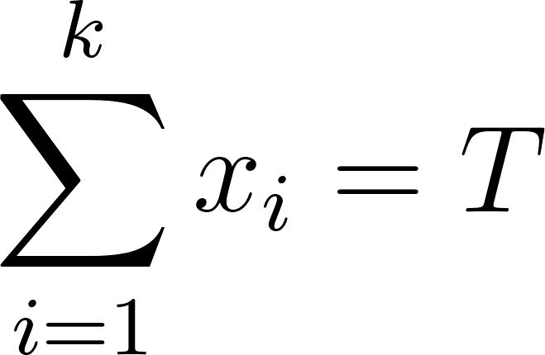
Compositional Data
vector of proportions
all components positive
sum to a constant
(often T=1)
Positivity and summation constraint complicate analysis
Complicated covariance structure (Aitchison, 1982)
As one component increases some other(s) must decrease
“Spurious correlation” (Pearson, 1897) - “fraught with difficulty and danger”

Slide 15
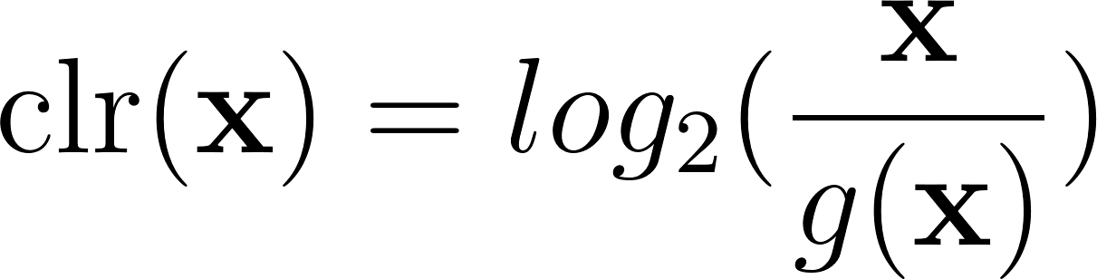

Mathematics of Compositions
Aitchison 1982, 1986
Compositions lie in the k-1 dimensional simplex (S^{k-1})
Use transformations to mitigate effects of constraints
(multiple transformations to achieve different goals)
One such transformation is the centered log ratio (clr)
where is the geometric mean
Resulting data in R^{k-1} (sums to 0), but angles between components are interpretable
Notes:
usual euclidean distance works similarly to the Aitchison distance -- can do “usual” stuff with respect to data reduction, etc.

Slide 16
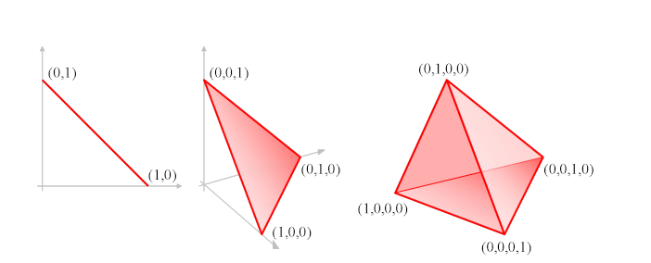


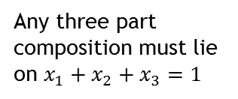
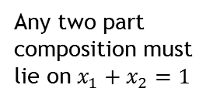
Geometry of Compositions
Any two part composition must lie on $x_{1}+x_{2}=1$
Any three part composition must lie on $x_{1}+x_{2}+x_{3}=1$
Any four part composition must lie on $x_{1}+x_{2}+x_{3}+x_{4}=1$
Each figure represents a “standard simplex”
Source:
Notes:
usual euclidean distance works similarly to the Aitchison distance -- can do “usual” stuff with respect to data reduction, etc.

Slide 17
Properties of Compositional Geometry
Amalgamation - can group/split components to work across hierarchical levels
Retain compositional structure at each level
Subcompositional coherence - can omit unneeded components, and still retain coherent inference

Slide 18
Hierarchical Amalgamation
Total Aligned Reads
Sample 1
Sample n
Level 1
Level 3
Sample 2
…
Level 2
Group 3
Group 1
Group 2
Probe 1
Probe 2
…
Group m
Probe p
…
Example of a group: tissue type, clinical subtype, translational/functional category

Slide 19
Example Data
Probe Set | WT-miRNA
Sample ID | 1 | 2 | 3 | 4 | 5
Well | A1 | B1 | C1 | D1 | E1
Sample Name | run228-Plasma_4_1 | run228-FFPE_5_1 | run228-Plasma_8_1 | run228-Brain_6_1 | run228-FFPE_2_1
Total Reads | 607503 | 482904 | 502930 | 534275 | 591505
Aligned Reads | 472621 | 454161 | 396747 | 508749 | 553588
CTRL_ANT1 | 19 | 0 | 0 | 0 | 0
CTRL_ANT2 | 15 | 0 | 4 | 0 | 0
CTRL_ANT3 | 26 | 1 | 3 | 0 | 3
CTRL_ANT4 | 12 | 0 | 7 | 0 | 0
CTRL_ANT5 | 4 | 0 | 7 | 0 | 0
CTRL_miR_POS1 | 31230 | 1103 | 30389 | 3164 | 1190
CTRL_miR_POS2 | 21932 | 711 | 20076 | 2031 | 705
CTRL_miR_POS3 | 30824 | 1069 | 29763 | 3245 | 1111
CTRL_miR_POS4 | 25986 | 977 | 24757 | 2593 | 955
CTRL_miR_POS5 | 31259 | 1101 | 29123 | 3074 | 1051
CTRL_miR_POS6 | 28501 | 961 | 26477 | 2752 | 911
HK_ACTB | 12 | 518 | 18 | 28 | 735
HK_B2M | 135 | 1391 | 110 | 78 | 1879
HK_GAPDH | 379 | 425 | 171 | 406 | 548
HK_PPIA | 21 | 368 | 12 | 16 | 418
HK_RNU47 | 19 | 1792 | 4 | 648 | 1818
HK_RNU75 | 32 | 6519 | 5 | 307 | 8267
HK_RNY3 | 536 | 576 | 362 | 716 | 600
HK_RPL19 | 39 | 428 | 18 | 38 | 504
HK_RPL27 | 20 | 390 | 2 | 75 | 463
HK_RPS12 | 9 | 399 | 6 | 66 | 628
HK_RPS20 | 12 | 398 | 8 | 37 | 470
HK_SNORA66 | 18 | 1384 | 11 | 104 | 1682
HK_YWHAZ | 33 | 474 | 20 | 126 | 659
let-7a-2-3p | 19 | 6 | 2 | 5 | 3
let-7a-3p | 13 | 0 | 1 | 0 | 1
let-7a-5p | 1974 | 5685 | 1612 | 26055 | 7780
let-7b-5p | 545 | 4746 | 438 | 17057 | 6437
let-7c-3p | 14 | 0 | 5 | 1 | 1
let-7c-5p | 434 | 2699 | 362 | 15988 | 3775
Example of Hierarchy:
Total reads over entire run
Sample level reads
Functional group of probe reads (Control, HK, oncogenes, etc.)

Slide 20
Proposition 2
Quality control metrics can be viewed as detection of unexpected data features
Number of aligned reads example

Slide 21
# Aligned Reads / Total Reads
Measured on the sample level
Number of aligned reads / total reads is compositional – that is it constrained by the available reads within a sequencing run
When these reads are transformed to the clr scale we can use Euclidean distance measures (Cooks distance) or goodness-of-fit tests to find outliers

Slide 22
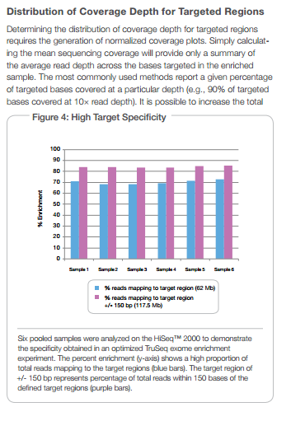
# Aligned Reads / Total Reads
Interested in how many sequencing counts have been allocated
Measured on the sample level
Ultimately impacts relative frequency at the probe level
Most important contributor to success of differential expression/prediction
Number of aligned reads / total reads is compositional – that is it constrained by the available reads within a sequencing run
Source:
http://support.illumina.com/content/dam/illumina-marketing/documents/products/technotes/technote_optimizing_coverage_for_targeted_resequencing.pdf

Slide 23
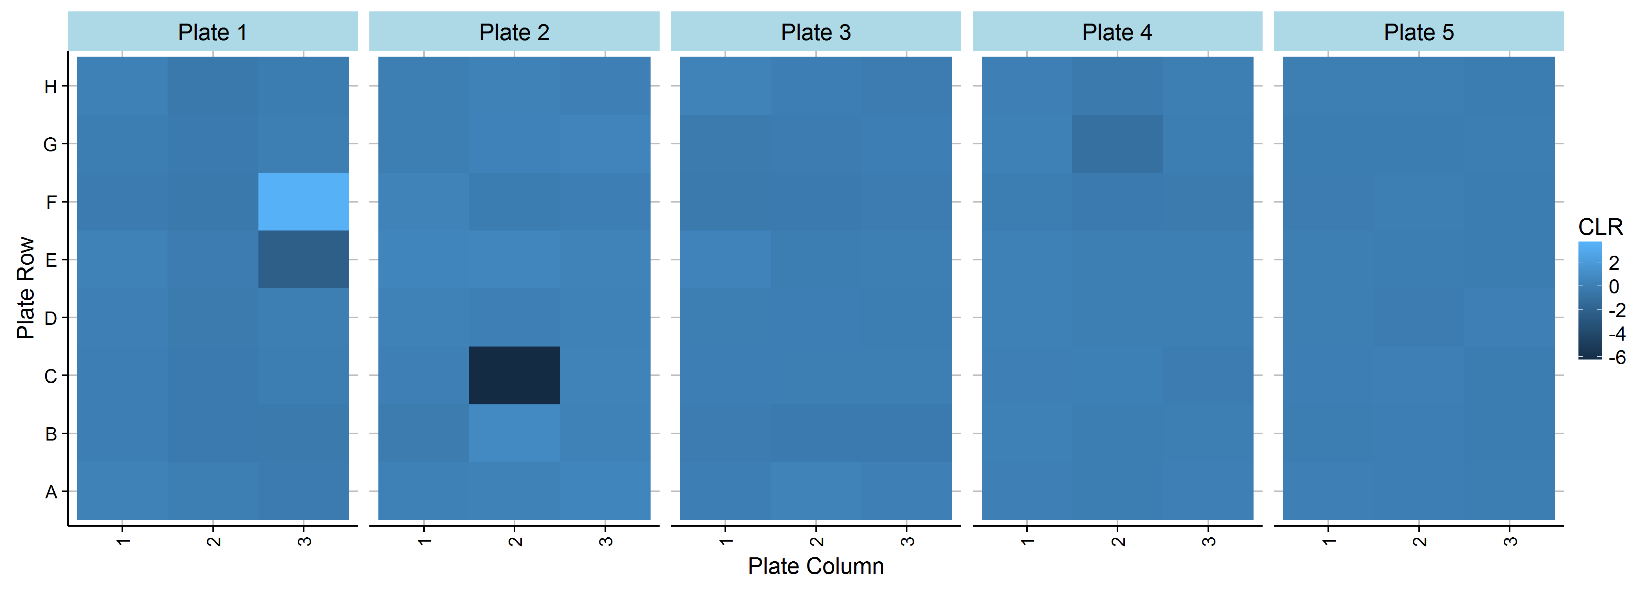
Example of Read Depth / # Aligned Reads
HTG EdgeSeq miRNA reproducibility study
Heatmap of sample level clr transformed total aligned reads
Transformation occurs at the plate level
Use extreme values using residuals under normal theory assumptions

Slide 24
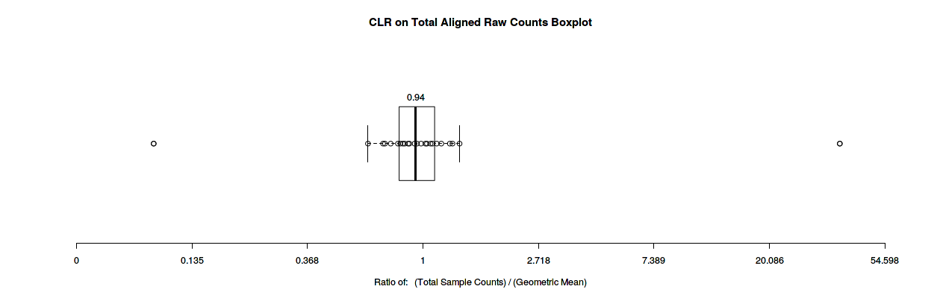
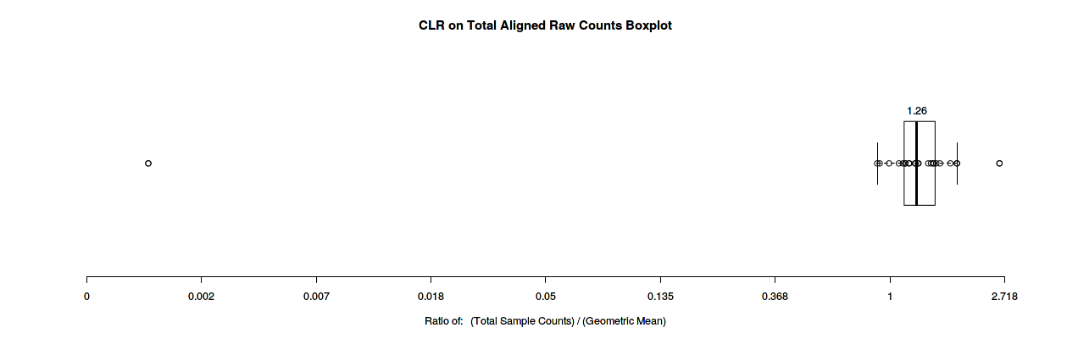
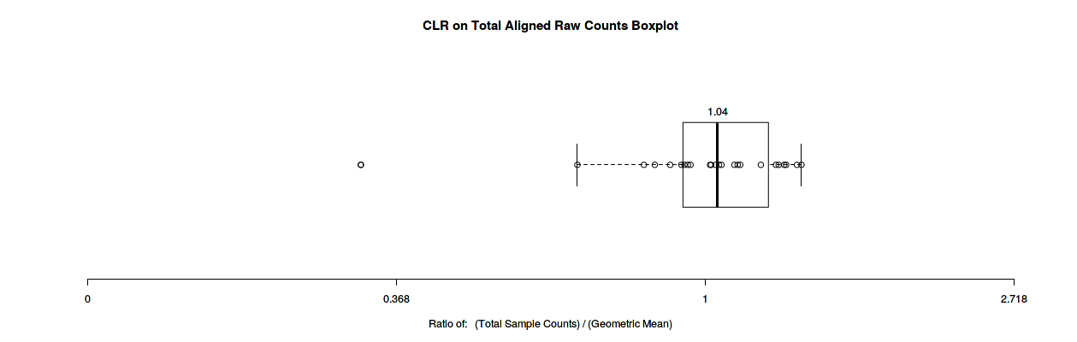
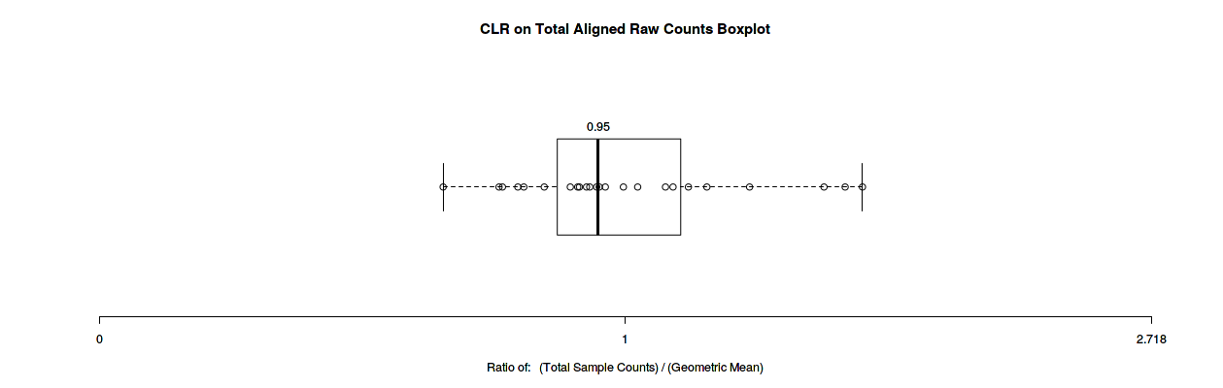
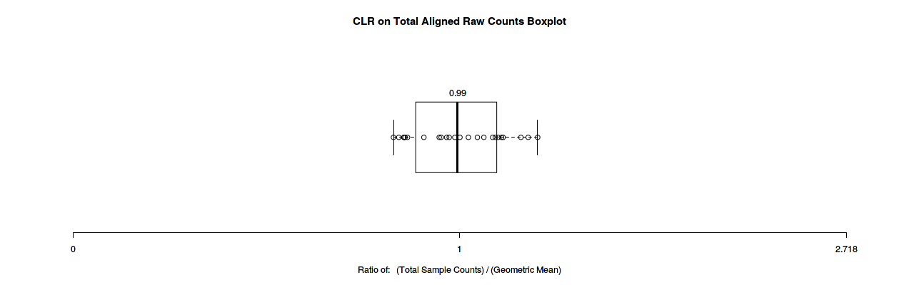
Example of Read Depth / # Aligned Reads
Application of clr transformation for outlier detection
Sample Name | Read Outliers
run228-Plasma_1_1 | Low Counts
run228-Plasma_5_1 | Low Counts
run228-Plasma_6_1 | Low Counts
run228-Plasma_7_1 | Low Counts
run229-FFPE_3_1 | Low Counts
run231-Plasma_1_1 | Low Counts
run228-Brain_5_1 | High Counts
Plate 1
Plate 2
Plate 4
Plate 3
Plate 5

Slide 25
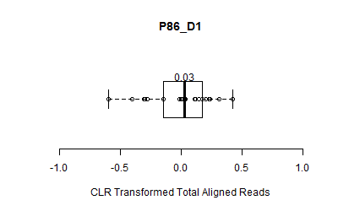
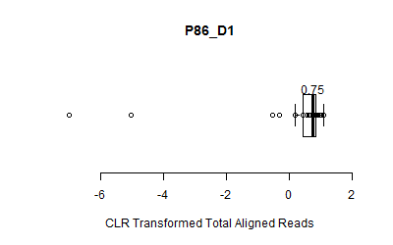
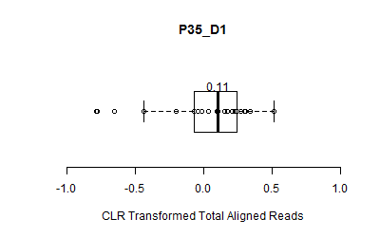
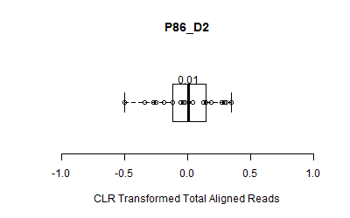
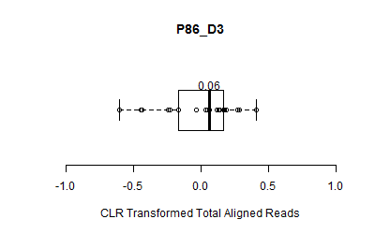
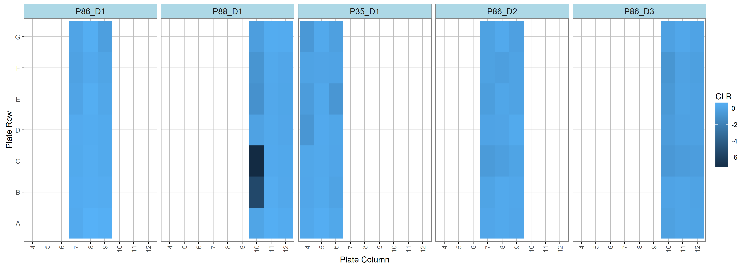
Example 2 of Read Depth / # Aligned Reads
HTG EdgeSeq Immuno-Oncology reproducibility study

Slide 26
Discussion
This simple example shows how exploiting the inherent compositional nature of RNASeq data can be used to detect outliers
This can be extended to other sequencing-based QC metrics (% passing Q30 score)
Detection of sample or run level failure is critical for diagnostic assays

Slide 27
Proposition 3
Compositional geometry enhances multivariate feature evaluation
Exploratory data for batch effects

Slide 28
Evaluation of Batch Effects
Definition: batch effects are technical variation that can possibly confound biologic variation
Typical methods for detection of batch effects
Multivariate methods – Principle Components Analysis
Visual inspection

Slide 29

Correlations and Distances
clr() covariances are interpretable in
Useful for PCA and other dimension reduction
Compute usual (Euclidean) covariances and correlations on clr transformed data
New distance metric - Aitchison distance (1986)
Accounts for compositional simplex structure
Statistical methods using correlations and distances are most affected by compositional structure
principal components, clustering, outlier detection

Slide 30
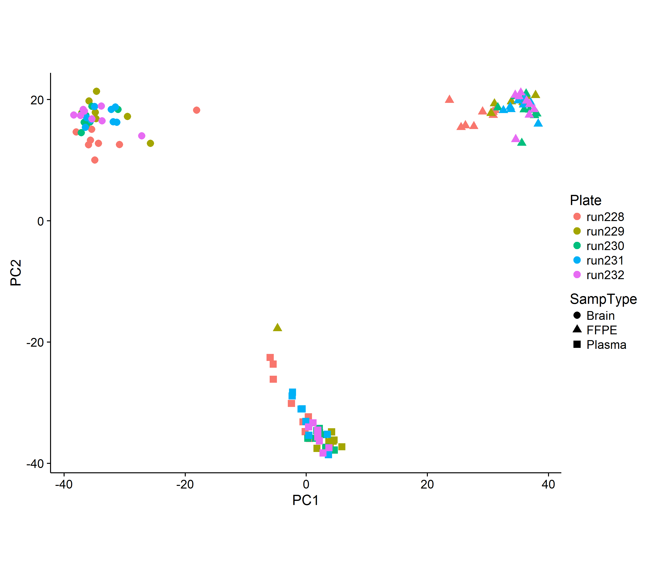
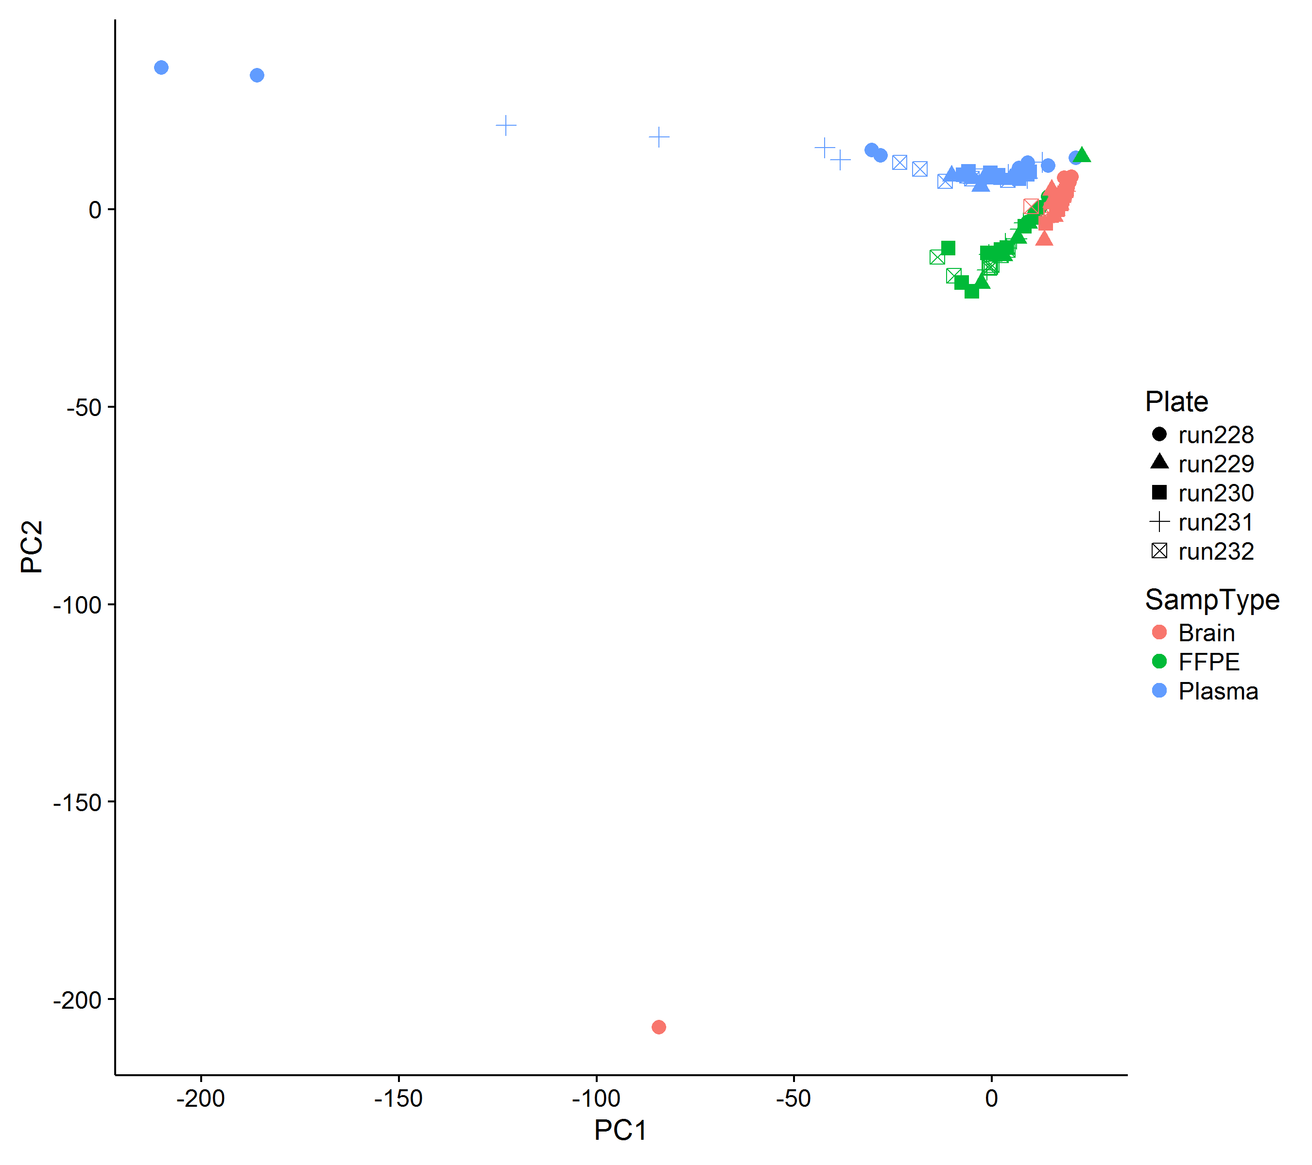
PCA Of Compositions
HTG EdgeSeq miRNA reproducibility study
raw data
clr data
Neither method identifies a batch effect - clr transformation results in more meaningful evaluation of sample effects

Slide 31
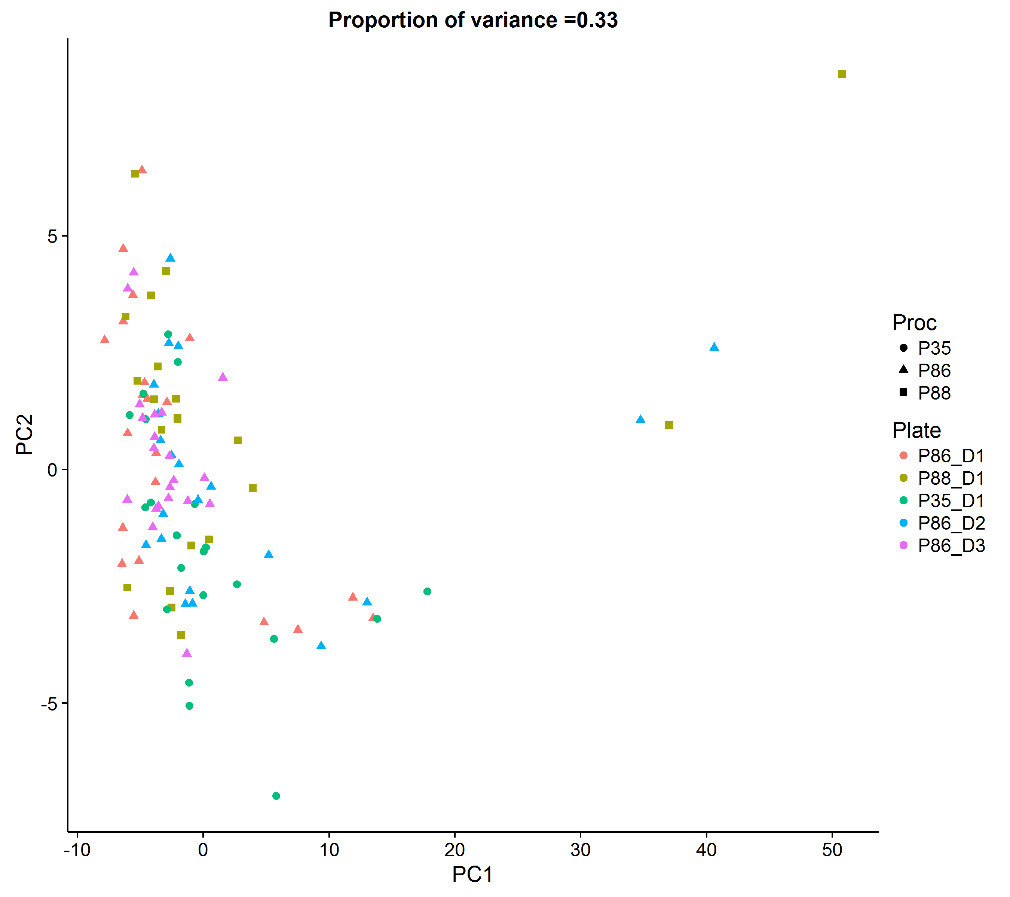
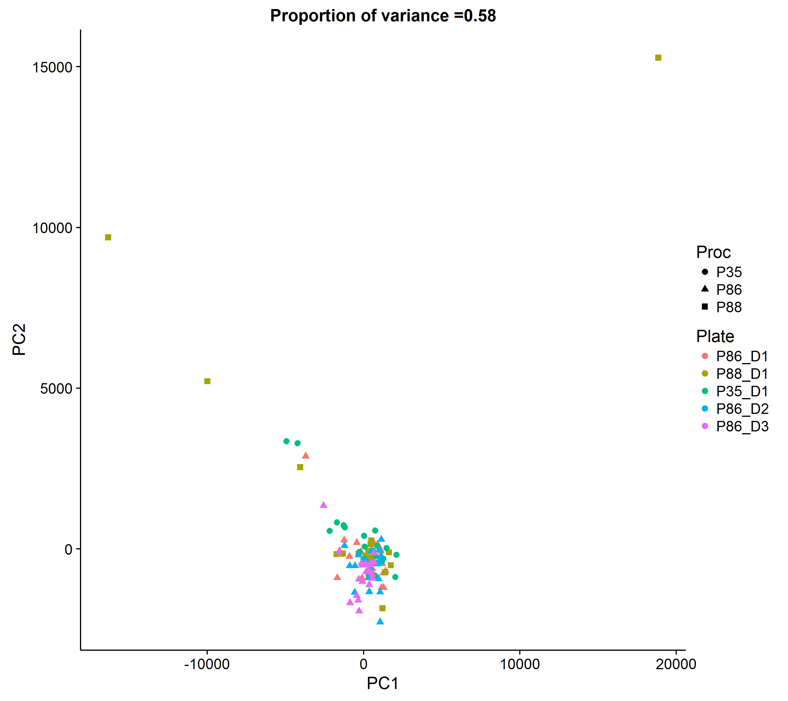
PCA Of Compositions
HTG EdgeSeq Immuno-Oncology reproducibility study
Quantile normalized data
clr data
Neither method identifies a batch effect after data transformation – one of benefits of the compositional structure is that it is a normalization that is performed at the sample level

Slide 32
Discussion
Aitchison distance and other compositional transformations provide more accurate measures of distance in multivariate space than naïve metrics
Can construct these tests for, and by extension remediation, at the sample level
Avoiding across sequencing normalization methods
More appropriate for diagnostic use

Slide 33
Future Directions
Use simplex geometry to evaluate biologic/clinical patterns between major groups of probes in place of probe level differential expression
Sample QC metrics of sequencing as an outlier detection method

Slide 34
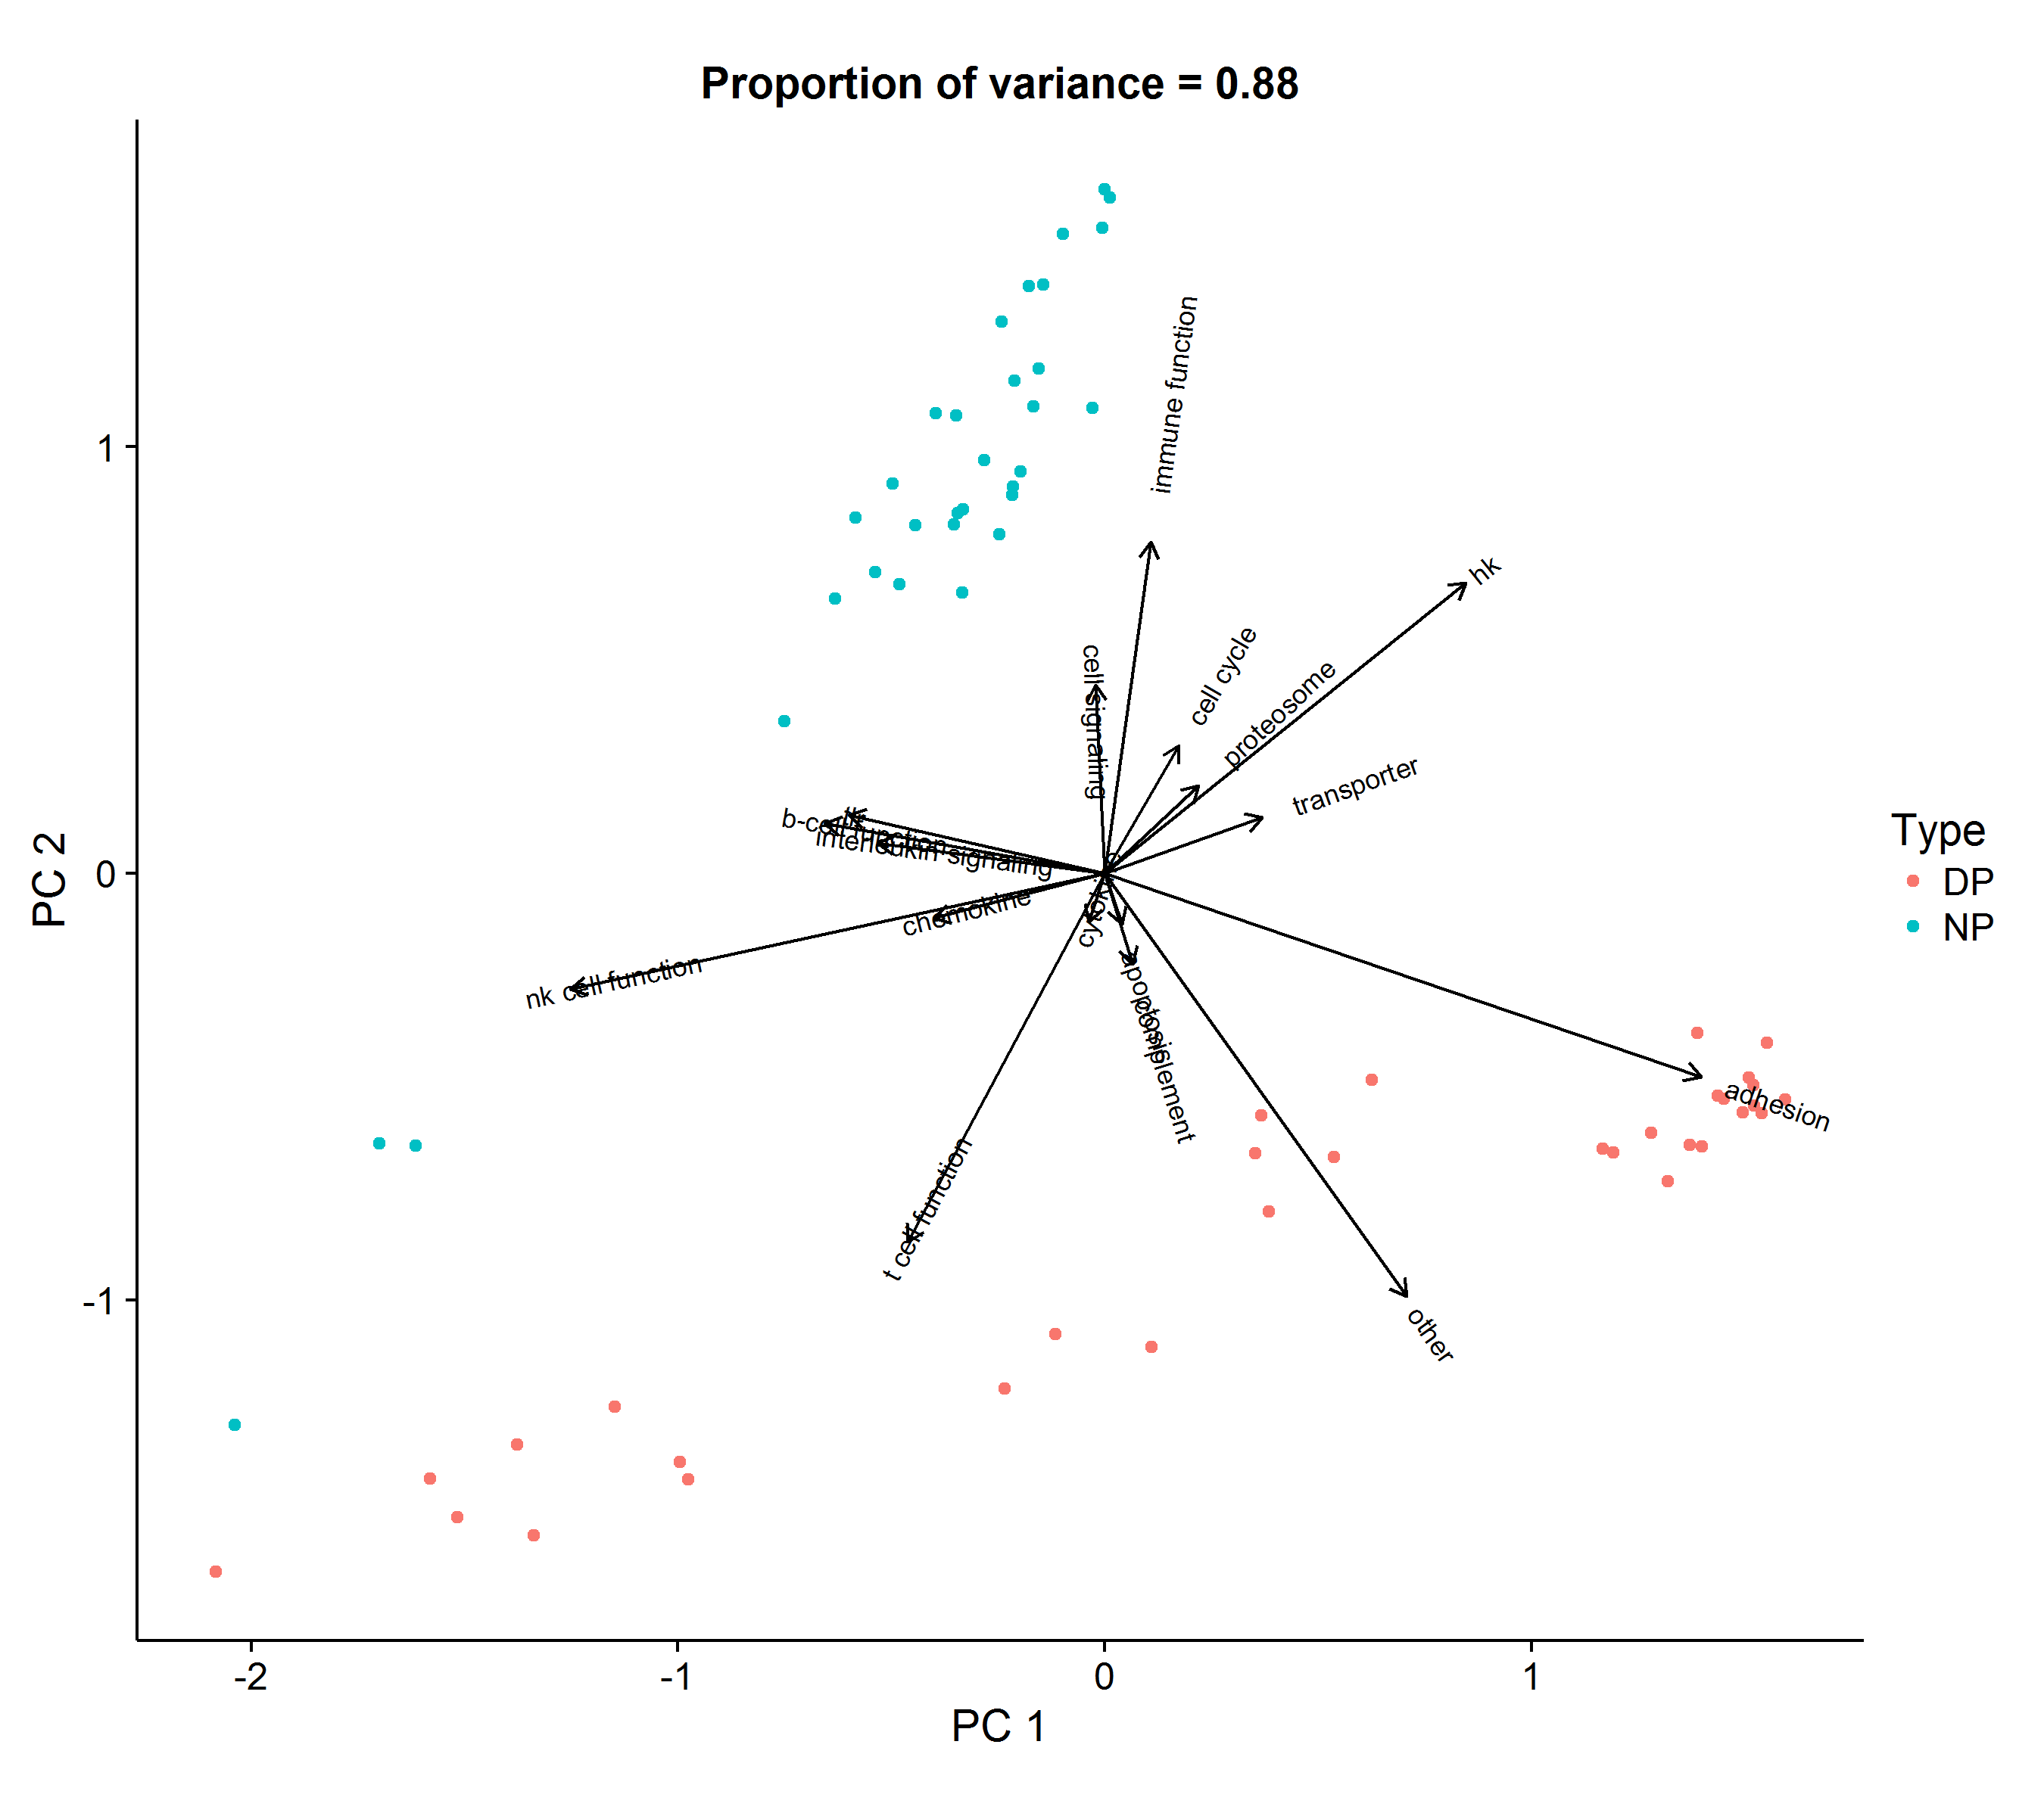
Covariance Biplot Of Compositions
HTG EdgeSeq Immuno-Onocology Internal Controls
Major grouping/pathway between normal pancreas (NP) and cancer (diseased pancreas = DP)
Compositional structure is maintained
Adhesion and immune function groups are contributing most to the discrimination between DP and NP
We can further amalgamate down to the probe level with the groupings

Slide 35
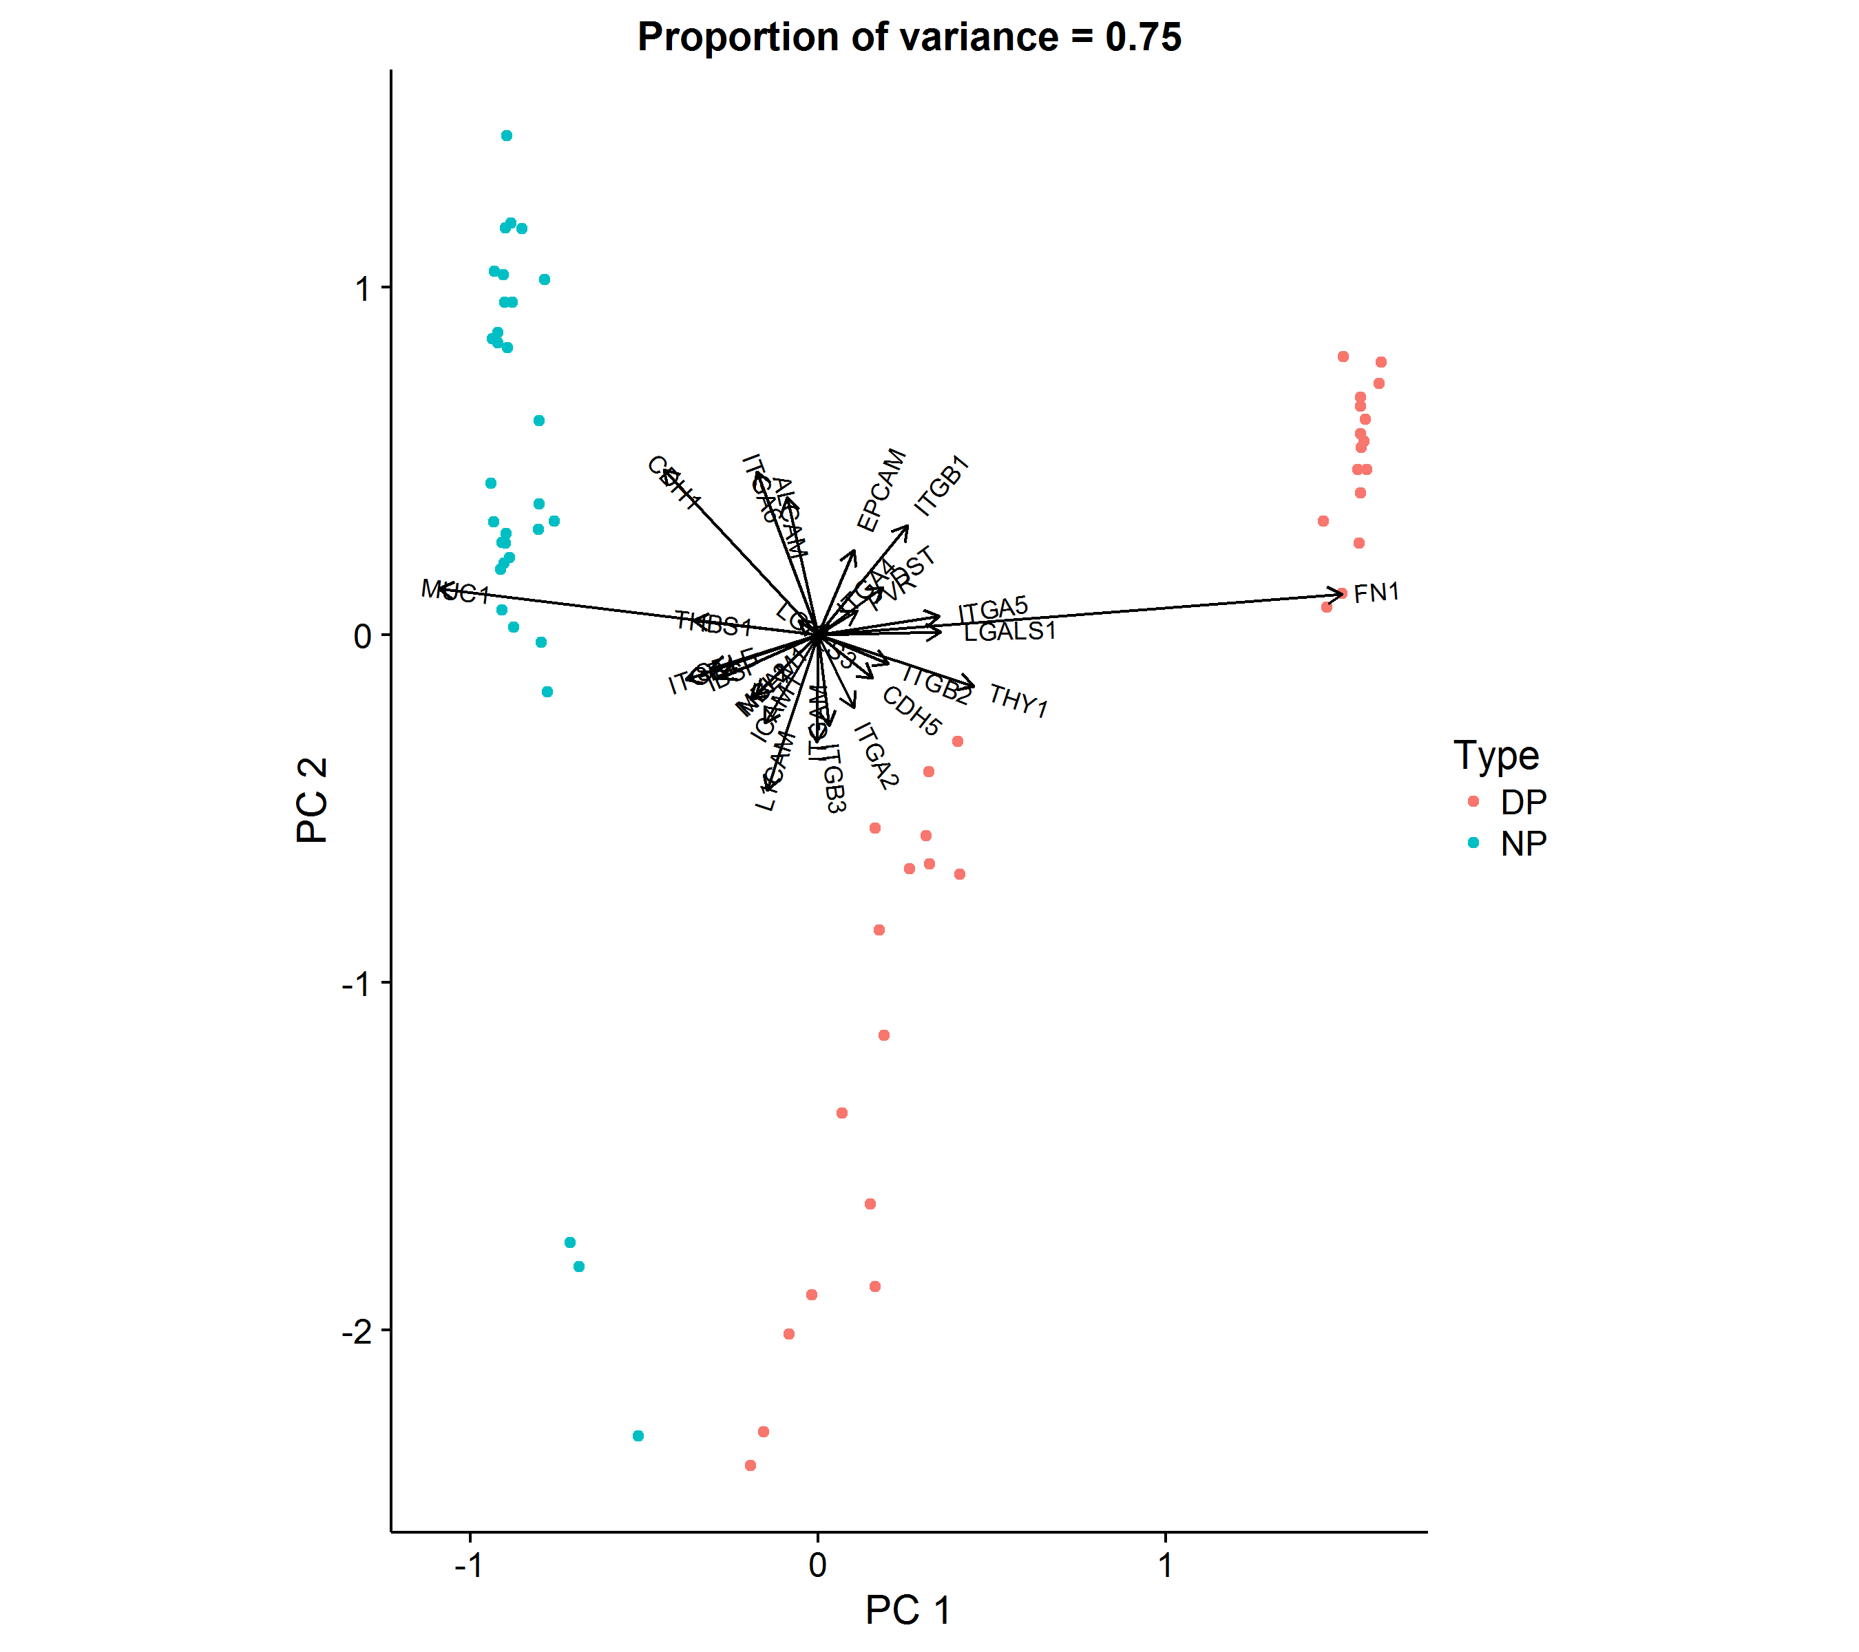
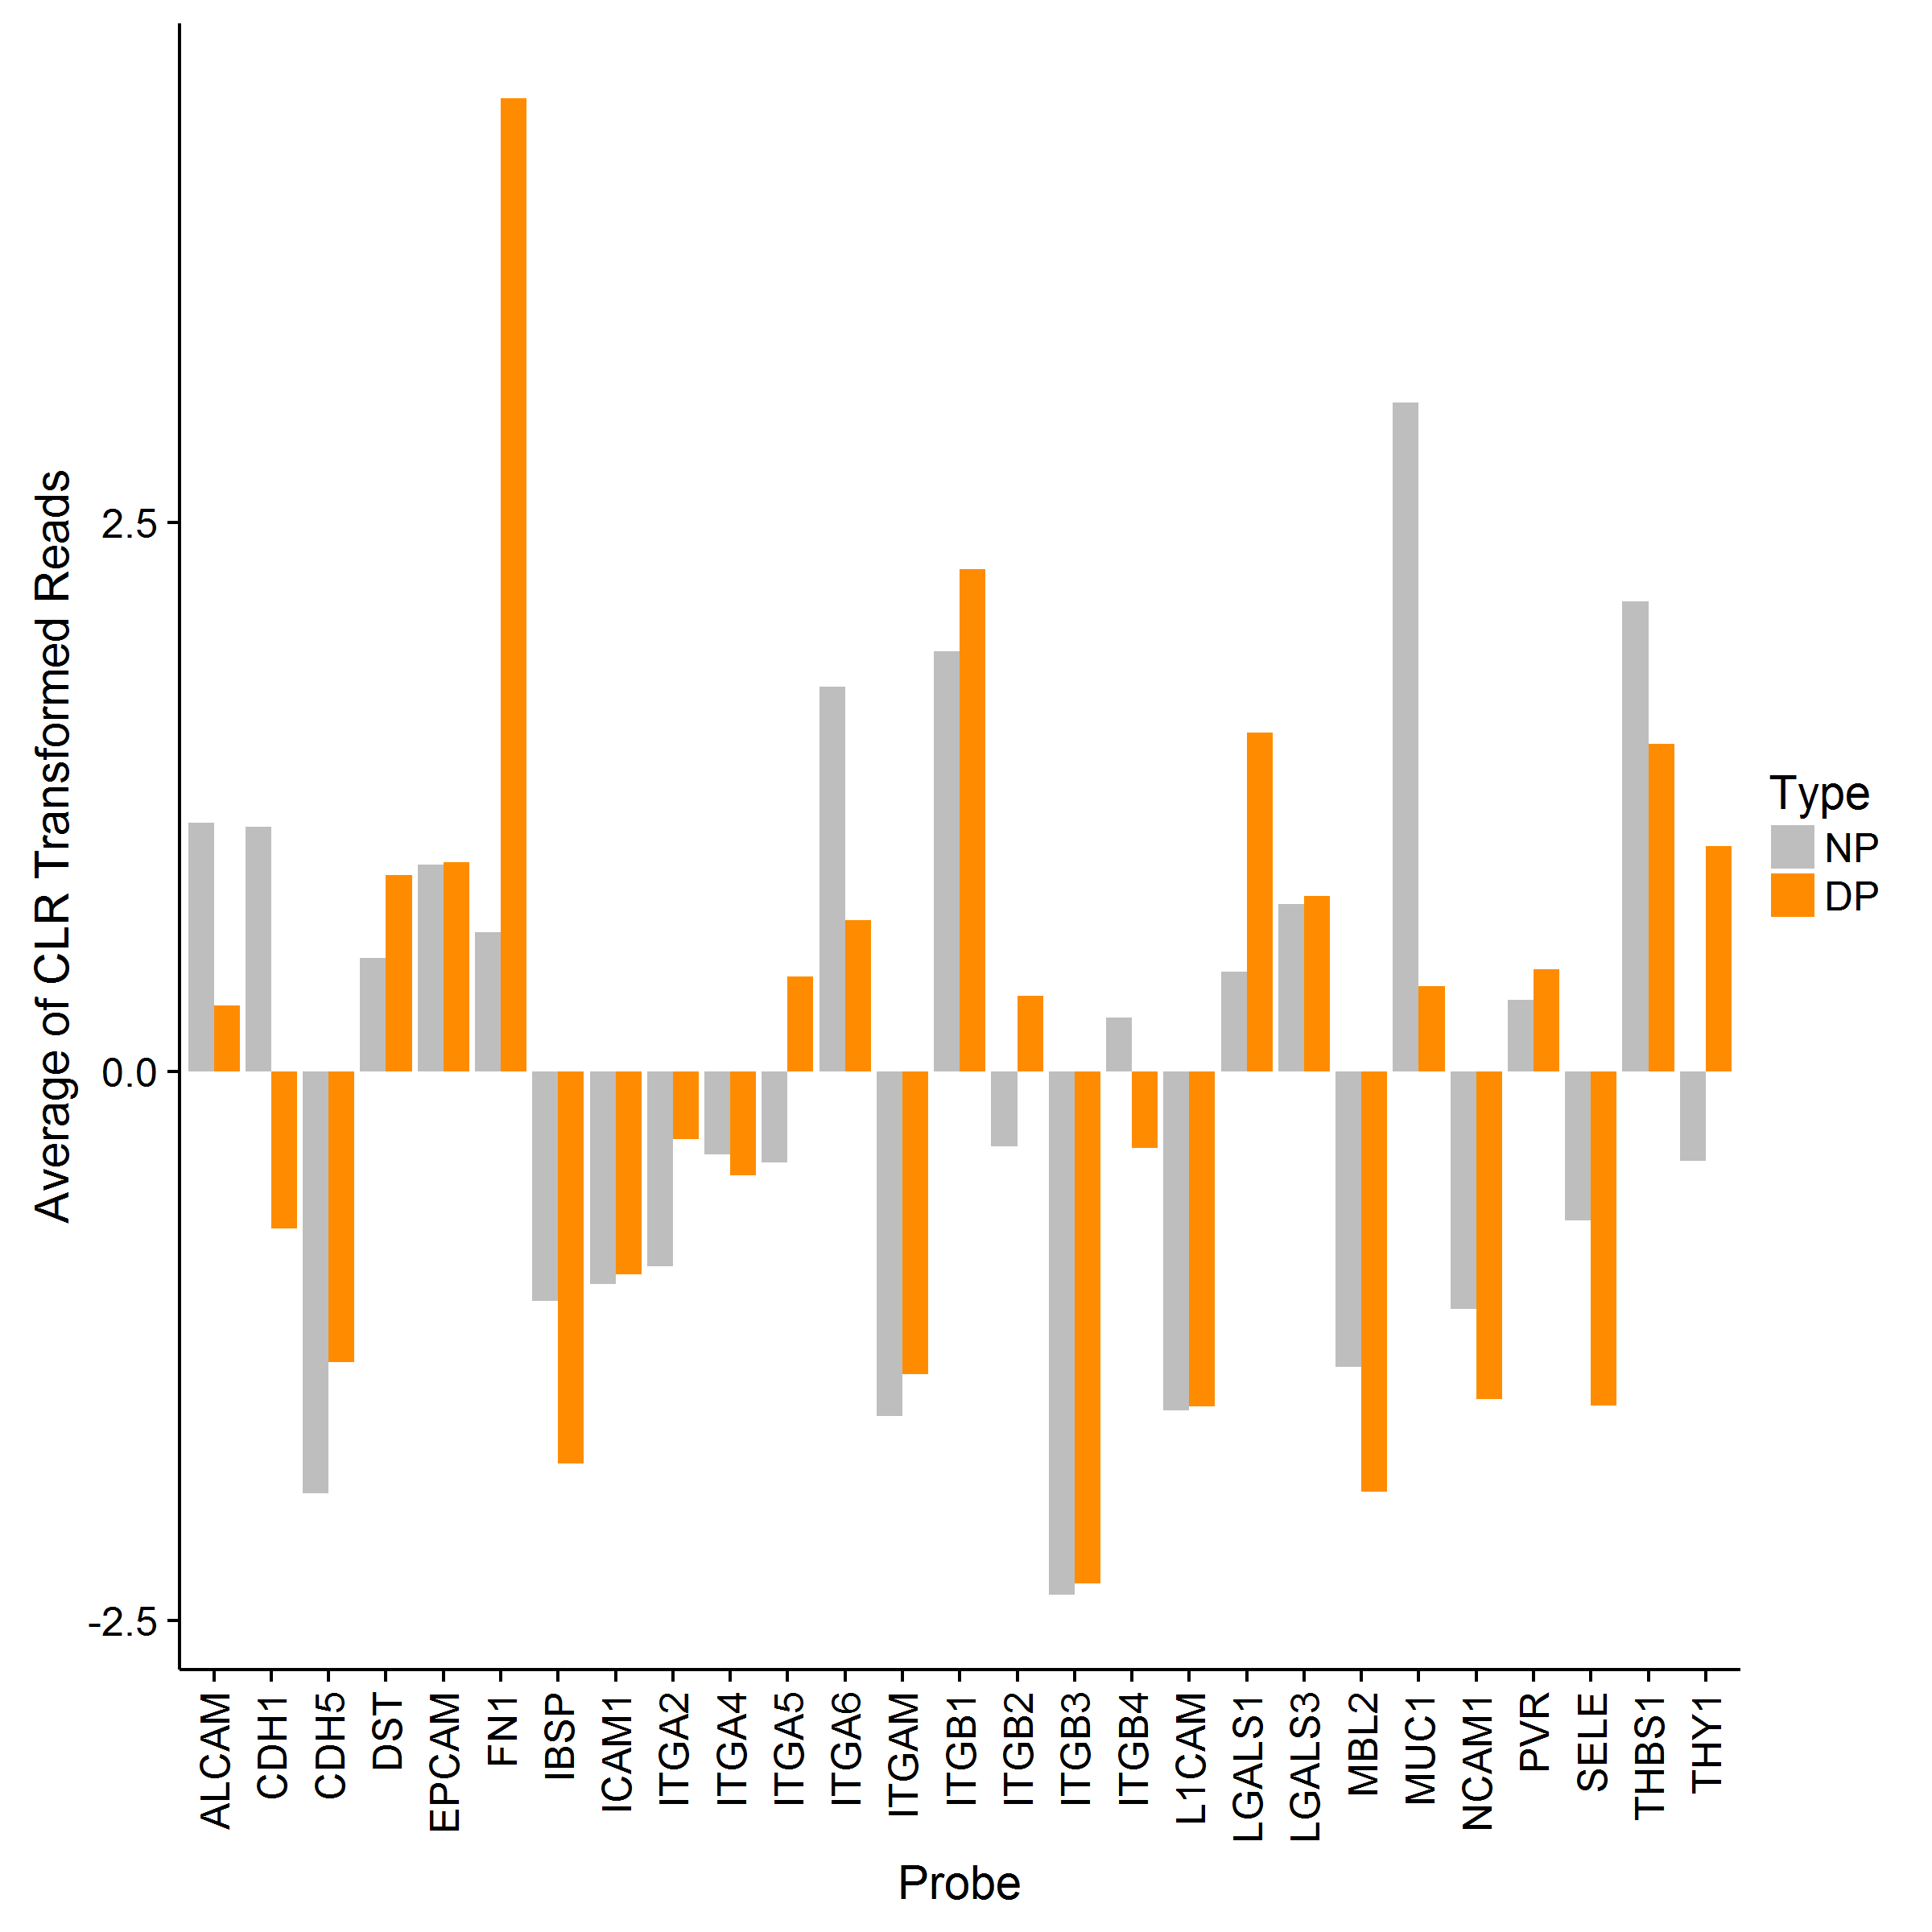
Probes Within Group Compositions
Cell Adhesion Probes
Biplot
Compositions

Slide 36
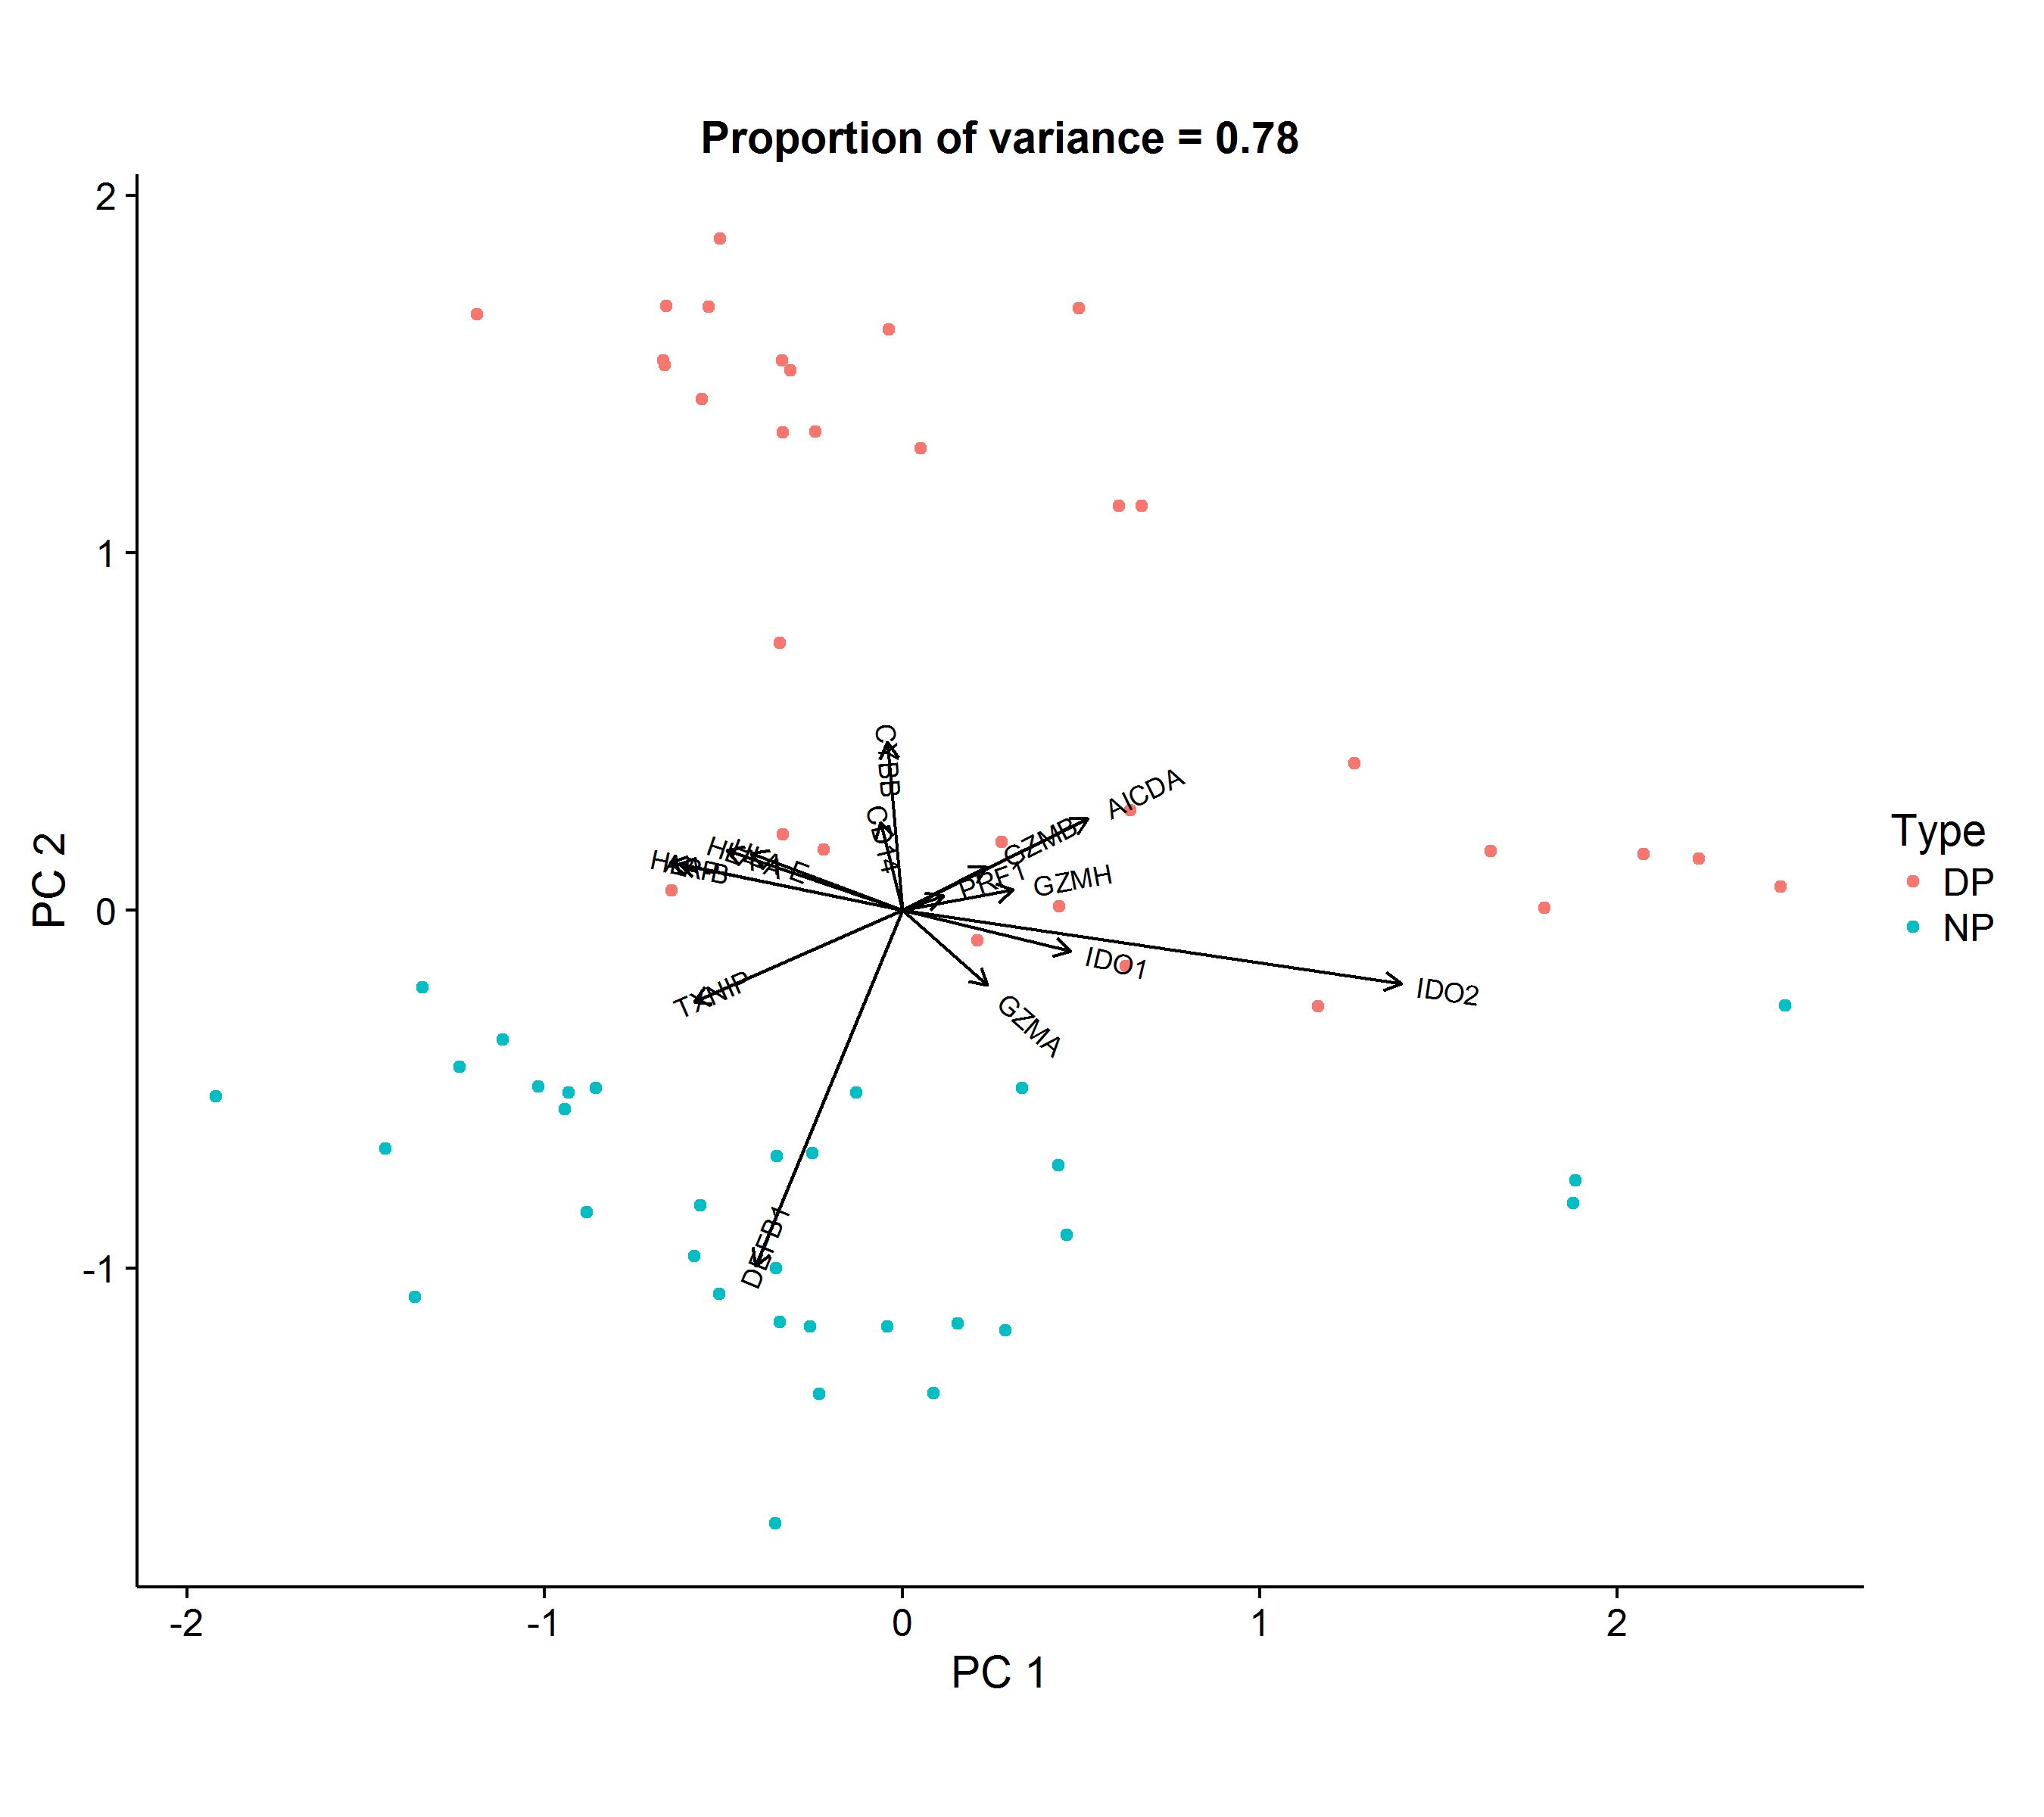
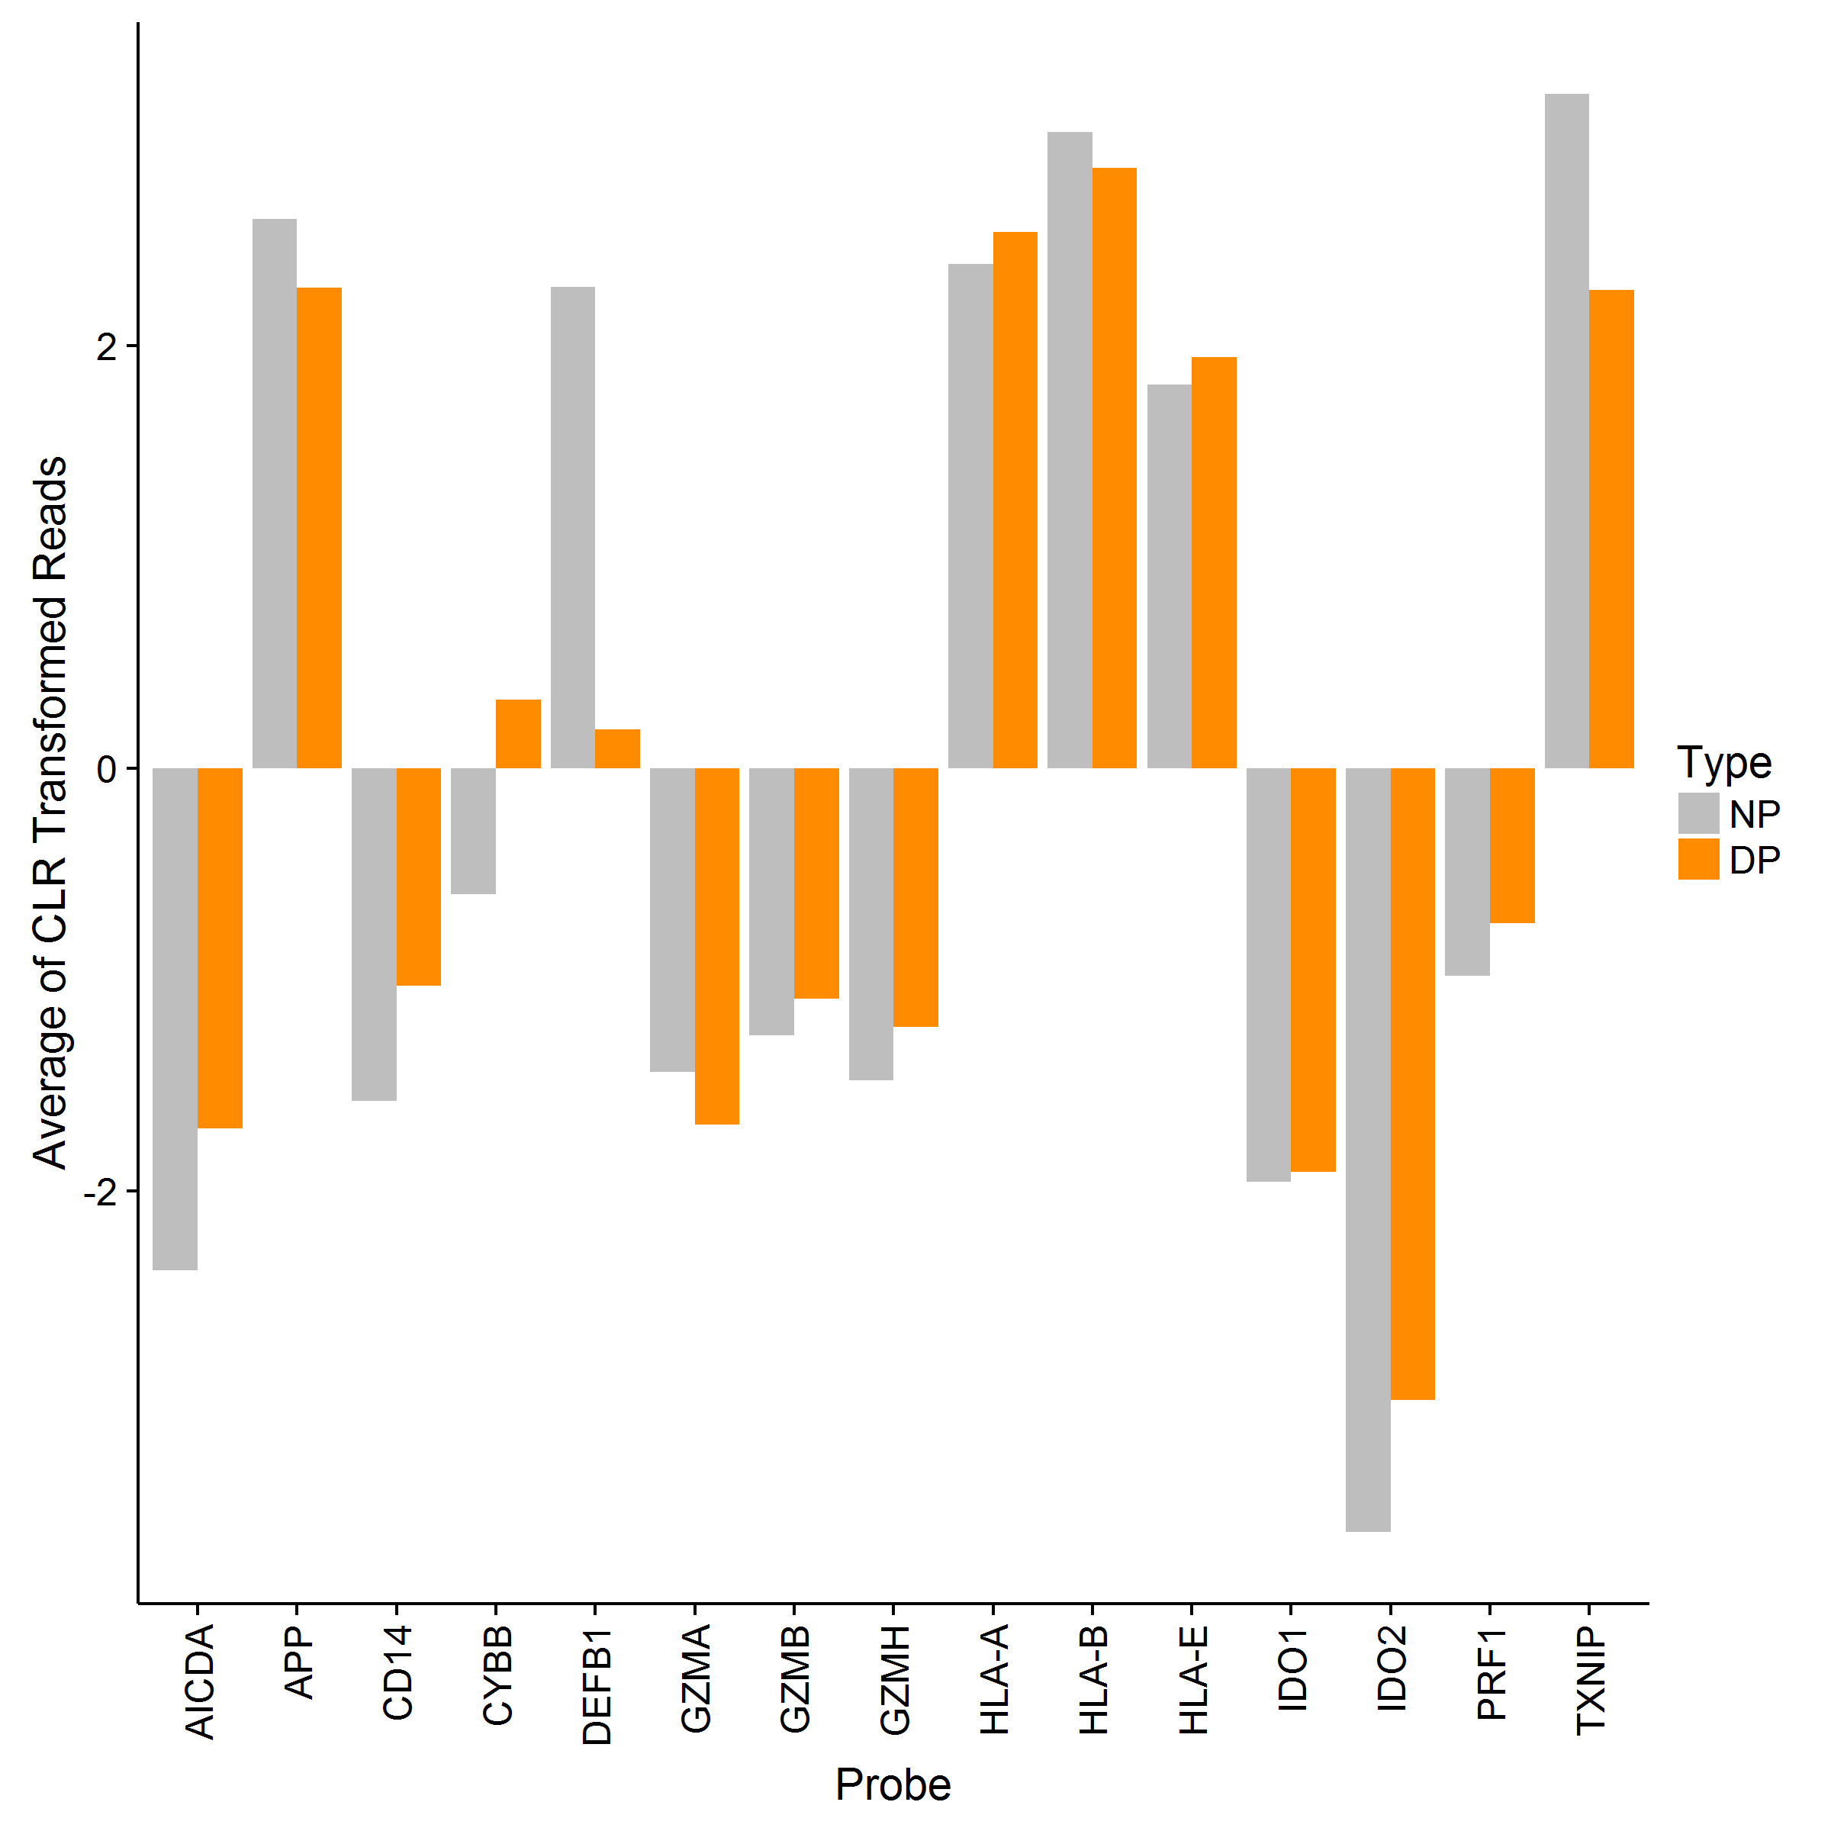
Probes Within Group Compositions
Immune Function Probes
Biplot
Compositions

Slide 37
Summary
Evaluation of features in RNASeq (targeted and de novo) can be viewed as compositions of totals
Mathematical properties of compositional data are well established
CPM transformation is a type of compositional transformation without some of the geometric benefits
Quality control metrics can be viewed as detection of unexpected data features
Outlier and influential sample features can be identified using well-established metrics on transformed data
Compositional geometry enhances multivariate feature evaluation
Aitchison distance is equivalent to Euclidean distance when using clr transformation

