Slide 1
Working with several data sets

Slide 2
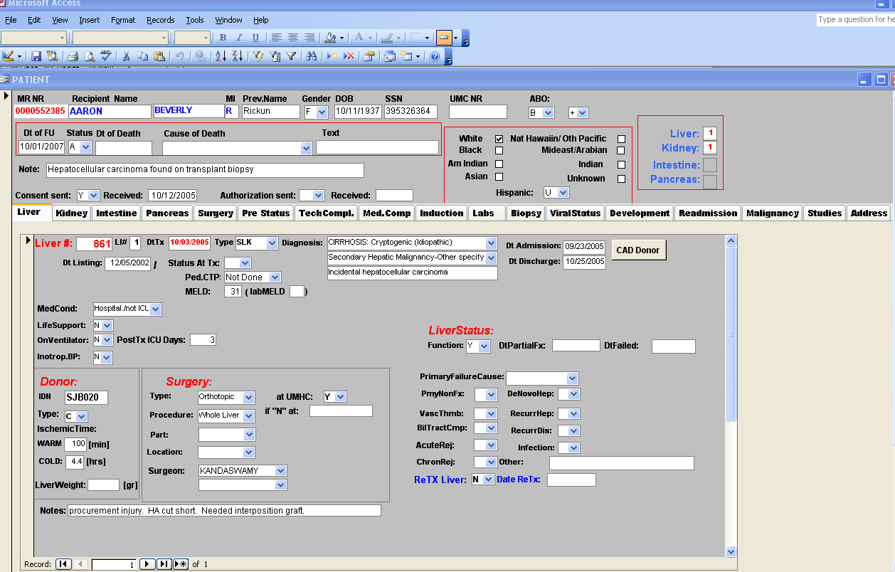
TEST

Slide 3
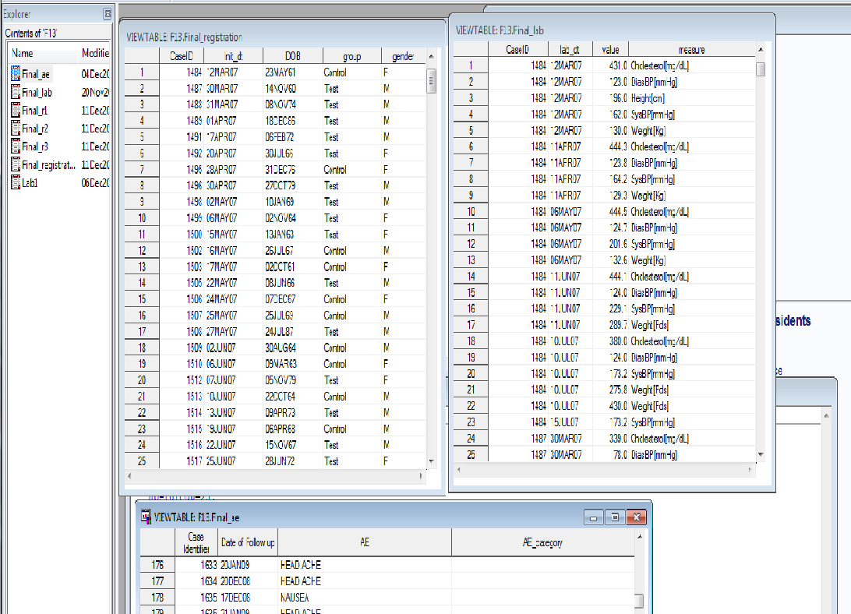

Slide 4
Merging 2 structural similar sets
My.UMC_data
My.TMC_data
PatID | ICD1 | ICD2
1 | 250.1 | 368.6
2 | 458.2 | 250.3
3 | 233.9 | 250.2
PatID | ICD1 | ICD2 | ICD3
102 | 250.1 | 368.6 | 427.9
103 | 458.2 | 250.3 | 101.6
105 | 233.9 | 250.2 | 104.3
My.AZ_data
PatID | ICD1 | ICD2 | ICD3
1 | 250.1 | 368.6 | .
2 | 458.2 | 250.3 | .
3 | 233.9 | 250.2 | .
102 | 250.1 | 368.6 | 427.9
103 | 458.2 | 250.3 | 101.6
105 | 233.9 | 250.2 | 104.3

Slide 5
Merging 2 structural similar sets
DATA My.AZ_data;
SET My.UMC_data My.TMC_data;
RUN;

Slide 6
Using PROC DATASETS
PROC DATASETS library=MY nolist;
APPEND BASE=UMC_data
DATA=TMC_data;
QUIT;
APPEND assumes that both data sets have the same suit of variables and that those variables have the same attributes. It fails if there are inconsistencies in the attributes.

Slide 7
Test_DB_SAS
Patient_admission
MR_NR | Admission_dt | Discharge_dt | ICD1 | ICD2 | icd3
111 | 10/1/2009 | 10/3/2009 | 042.0 | 201.9 | 250.0
252 | 10/14/2009 | 10/23/2009 | 250.0
262 | 10/6/2009 | 10/10/2009 | 996.8 | 456.3
446 | 10/5/2009 | 10/17/2009 | 996.86
Patient
MR_NR | Lname | Fname | DOB | Gender
111 | Mouse | Mickey | 9/18/1951 | M
123 | Bell | Tinker | 12/24/1932 | F
252 | Mouse | Minnie | 1/25/1936 | F
262 | Duck | Donald | 3/25/1963 | M
Patient_labs
MR_NR | Lab_dt | Serum_cr
111 | 10/1/2009 | 1.4
252 | 10/14/2009 | 2.8
262 | 10/6/2009 | 1.3
446 | 10/5/2009 | 2.2

Slide 8
We need a Flat file for analysis
Patient
MR_NR | Lname | Fname | DOB | Gender | Diabetic | Admission_dt | Age | Scr_1 | Scr_l
111 | Mouse | Mickey | 9/18/1951 | M
123 | Bell | Tinker | 12/24/1932 | F
252 | Mouse | Minnie | 1/25/1936 | F
262 | Duck | Donald | 3/25/1963 | M

Slide 9
Data set : Patient
Data set : Procedure
PatientID | Age | Gender
1024 | 40 | F
1037 | 43 | F
1051 | 31 | M
1079 | 36 | M
1158 | 3 | M
1257 | 65 | F
1396 | 24 | M
PatientID | Organ | Surgeon ID
1024 | K | S1
1079 | P | S1
1158 | K | S4
1024 | K | S1
1396 | K | S1
1257 | H | S4
1079 | L | S5
1079 | K | S5
1599 | Islet | S9
Data set : Surgeon
SurgeonID | SurgeonName | Hospital
S1 | Dr. X1 | UMC
S2 | Dr. X2 | UMC
S3 | Dr. X3 | UMC
S4 | Dr. X4 | TMC
S5 | Dr. X5 | VA

Slide 10
Set Theory
Venn diagram
Patient
Pat  Proc
Procedure

Slide 11
General Rules for Merge
All of the variables which are in common in the different data sets have to be of the same type
The length, format and labels of common variables will be defined by the first data set (Master data set) in the MERGE statement
Common variables in data set 2 will overwrite the variables in data set 1

Slide 12
Merging 2 data sets One-to-One
My.old_data1
My.old_data2
PatID | TX | Status | DnrID
102 | K | A | HH1
103 | K | A | HH2
105 | K | D | HH3
107 | K | A | HH7
DnrID | Age | DGender
HH1 | 25 | F
HH2 | 45 | M
HH3 | 23 | M
HH7 | 40 | F
My.New_data
PatID | TX | Status | DnrID | Age | DGender
102 | K | A | HH1 | 25 | F
103 | K | A | HH2 | 45 | M
105 | K | D | HH3 | 23 | M
107 | K | A | HH7 | 40 | F

Slide 13
Simple Merging 2 data sets
PROC SORT data= My.old_data1;
By DnrID;
RUN;
PROC SORT data= My.old_data2;
By DnrID;
RUN;
/*Before you merge both data sets have to be sorted by DnrID */
DATA My.New_data;
Merge My.old_data1 My.old_data2;
By DnrID;
RUN;

Slide 14
Merging 2 data sets One –to-Many
My.old_data1
My.old_data2
PatID | TX | Status | DnrID
102 | K | A | HH1
103 | H | A | HH3
105 | L | D | HH3
107 | P | A | HH3
DnrID | Age | DGender
HH1 | 25 | F
HH2 | 45 | M
HH3 | 23 | M
HH7 | 40 | F
My.New_data
PatID | TX | Status | DnrID | Age | DGender
102 | K | A | HH1 | 25 | F
. | . | . | HH2 | 45 | M
103 | H | A | HH3 | 23 | M
105 | L | D | HH3 | 23 | M
107 | P | A | HH3 | 23 | M
. | . | . | HH7 | 40 | F

Slide 15
Simple Merging 2 data sets
PROC SORT data= My.old_data1;
By DnrID;
RUN;
PROC SORT data= My.old_data2;
By DnrID;
RUN;
/*Before you merge both data sets have to be sorted by DnrID */
DATA My.New_data;
Merge My.old_data1 My.old_data2;
By DnrID;
If PatID=. Then delete;
RUN;

Slide 16
Simple Merging 2 data sets
PROC SORT data= My.old_data1;
By DnrID;
RUN;
PROC SORT data= My.old_data2;
By DnrID;
RUN;
/*Before you merge both data sets have to be sorted by DnrID */
DATA My.New_data;
Merge My.old_data1 (in= in1) My.old_data2;
By DnrID;
If in1;
RUN;

Slide 17
Using Data Set Options
(KEEP = variable list ) tells SAS which variables to keep
(DROP= variable list) tells SAS which variables to drop
(RENAME=(oldvar=newvar)) SAS renames variable
(FIRSTOBS=n) SAS starts reading at observation n
(OBS=n) SAS stops reading at observation n
(In=NewVar) creates a new temporary variable for Tracking
(Where=condition) select observations which
meet condition

Slide 18
SAS data set OPTIONS
KEEP = variable list
Data test (keep = ID P1 – p9);
SET my.test2 (keep = f4 – f8);
DROP = variable list
MERGE data1 data2 (drop x4 – x7);
RENAME = (old name=new name)
SET TEST2 (rename=(ID=PID));
IN= new temporary variable name MERGE test1 (IN=in1) test3 (IN=in3); IF in1;

Slide 19
Options vs Statements
The DROP=, KEEP=, RENAME= options are similar to the DROP, KEEP, RENAME statements! However the statements apply to the data sets named in the DATA statement while the options apply only to the particular data set whose name they follow.
The options can be used in the DATA and PROC steps

Slide 20
Usage
DATA test;
SET test2 (FIRSTOBS=2 obs=10):
…………………….
PROC PRINT DATA=TEST2 (FIRSTOBS=2 OBS=10);

Slide 21
ADD Variables to Data set (add missing r_dob)
proc sort data=u.usa2014; /* file which contains complete info */
by px_id;
run;
proc sort data=my.test_pta; /* file with missing info */
by px_id;
run;
data my.test_pta;
merge my.test_pta (in=my_pta) u.usa2014 (keep=px_id r_dob);
By px_id;
If my_pta;
run;

Slide 22
Merging 2 data sets
PROC SORT data= My.old_data1;
By DnrID;
RUN;
PROC SORT data= My.old_data2;
By DnrID;
RUN;
/*Before you merge both data sets have to be sorted by DnrID */
DATA My.New_data;
Merge My.old_data1 (IN=SW1) My.old_data2 (IN=SW2);
By DnrID;
If SW1;
RUN;

Slide 23
Merging 2 data sets with different BY Variable names
PROC SORT data= My.old_data1;
By DnrID;
RUN;
PROC SORT data= My.old_data2;
By DonorID;
RUN;
/*Before you merge both data sets have to be sorted */
DATA My.New_data;
Merge My.old_data1 My.old_data2 (Rename=(DonorID=DnrID));
By DnrID;
RUN;

Slide 24
Merging 2 data sets One –to-Many with different type of BY variable
My.Med
My.Insure
SSN | TX | Status
102222444 | K | A
103441234 | H | A
105551234 | L | D
107661234 | P | A
SSN | Age | Insurance
102-22-2444 | 25 | Medicare
103-44-1234 | 45 | Medicaid
105-55-1234 | 23 | Private
107-66-1234 | 40 | Private
numeric
character
My.New_data
SSN | TX | Status | Age | Insurance
102-22-2444 | K | A | 25 | Medicare
103-44-1234 | H | A | 45 | Medicaid
105-55-1234 | L | D | 23 | Private
107-66-1234 | P | A | 40 | Private

Slide 25
Merging 2 data sets with different BY Variable types
/* merge with SSN as character string */
Data med;
Set my.med (rename=( ssn=ssn2));
/* changing into character with common SSN format */
ssn=put(ssn2,ssn11.);
Drop ssn2;
Run;
/* make sure that both data sets are ordered appropriately */
/*Before you merge you have to change the data type to make it equal */
DATA My.New_data;
Merge med My.insure;
By ssn;
RUN;

Slide 26
Merging 2 data sets with different BY Variable types
/* merge with SSN as numeric variable */
Data insure;
Set my.insure (rename=( ssn=ssn3));
/* removal of ‘-’ and changing into numeric */
ssn=input(compress(ssn3,’-’),9.);
Drop ssn3;
Run;
/* make sure that both data sets are ordered appropiately */
/*Before you merge you have to change the data type to make it equal */
DATA My.New_data;
Merge my.med insure;
By ssn;
RUN;

Slide 27
Merging 2 data sets Many-to-Many
Data set : Patient admission
Data set : Problem
PatientID | Date
1024 | 8/15/08
1024 | 4/1/09
1024 | 5/31/10
1079 | 8/15/04
1158 | 3/20/95
1158 | 6/5/98
1158 | 2/4/01
PatientID | ICD
1024 | 253.2
1024 | 358.0
1158 | 95.1
1158 | 28.0
1396 | 356
1396 | 259.2
1396 | 33.1
1396 | 258.6
1599 | 233.4
Can not be solved directly with MERGE

Slide 28
Merging 2 data sets Omitting BY
My.old_data1
My.old_data2
PatID | TX | Status | DnrID
102 | K | A | HH1
103 | H | A | HH3
105 | L | D | HH3
107 | P | A | HH3
DnrID | Age | DGender
HH1 | 25 | F
HH2 | 45 | M
HH3 | 23 | M
HH7 | 40 | F
My.InCorrect_data
PatID | TX | Status | DnrID | Age | DGender
102 | K | A | HH1 | 25 | F
103 | H | A | HH2 | 45 | M
105 | L | D | HH3 | 23 | M
107 | P | A | HH7 | 40 | F

Slide 29
Merging 2 data sets
My.old_data1
My.old_data2
PatID | TX | Status | DnrID
102 | K | A | HH1
103 | H | A | HH3
105 | L | D | HH3
107 | P | A | HH3
DnrID | Age | DGender
HH1 | 25 | F
HH2 | 45 | M
HH3 | 23 | M
HH7 | 40 | F
My.New_data
PatID | TX | Status | DnrID | Age | DGender
102 | K | A | HH1 | 25 | F
103 | H | A | HH3 | 23 | M
105 | L | D | HH3 | 23 | M
107 | P | A | HH3 | 23 | M

Slide 30
Merging 2 data sets Omitting BY
You can make sure that you get at least a warning when you don’t use a BY statement in a MERGE with:
OPTIONS MERGENOBY=WARN;
OPTIONS MERGENOBY=ERROR;
Default: OPTIONS MERGENOBY=NOWARN;

Slide 31
Update
Master file
PatID | Dt_fu | Status
1024 | 01/09/09 | D
1079 | 12/15/07 | A
1158 | 01/15/08 | D
1234 | 02/12/08 | D
1396 | 12/15/07 | A
1457 | 12/15/07 | A
1589 | 03/18/08 | D
1679 | 12/15/07 | A
PatID | Dt_fu | Status
1024 | 12/15/07 | A
1079 | 12/15/07 | A
1158 | 12/15/07 | A
1234 | 12/15/07 | A
1396 | 12/15/07 | A
1457 | 12/15/07 | A
1589 | 12/15/07 | A
1679 | 12/15/07 | A
Transaction file
PatID | Dt_fu | Status
1024 | 01/09/09 | D
1158 | 01/15/08 | D
1234 | 02/12/08 | D
1396 | .
1589 | 03/18/08 | D

Slide 32
Update
PROC SORT data= My.master;
By PatID;
RUN;
PROC SORT data= My.Trans;
By PatID;
RUN;
/*Before you merge both data sets have to be sorted */
DATA My.Master;
UPDATE My.Master My.Trans ;
By PatID;
RUN;

Slide 33
UPDATE
Values of the BY variable must be unique for each observation in the master data set.
If the master data set contains more than one observation with the same value for the BY variable, the first observation is updated and the second observation is ignored etc.
SAS writes a warning in the log

Slide 34
Update
Master file
Transaction file
PatID | Tx_dt | Dt_fu
1024 | 1/15/1996 | 12/15/07
1079 | 2/3/1963 | 12/15/07
1158 | 2/15/89 | 12/15/06
1158 | 6/9/99 | 1/15/07
PatID | Tx_dt | Dt_fu
1024 | 1/15/96 | 01/09/09
1158 | 2/15/89 | 9/20/10
1234 | 9/20/01 | 02/12/08
1396 | 12/15/08 | .
1589 |  | 03/18/08
PatID | Tx_dt | Dt_fu
1024 | 1/15/1996 | 1/9/09
1079 | 2/3/1963 | 12/15/07
1158 | 2/15/89 | 9/20/10
1158 | 6/9/99 | 1/15/07

Slide 35
Update
PROC SORT data= My.master;
By PatID tx_dt;
RUN;
PROC SORT data= My.Trans;
By PatID tx_dt;
RUN;
/*Before you merge both data sets have to be sorted */
DATA My.Master;
UPDATE My.Master My.Trans ;
By PatID tx_dt;
RUN;

Slide 36
Table Lookup

Slide 37
Data set : x.Target
Data set: x.Inst_Lookup
ID | Organ | Inst_ID
1024 | K | 1
1079 | P | 1
1158 | K | 4
1024 | K | 1
1396 | K | 1
1257 | H | 4
1079 | L | 5
1079 | K | 5
Inst_ID | Name | country | Cont
1 | U_MN | USA | NrAm
2 | U_MA | USA | NrAm
3 | U_TX | USA | NrAm
4 | HD | G | Eu
5 | MU | G | Eu
6 | U_P | FR | Eu
7 | M | SP | Eu

Slide 38
SAS Merge / LOOKUP
Proc sort data= x.Target;
By Inst_ID;
Run;
Proc sort data= x.Inst_Lookup;
By Inst_ID;
Run;
Data x.Target;
Merge x.Target (in=F1) x.Inst_Lookup;
By Inst_id;
If F1;
Run;
Proc freq;
Table country;
Run;

Slide 39
Lookup with SAS Formats
Proc format value country_fmt
1-3 =‘USA’
4-5 =‘G’
6 =‘FR’
7 =‘SP’;
Other =‘Unknown’;
Run;
Data lookup;
Set x.Target;
Country=put(inst_id,country_fmt.);
Run;
Proc freq;
Table country;
Run;

Slide 40
Working with data set INDEXING

Slide 41
Data set Indexing
Indexes provide a search tool that allows detection and extraction of a data subset.
Well-defined indexes can especially useful in increasing the efficiency of the sub-setting process.
The highest efficiency gains are in speeding up sorting processes

Slide 42
Types of indexes
There are two types of indexes: simple and composite. A simple index has only one key variable. A key variable is the variable upon which the data file is indexed. You can have multiple simple indexes associated with a given data file. The name of the simple index is the same as the name of the key variable. A composite index is one in which the values of two or more variables have been concatenated together to form one value. When creating a composite index, you also need to give it a name.

Slide 43
Options for Indexes
There are two options that you can use when creating indexes: unique and nomiss. The unique option declares that the values for a variable are unique, such as the values of an id variable or social security numbers would be unique. If an attempt is made to add an observation with a duplicate value, that update is rejected. The nomiss option instructs SAS not to include missing values in the index. This can make the index more efficient if there are many missing data points in the key variable. Unlike the unique option, observations with missing values on the key variable can be added to the data set.

Slide 44
Creating an Index 1
DATA MY.weight_reg2 (index=(CaseID/nomiss/unique));
Set My.weight_reg;
RUN;

Slide 45
Creating an Index 2
PROC DATASETS library=my;
MODIFY weight_reg;
INDEX CREATE caseID/Unique Nomiss;
INDEX CREATE (Gender Race);
Quit;

Slide 46
Creating an Index 3
=> Use PROC SQL

Slide 47
Deleting an Index
PROC DATASETS library=my;
MODIFY weight_reg;
INDEX delete caseID;
Quit;

Slide 48
Alphabetic List of Variables and Attributes
# Variable Type Len Format Informat
1 CaseID Num 8 BEST12. BEST32.
5 DOB Num 8 DATE7. DATE7.
7 Init_BP_dias Num 8 BEST12. BEST32.
6 Init_BP_sys Num 8 BEST12. BEST32.
3 Init_Height_cm Num 8 BEST12. BEST32.
8 Init_TotalChol Num 8 BEST12. BEST32.
4 Init_Weight_kg Num 8 BEST12. BEST32.
2 Init_dt Num 8 DATE7. DATE7.
12 age Num 8
11 bmi_0 Num 8 8.1
10 gender Char 1 $1. $1.
9 group Char 7 $7. $7.
Alphabetic List of Indexes and Attributes
# of
Unique
# Index Values
1 CaseID 330

Slide 49
USING INDEXING
PROC PRINT data=my.weight_reg;
BY caseId;
ID caseID;
Run;
9264 PROC PRINT data=my.weight_reg;
9265 BY caseId;
NOTE: An index was selected to execute the BY statement.
The observations will be returned in index order rather than in physical order. The selected index is for the variable(s):
CaseID
9266 ID caseID;
9267 Run;

Slide 50
USING INDEXING
PROC MEANS data=my.weight_reg;
VAR weight;
Where gender=‘M” and Race=“AfriAM”;
Run;

Slide 51
USING INDEXING
data test_pta_reg (index=(px_id tx_dt));
set my.test_pta_reg;
run;
proc contents;
run;
data test_pta_fu (index=(px_id tx_dt));
set my.test_pta_fu;
run;
proc contents;
run;
data test;
merge test_pta_fu test_pta_reg (in=PTA);
by px_id tx_dt;
If PTA;
run;

Slide 52
Without Indexes
proc sort data=my.test_pta_reg;
by px_id tx_dt;
run;
proc sort data=my.test_pta_fu;
by px_id tx_dt;
run;
data test;
merge my.test_pta_fu my.test_pta_reg (in=PTA);
by px_id tx_dt;
if PTA;
run;

Slide 53
Writing several OUTPUT files
DATA tiger mouse;
SET animals;
………………………..
If animal=“TIGER” then OUTPUT tiger;
If animal=“MOUSE” then OUTPUT mouse;
…………………….

Slide 54
Replacing missing data with Summaries
ID | P1 | P2 | P3 | P4
1 | 4 | 4 | 3 | 5
2 | 3 | . | 5 | 4
3 | . | 6 | 2 | 3
Mean | 3.5 | 5 | 3.3 | 4
ID | P1 | P2 | P3 | P4
1 | 4 | 4 | 3 | 5
2 | 3 | 5 | 5 | 4
3 | 3.5 | 6 | 2 | 3

Slide 55
First Try
/* Computing Summary Statistics */
proc means data=my.test_Flc maxdec=1 mean ;
output out=test_flc_mean;
var p1 -- p4;
run;
/* Check output */
proc print data=test_flc_mean;
run;
/* Rename for Merge */
data test_flc_mean ;
set test_flc_mean;
rename p1=p1m p2=p2m p3=p3m p4=p4m ;
if _stat_ ne "MEAN " then delete;
drop _type_ _freq_ _stat_;
run;
data test;
merge my.test_Flc test_flc_mean;
run;

Slide 56
Solution
proc means data=my.test_Flc maxdec=1 mean ;
output out=test_flc_mean;
var p1 -- p4;
run;
proc print data=test_flc_mean;
run;
data test_flc_mean ;
set test_flc_mean;
rename p1=p1m p2=p2m p3=p3m p4=p4m ;
if _stat_ ne "MEAN " then delete;
drop _type_ _freq_ _stat_;
run;
data test;
if _N_=1 then set test_flc_mean;
set my.test_Flc;
run;
proc print data =test;
run;

