Slide 1


5G Technology
Zywynne Jedrick Ambunan
Brent Mamaradlo

Slide 2
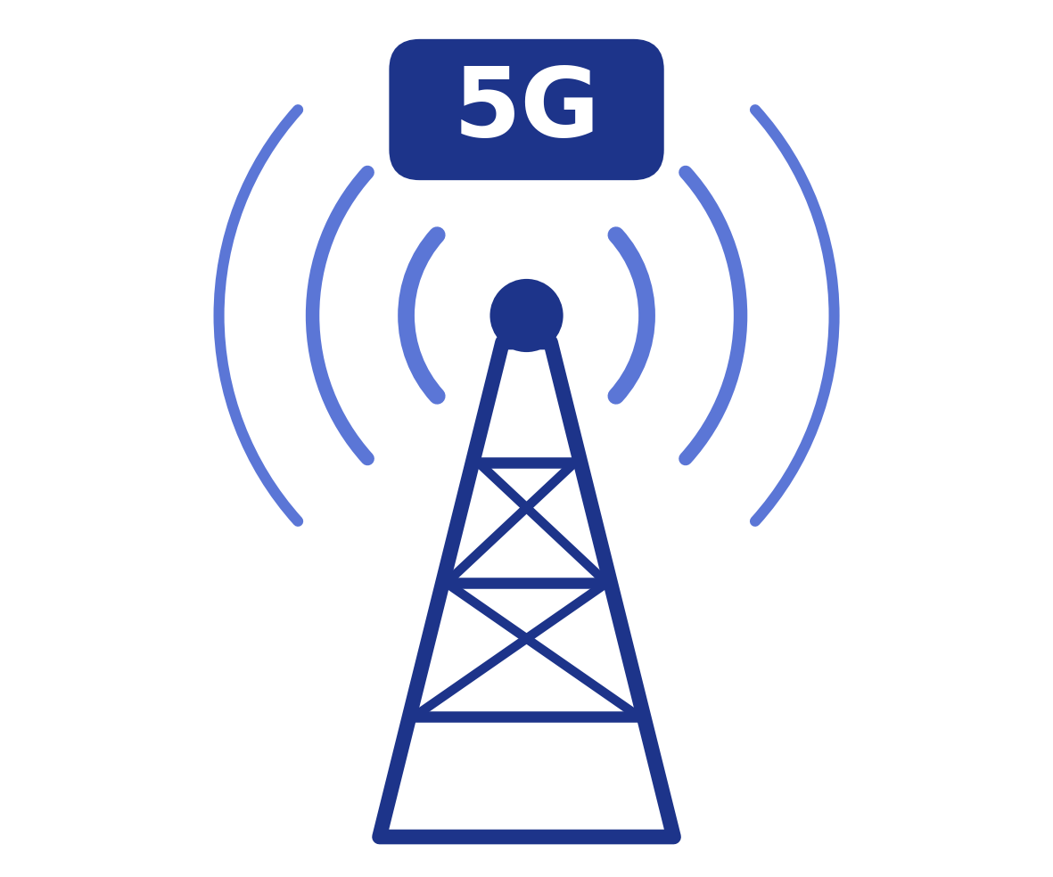
An Introduction to 5G Technology
  5G is the fifth generation of wireless technology.
  It is designed to provide significantly faster speed, reduced latency, improved performance, greater capacity, and higher bandwidth.
  It can support massive connectivity of devices and services.

Slide 3
Importance of
﻿5G Technology
Why is 5G important?
5G wireless technology is the next-generation technology that can impact:
  highspeed
  adoptability
  low-latency
  enormous capacity
  improved performance
  greater efficiency
  reduced carbon footprints
  supersmooth mobility
  Business and industries
  Society and social life
  Governments
  Automation
  Modern technologies
  Cybersecurity
  Industry 4.0
  Remote workplace
  Healthcare

Slide 4
Evolution of Cellular Networks
Cellular networks have evolved through four decades using numerous analog and digital technologies, with task-specific applications and communication protocols.
﻿GENERATION OF CELLULAR NETWORKS
1G
2G
3G
4G
5G
6G

Slide 5
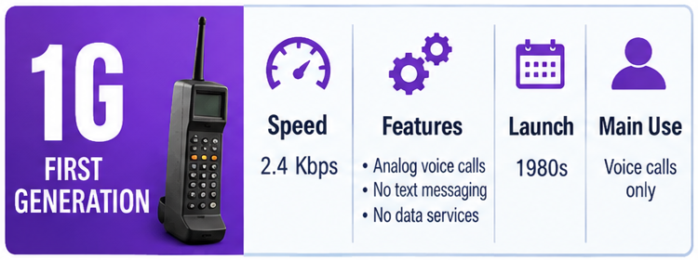
First Generation (1G)
  Can be tracked back to the 1960s through primitive research and development.
  Started when commercial cellular communication was launched in 1979 in Tokyo, Japan.
  1980 - different countries launched technologies such as AMPS (USA), NMT (Nordic)
  used 800 MHz band for voice and signaling based on frequency division multiple access (FDMA) technology.
1G
2G
3G
4G
5G
6G

Slide 6
First Generation (1G)
  It was an analog wireless technology — highly prone to interference
  Limited to voice calls with no support for text or other software-based applications.
  Initial paging networks were also considered part of 1G wireless networks.
1G
2G
3G
4G
5G
6G

Slide 7
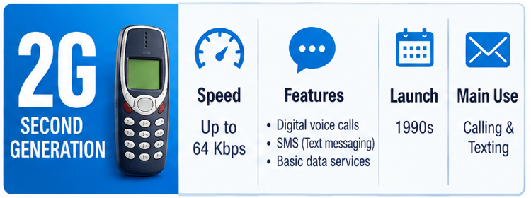
Second Generation (2G)
  Evolved from the 1G analog networks to digital networks.
  Supported:
  Voice
  Text messaging
  Multimedia messages
  Very low-speed Internet services
  Operated at 900 MHz and 1800 MHz bands.
  Used Time Division Multiple Access (TDMA) instead of FDMA.
  GPRS and EDGE were introduced to improve Internet speed.
  GSM (Global System for Mobile Communication) was launched in 1991 in Finland.
1G
2G
3G
4G
5G
6G

Slide 8
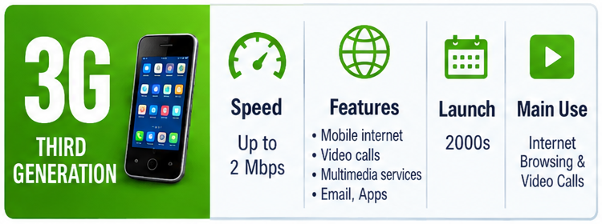
Third Generation (3G)
  based on the core structure of wireless network governed by the Universal Mobile Telecommunication System (UMTS) standard
  Designed to provide better Internet speed and performance.
  Example: IS95 (Interim Standard 95) used in the USA, CDMA-One, CDMA2000
  offered better speeds up to 21.6 Mbps under HSPA + (Evolved High Speed Packet Access plus)
  Initially supported speeds of up to 2 Mbps.
  Started utilizing packet switching to improve data throughput and transmission performance.
  Operated at 2100 MHz with 15–20 MHz channel bands.
1G
2G
3G
4G
5G
6G

Slide 9
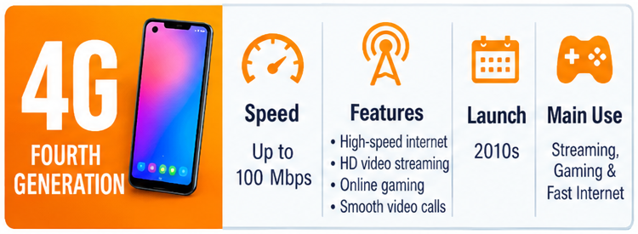
Fourth Generation (4G)
  Developed under the 3rd Generation Partnership Project (3GPP).
  The fundamental technology for the evolution of 4G is Long Term Evolution (LTE).
  Wi-Max provided fixed and mobile wireless communication.
  First 4G network was launched in 2009 in Norway.
  Released in two versions: R8 and R9.
  Uses Orthogonal Frequency Division Multiplexing (OFDM).
  Supports Multiple Input and Multiple Output (MIMO) for increased throughput
1G
2G
3G
4G
5G
6G

Slide 10
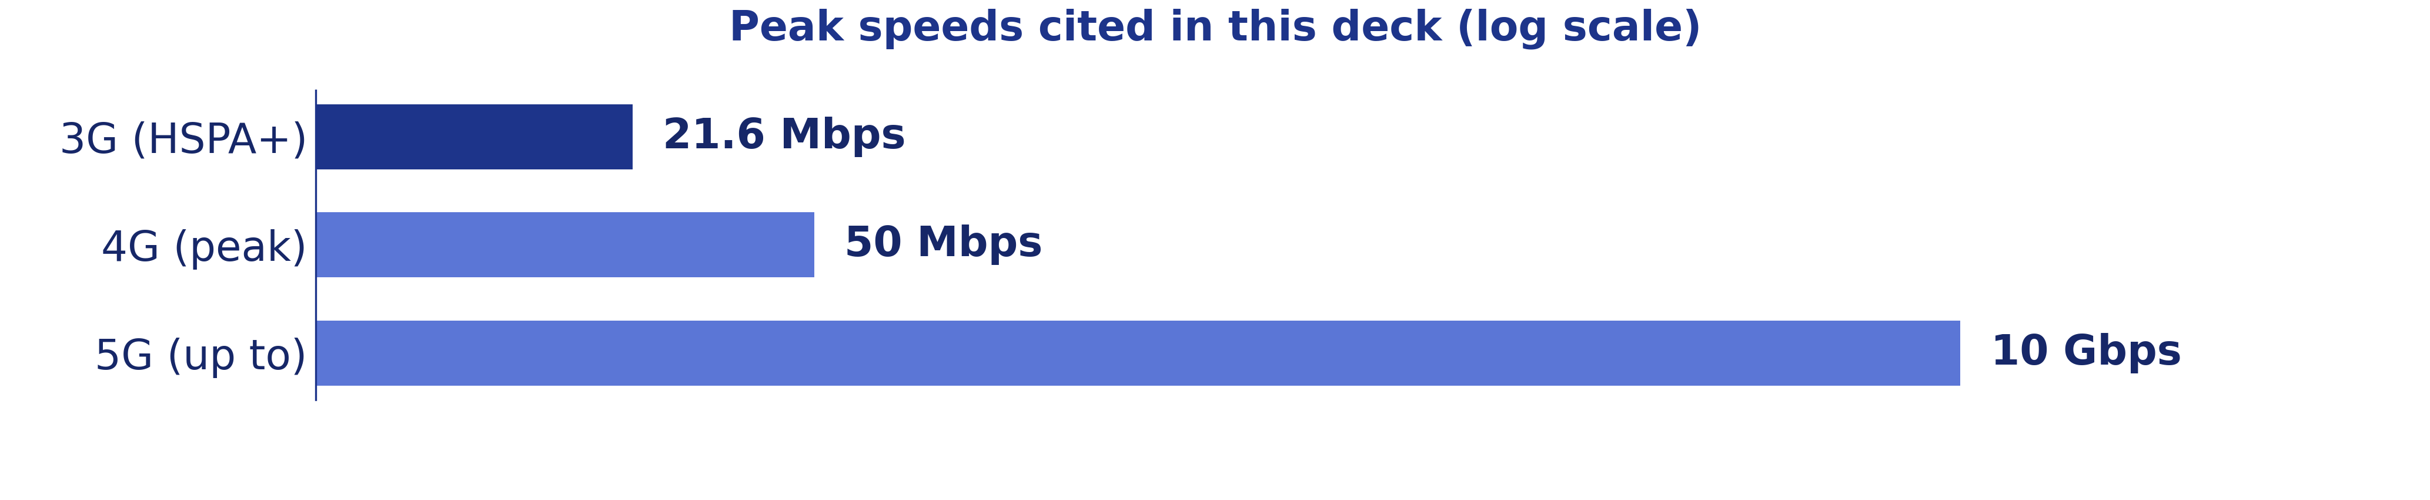
Fourth Generation (4G)
  Mostly operates at the 700 MHz band.
  Supports high-speed video streaming, voice, and multimedia services.
  Peak speed: up to 50 Mbps; real-world average: 15–20 Mbps.
1G
2G
3G
4G
5G
6G

Slide 11
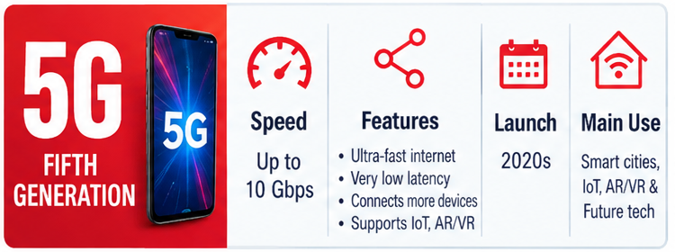
Key Features of 5G
  Considered a futuristic wireless technology.
  Provides about 100 times faster speed compared to 4G.
  Has reduced latency and improved performance.
  Designed to support up to 10 Gbps Internet speed.
  Provides very negligible latency.
  Basic characteristics include:
  larger bandwidths
  lower latency
  higher capacity
  was launched in 2019 and will continue to expand
1G
2G
3G
4G
5G
6G

Slide 12
Capabilities of 5G
  The most salient capabilities can be defined as:
  eMBB – Enhanced Mobile Broadband
  mMTC – Massive Machine Type Communication
  URLLC – Ultra-Reliable Low Latency Communication
  Uses millimeter waves.
  Effective for:
  Internet of Things (IoT)
  Virtual Reality and Augmented Reality
  (AR/VR)
  driverless vehicles
  drones and robotics
1G
2G
3G
4G
5G
6G

Slide 13
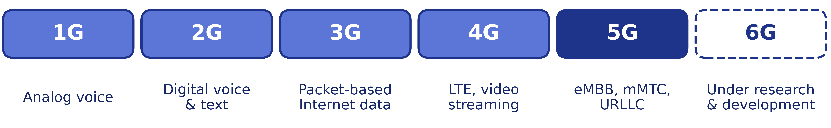
Sixth Generation (6G)
  6G technology is under development and research phase.
  It has not materialized yet.
  It is characterized as an upcoming futuristic technology.
1G
2G
3G
4G
5G
6G

Slide 14

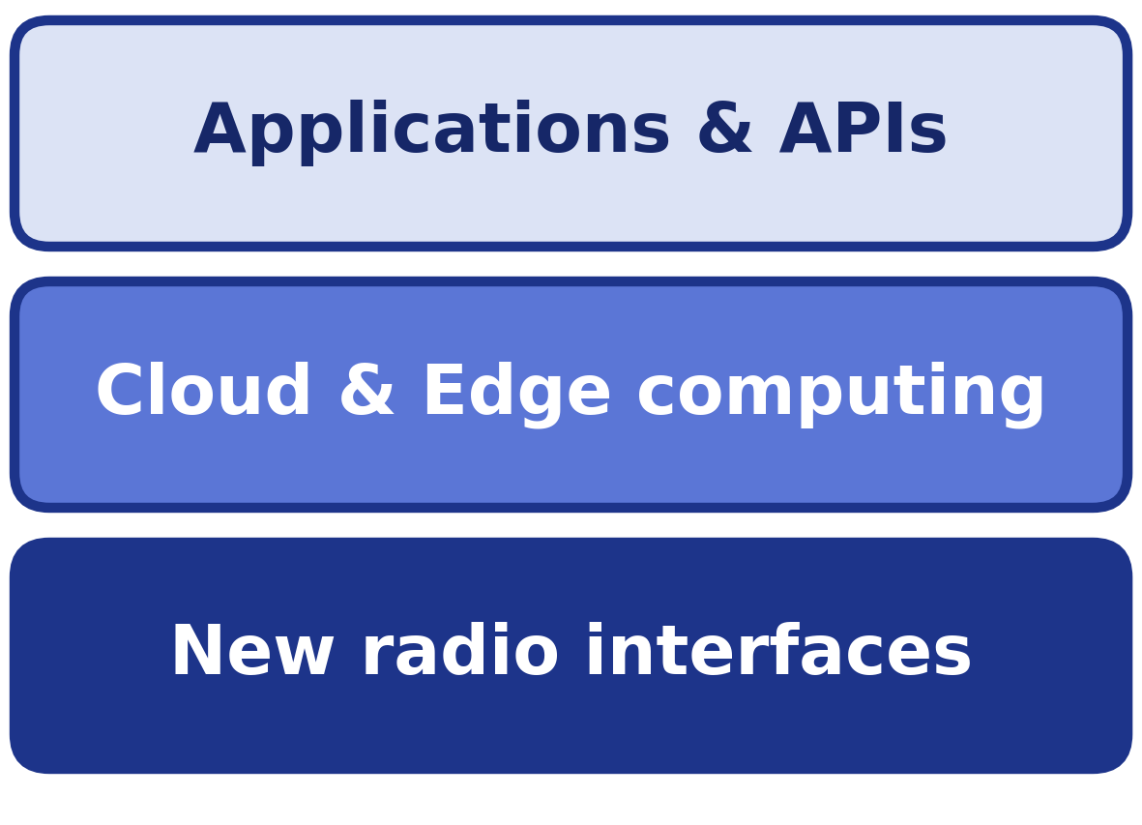
Architecture of 5G Network
  5G architecture is modular and open
  Powered by more software-defined infrastructure
  Open for custom development of interfaces, applications, and services
  Uses:
  Application Programming Interfaces
  Cloud computing
  Edge computing
  New radio interfaces

Slide 15
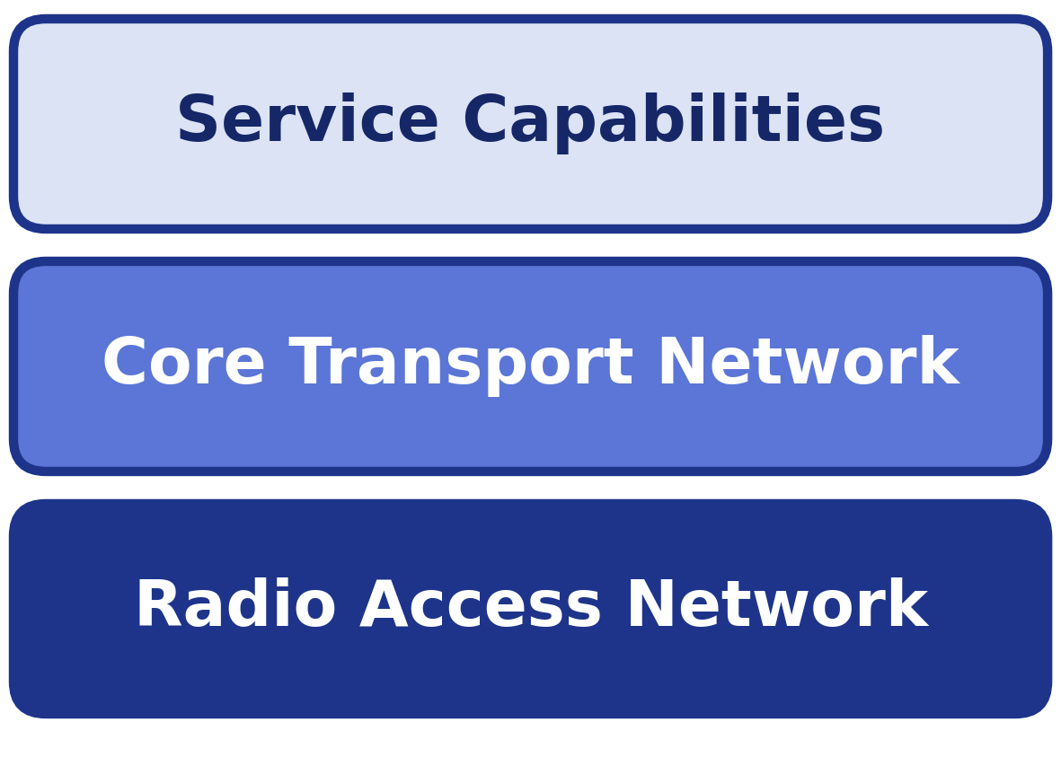
Architecture of 5G Network
  Three major components according to 3GPP:
  Core Transport Network
  Radio Access Network
  Service Capabilities
  Core network consists of servers, data storage, switches, and security systems
  Radio Access Network supports eCPRI, beamforming, MIMO, and 5G NR
  5G supports network slicing — process of using the same infrastructures for numerous virtual networks through virtualization

Slide 16
5g Network Slicing
• 5G network slicing uses virtualization to create multiple virtual networks from a shared physical infrastructure.
• A slicing controller/orchestrator manages and creates these virtual networks based on different service needs.
• It allows service providers and businesses to offer customized services using shared or dedicated virtual networks.
• 3GPP defines the 5G architecture into four main parts:
• Infrastructure Layer – physical network resources
• Network Function Layer – network functions and services
• Service Layer – applications and services for users
• Network Slice Controller/Orchestrator – manages and coordinates network slices

Slide 17
5G Functional Architecturee
• 5G technology is organized into four major functional layers, each containing software and hardware components.
• Network Layer – provides the core network infrastructure and connectivity.
• Controller Layer – controls and manages network functions.
• Management & Orchestration Layer – coordinates network resources and services.
• Service Layer – delivers applications and services to users.

Slide 18
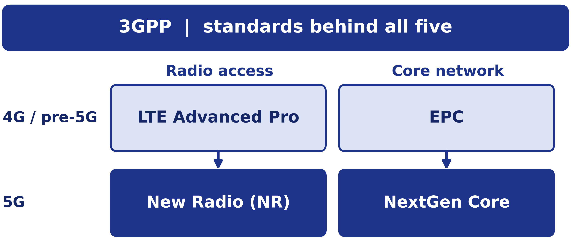
Top Protocols Used
in 5G Networks
  3GPP
  New Radio (NR)
  NextGen Core
  LTE Advanced Pro
  EPC Evolution

Slide 19
3GGP
  3GPP — Third-Generation Partnership Project
  Organization focused on developing standards for wireless telecommunication systems
  Established in 1998
  Originally focused on standards for the 3rd generation wireless network
  At present, it is a core standard development body behind 5G technology
  Supports development of:
  Technology standards
  Specifications
  Protocols
  Network element compatibility
  Forward and backward compatibility

Slide 20
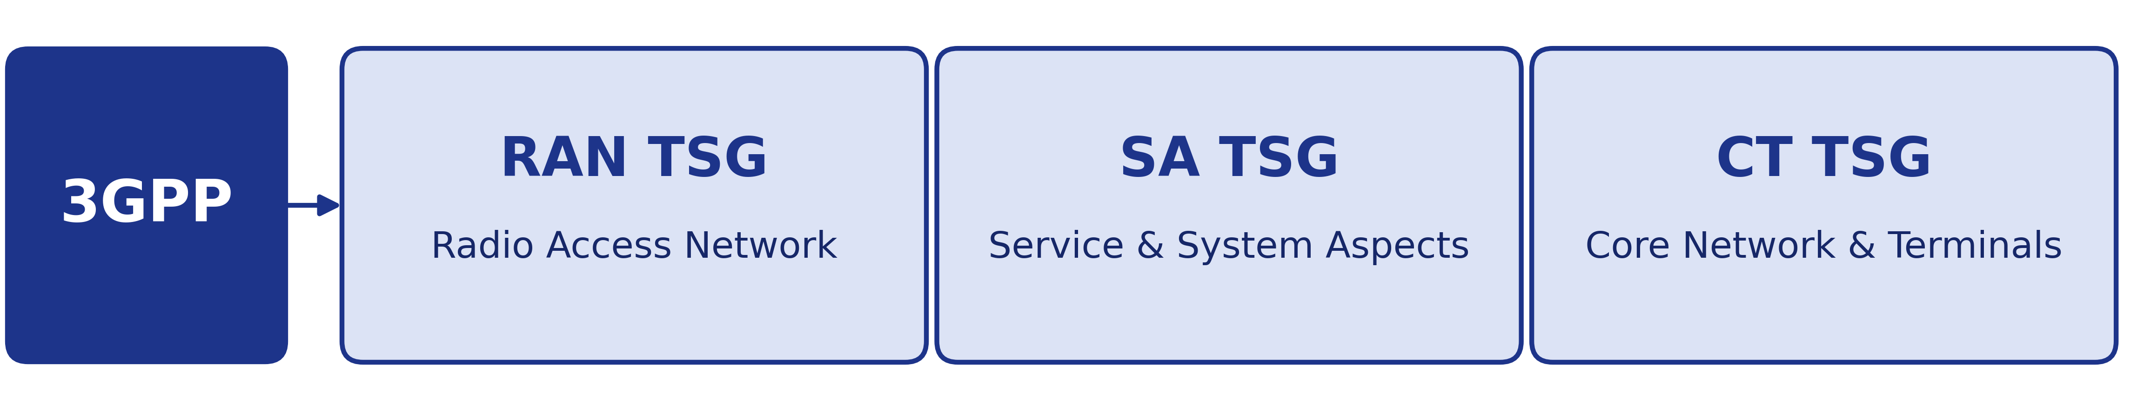
3GGP
  There are three Technical Specification Groups (TSGs) that deal with different domains of wireless technologies for building specification and technical recommendations:
  RAN TSG — Radio Access Network
  SA TSG — Service & System Aspect
  CT TSG — Core Network & Terminals

Slide 21
New Radio (NR)
  A 5G wireless technology standard developed by 3GPP with its partners
  Defines a wireless interface capable of performing 5G network functionalities
  Two types of 5G NR:
Frequency ranges:
  FR1: 410–7125 MHz
  FR2: 24,250–52,600 MHz
  Non-Standalone NR
  Compatible with the existing 4G LTE wireless network
  Released under 3GPP Release 15
  Allows frequency bands to be shared with existing 4G networks
2. Standalone NR
  Defines both control and data transfers under 5G
  Does not require compatibility with predecessor networks such as LTE
  Provides the full capabilities of 5G with high speed and low latency

Slide 22
NextGen Core
  An important part of the 3GPP specification for 5G networks
  Plays a crucial role in the 5G core network to materialized:
  High-speed Internet
  Virtualized services
  Low-latency data transmission
  Provides high flexibility, efficiency, and scalability
  Uses SDN (Software-Defined Networking)
  Supports NFV (Network Functions Virtualization)
  Allows network functions to be virtualized and used on the same hardware
  Supports network slicing for unique and customized services

Slide 23
LTE Advanced Pro
  LTE Advanced Pro (LTE-A Pro) is a pre-5G wireless technology
  Can be integrated with the 5G non-standalone standard under Release 15
  Defined under 3GPP Release 13 and Release 14
  Also referred to as: Pre-5G, 4.9G, 4.5G, 4.5G Pro
  Supports up to 3 Gbps speed and 32 carrier aggregation
  Supports sharing of licensed and unlicensed spectrum
  Incorporates massive MIMO
  Uses 256 QAM (Quadrature Amplitude Modulation)
  Compatible with the first version of 5G
  Useful for data-intensive and critical applications requiring high data rates and lower latency

Slide 24
EPC Evolution
  EPC — Evolved Packet Core
  An LTE standard that combines voice and data through packet switching
  Defined by the 3GPP project under Release 8
  Before Release 8:
  Release 8 paved the way for an advanced core network based on packet switching
  Voice calls used circuit switching
  Data calls used packet switching

Slide 25
Impact of 5G Technology on Cybersecurity
  5G is very different from traditional mobile cellular networks
  Numerous hardware devices are replaced by software functions/applications: Firewalls, Routers, Load-balancers
  Traditional cybersecurity approaches may not work properly in the 5G environment
MAJOR CYBERSECURITY CHALLENGES:
  Hardware-based switching → software-based routing
> Creates more routing points where attackers can intrude
  Centralized switching → distributed routing
> Creates additional security risks

Slide 26
Impact of 5G Technology on Cybersecurity
MAJOR CYBERSECURITY CHALLENGES:
  Network function virtualization
> Software-defined functions and virtualization introduce security threats
  Proprietary operating systems → standard Internet protocols
> Standard protocols may be more familiar to attackers
  Software-based network management creates additional vulnerabilities and access points
  Large number of access points and base-station units can increase security risks
  More connected IoT devices increase the potential security issues
  Dynamic Spectrum Sharing (DSS) through network slicing creates additional security concerns

Slide 27
Thank You!
Zywynne Jedrick Ambunan
Brent Mamaradlo

