Slide 1

Synthetic Diff in DifF
Rodrigo da Luz Barcellos

Slide 2
Summary
Counterfactual Intuition
Methods:
Difference-in-Differences (DID)
Synthetic Control Method (SCM)
Synthetic Diff-in-Diff (SDID)
Context: Tobacco Control Program in California
(Abadie et al, 2010; Arkhangelsky et al, 2021)
GitHub & Colab

Slide 3

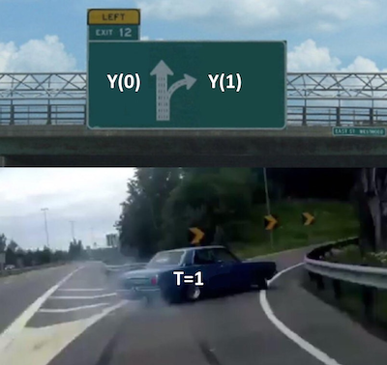



Counterfactual Intuition – The Problem
?

Slide 4

Counterfactual Intuition – Ideal Experiment
Pre-treatment (Training)
Post-treatment (Test)
Control Treated

Slide 5
DiD
Difference-in-Differences, Diff-in-Diff or DD

Slide 6
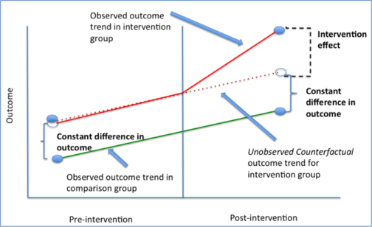
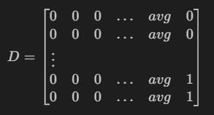

Diff-in-Diff Intuition – Parallelism Assumption
Pre
Post
Control AVG Treated
or Unit

Slide 7
SCM
Synthetic Control Method

Slide 8
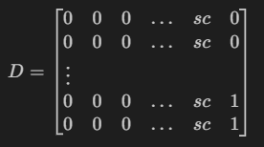
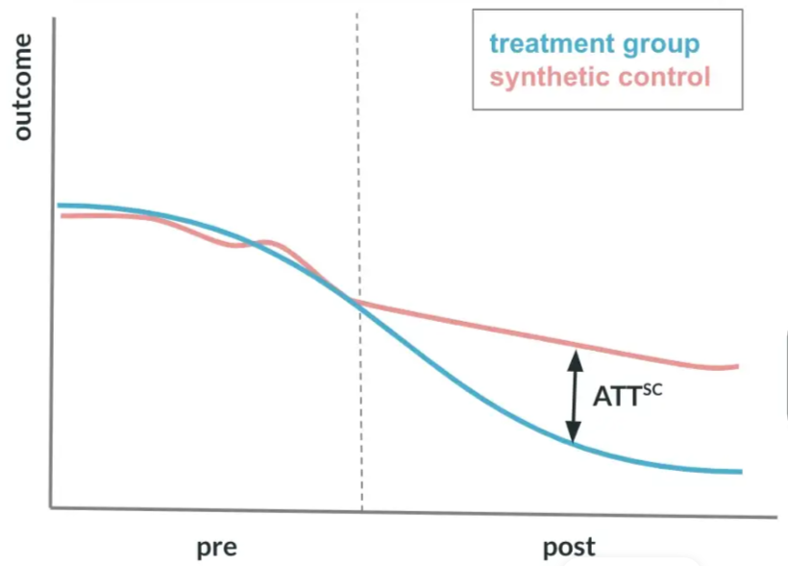


SCM Intuition – Weighted Approximation
Pre
Post
Control SC Treated

Slide 9
SDID
Synthetic Difference-in-Differences, also SDD

Slide 10
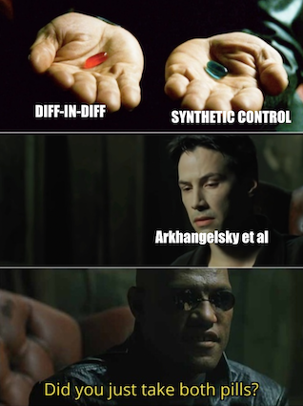
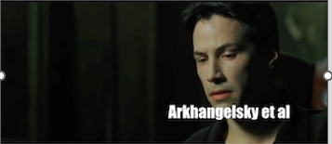

Slide 11
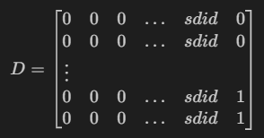
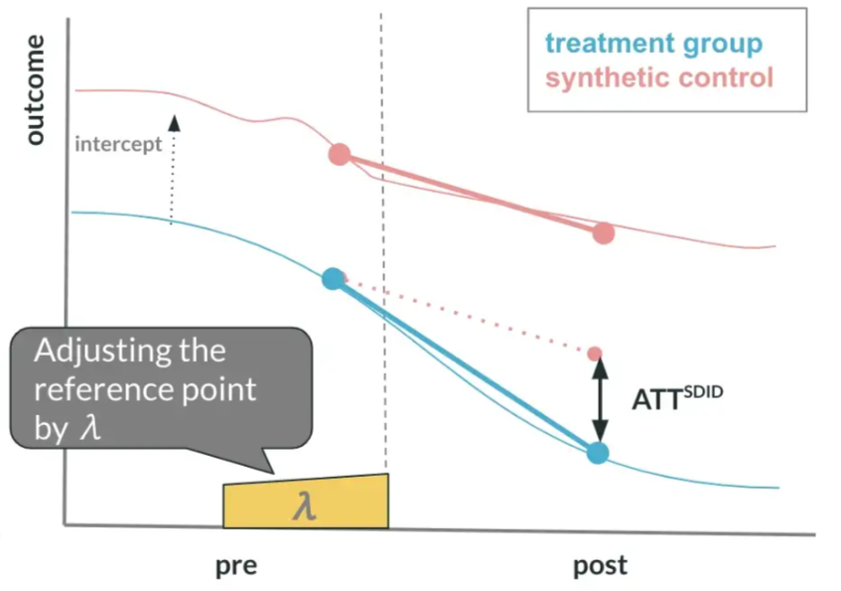


Synthetic Diff-in-Diff – Combo
Pre
Post
Control SDID Treated
Note: Ridge (L2) Regularizaion

Slide 12
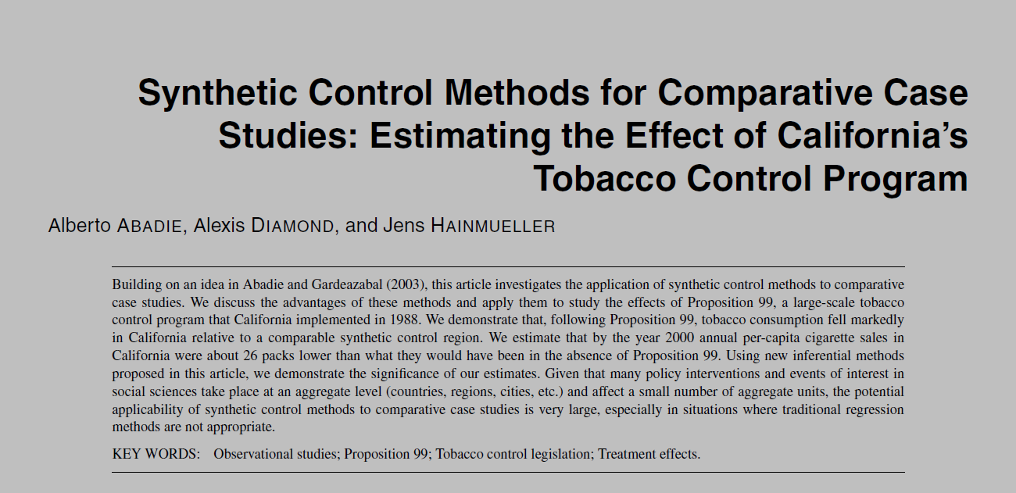
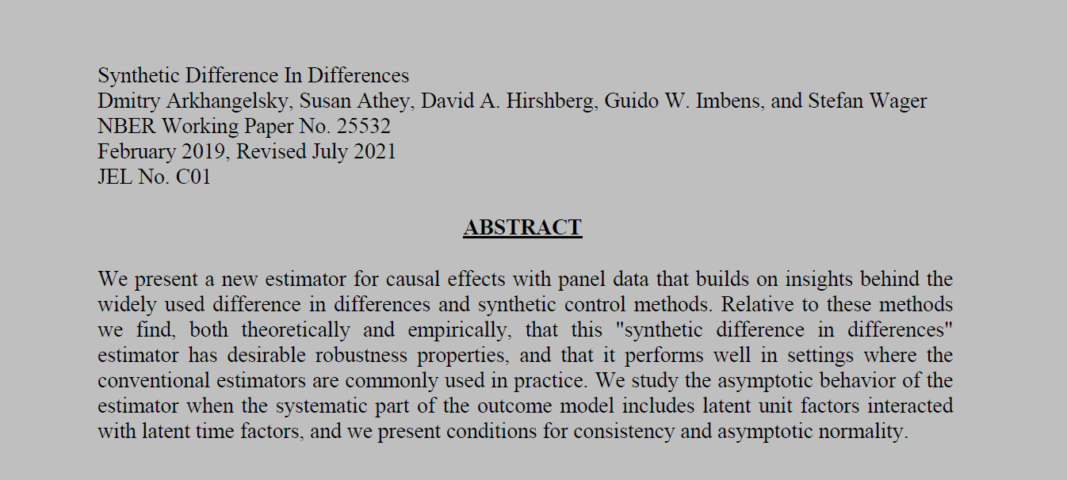
Alberto Abadie, Alexis Diamond, and Jens Hainmueller. Synthetic control methods for comparative case studies: Estimating the effect of California's tobacco control program. Journal of the American Statistical Association, 105(490):493{505, 2010.
Dmitry Arkhangelsky, Susan Athey, David A. Hirshberg, Guido W. Imbens, and Stefan Wager. Synthetic Difference In Differences. NBER Working Paper No. 25532, February 2019, Revised July 2021, JEL No. C01

Slide 13
Context: Effect of Proposition 99 in California's Cigarette consumption
Its primary effect is to impose a 25-cent per pack state excise tax on the sale of tobacco cigarettes within California, with approximately equivalent excise taxes similarly imposed on the retail sale of other commercial tobacco products, such as cigars and chewing tobacco.
Additional restrictions placed on the sale of tobacco include a ban on cigarette vending machines in public areas accessible by juveniles.
Ban on the individual sale of single cigarettes.
Revenue generated by the act was earmarked for various environmental and health care programs, and anti-tobacco advertisements.

Slide 14
GitHub & Colab
https://github.com/rod53/PresentationSDID
Adapted from Alves, M. F. Causal Inference for The Brave and True. 2020 (Available on: https://matheusfacure.github.io/python-causality-handbook/25-Synthetic-Diff-in-Diff.html)
REFERENCES
Angrist, J. D.; and Pischke J.. Mostly Harmless Econometrics. Princeton University Press, 2008.
Alberto Abadie, Alexis Diamond, and Jens Hainmueller. Synthetic control methods for comparative case studies: Estimating the effect of California's tobacco control program. Journal of the American Statistical Association, 105(490):493{505, 2010.
Dmitry Arkhangelsky, Susan Athey, David A. Hirshberg, Guido W. Imbens, and Stefan Wager. Synthetic Difference In Differences. NBER Working Paper No. 25532, February 2019, Revised July 2021, JEL No. C01

