Slide 1
RTI Code Generator 2.0 Architecture overview

Slide 2
Why a New Code Generator?
Performance
Code generation with first rtiddsgen generation (rtiddsgen 1) is slow for certain use cases
XSLT parsing and loading is slow especially with large files
Maintenance
Internal:
RTI is developing new features that require code generation changes
With rtiddsgen 1 is difficult to update existing XSLT templates
External:
RTI customers want to customize the generated code
XSLT templates are not intuitive nor easy to customize

Slide 3
New Code Generator Highlights
Written entirely in Java
Replaces XSLT templates with Apache Velocity (VLT) templates
Can avoid loading the JVM and recompiling templates (when run in server mode)
Is easy to customize: customers can change the generated code by updating VLT templates

Slide 4
Open Source Components
rtiddsgen 2 makes uses three open source projects:
ANTLR (http://www.antlr.org/ ):
To generate the parser
To parse the IDL files
Apache Velocity Template Language (VTL) used for code generation (http://velocity.apache.org/):
Velocity plugin for Eclipse eases editing of templates
Log4j libraries for logging infrastructure (http://logging.apache.org/log4j/1.2/)

Slide 5
rtiddsgen 2: Architecture and Design
Code Generation Process Overview
preprocessor
Parsing
Raw
Tree
AST
Tree
IDL/XML
(ANTLR)
ppDisable
Code
Emitters
VTL
Templates

Slide 6
Generation of the Abstract Syntax Tree (AST)
AST is an “in-memory” tree representation of an IDL file
There are nodes for different IDL constructs (struct, module, unions, …)
The AST is equivalent to the simplified XML generated with rtiddsgen 1
Generation of the AST involves:
Parsing the file
For this, we use the generated ANTLR parser
Creating the RAW Tree
Tree obtained directly from the grammar
Creating the simplified tree (AST)
From the RAW tree we obtain a simplified representation
This tree contains all the necessary information to generate the code from the input files
The emitters get information from this tree
AST
root
Module
Struct
union
Module
valuetype
Struct
member
member
member
member
member

Slide 7
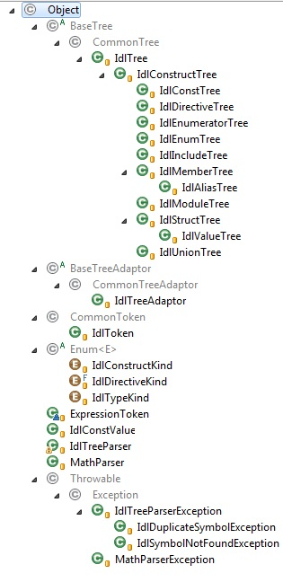
AST Nodes
Kind of nodes in the AST (all the nodes inherit from IdlConstructTree)
IdlAliasTree: Inherits from IdlMemberTree
IdlConstTree
IdlDirectiveTree
IdlEnumTree : Contains IdlEnumeratorTree instances
IdlIncludeTree
IdlMemberTree
IdlModuleTree
IdlStructTree : Contains IdlMemberTree instances
IdlUnionTree : Contains IdlMemberTree instances
IdlValueTree : Contains IdlMemberTree instances
Other classes
IdlTypeKind
IdlConstValue

Slide 8
Templates: The Velocity Template Language (VTL) (I)
Example Part 1: Java Code
Loading the Velocity engine and parsing the template
Creating the variables
Creating the context and the writer
VelocityEngine ve = new VelocityEngine();
ve.init();
Template t = ve.getTemplate(“templateName.vm”);
ArrayList list = new ArrayList();
list.add(“Ribeira”);
list.add(“Cordoba”);
list.add(“Granada”);
VelocityContext context = new VelocityContext();
context.put(“greeting", “Hello World");
context.put(“elements”, list);
StringWriter writer = new StringWriter();
t.merge(context,writer);
System.out.println(writer.toString());

Slide 9
Templates: The Velocity Template Language (VTL) (II)
Example Part 2. Template Code:
Variables (The variables are in the Velocity Context)
Template:
Output:
$elements = Ribeira Cordoba Granada
$greeting= Hello World
Note: $velocityCount is a Velocity internal variable whose value is the loop count of the #foreach loop starting at 1
#macro( printElements $elements)
#foreach($unit in $elements)
$unit #if($velocityCount<$elements.size()),#end
#end
#end ##end of the macro
$greeting,
Some cities from Spain are #printElements($elements)
Hello World,
Some cities from Spain are Ribeira, Cordoba, Granada

Slide 10
Templates: The Velocity Template Language (VTL) (III)
The VTL templates are intuitive to read because they resemble the file that will be generated
Code generation using Velocity involves:
Loading the Velocity Engine
Parsing the templates
Creating the Velocity Context
The context contains all the variables that the templates use
When generating from the templates, Velocity will replace a variable with its value from the Velocity Context
Create the Writer
The writer resolves the templates by merging them with the Velocity Context

Slide 11
Templates: The Velocity Template Language (VTL) (IV)
Variable values can be of any type in the Velocity Context (string, list, map…)
Variables are referred with this syntax “${variableName}”
Control statements in the templates
#foreach. To access to each of the elements of a list.
#if, #elseif, #else.
Java methods can be invoked from the templates
You can use #macro to organize the code. The macros can be in the same file or in other file, as long as it’s loaded in the emitter.
Watch out for reserved characters:
‘$’ indicates the beginning of a variable.
If you need to use this character, just make sure that you don’t have any variable named the same than the string that is just after the ‘$’
‘#’ indicates the beginning of an instruction.
If you need to use this character, replace it with the variable ${POUND_CHAR} that is included in the Velocity Context by the code generator.

Slide 12
Template Location and Organization
Under resource/rtiddsgen/templates we can find one folder for each of the languages.
Inside each of these folders, we find the templates necessary to generate code.
These templates are divided in source code and utility templates.
The source code templates have most of the code that will be output.
Each source code template is directly associated to a source file.
The utility templates contain utility logic (macros) that assist in generating code
For more information check RTI_rtiddsgen_template_variables.xlsx

Slide 13
Emitters
The tasks of an emitter are:
Loading the templates
Getting the data from the AST and transform it into a set of variables that will be used in the templates.
Adding the variables to the Velocity Context
Producing the output files by merging the Velocity Context with the templates
The EmitterManager is the object that creates the emitters
There is one emitter for each language

Slide 14
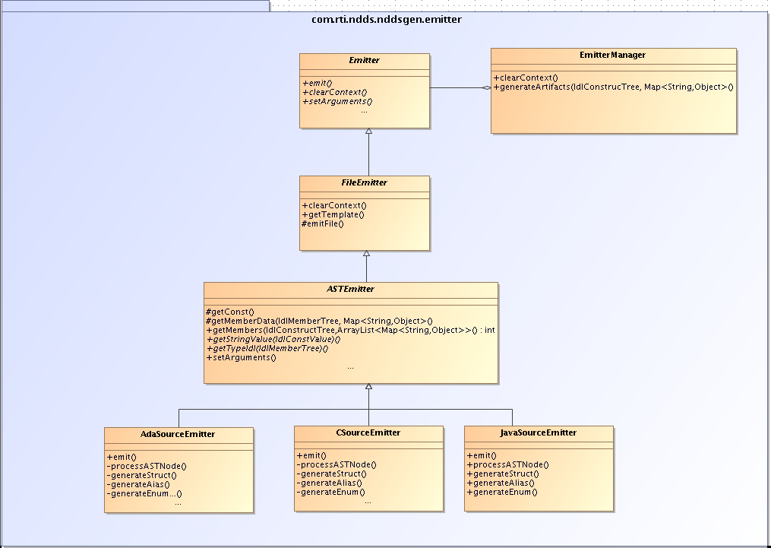
Emitter Class Diagram
Contains methods to get templates and emit the files (merge the Velocity Context with the templates)
Contains methods to initialize language-independent variables
Contains methods to initialize language-dependent variables

Slide 15
Processing the tree
Java
C/C++
ADA
Process AST Node
Process AST Node
Process AST Node
Store in variable
Store in variable
Set context
Set context
Set context
no
no
Is a module or top-level type?
All nodes procesed?
Emit files
Emit files
Emit files
yes
yes
Clean context
Clean context

Slide 16
Server-mode Execution (I)
Enhances performance significantly when processing many IDL files
Server mode execution model
Invoking rtiddsgen2_fast runs a native process which attempts to communicate with the Java rtiddsgen process
If this fails (which is always expected the first time), start Java rtiddsgen process
Pass command line options through a socket to the Java rtiddsgen process
The Java rtiddsgen process:
Parse IDL
Parse Velocity templates
These templates will now be cached by Velocity so this happens only when the template is not in the cache
Merge templates with IDL parse tree to generate files
After an inactivity timeout (20 seconds), the Java rtiddsgen process exits
Server mode script (rtiddsgen2_fast) uses the same command line options as the rtiddsgen script (rtiddsgen2)

Slide 17
Server-mode execution (II)
creates
20 sec
rtiddsgen_fast
Native
Java
TCP
client
server
rtiddsgen2.0

Slide 18
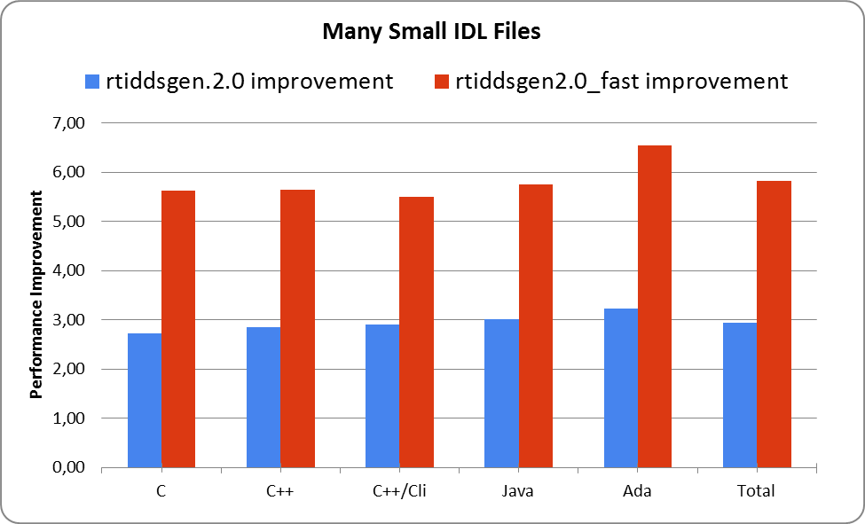
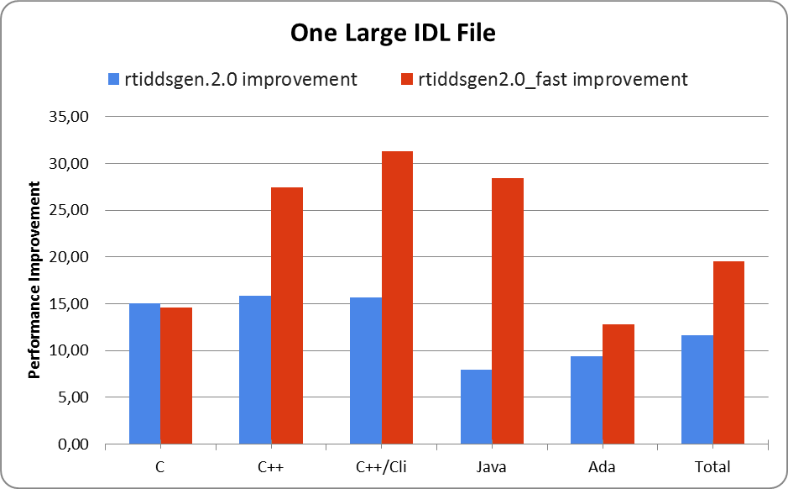
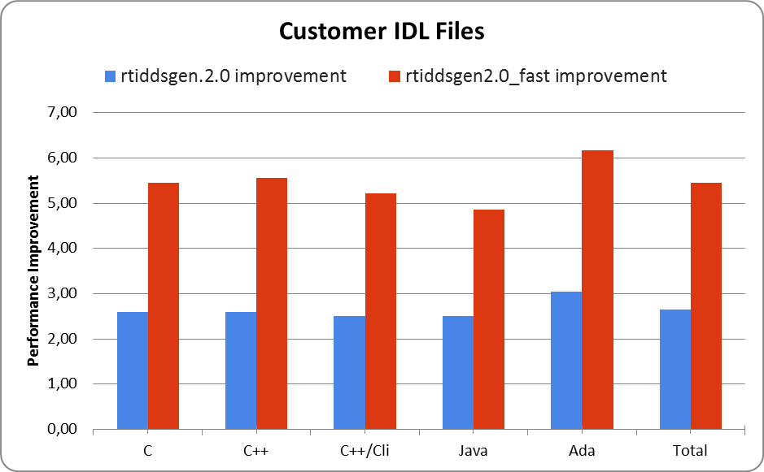
Rtiddsgen2.0 Performance results (I)

Slide 19
Rtiddsgen2.0 Performance results (II)
Raw Performance Results
 |  | rtiddsgen 1.0 | rtiddsgen 2.0 | rtiddsgen 2.0_fast | rtiddsgen.2.0 improvement | rtiddsgen2.0_fast improvement
Many Small IDLs | C | 171.009 | 62.676 | 30.4 | 2.73 | 5.63
 | C++ | 166.167 | 58.377 | 29.453 | 2.85 | 5.64
 | C++/Cli | 158.756 | 54.721 | 28.819 | 2.90 | 5.51
 | Java | 170.12 | 56.372 | 29.57 | 3.02 | 5.75
 | Ada | 196.807 | 60.966 | 30.086 | 3.23 | 6.54
 | Total | 862.859 | 293.112 | 148.328 | 2.94 | 5.82
One Large IDL | C | 33.406 | 2.219 | 2.286 | 15.05 | 14.61
 | C++ | 34.269 | 2.161 | 1.249 | 15.86 | 27.44
 | C++/Cli | 31.321 | 2.003 | 1.002 | 15.64 | 31.26
 | Java | 34.043 | 4.291 | 1.197 | 7.93 | 28.44
 | Ada | 40.137 | 4.267 | 3.131 | 9.41 | 12.82
 | Total | 173.176 | 14.941 | 8.865 | 11.59 | 19.53
Customer's IDL | C | 272.718 | 105.001 | 50.027 | 2.60 | 5.45
 | C++ | 269.307 | 104.006 | 48.442 | 2.59 | 5.56
 | C++/Cli | 249.551 | 99.654 | 47.871 | 2.50 | 5.21
 | Java | 258.838 | 103.467 | 53.29 | 2.50 | 4.86
 | Ada | 317.636 | 104.128 | 51.535 | 3.05 | 6.16
 | Total | 1368.05 | 516.256 | 251.165 | 2.65 | 5.45
Results obtained in x64Linux2.6gcc4.1.1. Rtiddsgen.1.0 is version of ndds500.rev08

Slide 20
Rtiddsgen2.0 Performance Results (III)
rtiddsgen 2 improves the performance of the rtiddsgen 1, both during parsing and code generation
With a large IDL file (2,000 structs) rtiddsgen 2 is 12x to 20x (server-mode) faster
With an actual customer use case, rtiddsgen 2 is 3x to 5x (server-mode) faster

