Slide 1


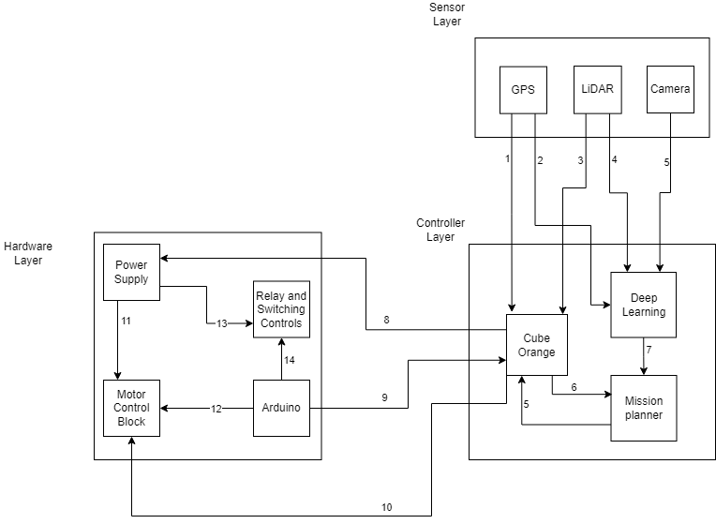
IGVC
QR Code To Website or Paper Goes Here
Senior Design
Hernandez-Pleitez, Rodrigo, Meron, Tsebaot, Nayyar, Nabeel, Siljan, Jerome, Singh, Vanshdeep ,Uwineza, Jeanne
Background
Architectural Design
The opportunity to undertake this project lies in several aspects. Firstly, the competition itself provides a platform to demonstrate the technical expertise and problem-solving abilities of the team. By participating and excelling in the competition, the team can establish a strong reputation for the College of Engineering at UTA, attracting attention from companies, schools, and prospective students. Additionally, the project offers an opportunity to push the boundaries of autonomous vehicle technology. By developing a modular ground vehicle that can autonomously navigate obstacle courses efficiently and quickly, the team aims to contribute to the advancement of autonomous systems. This aligns with the growing demand for autonomous vehicles in various industries, such as transportation, logistics, and defense. The existing relationship between the development team and the customer, in this case, the competition organizers, is based on the mutual goal of advancing autonomous vehicle technology. The team aims to leverage its expertise and resources within the College of Engineering to design and develop a ground vehicle that meets the competition’s requirements.
The Hardware layer was constructed to be the bridge of executing the demanded control signals from the software functional on the hardware along with doing a gate-keeping job of being responsible for all low-level or close-to-abstraction level operations such as powering, circuit current regulations, motors, safety standards and allowing faster computing resources available to the primary computer for its own designated operations. Most of the focus for the hardware lied in the controllers and the modular vehicle design.
The sensor layer will house the vehicle's sensors. These sensors gather information from the environment and then send that information to the controller layer for processing. The camera gathers images of the environment to detect obstacles via object recognition. The LiDAR creates a map of the environment that we can crosscheck with the camera's data to understand where every object is in relation to the vehicle. The GPS gives us the exact location of the vehicle and that location is sent to the controller layer for path planning.
The controller layer is planned to provides the vehicle with its navigation plan for its course. To make it possible for the vehicle to navigate using deep learning and AI for a given path, a companion computer will be used. A cube orange will be used for the microcontrollers of the vehicle.
Implementation Details and Test Plan
Hardware Implementation
For the testing and implementation of the vehicle, this team mostly concentrated on the build of the vehicle making sure that all the components can withstand any stress it will face. For the vehicle shell, it was fit tested to make sure that the frame is sturdy enough to carry the payload, motor, batteries and the other working components. For the vehicle motors, the team did extensive testing to make sure the motors would be able to handle the weight of the vehicles with out buckling. Another important aspect of the hardware is the modularity of the vehicle. The vehicle was designed to be able to be taken apart and built relatively easy. This was to alleviate the expenses of transporting the vehicle.
Key Requirements
For this vehicle, the client conveyed that the be vehicle modular. From the previous team, the one major concern was that the vehicle being hard to transport. Another major requirement for this vehicle was for it to be omni-directional. To achieve this the vehicle is constructed to give the client the option of either using omni wheels or Mecanum wheels depending on the terrain of the course. The remaining requirements such as lane detection, obstacle detection, speed guidelines, dimensions, and payload carrier come from a combination of the rules set in place for the 2024 IGVC competition and ideas as to how the vehicle could go through the obstacle course.
Future Software Implementation
For the software portion of the vehicle, the incoming team will be responsible for improving the first team's implementation of A* search. They can also make changes in the path planning as needed. The goal for this vehicle is to incorporate components of deep learning in order to be able to assess the environment in a fast manner. To accomplish this the next team will have the responsibility to train this vehicle to get it ready to tackle the course of the competition on its own.
Conclusions and Future Work
References
This project will be handed down to the next incoming senior design teams for the implementation of the software and further work on the vehicle base. As of right now the vehicle shell is built out with a wooden frame so the next team will be responsible for finishing the assembly of the final vehicle using the ordered aluminum and wheels according to our sponsors requirements and the IGVC rulesets. For the future teams we believe this vehicle is a good basis to build out a vehicle that will be more efficient and reliable while upholding the clients needs
“The 31st Annual Intelligent Ground Vehicle Competition.” Official Competition Rules, Okland University , www.igvc.org/rules.htm. Accessed 30 Nov. 2023.
October 2023

Slide 2
Charts
Feel free to add your data to these charts and add them to your poster.

