Slide 1
Node.js
Building a store
EDDISRUPT WORKSHOP
Welcome to Node.js! Payments (Stripe)
Servers (Express)

Slide 2
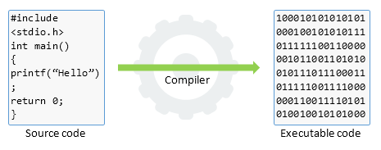
COMPILE TIME

Slide 3
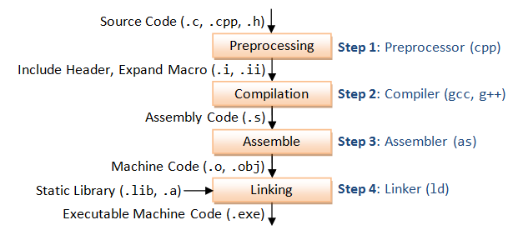
COMPILE TIME

Slide 4
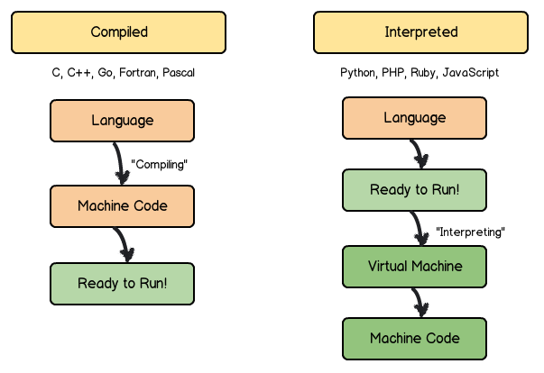
Compiled vs Interpreted

Slide 5
WHAT IS RUN TIME?

Slide 6
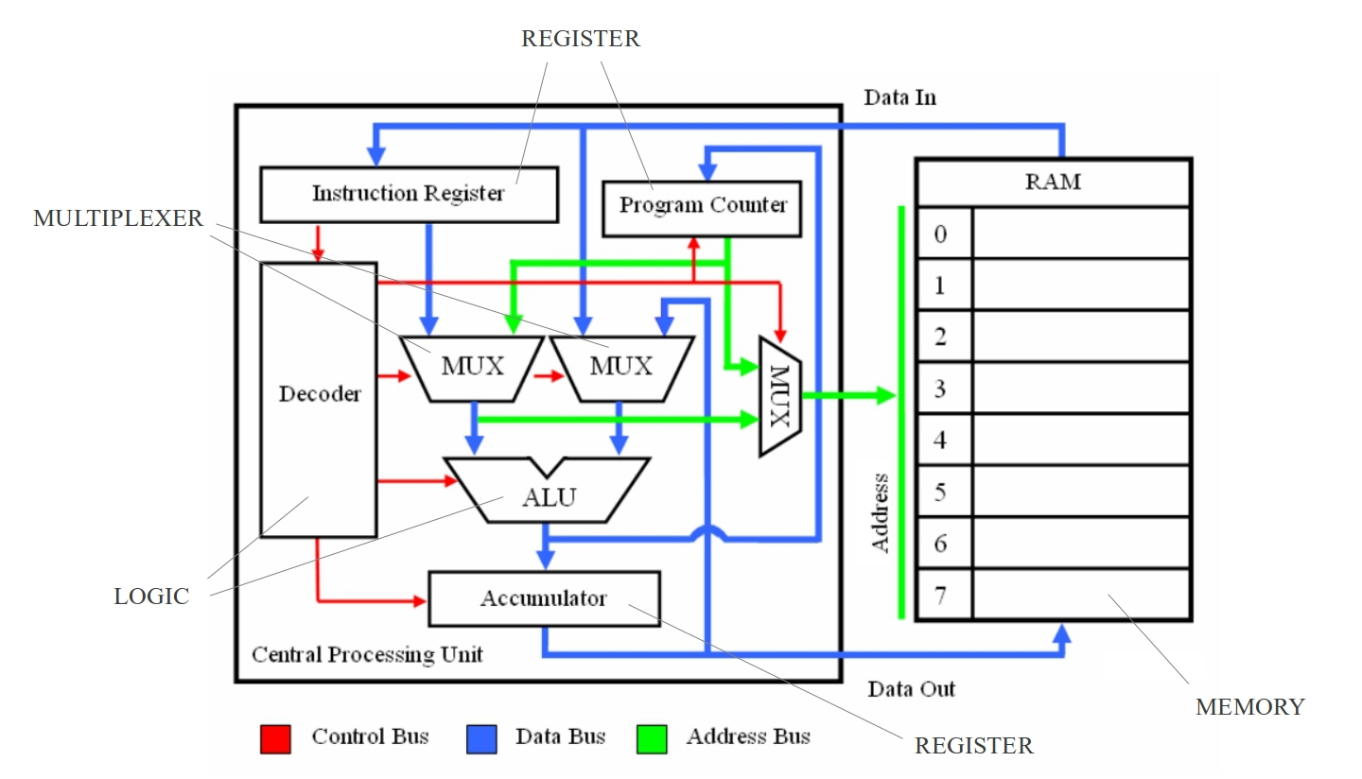
RUN TIME - CPU’s Magic

Slide 7
COMPILE TIME ---> RUN TIME

Slide 8
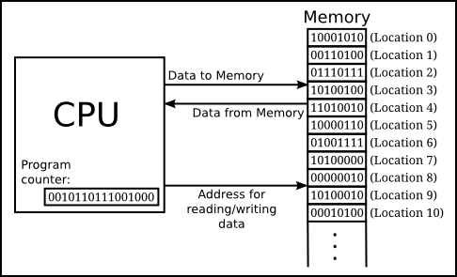
Processos
● When a process is executed (RUN TIME) the CPU allocates a portion of memory for the execution fo that program, creating a aprocess

Slide 9
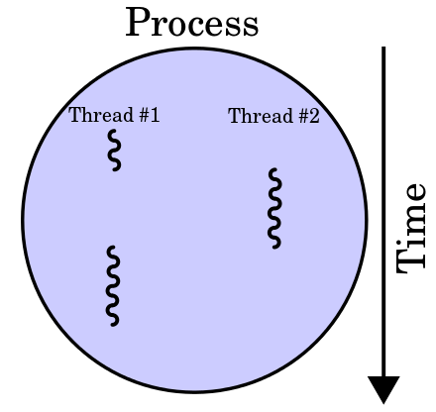
At run time - Process vs Threads

Slide 10
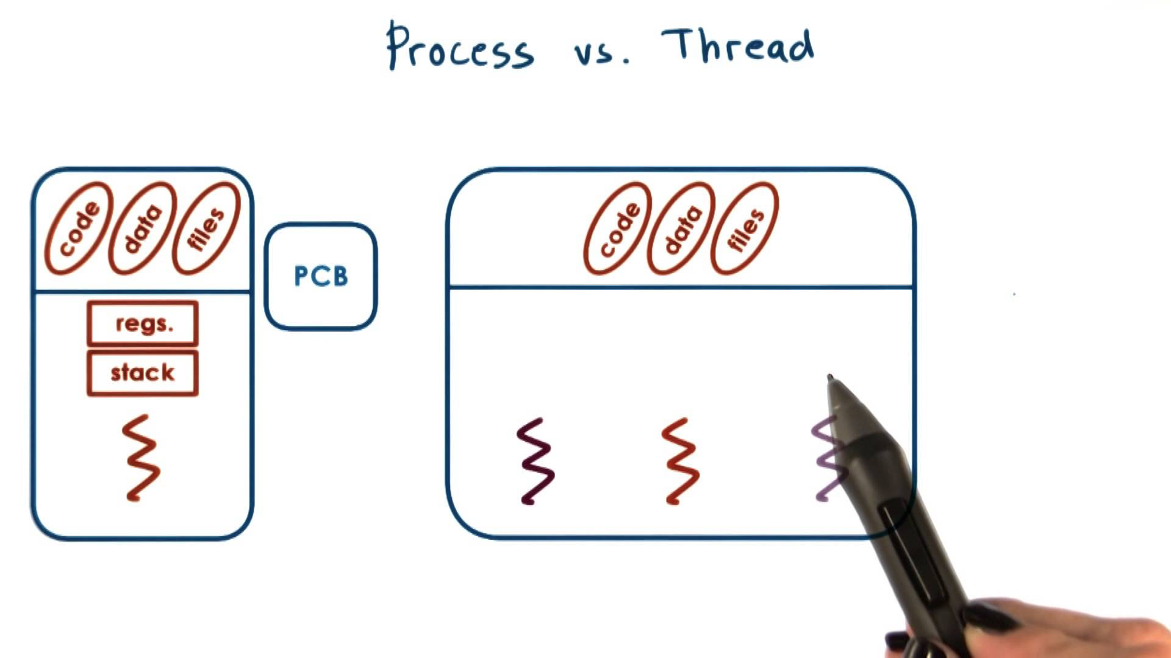
At run time

Slide 11
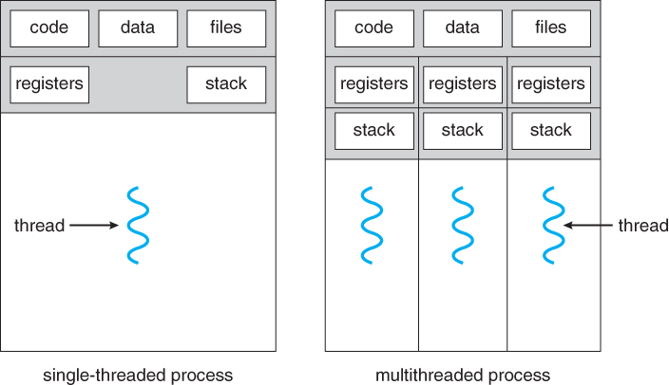
Threads
● Each thread shares the reference of the “father” process, his code and a pieace of his memory

Slide 12
NODE.JS

Slide 13
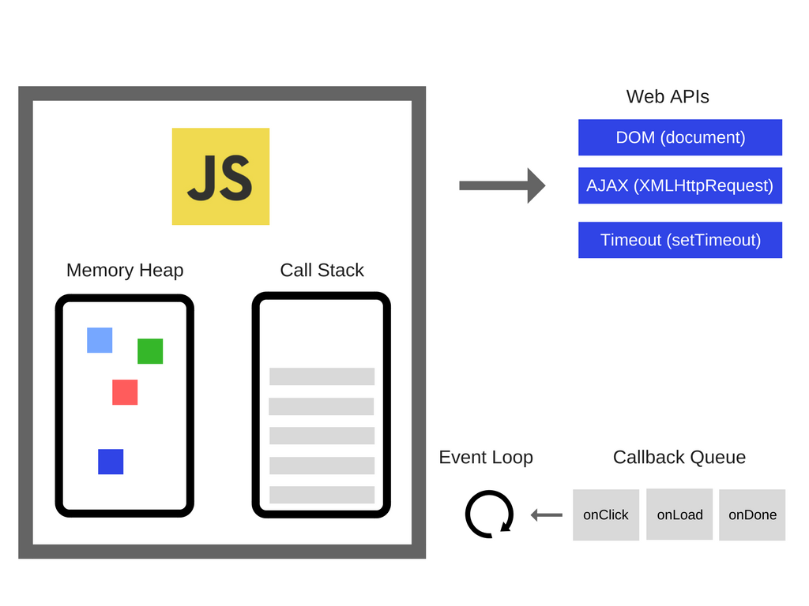
RECAP
Javascript is Single-Threaded
Computation in concurrency
Asyncronous handling through browser APIs (browser) or C/C++ APIs (node.js)

Slide 14
V8 ENGINE
LET’S COMPILE JS

Slide 15
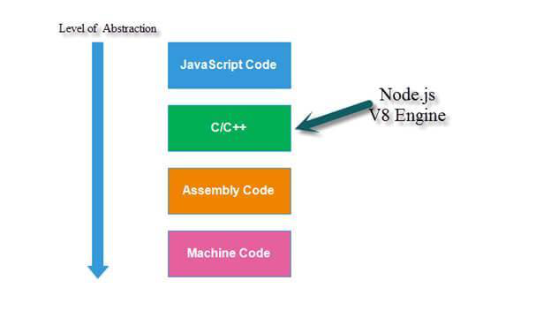

Slide 16
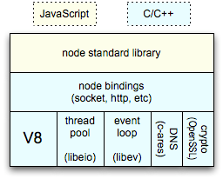

Não é só o V8 e o event loop...

Slide 17
“Node.js® is a JavaScript runtime built on Chrome's V8 JavaScript engine. Node.js uses an event-driven, non-blocking I/O model that makes it lightweight and efficient. Node.js' package ecosystem, npm, is the largest ecosystem of open source libraries in the world.”

Slide 18
NODE.JS NÃO É...

Slide 19
Não é um library...
Bootstrap, jQuery, React, etc
Não é uma framework...
Angular, Express.js, Spring, etc

Slide 20

Node.js?

Slide 21
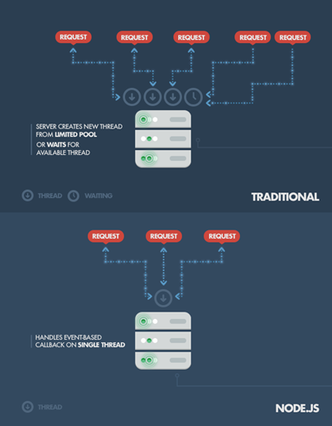
Com outras tecnologias, cada ligação teria de criar uma nova thread dentro do processo principal
Escalabilidade e velocidade

Slide 22
A quick calculation: assuming that each thread potentially has an accompanying 2 MB of memory with it, running on a system with 8 GB of RAM puts us at a theoretical maximum of 4,000 concurrent connections (calculations taken from Michael Abernethy’s article “Just what is Node.js?”, published on IBM, plus the cost of context-switching between threads. That’s the scenario you typically deal with in traditional web-serving techniques
By avoiding all that, Node.js achieves scalability levels of over 1M concurrent connections, and over 600k concurrent websockets connections.

Slide 23
Tudo javascript e JSON
2. Uma linguagem e um padrão de dados

Slide 24
3. Comunidade / NPM

Slide 25

LinkedIn Mobile Development Lead
“The Node.js app was built almost twice as fast with fewer people, in 33% fewer lines of code and 40% fewer files (in comparison with previous Java based application). “One reason was scale. The second is, if you look at Node, the thing it’s best at doing is talking to other services.” When compared with the previous Ruby on Rails based version, the new mobile app is up to 20 times faster and uses only a fraction of resources – servers were cut from 30 to 3. The development itself was unusually fast.”

Slide 26
SERVERS and EXPRESS.JS

Slide 27
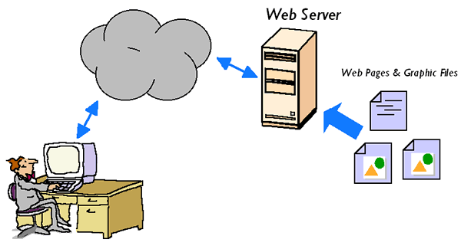

Slide 28
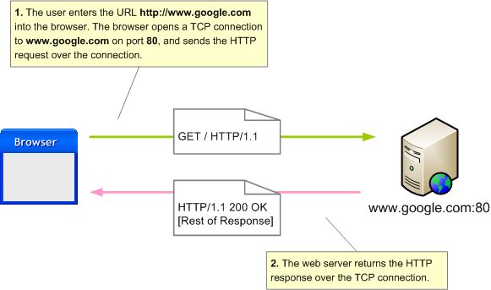
HTTP Requests

Slide 29

Go to

