Slide 1
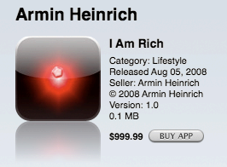
Flutter
Material Design
Material 3 is the latest version of Google’s open-source design system. Design and build beautiful, usable products with Material 3.
https://m3.material.io/get-started
Showcase App
https://flutter.github.io/samples/material_3.html

Slide 2
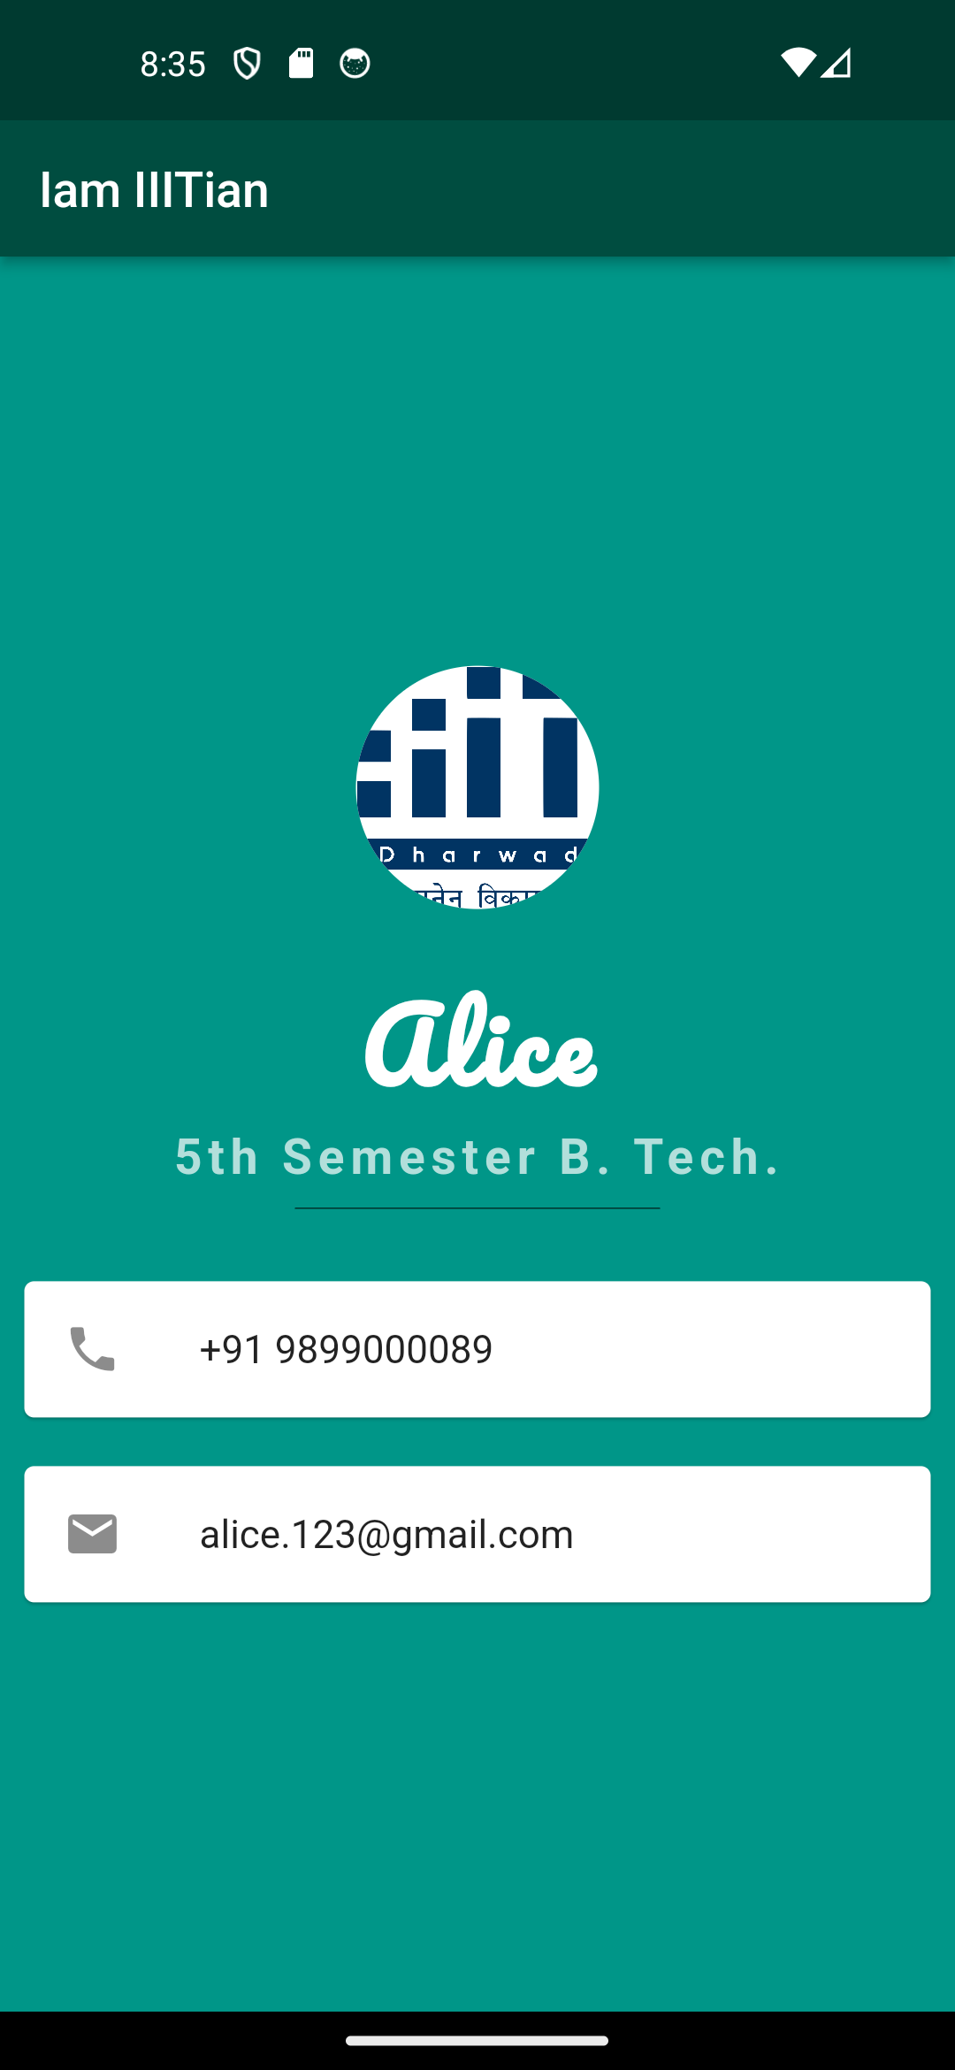
Flutter Widgets
MaterialApp
Text
Center
Scaffold
AppBar
Image, NetworkImage, AssetImage
Container
Row, Column
Card
SizedBox
CircleAvatar
ListTile
Icon
https://github.com/rodavid20/Flutter2023
https://docs.flutter.dev/ui/widgets
https://api.flutter.dev/flutter/widgets/widgets-library.html

Slide 3
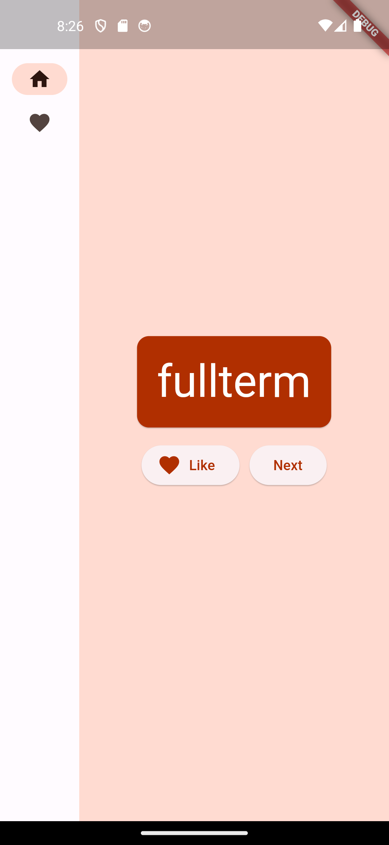
Flutter
https://www.appicon.co/
https://pub.dev/
https://codelabs.developers.google.com/codelabs/flutter-codelab-first#0

Slide 4
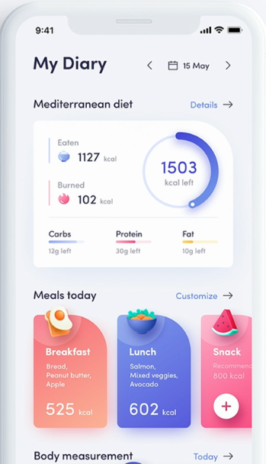
Tutorial 3

