Slide 1
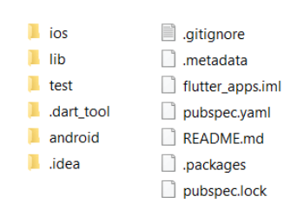
Flutter Folder Structure
• android/ and ios/: platform-specific code for each OS
• lib/: Contains the Dart source code of your Flutter app
• test/: Unit tests, widget tests, and integration tests all go in this folder
•pubspec.yaml: Defines a Dart package and lists dependencies of your Flutter app.
•README.md: Markdown file used for your git repository and at the same time as a "home page" at https://pub.dev in case you wanted to publish a package.

Slide 2
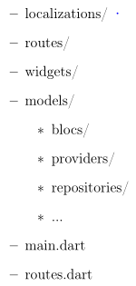
Suggested Lib Folder Structure
The official Flutter documentation doesn't give any guidelines about this since you're free to do what you prefer:
Suggestion
routes/ App's pages
models/ business logic
widgets/ Reusable UI widgets
localizations/ Localization logic

Slide 3
Pubspec.yaml
version
Required for packages that are hosted on the pub.dev site
description
Required for packages that are hosted on the pub.dev site
environment
Specifying Flutter SDK constraints
repository
Optional. URL pointing to the package’s source code repository.
dependencies
Can be omitted if your package has no dependencies.
assets
Specifies the paths to static resources your app will use, such as images, SVG vectors, audio/video files, or simple text.

Slide 4
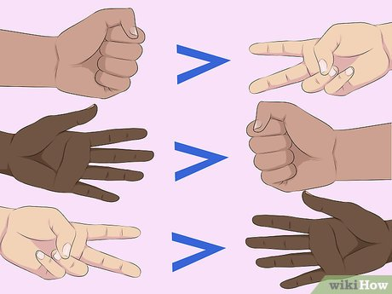
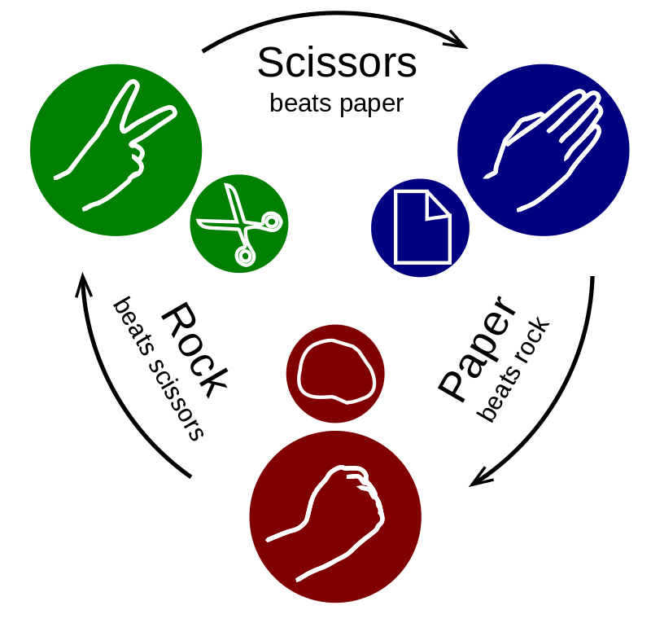
Rock Paper Scissors Game

Slide 5
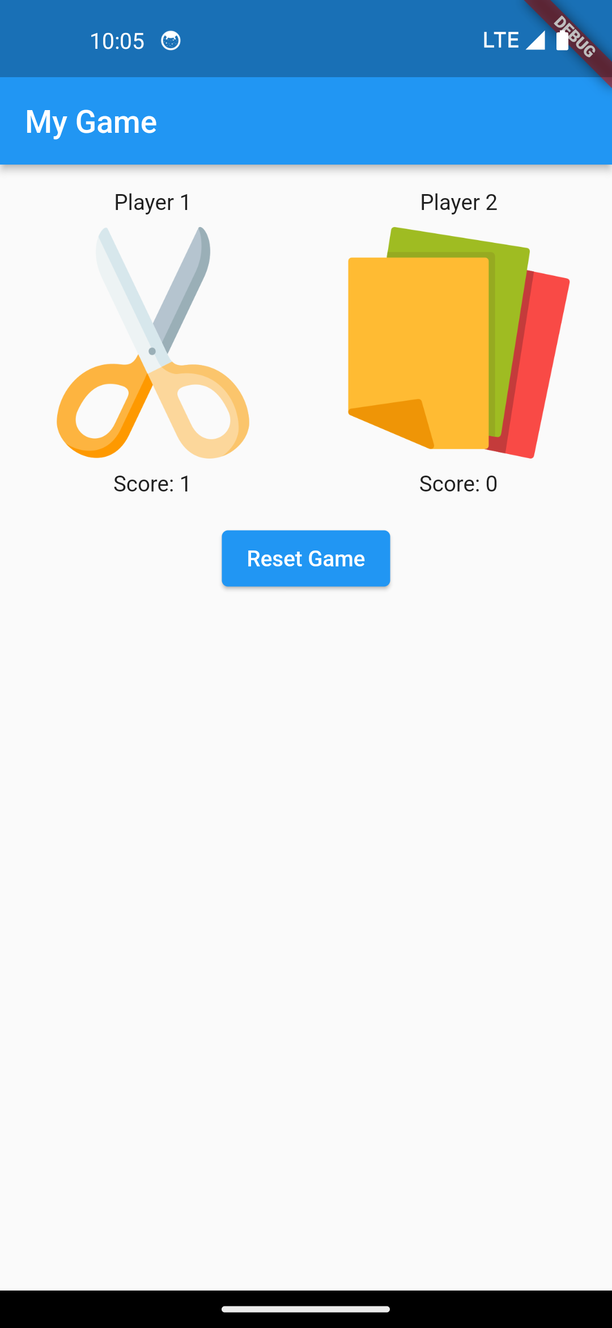
Flutter
Stateful Widget
initState()
onPressed()
setState()
Random().nextInt(3)
Image.asset
TextStyle
Expanded
Padding
TextButton
ElevatedButton
Card
ListTile
https://github.com/rodavid20/Flutter2023
https://docs.flutter.dev/ui/widgets
https://api.flutter.dev/flutter/widgets/widgets-library.html

Slide 6
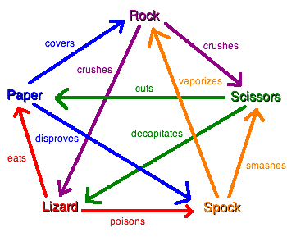
Rock Paper Scissors Lizard Spock Game

