Slide 1
Change app launch icon
https://www.educative.io/answers/how-to-change-app-launch-icon-in-flutter

Slide 2

Figma
Figma is an online design tool for riffing on, sharing, and creating the best work, together.
https://www.figma.com/design/

Slide 3
Asynchronous programming
futures, async, await
https://dart.dev/codelabs/async-await

Slide 4
Firebase Integration
Stateful Widget
initState()
onPressed()
setState()
Random().nextInt(3)
Image.asset
TextStyle

Slide 6
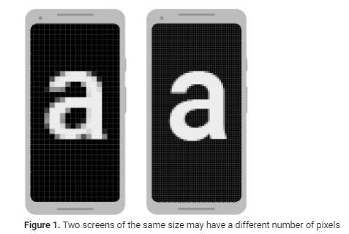
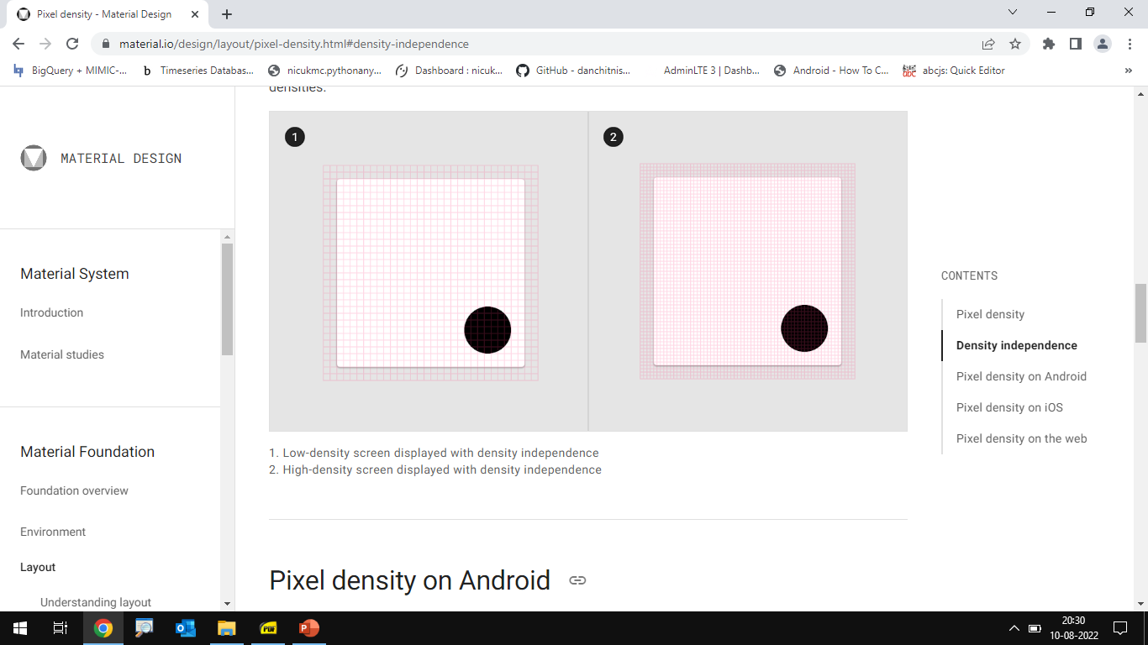
density-independent pixels (dp)
Different screen sizes (handsets, tablets, TVs, and so on)
Screens have different pixel sizes
One device has 160 pixels per square inch, another device fits 480 pixels in the same space
One dp is a virtual pixel unit that's roughly equal to one pixel on a medium-density screen (160dpi; the "baseline" density)
Actual pixel = dp * dpi/160
For text sizes use scalable pixels (sp) as your units. The sp unit is the same size as dp, by default, but it resizes based on the user's preferred text size.

Slide 7
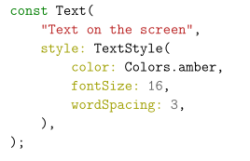
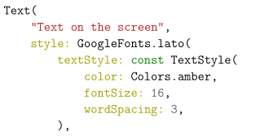
Text

Slide 8
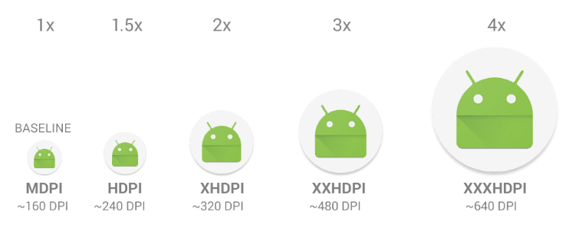
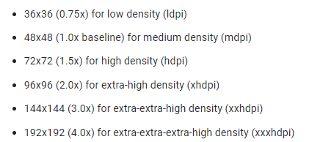
Provide alternative bitmaps
To provide good graphical qualities on devices with different pixel densities, you should provide multiple versions of each bitmap in your app—one for each density bucket, at a corresponding resolution. Otherwise, Android must scale your bitmap so it occupies the same visible space on each screen, resulting in scaling artifacts such as blurring
https://appicon.co/
https://icon.kitchen/
Notes:
Use 3:4:6:8:12:16 scaling ratio between the six primary densities. For example, if you have a bitmap drawable that's 48x48 pixels for medium-density screens, all the different sizes should be

Slide 9
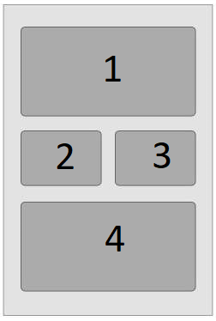
Tutorial
Design this layout with only LinearLayouts where 1,2,3 and 4 are textviews
Design this layout with a RelativeLayout and a LinearLayout where 1,2,3 and 4 are textviews
Design this layout with only ConstraintLayout where 1,2,3 and 4 are textviews

Slide 10
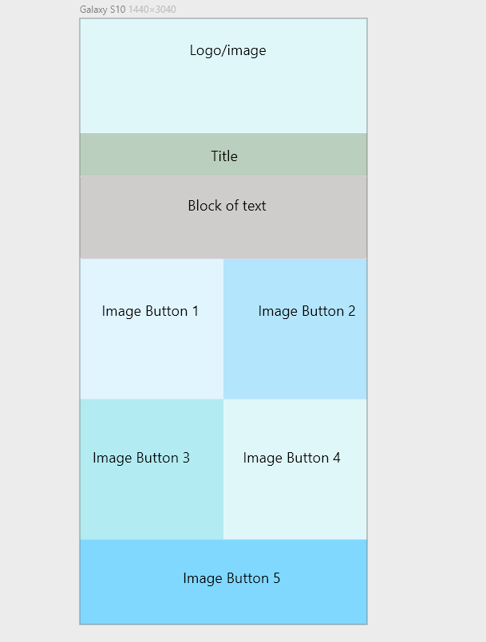
Tutorial

Slide 11

XML
XML documents must start with an XML declaration like
<?xml version="1.0"?>
XML elements are case sensitive
All elements must be nested in a single root element.
Every element must be fully enclosed.
<Product><ID></ID></Product> is valid, but
<Product><ID></Product></ID> isn’t
Attributes contain values that are associated with an element
<element attribute=”value”></element>

Slide 12

JSON
Data is represented as field name (in double quotes), followed by a colon, followed by a value
Value can be a string, a number, an object, an array, a boolean or null
Data is separated by commas
Curly braces hold objects
Square brackets hold arrays

