Slide 1
DAY 2 · SESSION 1 · 90 MINUTES
ASP.NET Web API (Backend Services)
WHAT WE COVER
BY THE END YOU CAN
What REST actually means
Resources, verbs, status codes, statelessness
Explain REST without hand-waving
Choose the right HTTP verb and status code for an operation
Write an API controller that returns JSON
Accept a JSON payload and validate it
Test your own endpoints without a front end
1
API controllers
ControllerBase, [ApiController], attribute routes
2
JSON in and out
Serialisation, model binding, DTOs
3
GET and POST endpoints
The two you will write most often
4
About 45 minutes of concept and demonstration, then 45 minutes at the keyboard.
Hands-on
A Parts API, exercised through Swagger
5
HAL · .NET, React & SQL Programme
Day 2 · Session 1 — ASP.NET Web API
1
Notes:
Ask who has used a REST API before, even indirectly. Most will have — any mobile app they use is a client of one.

Slide 2

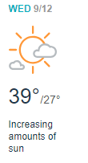
Introduction

Slide 3
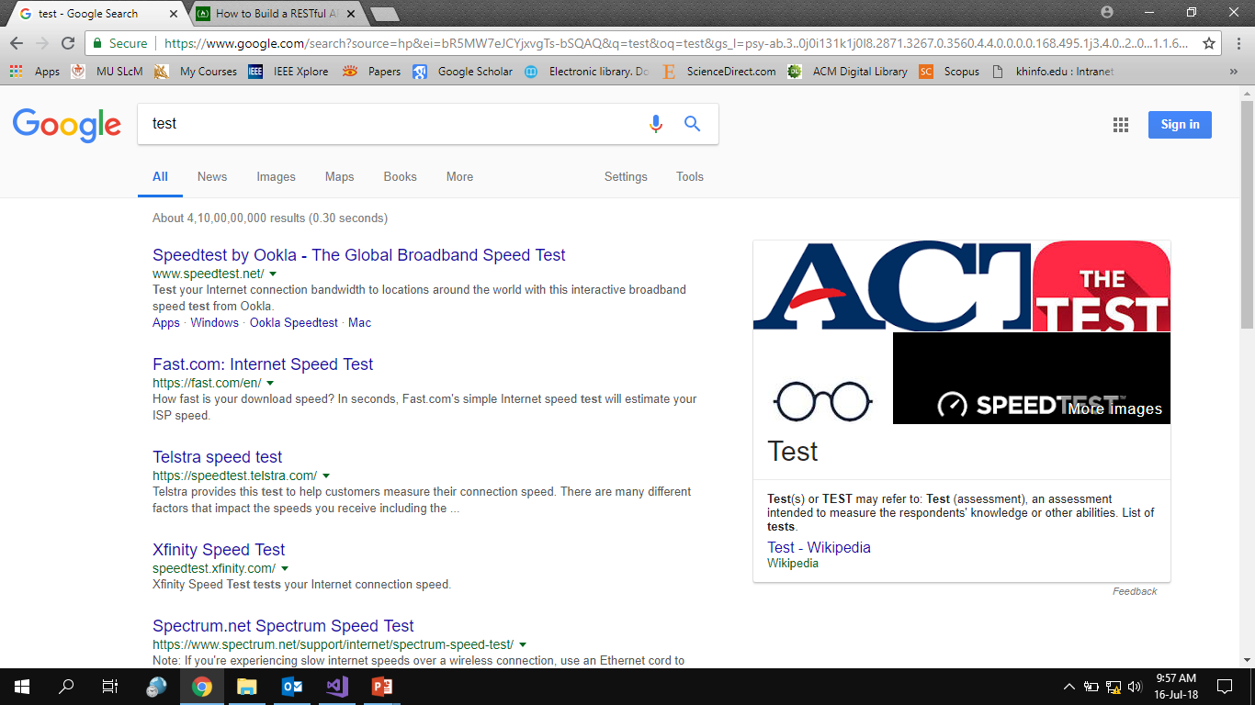
Introduction

Slide 4
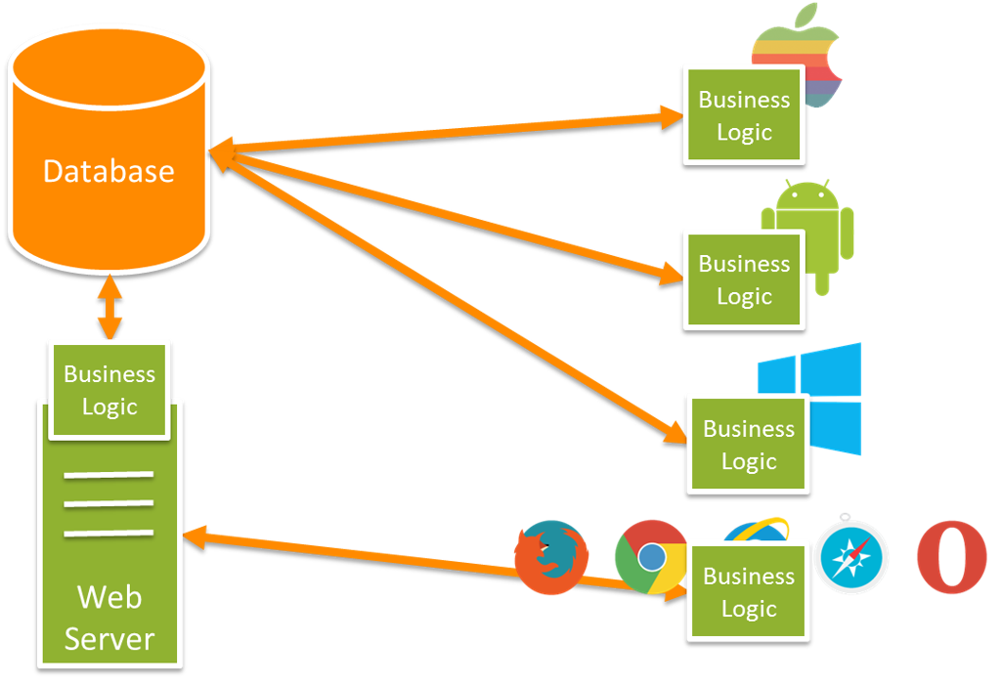
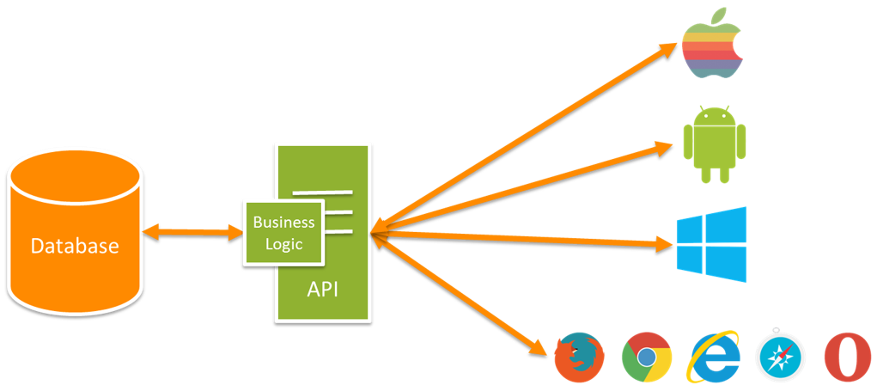
Introduction
https://blogs.msdn.microsoft.com/martinkearn/2015/01/05/introduction-to-rest-and-net-web-api/

Slide 5
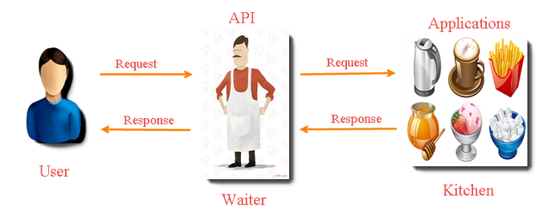
Introduction
https://keshavtechinfo.wordpress.com/api-testing/api-manual/

Slide 6
WHAT IS REST
Nouns in the URL, verbs in the request
Code | Meaning | When you return it
200 | OK | A successful GET or PUT
201 | Created | A POST that created a resource
400 | Bad Request | The payload failed validation
401 / 403 | Unauthorised / Forbidden | Not signed in, or not allowed
404 | Not Found | That part number does not exist
500 | Server Error | Your code threw — and you should log it
THE RESOURCE IS THE NOUN
GET /api/parts list them
GET /api/parts/HAL-4471 fetch one
POST /api/parts create one
PUT /api/parts/HAL-4471 replace one
DELETE /api/parts/HAL-4471 remove one
Four rules worth remembering
The URL names a thing; the verb says what to do with it
Every request stands alone — the server remembers nothing between calls
GET never changes data, and can be repeated safely
The response says what happened in a status code, not only in the body
HAL · .NET, React & SQL Programme
Day 2 · Session 1 — ASP.NET Web API
3
Notes:
Status codes are the part teams get lazy about — returning 200 with an error message inside is the classic mistake. It breaks every client that trusts the protocol.

Slide 7
WHAT ACTUALLY CROSSES THE WIRE
Request and response, in full
Verb, path, headers, body
Every request is these four things. Nothing more mysterious is happening.
REQUEST
POST /api/parts HTTP/1.1
Host: spares.hal.int
Content-Type: application/json
Authorization: Bearer eyJhbGci...
{ "partNo": "HAL-4471", "quantity": 12 }
1
Headers carry the metadata
Content type, authentication, caching. The body carries the data.
2
RESPONSE
HTTP/1.1 201 Created
Location: /api/parts/HAL-4471
Content-Type: application/json
{ "partNo": "HAL-4471", "quantity": 12 }
The status line is the verdict
Read it first when something fails — it usually tells you which layer to look at.
3
Watch it in the browser
F12, Network tab. Every request your React app makes is visible there, in full.
4
HAL · .NET, React & SQL Programme
Day 2 · Session 1 — ASP.NET Web API
4
Notes:
Open the network tab on any site and show a real request. Demystifying this makes tomorrow's debugging far less frightening.

Slide 8
DESIGNING THE URLS
Nouns, plural, and no verbs
AVOID
PREFER
GET /api/getAllParts
POST /api/createPart
GET /api/part?action=delete&id=4471
GET /api/PartsAndWorkOrdersAndStock
GET /api/parts
POST /api/parts
DELETE /api/parts/HAL-4471
GET /api/parts/HAL-4471/issues
GET /api/parts?belowMinimum=true&page=2
The verb is already in the request. Putting it in the URL too is how an API becomes a pile of one-off methods.
HAL · .NET, React & SQL Programme
Day 2 · Session 1 — ASP.NET Web API
5
Notes:
Filtering and paging belong in the query string, not in new endpoints. Otherwise you end up with getPartsBelowMinimumForStore.

Slide 9
GETTING THE RESPONSE RIGHT
What you return is part of the contract
Never return 200 with an error inside
Every client then has to parse the body to find out whether it worked. This is the most common API design failure.
SAY WHAT HAPPENED, PROPERLY
if (part is null)
return NotFound();
if (!ModelState.IsValid)
return BadRequest(ModelState);
return CreatedAtAction(nameof(Get),
new { partNo = part.PartNo }, part);
1
Do not leak the exception
A stack trace in the response tells an attacker your framework, your versions and your file paths.
2
A consistent error shape
404 means the resource, not the route
If /api/parts/9999 returns 404, that is correct. If /api/parts does, your routing is wrong.
ASP.NET Core returns a standard problem-details object for errors: a type, a title, a status and detail. Use it rather than inventing your own, so every client can handle failures the same way.
3
Be consistent above all
A predictable API is easier to use than a clever one.
4
HAL · .NET, React & SQL Programme
Day 2 · Session 1 — ASP.NET Web API
6
Notes:
The 200-with-an-error pattern is everywhere in older in-house services. Name it as a defect, not a style choice.

Slide 10
CREATING WEB API CONTROLLERS
Same framework, different return type
ControllerBase, not Controller
An API has no views, so it does not need view support.
CONTROLLERS/PARTSAPICONTROLLER.CS
1
[ApiController]
[Route("api/parts")]
public class PartsApiController : ControllerBase
{
private readonly IPartRepository _repo;
public PartsApiController(IPartRepository repo)
=> _repo = repo;
[HttpGet]
public ActionResult<IEnumerable<SparePart>> GetAll()
=> Ok(_repo.GetAll());
[HttpGet("{partNo}")]
public ActionResult<SparePart> Get(string partNo)
{
var part = _repo.GetByPartNo(partNo);
return part is null ? NotFound() : Ok(part);
}
}
[ApiController]
Automatic model validation, 400 responses and binding from the body.
2
Attribute routing
The route sits on the class and the action, where you can see it.
3
Constructor injection
The repository arrives from the container — the controller never news it up.
4
Return ActionResult<T>
You can return the object, or NotFound(), or BadRequest().
5
HAL · .NET, React & SQL Programme
Day 2 · Session 1 — ASP.NET Web API
7
Notes:
Constructor injection is the moment dependency inversion from Day 1 becomes concrete. Point back to it.

Slide 11
JSON INPUTS AND OUTPUTS
What crosses the wire, and what you accept back
RESPONSE BODY
ACCEPTING A POST
[
{
"partNo": "HAL-4471",
"nomenclature": "Hydraulic seal",
"quantity": 3,
"location": "Bay 2"
}
]
public class CreatePartRequest
{
[Required, StringLength(20)]
public string PartNo { get; set; }
[Range(0, 100000)]
public int Quantity { get; set; }
}
[HttpPost]
public ActionResult<SparePart> Create(
CreatePartRequest request)
{
var part = _repo.Add(request);
return CreatedAtAction(nameof(Get),
new { partNo = part.PartNo }, part);
}
Names change case automatically
C# PartNo becomes JSON partNo. That is the default camelCase policy, and JavaScript expects it.
Send a DTO, not your entity
A request model exposes only the fields a caller may set — never bind straight onto a database entity.
HAL · .NET, React & SQL Programme
Day 2 · Session 1 — ASP.NET Web API
8
Notes:
Explain why CreatedAtAction is worth the extra typing: it returns 201 and a Location header pointing at the new resource. Also note that [ApiController] turns a failed data annotation into a 400 automatically.

Slide 12
DTOS
What you accept is not what you store
Stops over-posting
A caller cannot set ApprovedBy simply because the column exists.
THREE TYPES, THREE JOBS
// what the caller may send
public record CreatePartRequest(
string PartNo, int Quantity);
// what you store
public class SparePart { ... }
// what you return
public record PartResponse(
string PartNo, int Quantity,
bool BelowMinimum);
1
Stops over-sharing
Internal costs, audit fields and identifiers stay inside.
2
Lets the response be useful
BelowMinimum is computed, not stored — the client should not have to work it out.
3
It feels like duplication
It is not. The three change for different reasons, and the seam is what stops a database column becoming a public promise.
Protects your callers
Rename a column and the API contract holds. Without DTOs, every client breaks.
4
HAL · .NET, React & SQL Programme
Day 2 · Session 1 — ASP.NET Web API
9
Notes:
Expect pushback about duplication. The answer is that the coupling it removes is worth far more than the typing it costs.

Slide 13
TESTING YOUR OWN API
Before anyone builds a screen for it
Swagger / OpenAPI
Postman or a .http file
A page generated from your controllers that lists every endpoint and lets you call it. Free documentation, and it cannot go out of date.
For saved requests you run repeatedly. A .http file sits in the project and gets committed with the code, so the whole team has it.
A .HTTP FILE LIVES WITH THE CODE
### list every part
GET https://localhost:7001/api/parts
### create one
POST https://localhost:7001/api/parts
Content-Type: application/json
HAL · .NET, React & SQL Programme
Day 2 · Session 1 — ASP.NET Web API
10
Notes:
Insist they check status codes in Swagger, not just the body. That habit catches the 200-with-error pattern immediately.

Slide 14
COMMON MISTAKES
What makes an API unpleasant to use
Returning the database entity
Every column becomes a public contract, including the ones you regret.
The test
1
Hand your API to someone who did not build it, with only the Swagger page. If they cannot use it in ten minutes, it needs work — not more documentation.
Inconsistent naming
partNo here, PartNumber there, part_no somewhere else. Pick one and enforce it.
2
No paging on a list endpoint
Fine with fifty rows, fatal with fifty thousand. Add it before you need it.
3
Sensible defaults
Chatty endpoints
If the screen must call you eleven times to draw itself, the API is modelled wrongly.
4
camelCase in JSON
ISO dates, always UTC
Page size capped server-side
Every list endpoint returns a total
No versioning plan
The day you must change a field, you will need one. /api/v1/ costs nothing today.
5
HAL · .NET, React & SQL Programme
Day 2 · Session 1 — ASP.NET Web API
11
Notes:
The UTC point saves genuine pain later — mixed local times across servers is a classic and horrible defect.

Slide 15
CHECKPOINT · 10 MINUTES
What would you expose first?
Which of your data does another team ask for?
Usually by email, spreadsheet or a direct database login today.
Running it
1
Two minutes in pairs, then three answers
Watch for endpoints named as verbs and correct them gently
Note anyone who mentions direct database access — that is a strong case for an API
How do they get it now?
And what breaks when your schema changes?
2
What would the URLs be?
Name three endpoints out loud, as nouns.
3
Who should be allowed to call it?
Everyone inside the network is not an answer.
4
HAL · .NET, React & SQL Programme
Day 2 · Session 1 — ASP.NET Web API
12
Notes:
Direct database logins handed to other departments is common and worth naming as the problem an API solves.

Slide 16
HANDS-ON · 40 MINUTES
Build and test your first API
Add an API alongside the MVC app you built yesterday — same project, new controller.
YOUR TASKS
WIRING UP SWAGGER
1
Add PartsApiController
Route api/parts, inheriting ControllerBase
// Program.cs
builder.Services.AddControllers();
builder.Services.AddEndpointsApiExplorer();
builder.Services.AddSwaggerGen();
if (app.Environment.IsDevelopment())
{
app.UseSwagger();
app.UseSwaggerUI();
}
app.MapControllers();
// then browse to /swagger
2
GET /api/parts
Return the seeded list as JSON
3
GET /api/parts/{partNo}
Return one part, or 404 when it is unknown
4
POST /api/parts
Accept a CreatePartRequest and return 201
5
Add validation attributes
Required, StringLength, Range
6
Exercise every endpoint in Swagger
Check the status code, not only the body
Post an invalid part number deliberately and read what comes back. Knowing what a 400 looks like saves an hour tomorrow.
HAL · .NET, React & SQL Programme
Day 2 · Session 1 — ASP.NET Web API
13
Notes:
Swagger gives them a UI without writing one, which keeps the focus on the API. Anyone who finishes early can add PUT and DELETE.

Slide 17
SESSION 1 RECAP
Your service now has a front door
1
URLs name resources; the verb says what to do
Practise
Add PUT and DELETE to your Parts API
Make one endpoint return a proper 400 with messages
Add paging to the list endpoint
2
Return the status code that describes what happened
3
Accept a request DTO, return a response DTO
4
Validate on the server, always
5
Swagger documents and tests it for free
6
Be consistent before you are clever
Next: replacing the in-memory list with SQL Server.
HAL · .NET, React & SQL Programme
Day 2 · Session 1 — ASP.NET Web API
14
Notes:
If people finished the hands-on early, the practice list is what to give them.

