Slide 1

Bullet Bio Automation Project
By: Brian Rodriguez

Slide 2
Purpose
Team members were manually compiling data one-by-one which was time-consuming.
The “BulletBioAutomation” application was developed to address inefficiencies in creating Bullet Bios at NMSU Foundation.
From taking 1 hour to compile all data needed for one bullet bio as opposed to 1 second with the app.
The applications automates data retrieval and formation to reduce time dedicated in retrieving each piece needed to compose a bio.

Slide 3
Functionality
“BulletBioAutomation” program is a Python-based application that performs the following functions:
Data Extraction: Connects to the NMSU Foundation Microsoft SQL Server database to retrieve donor information.
Data Processing: Processes and formats the extracted data into a structured CSV file
User Interaction: Offers a simple user interface (UI) for ease for use.
Error Handling: Detects and reports issues such as invalid Constituents IDs

Slide 4
Workflow
The user provides a file path for an Excel file containing Constituent IDs.
The applications reads the IDs and connect to the backend into the SQL server database to retrieve corresponding the donor data.
The data is exported as a CSV file, and the user is notified upon success
If IDs are formatted in an improper format, the user will be notified of the error and the reason.
It will also notify the user if the program itself is having issues

Slide 5
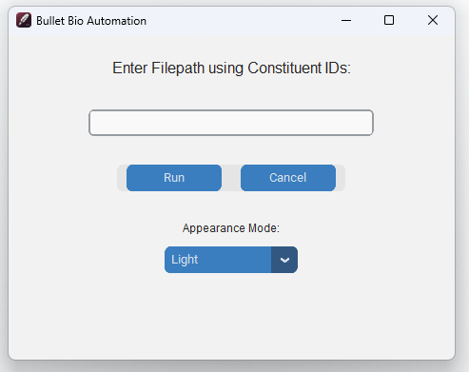
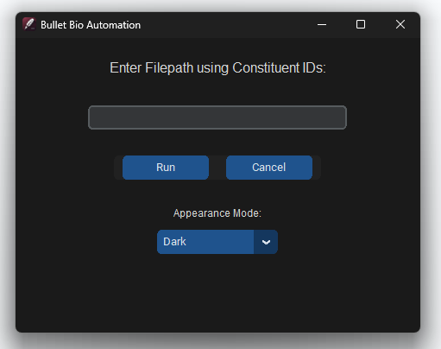
Use Instructions
Prepare an Excel (.xlsx) file with only numeric Constituent IDs (no need for headers).
Launch the application
Copy Excel file file-path
To copy file path from document, find file in file explorer, right click on document, and click on “Copy as path” or do Ctrl+Shift+C on the file selected.
Paste the file path into the input field.

Slide 6
Use Instructions (con.)
If when copied file path has quotations when pasted, remove them as it will not register the file path.
Click ‘Run’ to process the data, and let the program run.
Depending on how many Constituent IDs are provided, the program may take longer.
File explorer will open and choose a save location for the output CSV file.
Once completed successfully, an icon will appear.

Slide 7
Future Goals
“BulletBioAutomation” automates the process of creating Bullet Bios for the Advances Services Team and enhances productivity and offering a user-friendly solution for handling large datasets efficiently.
Automating task, reports, or workflows allows opportunities to focus on other items that could provide larger potential to the foundation.

