Slide 1
Virtualization

Slide 2
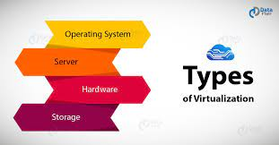
Types Of Virtualization

Slide 3
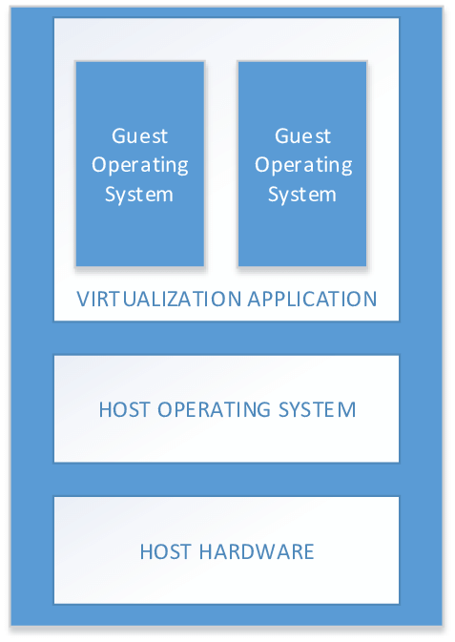
1.Operating system virtualization

Slide 4
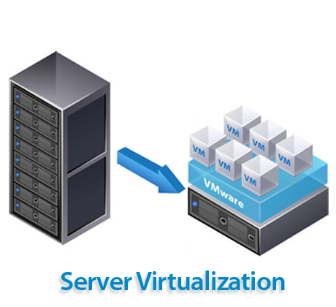
2. Server Virtualization

Slide 5
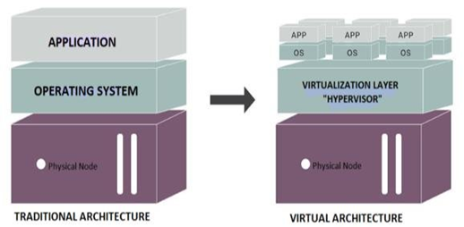
3. Hardware Virtualization

Slide 6
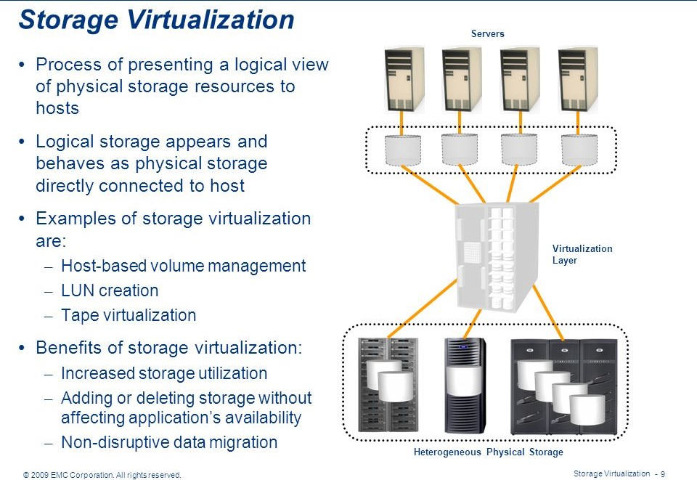
4. Storage Virtualization

