Slide 1
Classification (using CNN and Landmarks) and Object Detection for Sign Language
Rodrigo Picinini Méxas (120230184)
Computer Science and Engineering

Slide 2
Goal of the project
Train one classifier using CNN, one classifier using hand landmarks and one object detector using a sign language dataset. With that done, a comparison and analysis of the obtained results will be made.

Slide 3
Summary
Preparation of the datasets
YOLO object detection model
CNN classification model
Mediapipe’s extracted landmarks classification model
Comparison and analysis of results
Conclusion

Slide 4
1. Preparation of the datasets
1.1 Dataset for the classification models
27 Class Sign Language Dataset (https://www.kaggle.com/datasets/ardamavi/27-class-sign-language-dataset) The numbers 0 to 9 and the letters A, B, C, D and E will be used
The data was organized as numpy arrays: X.npy for the images and Y.npy for the labels.
They were converted into png and then reorganized manually so that the splitfolders library could be used. The data was splited into 3 different folders: test (10%), train (80%) and validation (10%).
Then, csv files were created to associating the image file names with theirs corresponding labels.
Total of 12972 images.

Slide 5
1. Preparation of the datasets
1.2 Dataset for the object detection model
The dataset American Sign Language Letters | User-friendly Deep Learning: Datasets (waikato.ac.nz) was used with only the letters A, B, C, D and E.
The dataset was in VOC format and Roboflow was used to convert the dataset to be in the format used in YOLOv5. In this process, the dataset was split in train (70%), test (10%) and validation (20%) datasets.
Total of 324 images.

Slide 6
2. YOLO object detection model
2.1 Training and test procedure
YOLOv5 from Ultralytics was used. (https://github.com/ultralytics/yolov5)
The command “python train.py --img 640 --batch 8 --epochs 250 --data "signlanguage-abcde.v1i.yolov5pytorch/data.yaml" --weights yolov5s.pt” was used to train the model.
The command “python val.py --weights "runs/train/exp/weights/best.pt" --data " signlanguage-abcde.v1i.yolov5pytorch/data.yaml " --task " test " ” was used to extract some metrics from the trained model in the test dataset.

Slide 7
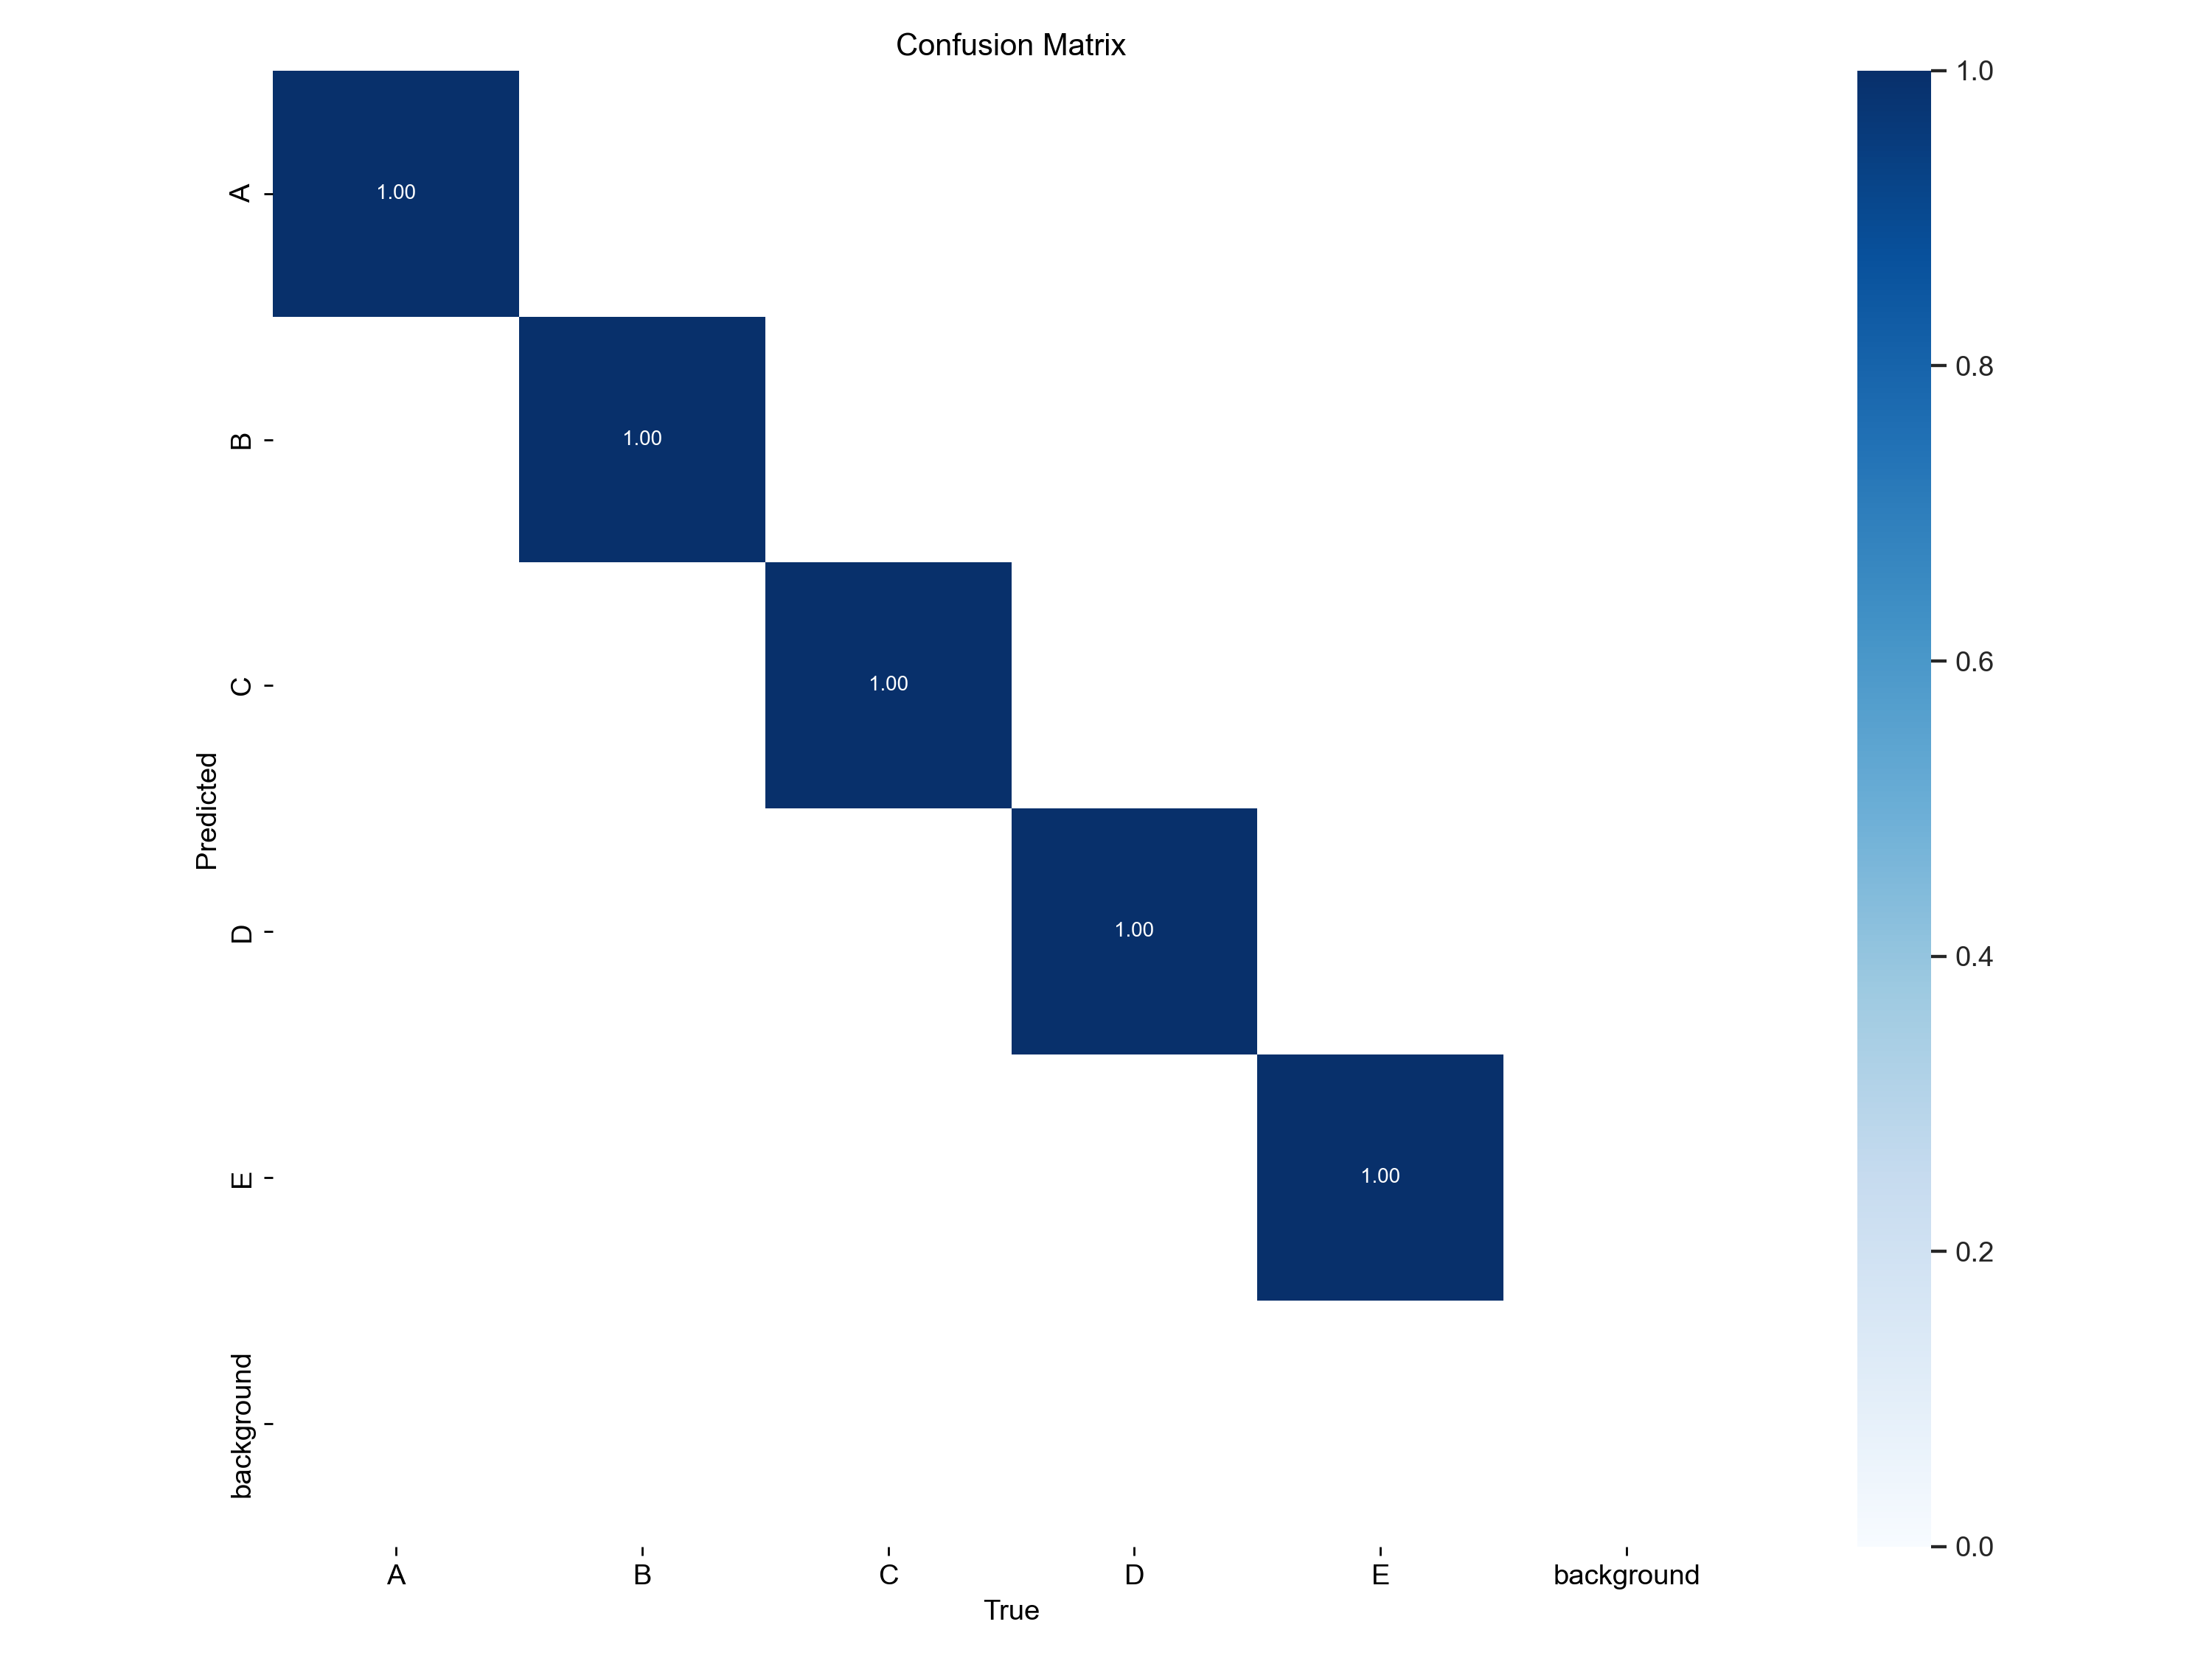
2. YOLO object detection model
2.1 Training Metrics

Slide 8
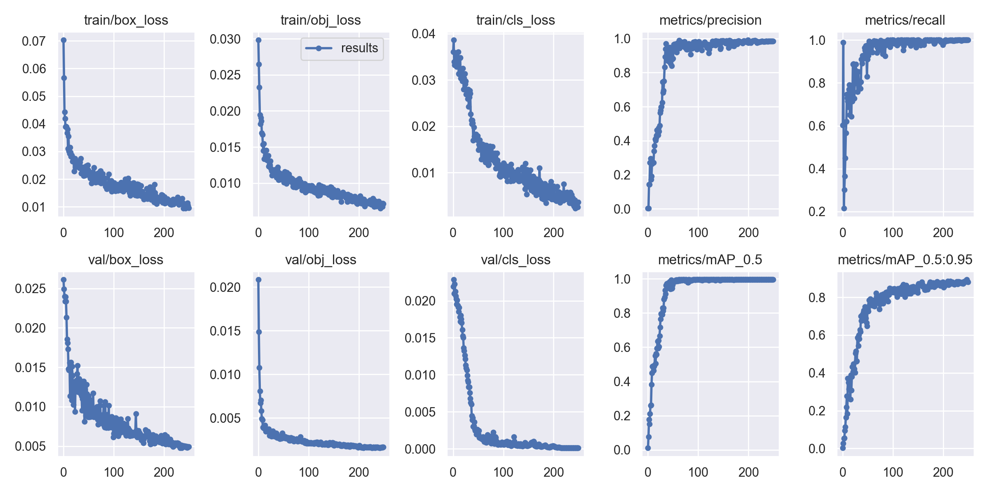
2. YOLO object detection model
2.2 Training Metrics

Slide 9
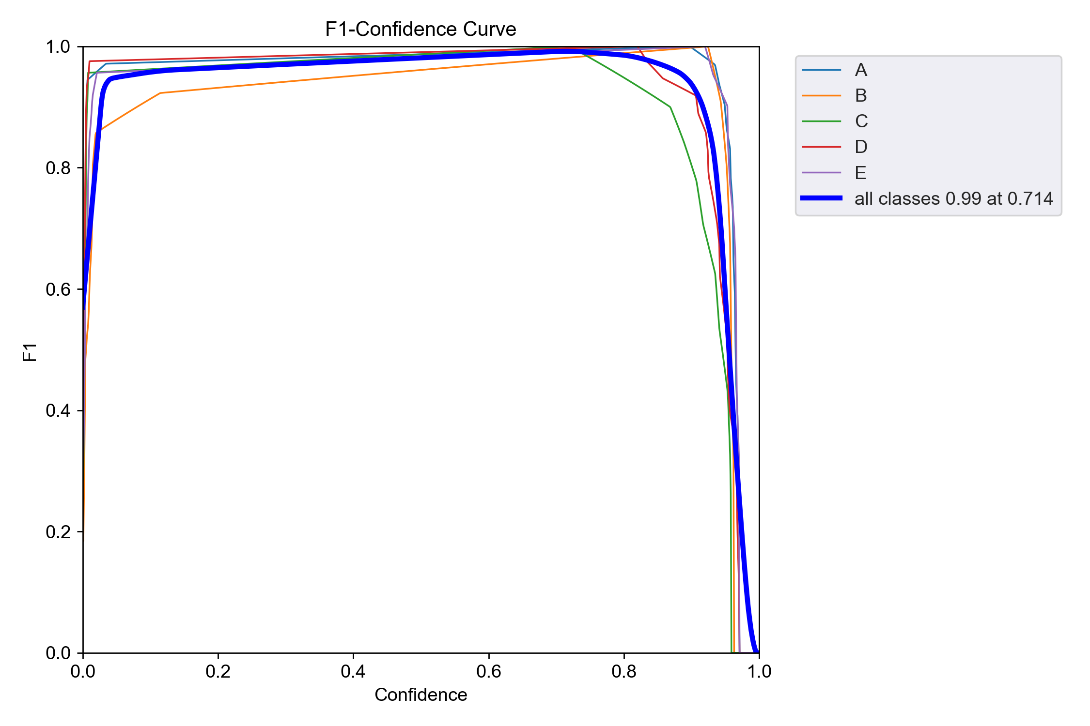
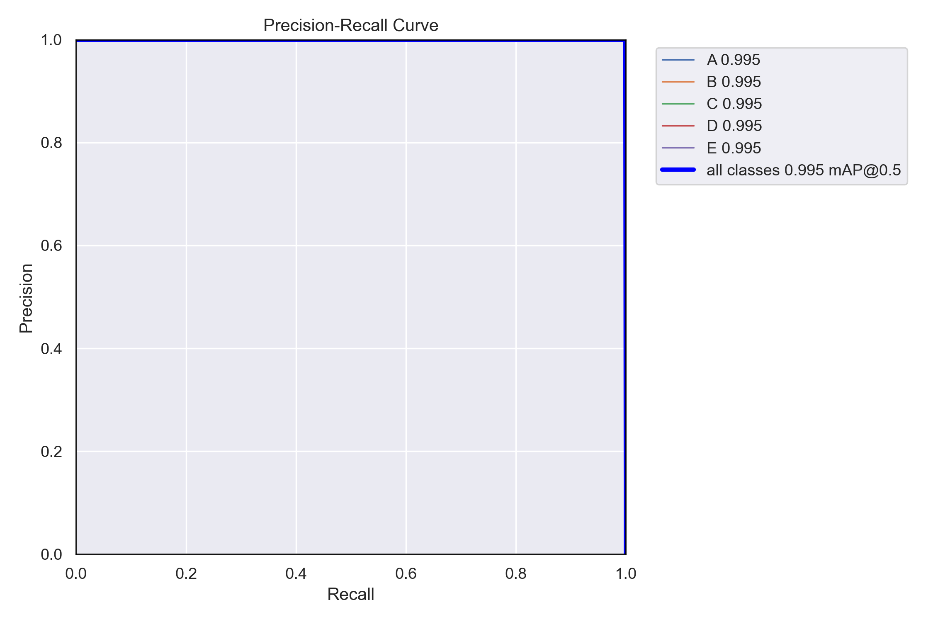
2. YOLO object detection model
2.2 Training Metrics

Slide 10
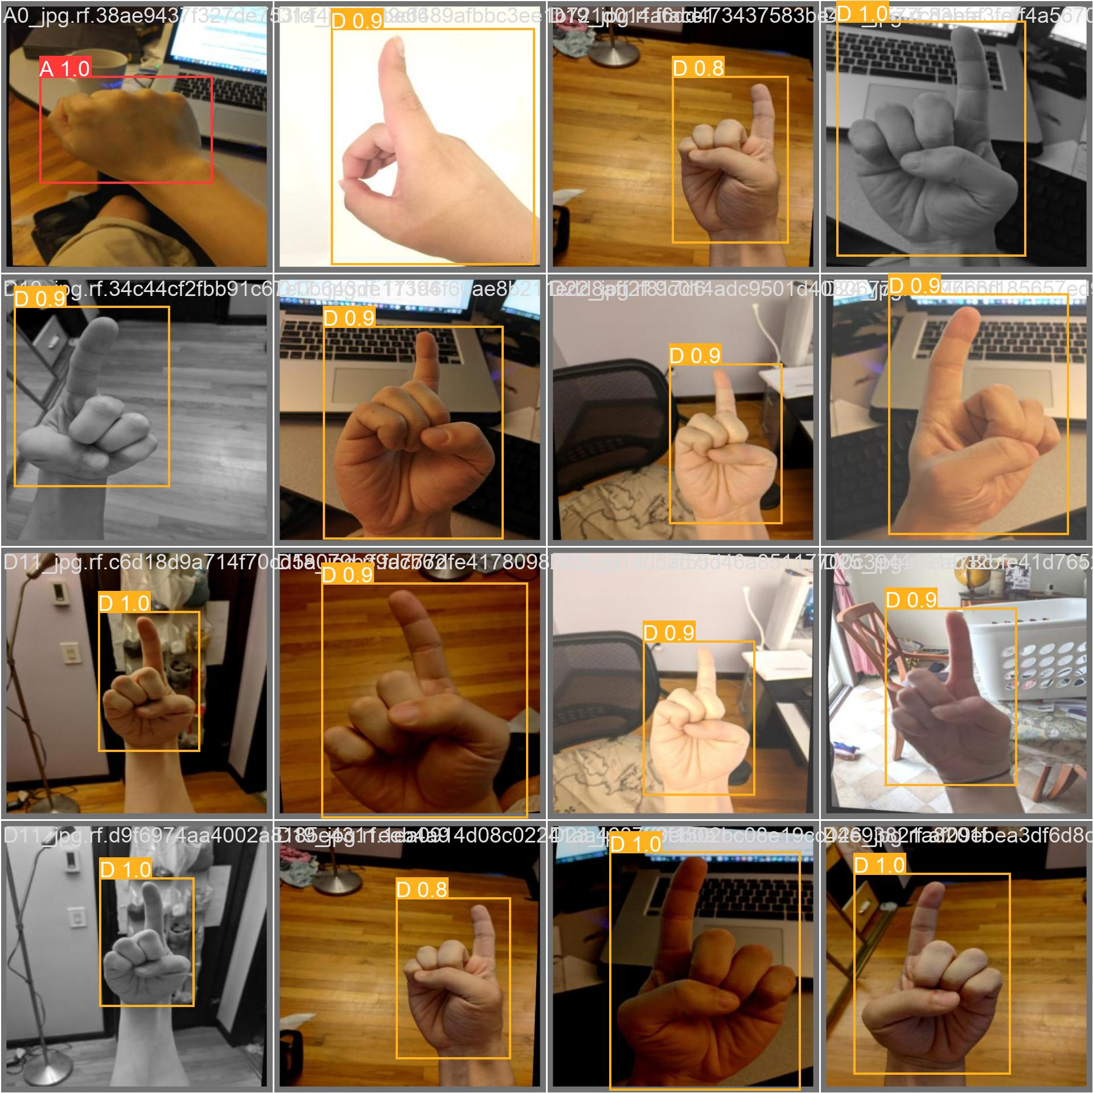
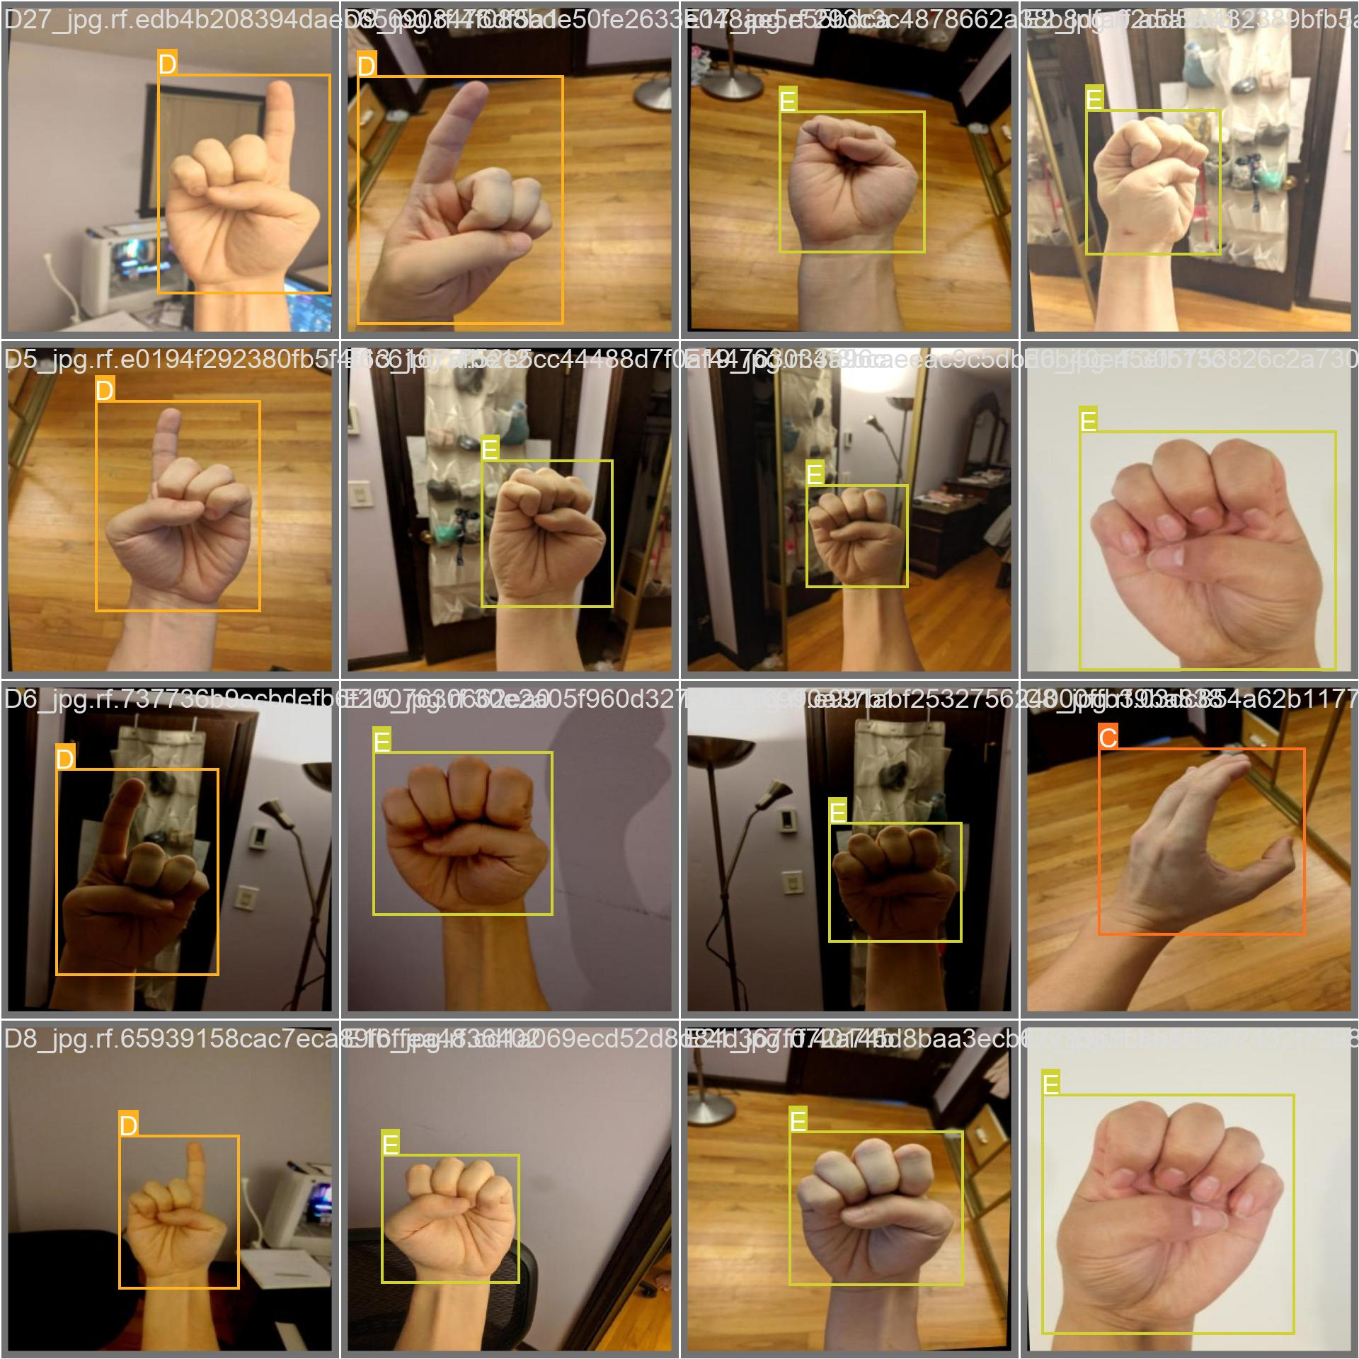
2. YOLO object detection model
2.2 Training Metrics
Predictions in validation batches

Slide 11
2. YOLO object detection model
2.3 Test Metrics
Precision: 0.989
Recall: 0.979
mAP50: 0.995
mAP50-95: 0.892

Slide 12
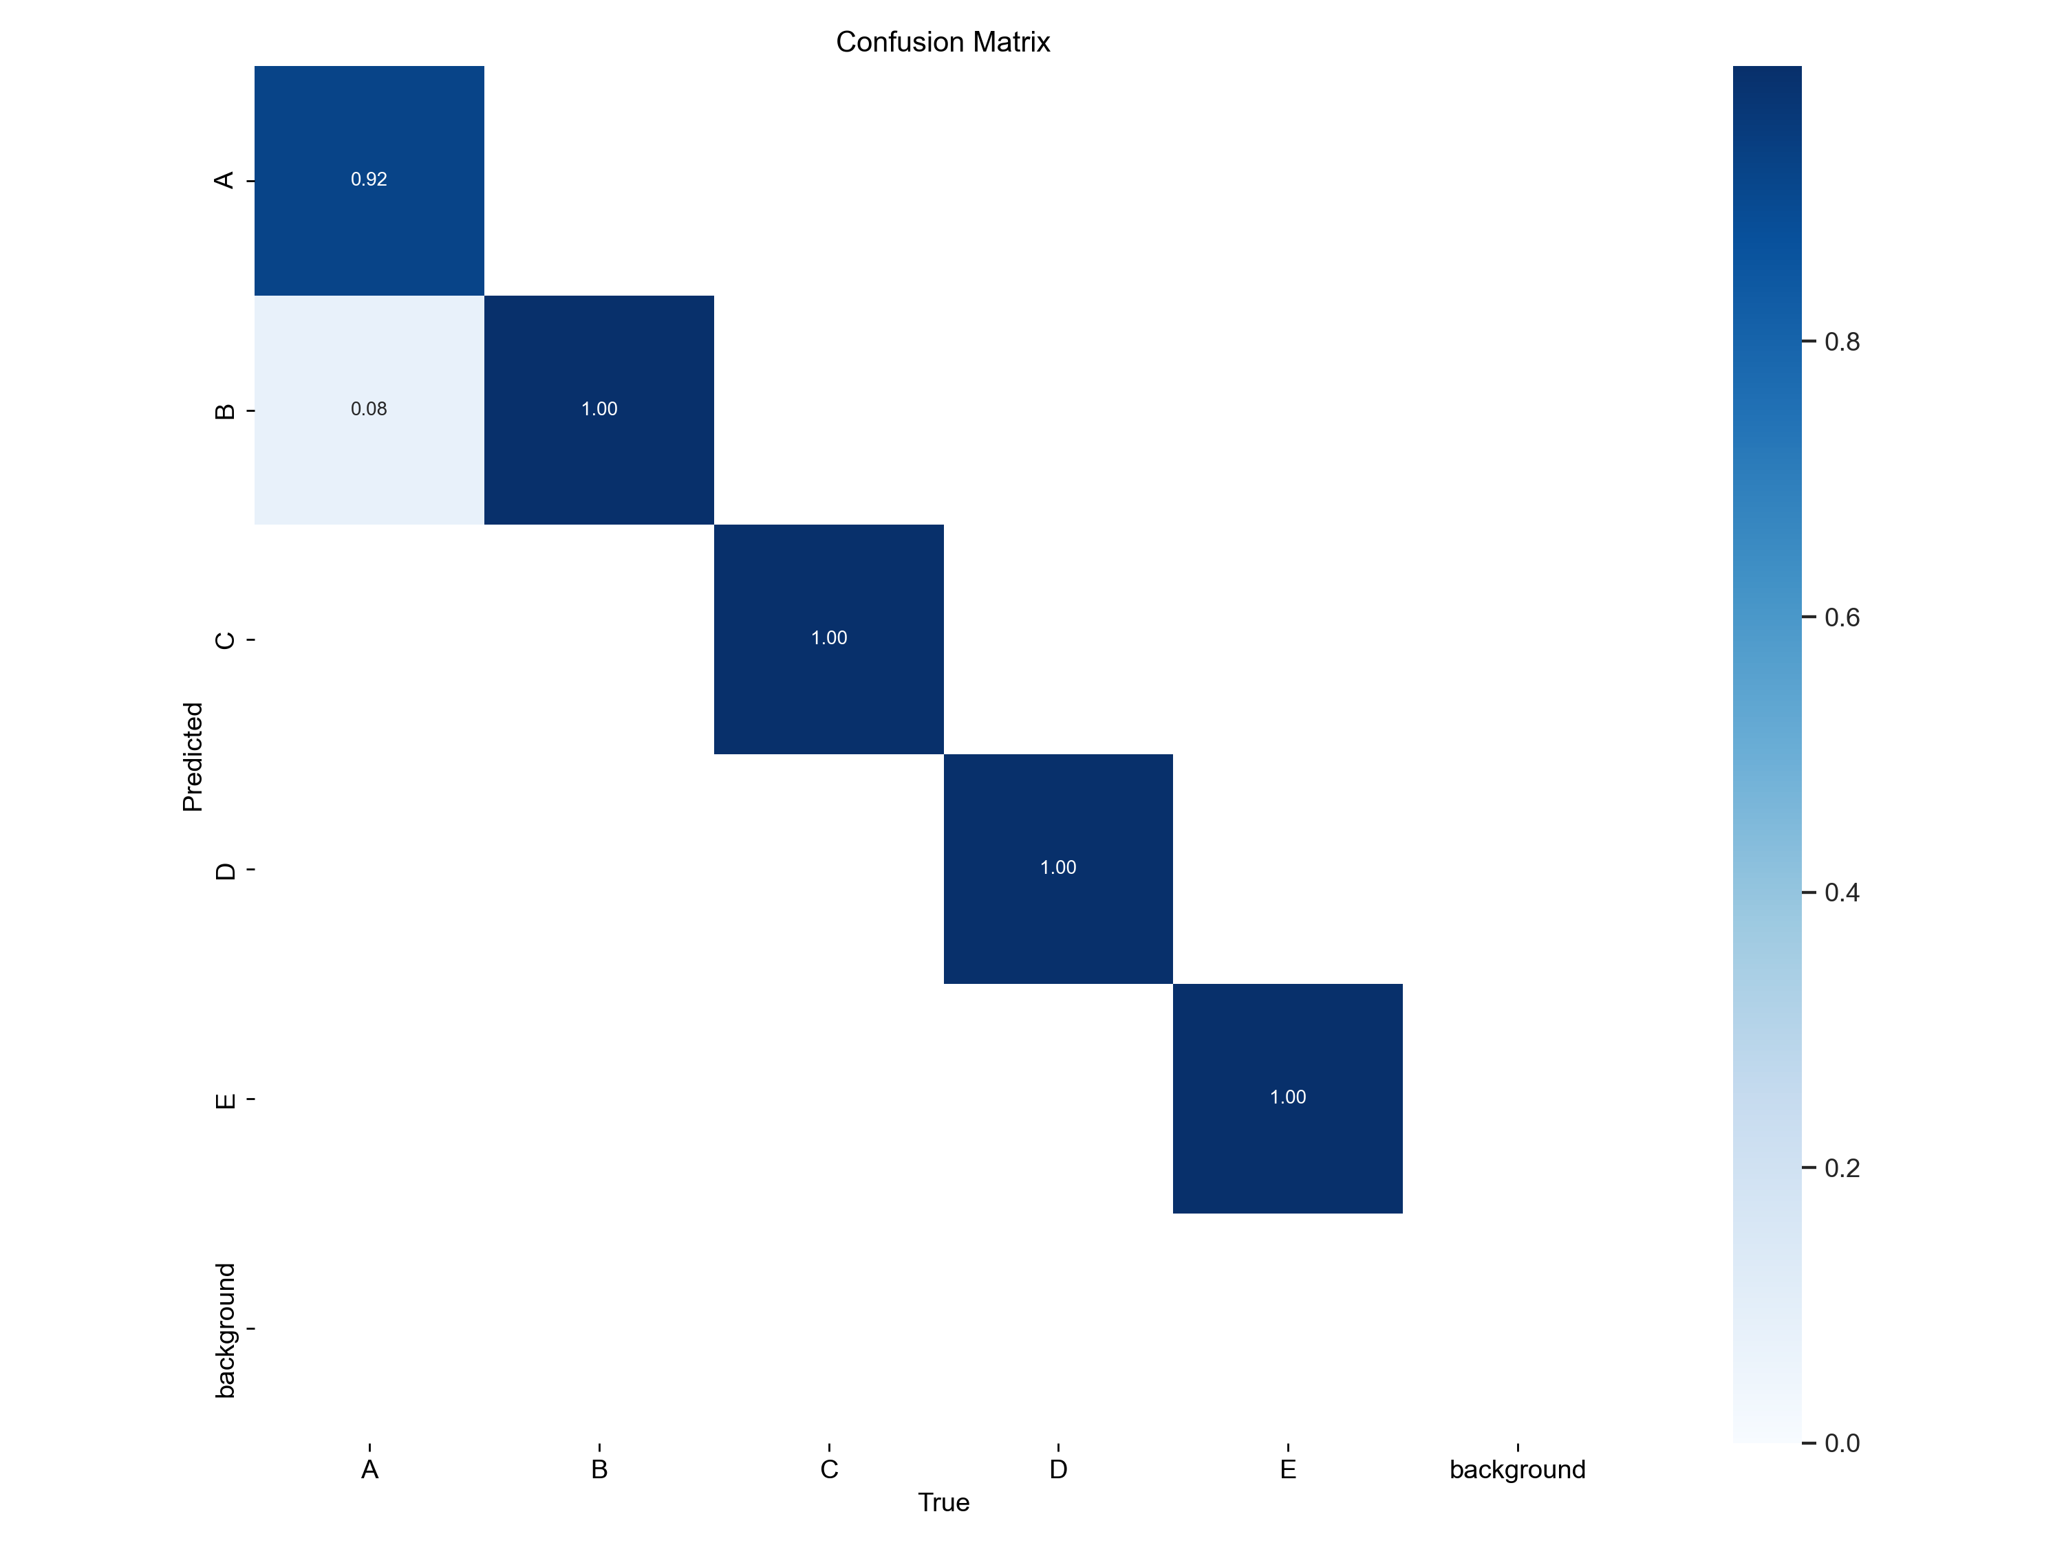
2. YOLO object detection model
2.3 Test Metrics

Slide 13
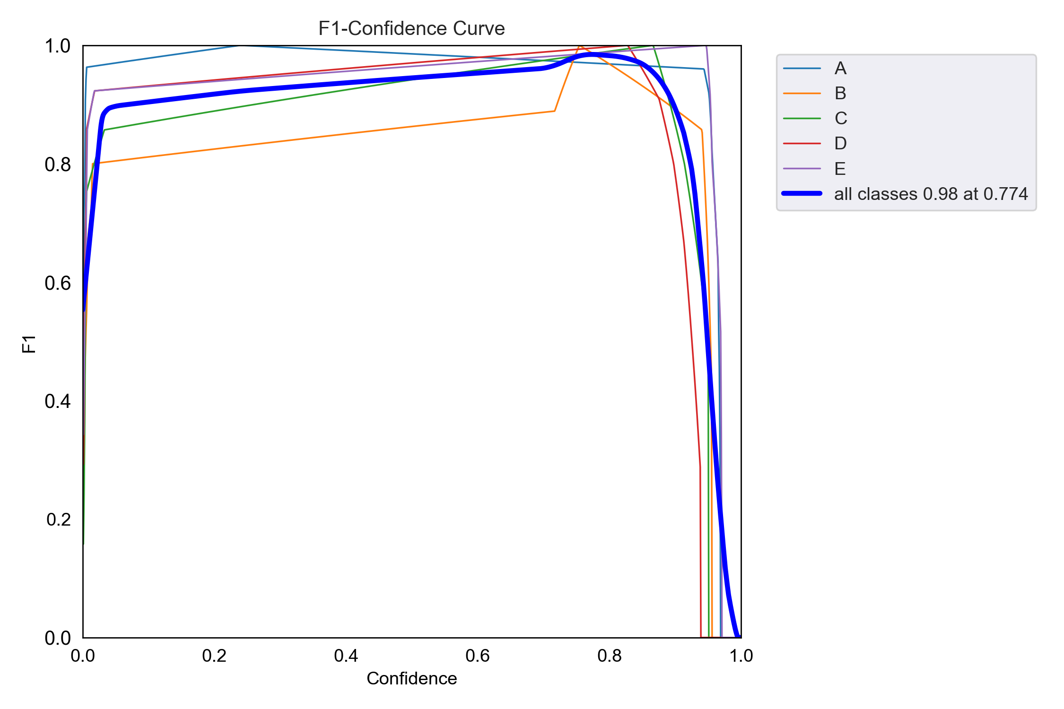
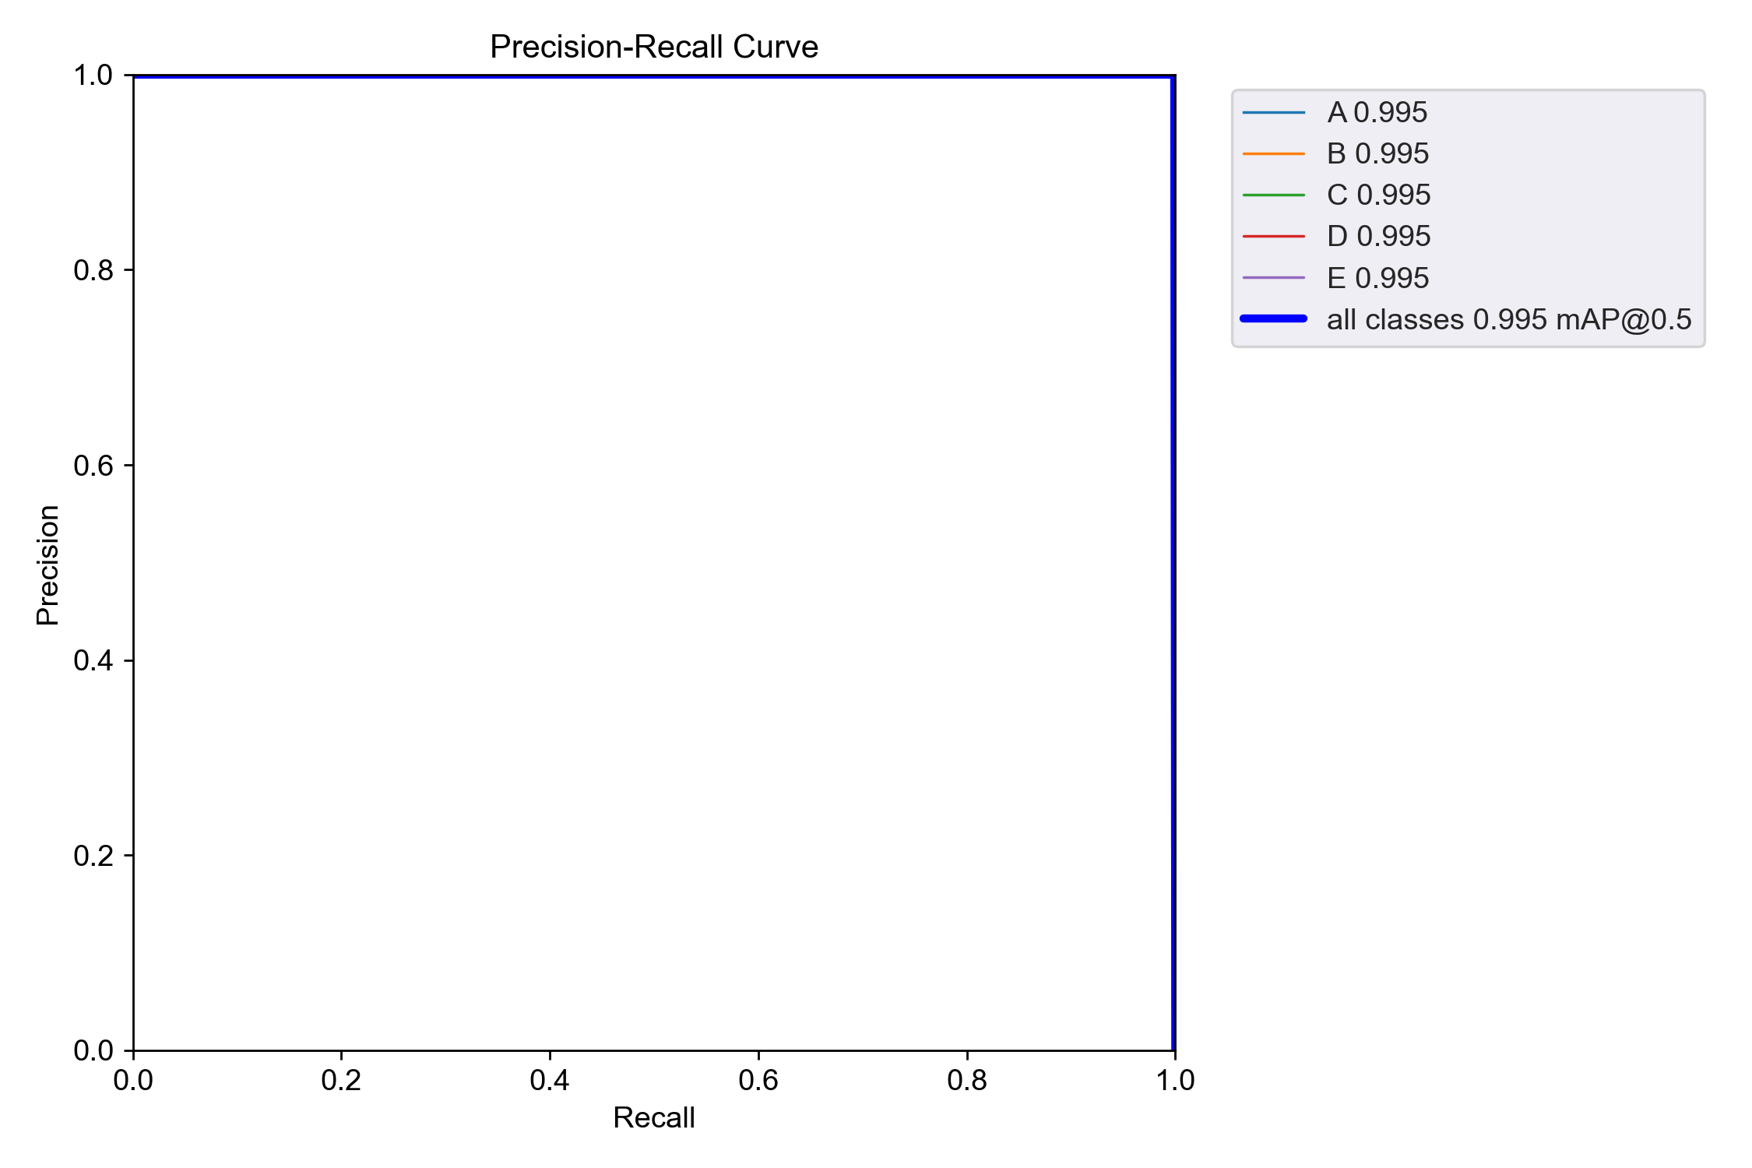
2. YOLO object detection model
2.3 Test Metrics

Slide 14
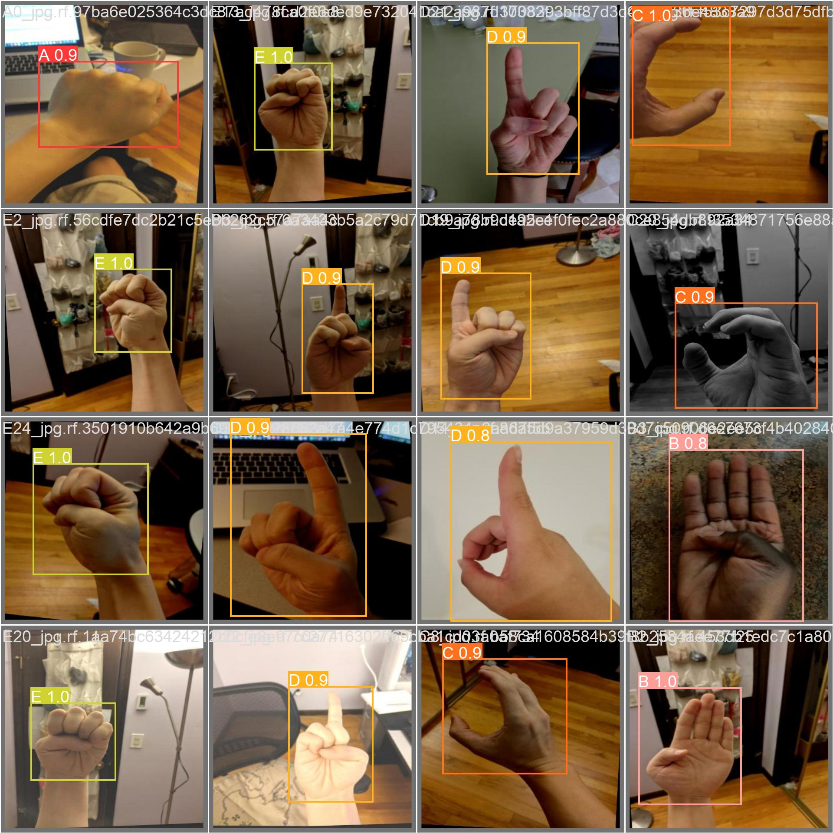
2. YOLO object detection model
2.3 Test Metrics
Predictions in a test batch

Slide 15
3. CNN classification model
3.1. Hyperparameters and definitions
Batch size: 5
Learning rate: 0.001
Weight decay: 0.0001
Number of epochs: 20
Optimizer: Adam
Criterion: Cross Entropy Loss
Input: 120x120 image
Output: Type of sign
The labels were replaced by the integers:
0:0, 1:1, 2:2, 3:3, 4:4, 5:5, 6:6, 7:7, 8:8, 9:9, a:10, b:11, c:12, d:13, e:14

Slide 16
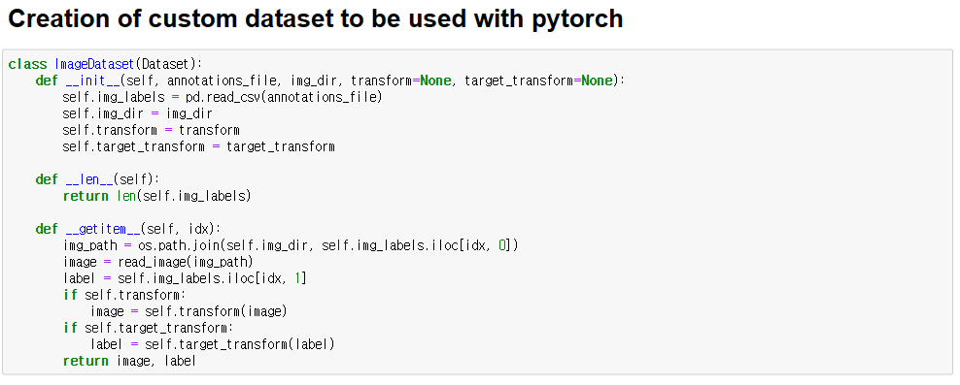
3. CNN classification model
3.2 Code Analysis

Slide 17
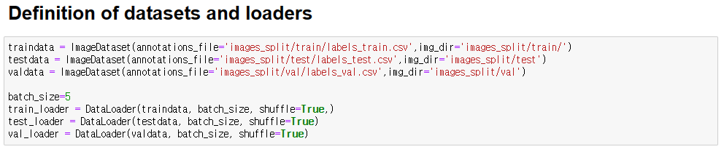
3. CNN classification model
3.2 Code Analysis

Slide 18
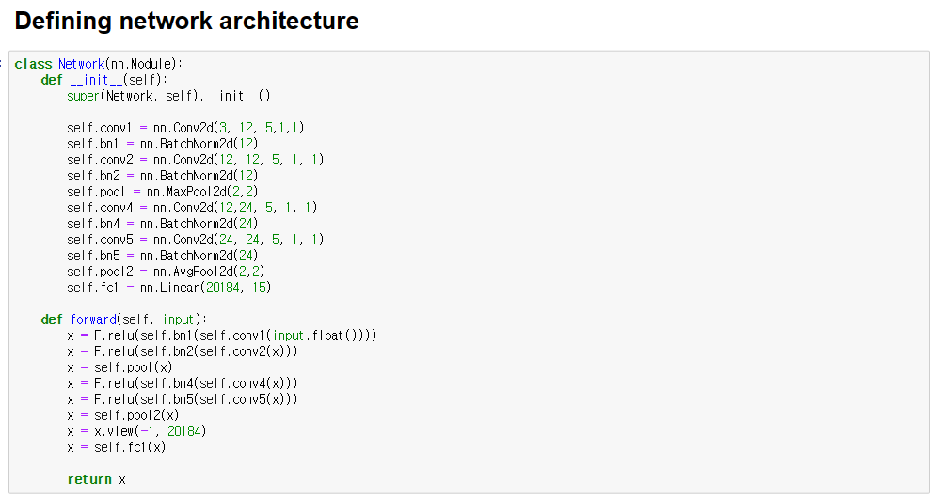
3. CNN classification model
3.2 Code Analysis

Slide 19
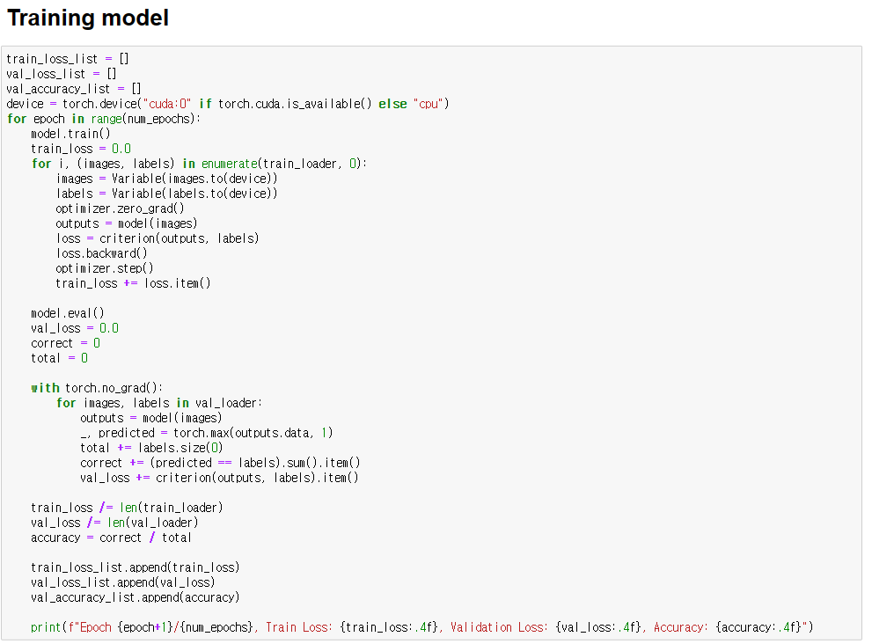
3. CNN classification model
3.2 Code Analysis

Slide 20
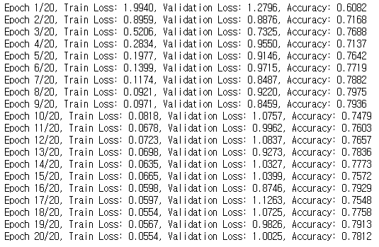
3. CNN classification model
3.2 Code Analysis

Slide 21
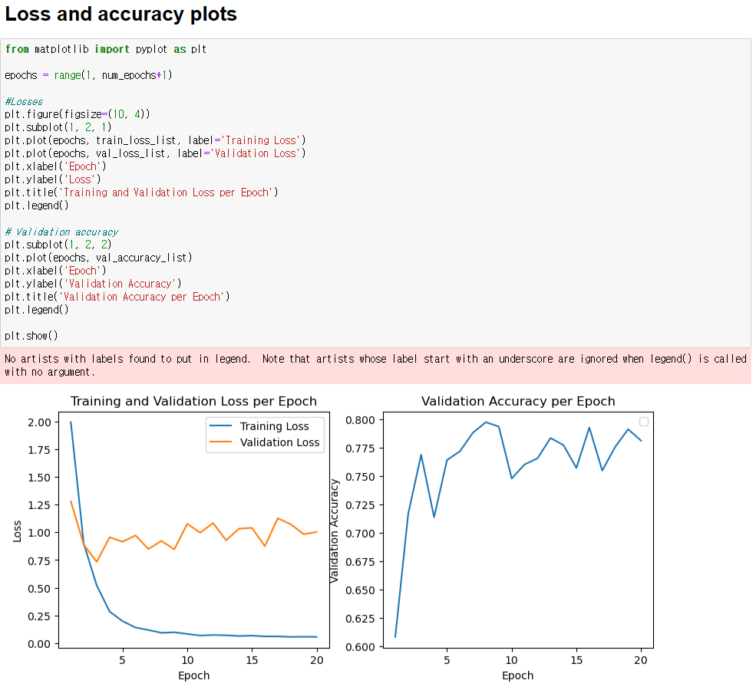
3. CNN classification model
3.2 Code Analysis

Slide 22
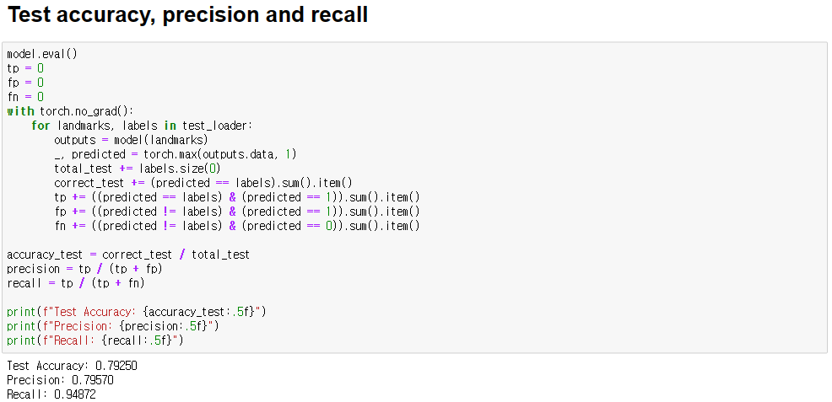
3. CNN classification model
3.2 Code Analysis

Slide 23
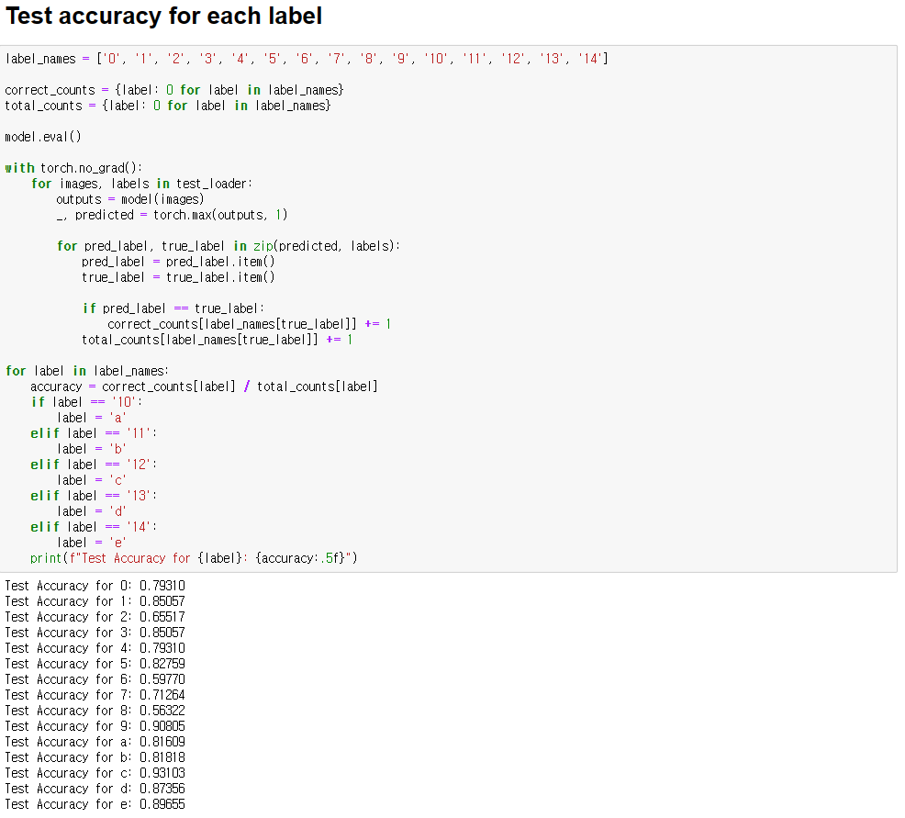
3. CNN classification model
3.2 Code Analysis

Slide 24
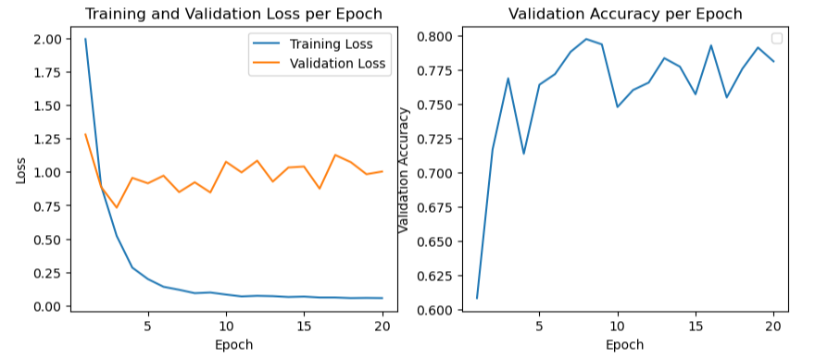
3. CNN classification model
3.3 Metrics

Slide 25
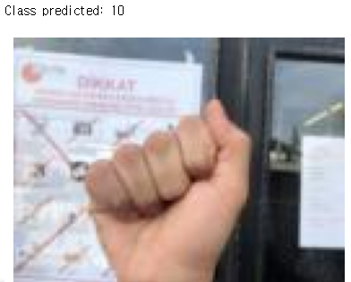
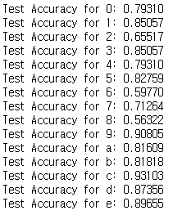
3. CNN classification model
3.3 Metrics
Test accuracy: 0.79250
Test precision: 0.79570
Test recall: 0.94872
“a” (labeled as 10) correctly predicted as 10.

Slide 26
4. Mediapipe’s extracted landmarks classification model
4.1 Hyperparameters and definitions
Batch size: 5
Learning rate: 0.001
Number of epochs: 150
Optimizer: Adam
Criterion: Cross Entropy Loss
Input: List of 60 floats
Output: Type of sign
The labels were replaced by the integers:
0:0, 1:1, 2:2, 3:3, 4:4, 5:5, 6:6, 7:7, 8:8, 9:9, a:10, b:11, c:12, d:13, e:14

Slide 27
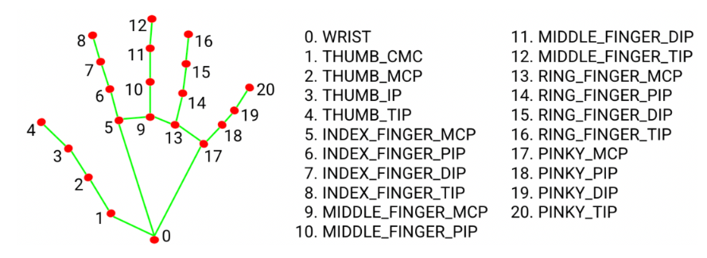
4. Mediapipe’s extracted landmarks classification model
4.1 Hyperparameters and definitions
From each image 20 landmarks were extracted, and each landmark had x, y and z coordinates. Flattening it, we get an array of 60 floats that were used as input.
All coordinates were subtracted from the coordinate “0” to make the positions of the landmarks relative to the hand.
Landmarks extracted using Mediapipe.

Slide 28
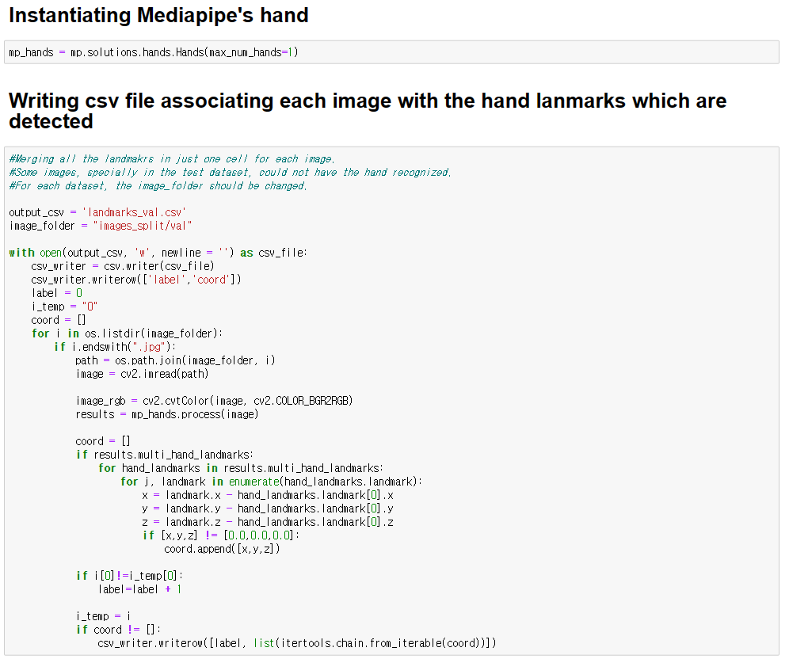
4. Mediapipe’s extracted landmarks classification model
4.2 Code Analysis

Slide 29
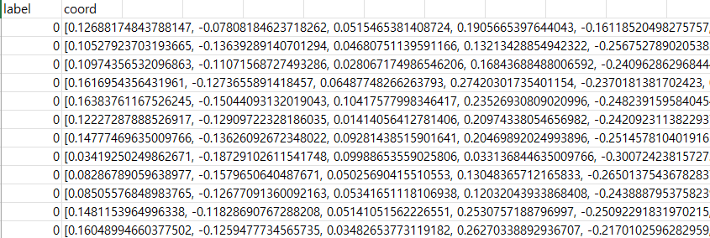
4. Mediapipe’s extracted landmarks classification model
4.2 Code Analysis
Example of a csv file. Each coordinate has 60 values.

Slide 30
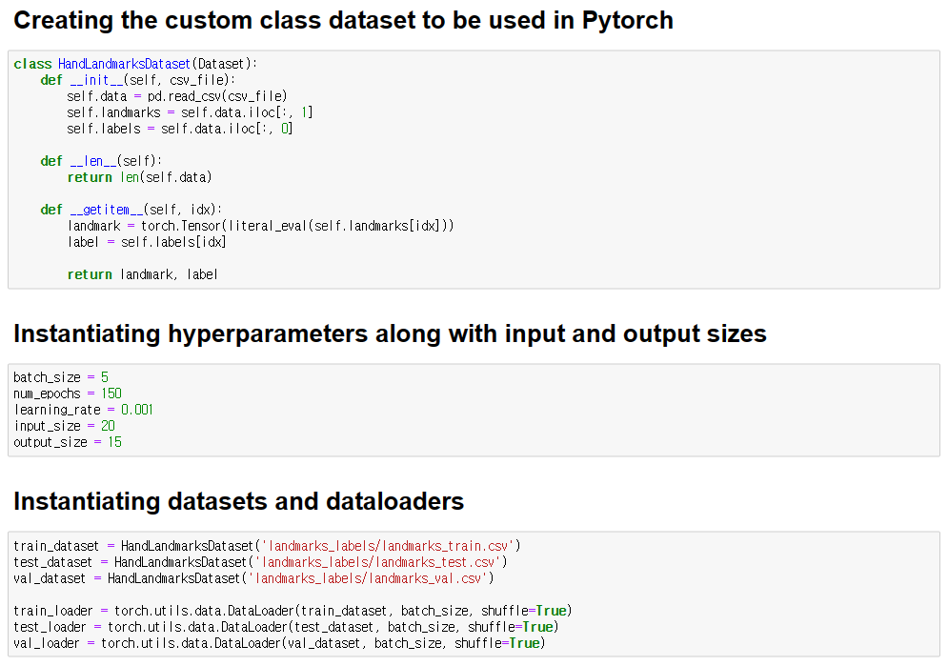
4. Mediapipe’s extracted landmarks classification model
4.2 Code Analysis

Slide 31
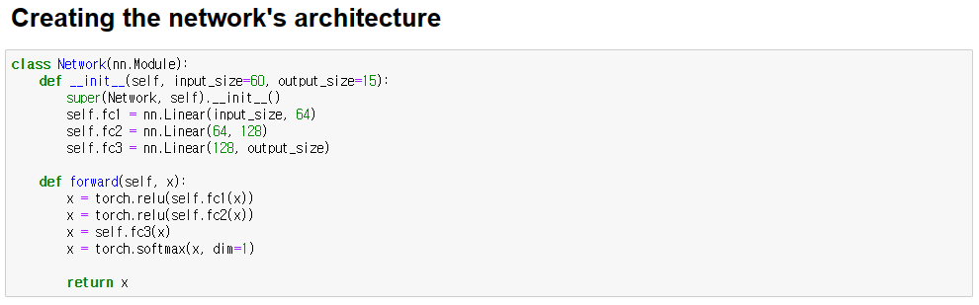
4. Mediapipe’s extracted landmarks classification model
4.2 Code Analysis

Slide 32
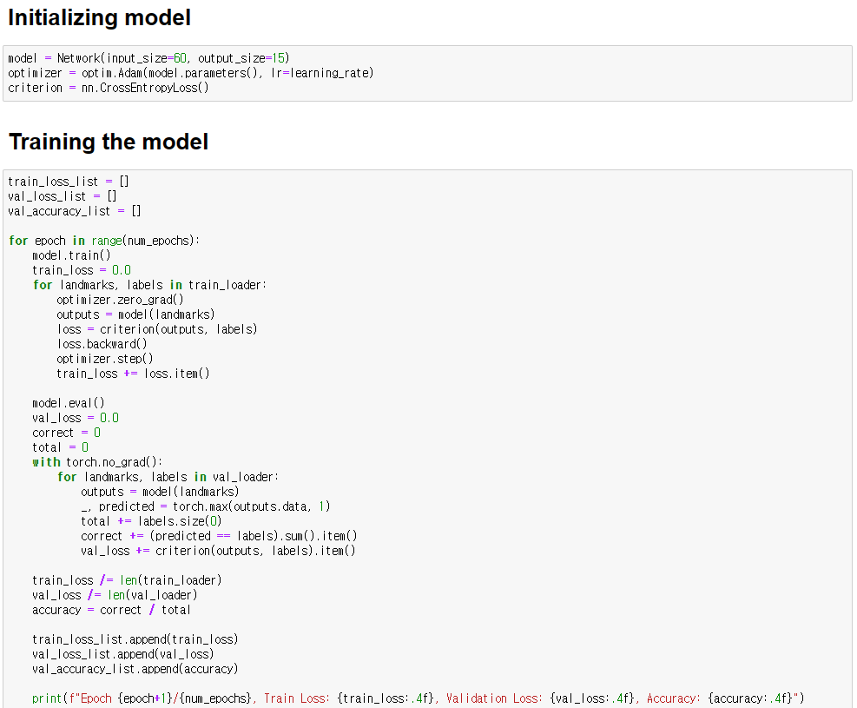
4. Mediapipe’s extracted landmarks classification model
4.2 Code Analysis

Slide 33
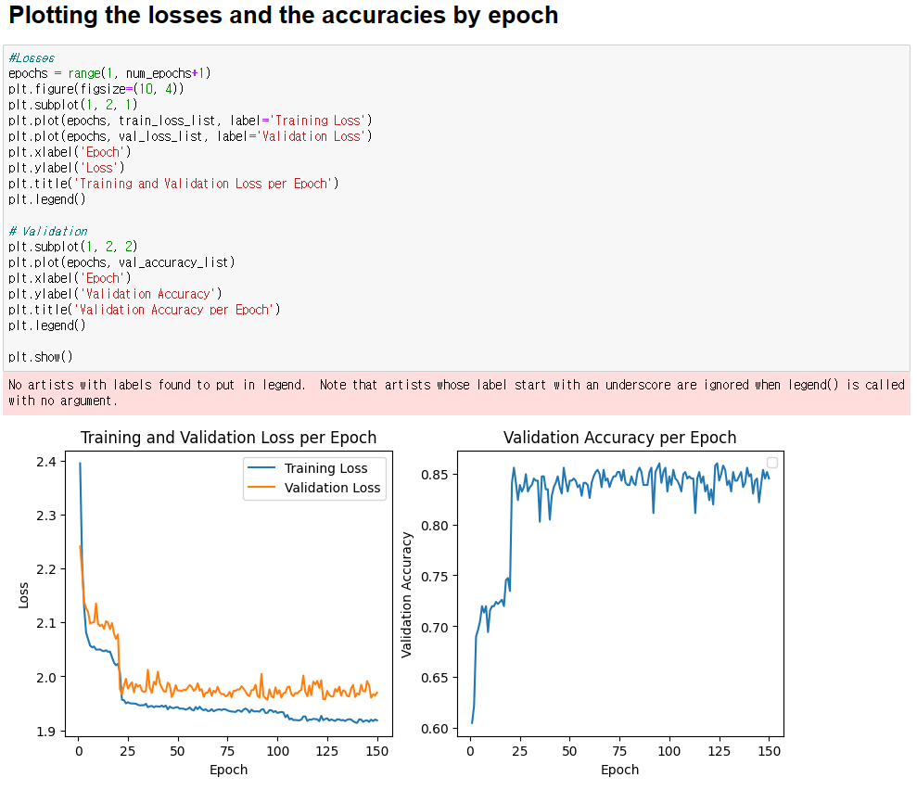
4. Mediapipe’s extracted landmarks classification model
4.2 Code Analysis

Slide 34
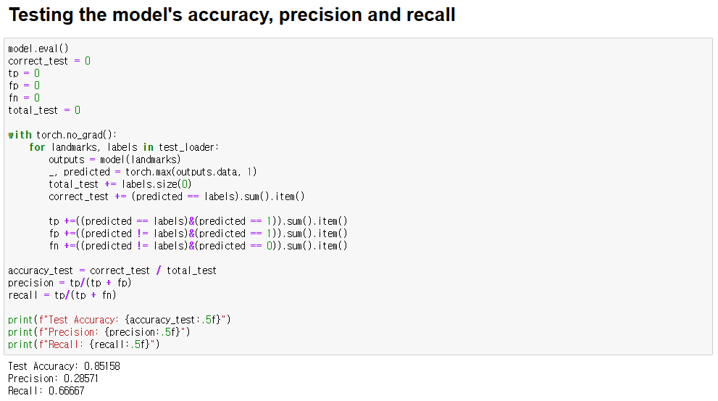
4. Mediapipe’s extracted landmarks classification model
4.2 Code Analysis

Slide 35
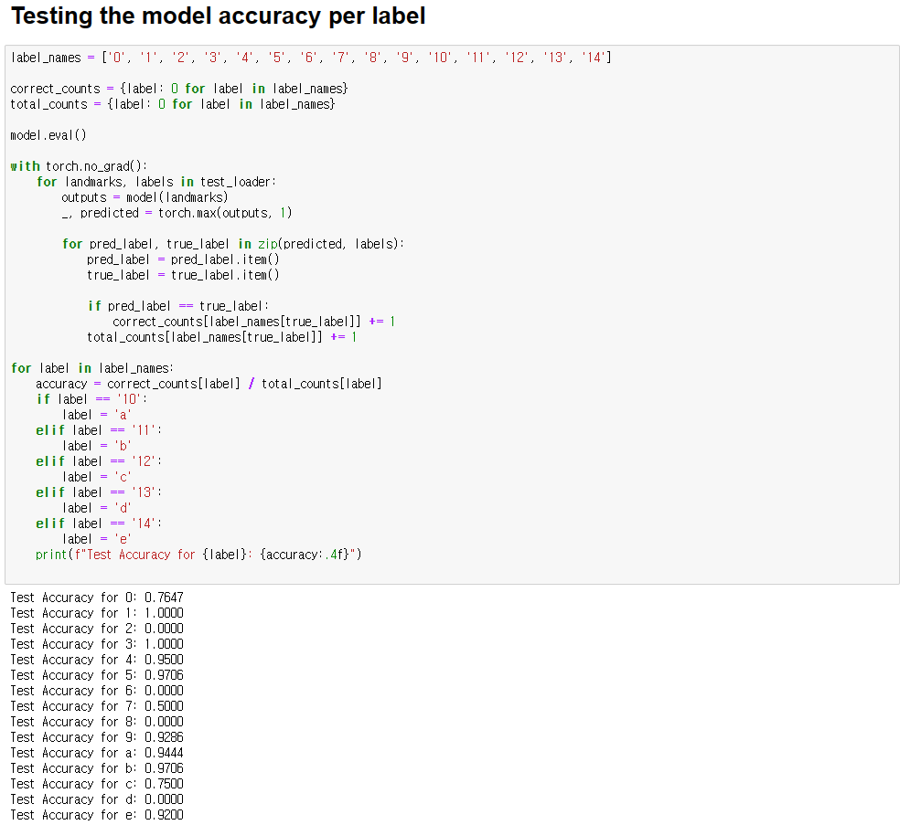
4. Mediapipe’s extracted landmarks classification model
4.2 Code Analysis

Slide 36
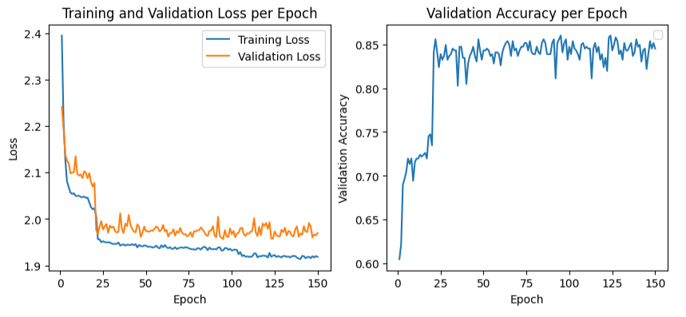
4. Mediapipe’s extracted landmarks classification model
4.3 Metrics

Slide 37
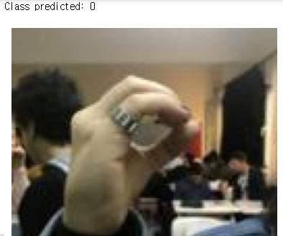
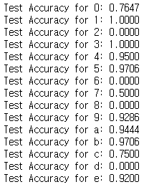
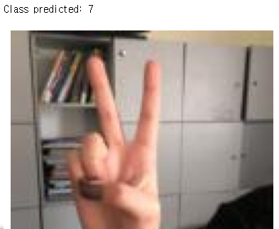
4. Mediapipe’s extracted landmarks classification model
4.3 Metrics
Test accuracy: 0.85158
Test precision: 0.28571
Test recall: 0.66667
0 rightly classified as 0
2 wrongly classified as 7

Slide 38
5. Comparison and analysis of results
5.1 Graphics from training
CNN classifier
YOLOv5
Mediapipe’s extracted landmarks classifier

Slide 39
5. Comparison and analysis of results
5.2 Accuracy, precision and recall
Accuracy, precision and recall | Test accuracy, precision and recall
 | Accuracy | Precision | Recall | mAP50 | mAP50-95
CNN | 0.79250 | 0.79570 | 0.94872 | - | -
Mediapipe | 0.85158 | 0.28571 | 0.66667 | - | -
YOLOv5 | - | 0.989 | 0.979 | 0.995 | 0.892

Slide 40






5. Comparison and analysis of results
5.3 Accuracies from each label coming from the CNN and Mediapipe’s classifiers
The labels 2, 6 and 8 were the hardest to classify in both models.
CNN classifier
Mediapipe classifier

Slide 41
5. Comparison and analysis of results
5.4 Final observations
YOLOv5 showed better results, however, it’s more costly to train and needs a dataset with the labeled bounding boxes, as in its core it’s an object detector.
The classifier using Mediapipe is more lightweight to train than the CNN classifier, as just floats were used as input and there is no need for Convolutional Neural Networks.
The test accuracy for the Mediapipe classifier was superior to the CNN classifier, however, its precision and recall were much lower.

Slide 42
6. Conclusions
Through this work it was possible to:
Learn how to prepare different datasets.
Experience building DNN projects from scratch using Pytorch.
Experience training and evaluating an object detector (YOLOv5).
Experience Mediapipe and learn the process necessary to use it for a classification procedure.
Analyze the results and see how the methods have their own advantages and disadvantages. This brings me a more critical results analysis for the future.
A sign language detector help speech-impaired people communicating with people that don’t understand the sign language.

