Slide 1
Website
Journaling your work using html

Slide 2
Journaling your work
Sharing of knowledge
Web site / blogs
Evidence of work
Allows for reflection / recovery of data
Web based advantages
Immediately accessible
Available anywhere / everywhere

Slide 3
Webpages
Can be hosted locally or remotely
Written in HTML (HyperText Markup Language) – normal text!
Almost like text, but … with tags e.g. <b>Bold Text</b>
The prettier the webpage the more difficult to edit.
Alternatives - MarkDown

Slide 4
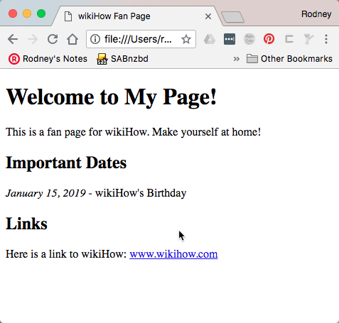
Webpage structure
<!DOCTYPE html>
<html>
<head>
<title>wikiHow Fan Page</title>
</head>
<body>
<h1>Welcome to My Page!</h1>
<p>This is a fan page for wikiHow. Make yourself at home!</p>
<h2>Important Dates</h2>
<p><i>January 15, 2019</i> - wikiHow's Birthday</p>
<h2>Links</h2>
<p>Here is a link to wikiHow: <a href="www.wikihow.com">www.wikihow.com</a></p>
</body>
</html>

Slide 5
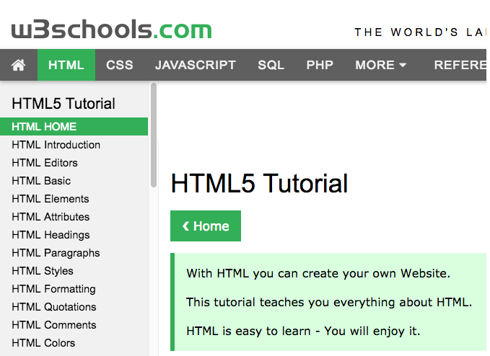
Enough to get you going…
head, title, body
Headers – h1, h2, h3, h4
Text – p, br, b, I, u
Lists – unordered (ul) & ordered (ol), items (li)
References – anchors (a href), images (img)
Tables – table, row (tr), column (td)
Divisions (div)
https://www.w3schools.com/html/default.asp

Slide 6
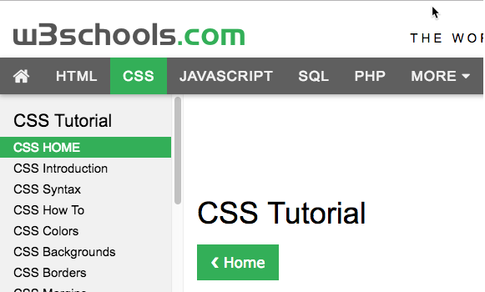
CSS – Cascading style sheets
Styles your webpage, makes your page look prettier.
Consistent formatting of your text.
Make it simple.
https://www.w3schools.com/css/default.asp

Slide 7
Your website (journal)
Create a folder e.g. easite, (called webroot folder) Save all .html, .css files in this folder
Need a root page – index.html
Create folders for images (img), documents (doc), drawings (dwg) Save the appropriate files in these folders.
easite
img
doc
dwg
index.html
team.html
blog.html

Slide 8
EA Journal
Minimum pages
index.html - your home page, give your team a name, show your projects here with descriptions.
team.html - pictures and description of your team
blog.html – your hour-by-hour, day-by-day journal, use photos (1024 x 576)
resources.html – references where you got your ideas, information, references.
review.html – group review of the project, and your personal reflections

Slide 9
Help!!!
Watch this first: YouTube: Learn HTML in 12 Minutes – Jake Wright
Select one (this will be your website):
W3 CSS Tutorial – Starting with HTML + CSS
Learn CSS in 12 minutes – Jake Wright

Slide 10
Create your website
Go through the material we have covered.
Go through the YouTube video(s)
Create your website for your journal. For now, most of the pages will be empty.
Fill in the root page, giving your team a name Create the team.html page with photos of your team and short descriptions. Start your blog, by showing how you created your website and the process. Enter the references you have used in the resources.html.

Slide 11
Show off your work!
Host your site locally on your PC
TinyWebServer (windows only)
Install Python 3, and follow instructions to host your site
Tips:
Be careful of your typing – lower and upper case treated differently
Use Google Chrome (Press F12 to view the debugging page)

