Slide 1


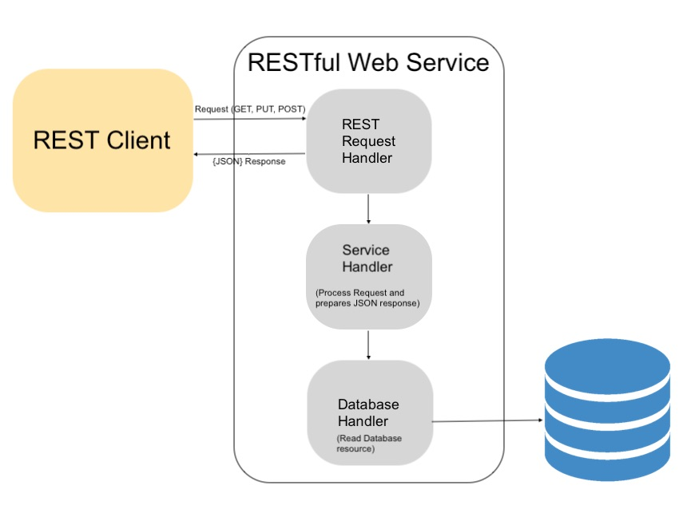
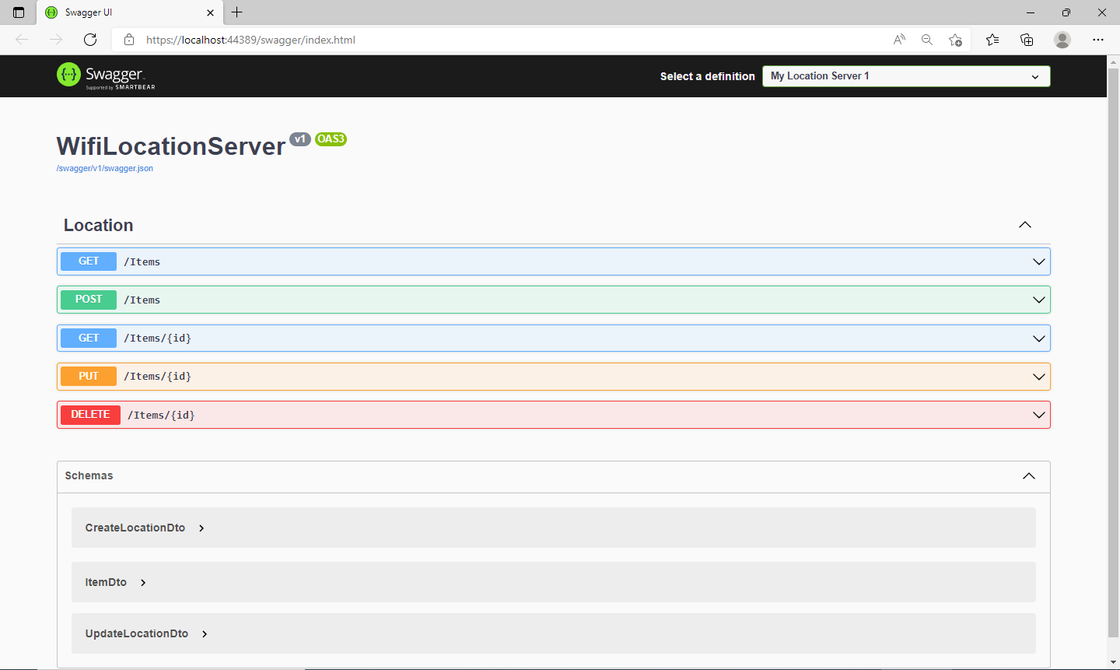
Using a Remote Server to Provide Location Data Inside of a Building
Marshall Rodegast and Dr. Randy Ribler PhD
Computer Science, University of Lynchburg, Lynchburg, VA
Introduction
Development
Conclusion
Development of the remote server began with writing C# code in Microsoft Visual Studio 2019. To start building the server the first thing that needed to be done was create a RESTful API project and connect the project to a resource called Swagger. Swagger is open-source tool used for API development. Connecting to this resource would allow for a smoother transition into using the application in web-browser.
Connect server to Swagger so that the application would be able to seamlessly be accessed in any web-browser.
Create entities that would be objects within a certain item (a data set based on objects) on the server.
GUID : Globally Unique Identifier
MAC : MAC address associated with signal strengths
MaxSignalStrenght: The max signal strength that an access point is giving off
MinSignalStrength: The min signal strength that an access point is giving off
Add a controller to the server that will have functions that allow users to manipulate data
GetItem (HTTP Get): Access the MongoDB to get an item to see a certain signal strength with a specific mac address
GetItems (HTTP Get): Access the MongoDB to get all items in the database to see all signal strengths and mac addresses. This is used to see what data the server is holding.
CreateItem(HTTP Post): Add an item to the server, an item can only be added if it has all objects needed (MAC, MaxSignalStrength, etc.).
UpdateItem (HTTP Put): Update an item in the database. If a signal strength average changes than it needs to be updated on the server for more accurate location information.
DeleteItem (HTTP Delete): Delete a no longer necessary item from the database. A delete may be needed if an item is no longer needed.
Implement all functions using a DTO for further ease of passing data from the server to the database. DTOs are necessary for all data items to properly be transferred.
Wi-fi, a wireless internet technology that allows for the creation of a local area network. Wi-fi is something that we use day to day, in our homes and in our offices. Wi-fi provides us with limitless internet connectivity so that we may be able to increase our productivity and work from other places. This amazing technology was not always as great as it is today, it was vastly bound by the range of the devices but that soon changed. With the introduction of wi-fi access points wi-fi has been able to reduce the bounds of its range and increased its limitlessness. When it comes to access points, they are not only an advancement in internet accessibility but are also extremely important to the development of future technology. Wi-fi access points provide information that can be used to develop location services. These access points provide two major pieces of data, signal strength and the mac address. With these pieces of information an access point can be used to determine distance based on the strength of its signal and its mac address can be used as a way of identifying a specific access point. Using this information, the development of a remote RESTful API server can be used to accurately take the data of specific access points’ signal strengths and their mac address to actively process the data and accurate predict a location based on a growing list of data that is asynchronously being recorded. This data can be intersected and condensed into an average of maximum and minimum signal strength and return a value that is the location you are either at or looking for.
In conclusion, the remote server can finally be used to compare an active wi-fi location application running on an android device to the translated data of the server. This means that the running application, that determines location by using wi-fi access points, will display the location that it thinks it may be at and compare that to the location that has been recognized in the server. This will allow with a lot of certainty exactly where someone is in a building or on a larger scale where they are on the campus of say The University of Lynchburg.
Future Steps
The future of this project is to take the data that has been added to the remote server and implement a couple of different data analysis tools such as a Bayesian Model or a Neural Network Model. These tools can help the user determine how accurate the data is in order to get as close to the location as possible. These tools are generally used to process data and find relationships within the data in order to predict certain outcomes. If the data is properly processed in models of this nature than it is possible to properly predict locations using wi-fi access points signal-strengths and their mac addresses. This will eliminate any uncertainty and provide value to the wi-fi location service.
References
Purpose
The purpose of this project was to increase my understanding of event-driven programming, application development, and display my understanding of a profusion of computer science fields. For purpose of the development itself was to implement an aspect of a wi-fi location service that can remotely translate data and allow for reasonable certainty on where your are located.

