Slide 1
Choose tile
Open in
JOSM
Valid?
No
Almost
Yes
Easy fix?
No
Yes
Fix
Invalidate
Validate

Slide 2
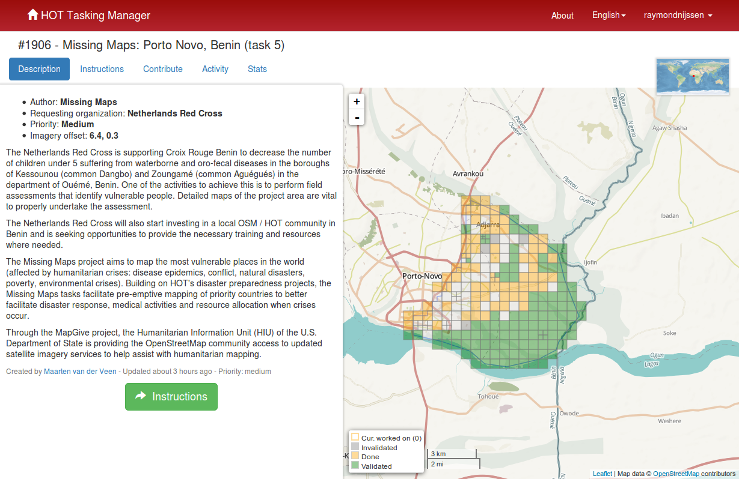
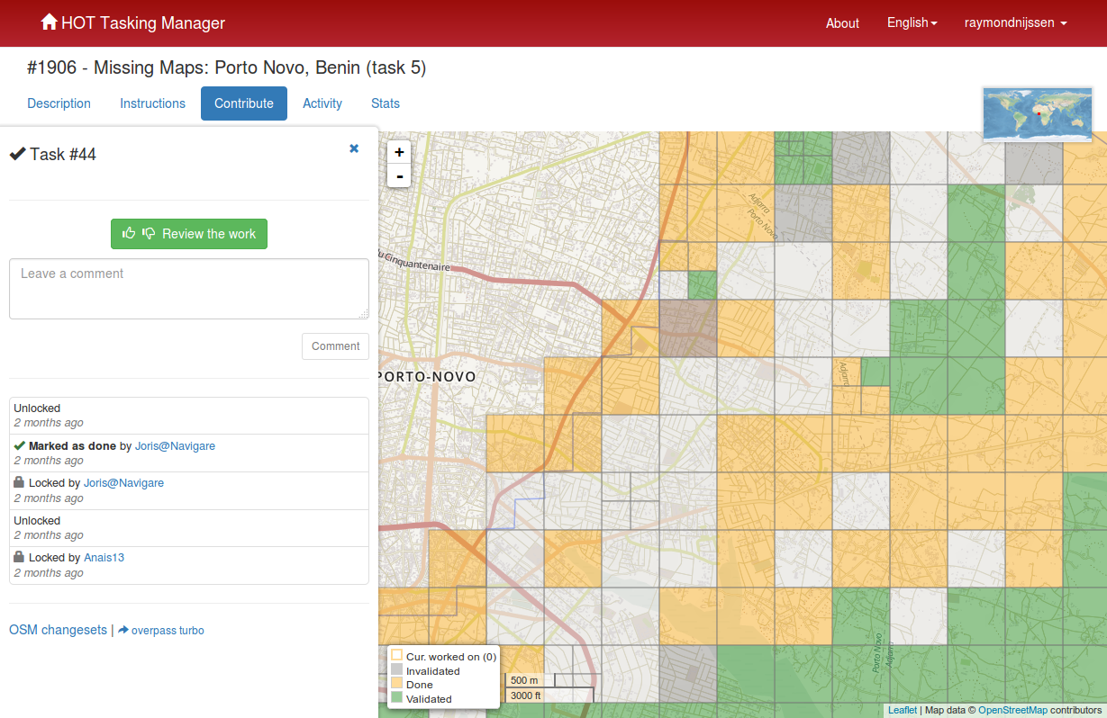

Choose tile and open in JOSM
Download / install JOSM > preferences > remote
Open
JOSM
Open
tasks.hotsosm.org
Open specific task (number, name),
Read instructions,
Check offset
Choose
yellow tile
Open specific task (number, name),
Read instructions
Start validating
JOSM
to JOSM
Check offset
Check offset
Change offset

Slide 3
Install JOSM
JOSM
Installation
https://josm.openstreetmap.de/wiki/Download
Enabling Remote Control
https://josm.openstreetmap.de/wiki/Help/Preferences/RemoteControl
and
https://help.openstreetmap.org/questions/2208/how-do-i-enable-the-remote-control-in-josm
- In the JOSM menu select Edit/Preferences.../ or press F12
- Click on the remote control icon
- Select "Enable Remote Control" and click OK.
- Restart JOSM
- Choose tile
- Edit with josm
Check
- Make sure JOSM is running
- Go to http://tasks.hotosm.org
- Choose project (Benin: 1151)
- Choose Review the work
- Choose "Open in JOSM"
Offset plugin
Taskmanager maakt offset voor default layer aan die iedereen kan
gebruiken in JOSM.
Eventueel bijbouwen in ID editor

Slide 4
Valid?
No
Almost
Yes
Check tile
First quick impression:
>10 min fixing time: stop validating
Else: start check and fix missing and wrong objects.
Check tile
Houses:
Completeness
Accuracy
rectangle
Roads:
Completeness
Accuracy
Joins
tag
Select tool
Select building check right tags
Sect roads, check tags
Etc.
Run valdiating tool
Resolve conflicts
Resolve warnings, except road names
Run validating tool again en resolve again
Validating tool

Slide 5
Validate
save
JOSM: Upload
comment
HOTOSM comment
content of map (houses, roads)
completeness
Clouds %
comment
HOTOSM:
validate
HOTOSM:
New tile.
Choos yellow tile

Slide 6
