Slide 1
Sending messages with CashPO

Slide 2
Table of contents
Sending messages to individuals
Sending mass messages
Creating new messages for mass sending

Slide 3
Sending messages to individuals

Slide 4
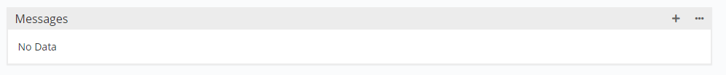
Sending messages to individuals (1/2)
Find the person (beneficiary or registration) in the system
If somebody is already converted into a beneficiary, use that one and stop using the registration. This will not work anymore.
Scroll down to messages and click the plus button (indicated red)

Slide 5
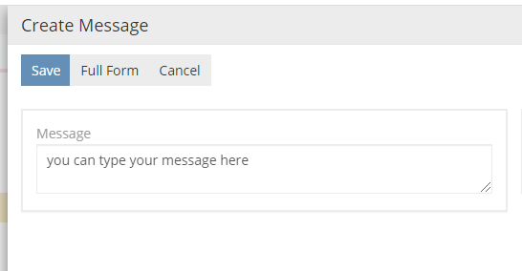
Sending messages to individuals (2/2)
Please type your message in the box that appears
If you click save, the message will automatically be send to the person

Slide 6
Creating mass messages

Slide 7


Creating mass messages (1/1)
Go to Message Types on the left
Click on Create Message Type on the top right
Give the message a name that reflects what the message will say
Fill in the messagebody in both Greek and English. Additionally: you can use placeholders ${firstname} and ${lastname}. Then first and lastname of the beneficiary will be put in.

Slide 8
Sending mass messages

Slide 9
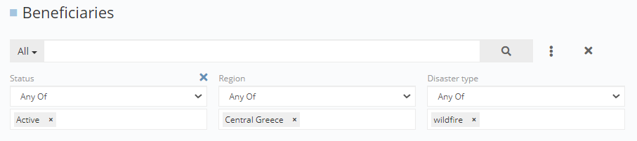
Sending mass messages (1/3)
If you have not done so, add the message that you want to send to the message types
Search and find all the beneficiaries that you want to send the message to by using filters in the beneficiaries overview (click apply)

Slide 10

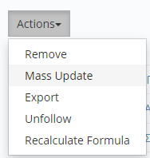
Sending mass messages (2/3)
Select all the beneficiaries from the resulting filtered list, by clicking on the triangle next to the checkbox, and then “Select All Results”
Click on Actions and click on mass update

Slide 11
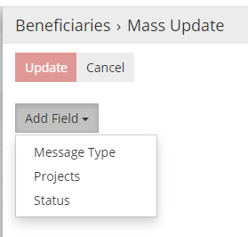

Sending mass messages (3/3)
Click on “Add Field” and select “Message Type”
Select the messagetype from the list by clicking the upward arrow
Then click update. Messages will be sent automatically

