Slide 1
IT Systems Monthly Report

Slide 2
IT USER REQUEST SYSTEM

Slide 3
June 2023 Overview
Node server setup at 172.17.225.55
Request Type Maintenance
Requirement Type Maintenance
QA Testing
Defect Tag Collaboration
Minor System Supports

Slide 4
Server Setup
NodeJS
>> a JavaScript runtime that allows developers to run JavaScript code outside of a web browser, enabling server-side and network applications.
PM2
>> a production process manager for Node.js applications with a built-in load balancer.

Slide 5
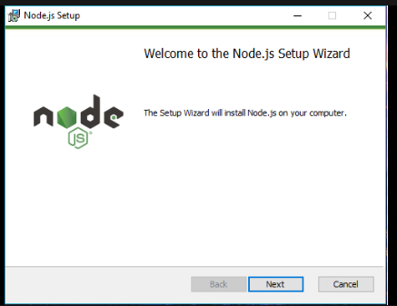
Server Setup: NodeJS

Slide 6
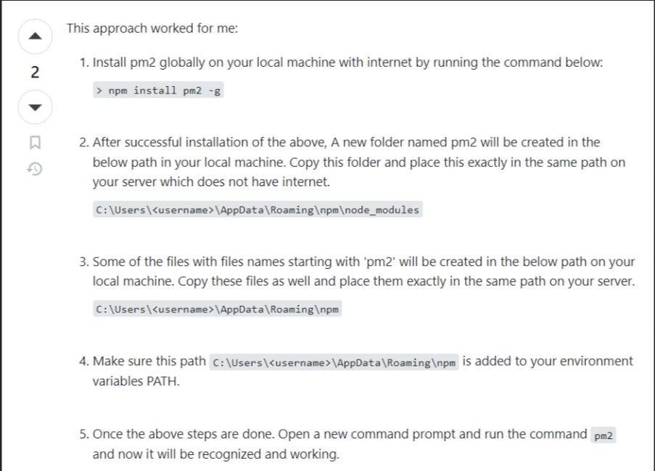
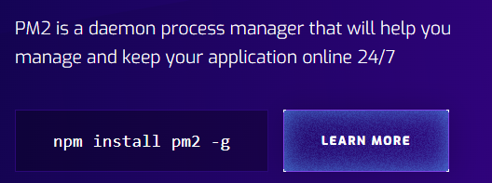
Server Setup: PM2
Usual Installation:
Workaround installation:
Won’t work if no network connection

Slide 7
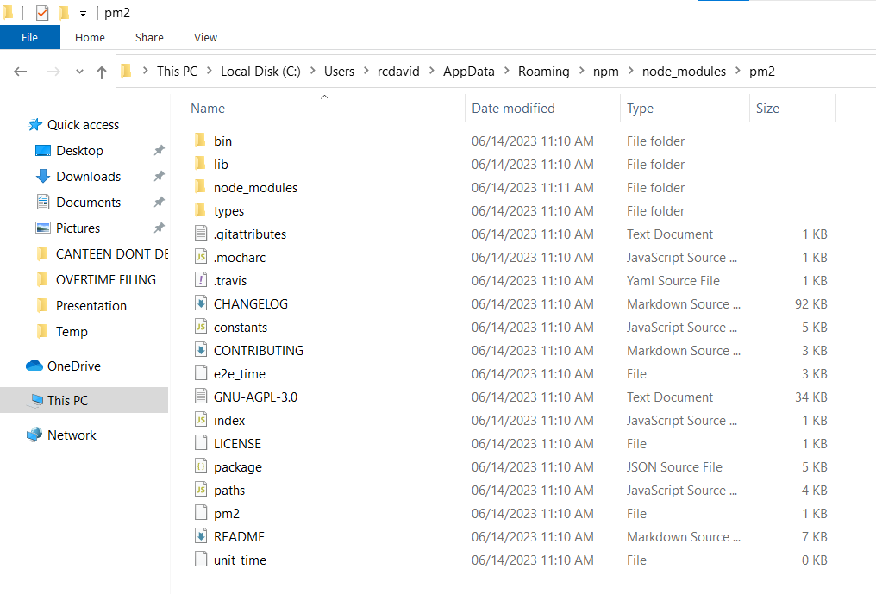
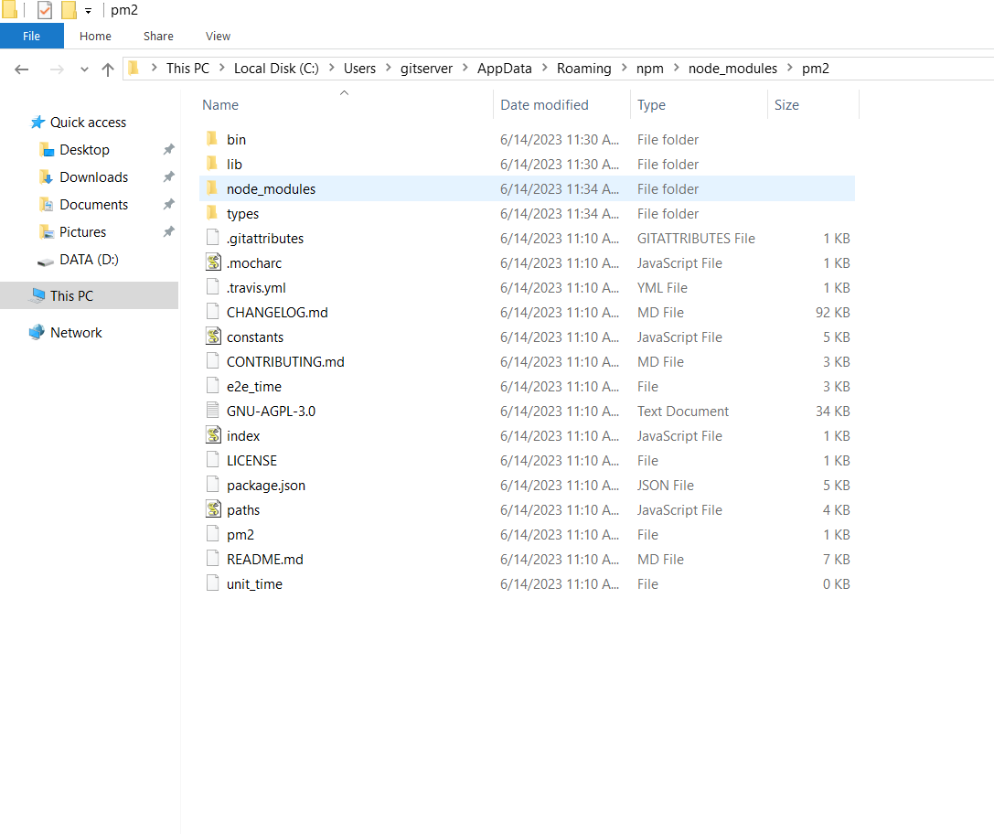
Server Setup: PM2
Copy

Slide 8
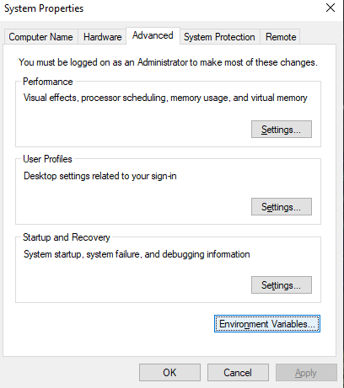
Server Setup : PM2
Add to Path for pm2 CLI to work
in shell

Slide 9
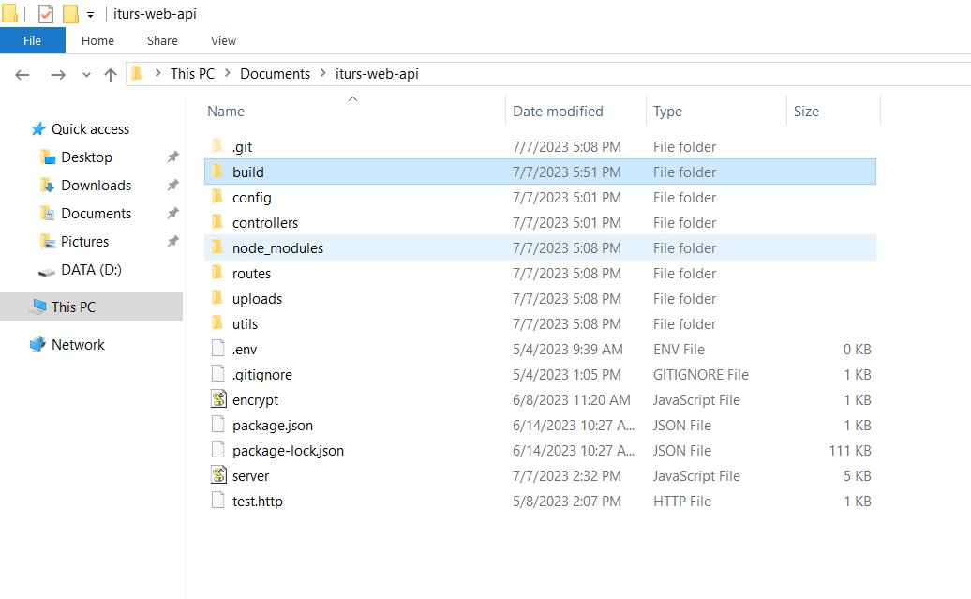
Server Setup : Moving project files
Frontend build folder
Backend project folder that runs the API and serve the build folder

Slide 10
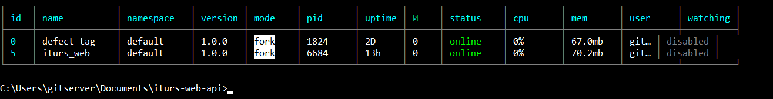
Going live:
pm2 start server.js --name iturs_web

Slide 11
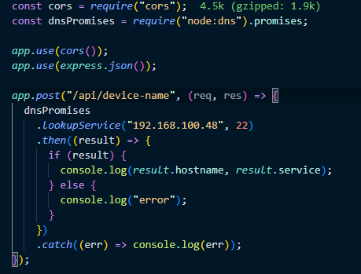
Dns lookup service
Server needs to be in the same network for this to work

Slide 12
Additional ITURS Demo
Updating User Profile
Request Type Definition
Requirement Type Definition
Create Request Attachments
Relogin upon change password

Slide 13

PROPOSED ITURS LOGO

Slide 14
PROPOSED ITURS LOGO
Shaped like the IWSP Logo
Circuits - symbolizes technology
Pencil – symbolizes creating request
Laptop with Wi-Fi symbol – symbolizes the requests that can be made with ITURS such as network, hardware, etc.
Letter U shaped as a mouse – symbolizes the digital nature of the new ITURS.

Slide 15
System Support
Fixing dll and ocx errors
Installation of iNavi
Updated iInvoice
iMake user account management
iSam – register user

Slide 16
FUTURE TODOS

Slide 17

JSON Web Token (JWT)

Slide 18
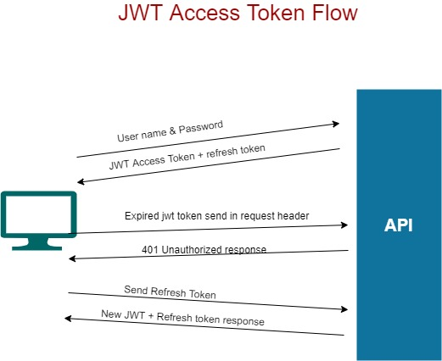
JSON Web Token (JWT)
Access token
>> shorter expiry time
Refresh token
>> longer expiry time
When both access and refresh tokens are expired, the user needs to be authenticated again (session expired >> relogin)

Slide 19
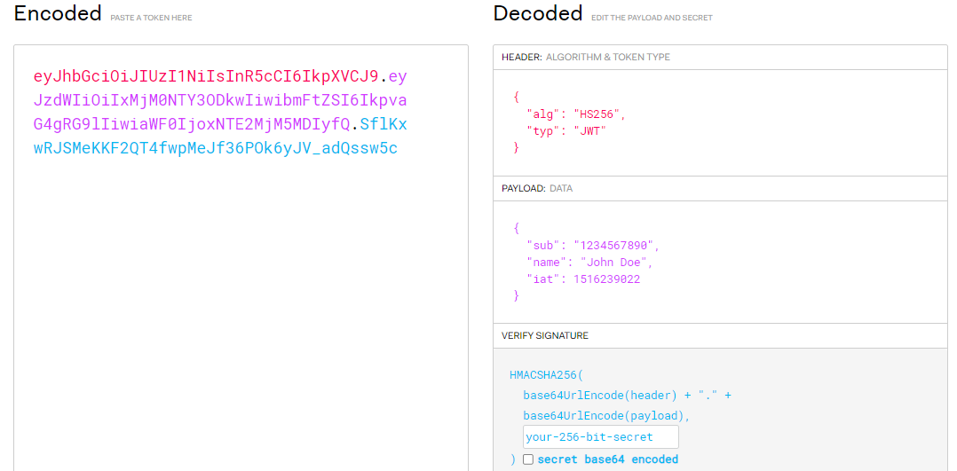
JSON Web Token (JWT)

Slide 20

Optional: NGINX

Slide 21
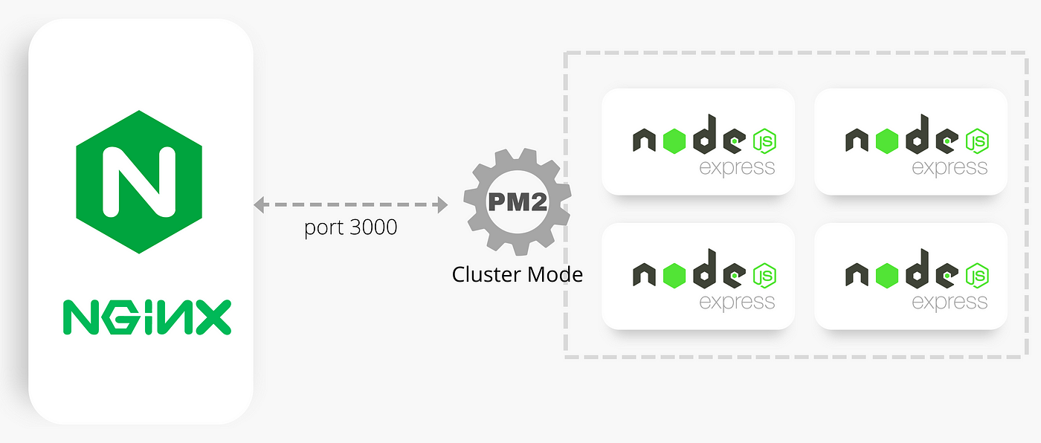
Optional: NGINX

Slide 22
Request Type
Redefine different request types
>> more specific types
Ask Ma’am Durcy about the type of attachments needed for each request types

Slide 23
Continue Learning…
C# (currently at Chapter 5 in Headfirst C#)
SSMS
Improve in Excel
Tracing errors
Software installations

Slide 24
iKai: Web Application for Software Installations

Slide 25
Shortcomings and Plan of Action to Improve
Shortcomings | Plan of Action
Speed

