Slide 1





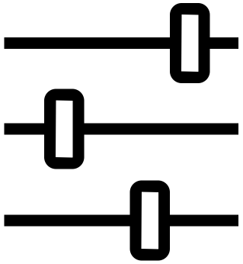



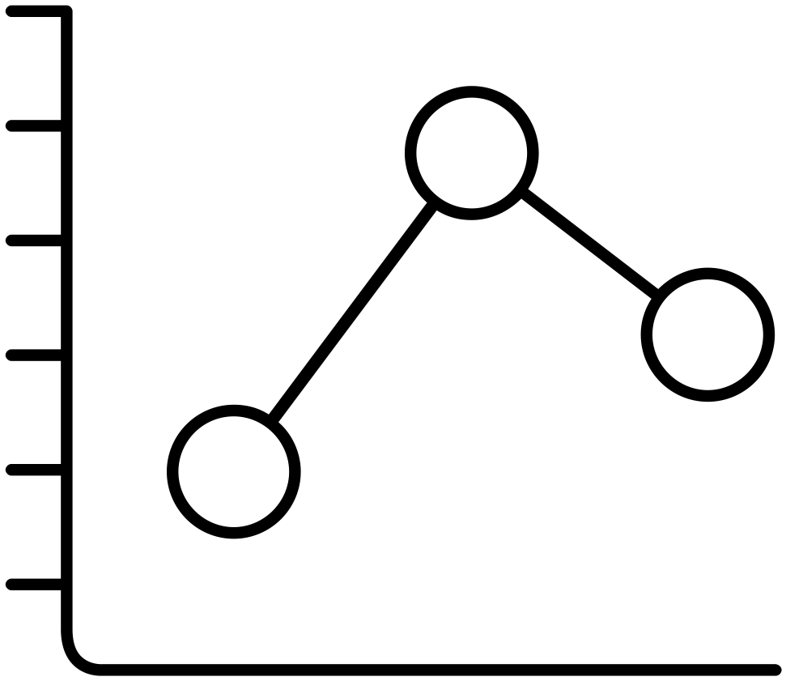





The Machine Learning Canvas (v0.4) Designed for:
Designed by:
Date:
Iteration: .
Decisions How are predictions used to make decisions that provide the proposed value to the end-user? Predictions are used to project which airline reviewers are likely to recommend and not recommend the specific airline. By understanding which reviewers would not recommend an airline it would be possible to either steam competitor business or retain your own business more effectively. | ML task Input, output to predict, type of problem. Classification problem. Input is airline reviews consisting of a freeform text review and several rating metrics; it may be determined that only the free text should be used for predictions, though. | Value Propositions What are we trying to do for the end-user(s) of the predictive system? What objectives are we serving? We are trying to minimize the damage of bad reviews and retain customers who may have had negative experiences. This could be done by replying to negative posts on social media, websites like Skytrax, or direct feedback. By reducing churn – especially with business travelers – revenue will be retained and new customer acquisition costs will decrease. | Data Sources Which raw data sources can we use (internal and external)? An airline data set scraped from Skytrax can be used initially. Additional data to add would be additional information related a particular flight experience such as weather, airport information, airplane information, etc. | Collecting Data How do we get new data to learn from (inputs and outputs)? The Skytrax dataset is already labeled if each reviewer would or would not recommend an airline following their flight experience.
Making Predictions When do we make predictions on new inputs? How long do we have to featurize a new input and make a prediction? If deployed to scrape tweets the predictions could be made as tweets are read in based on mentions and hashtags. There would not be a firm time requirement but the quicker responses could be processed and responded to the better. | Offline Evaluation Methods and metrics to evaluate the system before deployment. Accuracy would be main evaluation metric. It is possible though that this could be made more specific since false positives (predicted recommend and actually would not recommend) are more detrimental than false positives. |  | Features Input representations extracted from raw data sources. Features include the content of reviews, 1-10 ratings for various aspects of the flight experience, a value rating, a passenger class field and several sparsely populated fields. Additional features could be sourced from elsewhere but are under consideration | Building Models When do we create/update models with new training data? How long do we have to featurize training inputs and create a model? Could use input here. I am not sure how the evaluation process would play out.
 | Live Evaluation and Monitoring Methods and metrics to evaluate the system after deployment, and to quantify value creation.
Could be possible to predict fare class as well which could help to determine value of a customer.
After deployment it may be possible to measure churn but if deployed to Twitter or other social media the impact monitoring would be difficult. It may be possible to monitor the sentiment of responses from customers following any corrective actions taken automatically. There wouldn’t be a baseline to compare to since the alternative is no response, but positive sentiment could be taken as effective responses.
machinelearningcanvas.com by Louis Dorard, Ph.D.
Licensed under a Creative Commons Attribution-ShareAlike 4.0 International License.

Slide 2
References
Overview
https://indatalabs.com/blog/data-science/machine-learning-canvas-to-design-better-machine-learning-systems
Examples
Real-estate Deals
Priority Inbox
Customer Retention
Fake Hotel Reviews

