Slide 1
The model description
This example contains:
CPG (Corner Point Geometry) grid setup
Few grid and rock properties setup:
  mesh generation
  input files (grdecl)
Physics:
  Geothermal
  Deadoil (isothermal)
Well perforation definition:
  using Python code (XYZ and IJK)
  using SCH file (COMPDAT)
Well controls
  BHP
  Rate with BHP constraint
  Cyclic production and injection

Slide 2
DARTS Model and inheritance
DARTSModel
A part of open- DARTS package
Model_CPG
Reservoir related code
The model files
Model_DeadOil
Physics related code
Model_Geothermal

Slide 3
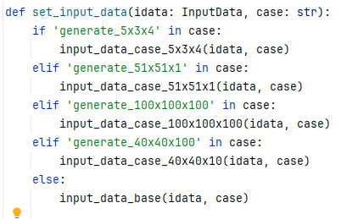

Case files
case_base.py
Common setup
Case files
Each case can overwrite some properties
case_40x40x10.py
case_generate_5x3x4.py
A synthetic grid can be generated or can be read from .grdecl files
Defined in case_base.py:
idata.generate_grid = 'generate' in case
Selecting a case by its name (set_case.py):
Copy everything from the “base” (or your own) case and overwrite only what is needed:

Slide 4
Grid generation
The grid is generated with a function gen_cpg_grid and can be
with a regular layers thickness:
  Defined in case_generate_51x51x1.py:
  geom.nx = 51
  geom.ny = 51
  geom.nz = 1
  geom.dx = 4000. / geom.nx
  geom.dy = geom.dx
  geom.dz = 100. / geom.nz
and the irregular layers thickness:
  Defined in case_generate_5x3x4.py:
  geom.dx = np.array([500, 200, 100, 300, 500])
  geom.dy = np.array([1000, 700, 300])
  geom.dz = np.array([100, 150, 180, 120])

Slide 5
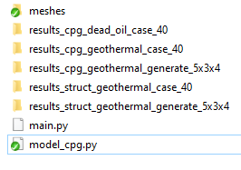




Model
  Input files in Eclipse format
  (grdecl)
  Grid
  Keywords: SPECGRID, COORD, ZCORN, ACTNUM
  Model folder
  Rock properties
  Keywords: PORO, PERMX, [PERMY, PERMZ]
  Output folders for each case
  Results
  Model
  scripts
  Vtk file (3D data)
  Vtk files (3D data)
  grdecl (3D data)
  Well results
  Well locations and static data: Perm, Depth, Volume
  One file per time step
  Initial+final or one file per time step
  pkl
  xlsx
  ParaView
  ResInsight

Slide 6
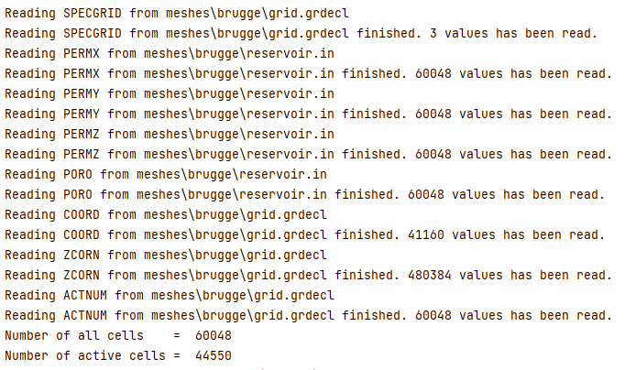
CPG Reservoir
  The main input of the reservoir class is a dictionary of numpy arrays containing grid data and rock properties.
  Read text files with grid and rock properties:
arrays = read_arrays(self.gridfile, self.propfile)
  Initialize the mesh (filter inactive cells, allocate arrays, compute connectivity, transmissibility, etc)
self.reservoir = CPG_Reservoir(self.timer, arrays)
self.reservoir.discretize()
Console output:
  One can implement own file reader or fill it in Python code depending on purpose.

Slide 7
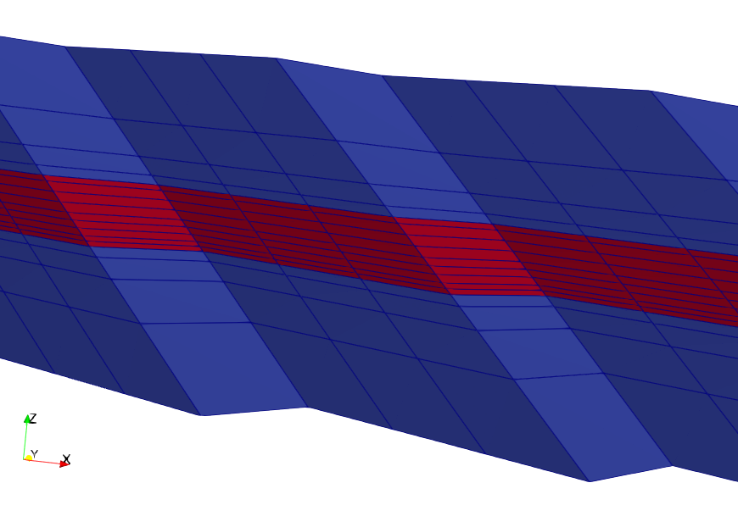
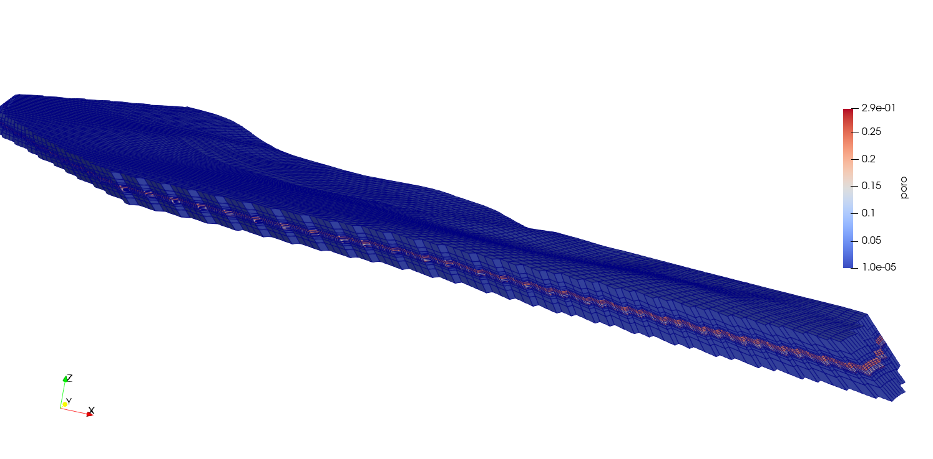
Over- and underburden layers generation
  If that layers were not generated in the geological modeling software, or one uses mesh generation option in open-DARTS, it is possible to do that using the next function:
  Overburden
  Reservoir
  Underburden
  Note: this feature doesn’t work well if the top or the bottom layers are fully or partly inactive (due to ACTNUM=0, PORO=0, thickness=0)

Slide 8
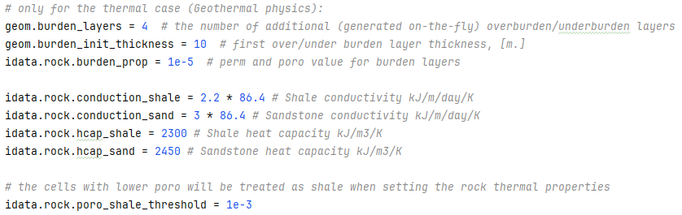
Over- and underburden rock properties
Defined in case_base.py

Slide 9
Fault transmissibility multipliers
  CPG_Reservoir class has an option to pass a filename with fault location and multipliers in format:
  I1 J1 K1 I2 J2 K2 M
  where
    I1, J1, K1 - indices of the first cell, integers
    I2, J2, K2 - indices of the second cell, integers
    M - multiplier, float value
  For example, setting M=0.0 will make the fault impermeable.

Slide 10
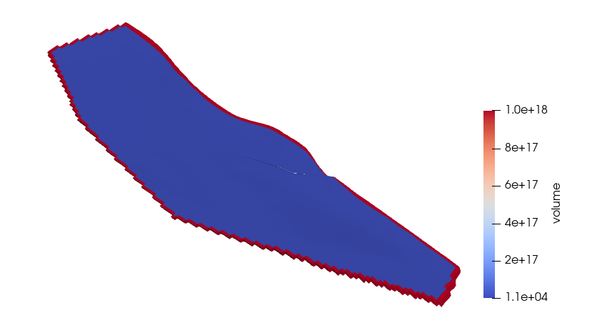
Boundary conditions
  Boundary conditions:
  top and bottom – no flow
  lateral boundaries – large volume
  In case ACTNUM array is defined, the volume will be set at the closest active cell:
Defined in case_base.py:
geom.bound_volume = 1e18 # lateral boundary volume, m^3

Slide 11
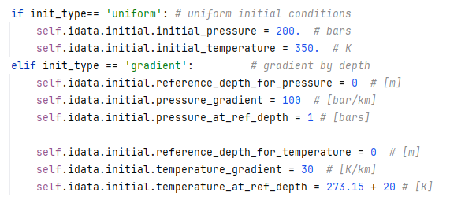
Initial conditions (geothermal physics)
Defined in model_geothermal.py:
  Uniform p,T
  Non-uniform p,T
  (set by gradient)
  Water saturation

Slide 12
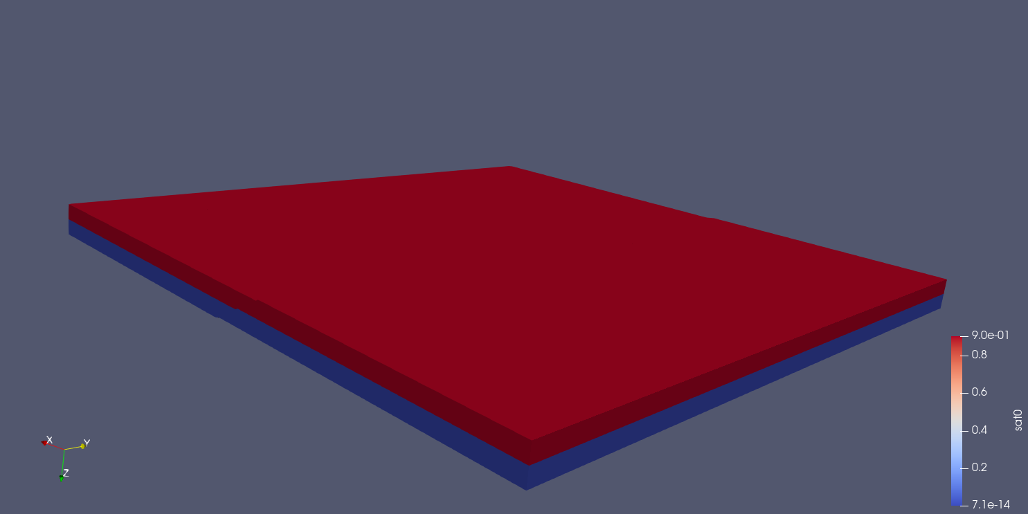
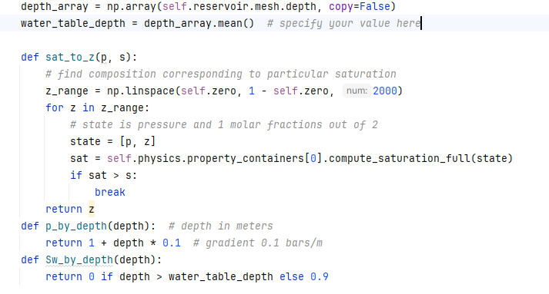
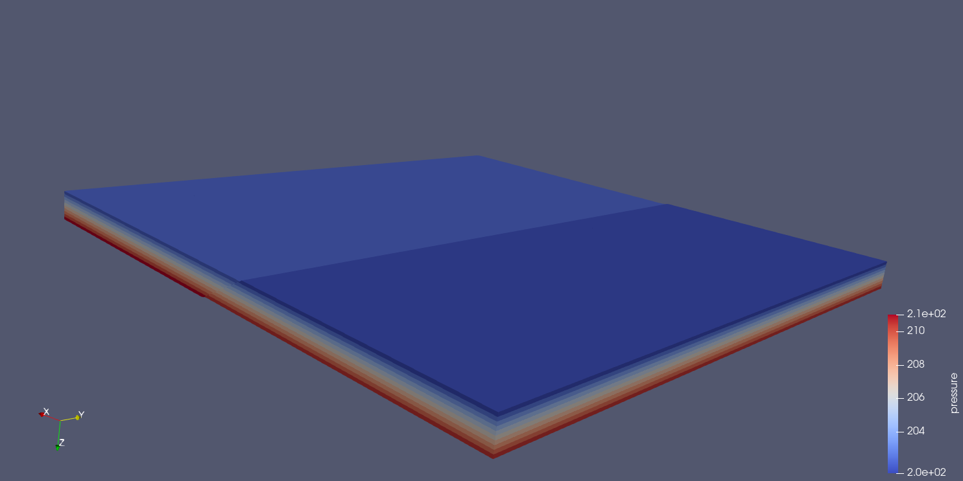
Initial conditions (deadoil physics)
  Water saturation
Defined in model_deadoil.py:
  Pressure

Slide 13
Well perforations
Adding wells and perforation is performed in set_well() function (model_cpg.py)
self.reservoir.add_well(wname)
self.reservoir.add_perforation(wname,
cell_index=(I,J,K), # location indices
well_index=perf.well_index, verbose=True)
or with higher level “idata” interface:
# the last index value (-1) will not be used since there will be a loop over the reservoir layers (assuming the well is vertical)
well_data.add_well(name='PRD', loc_type='ijk', loc_ijk=(1, 1, -1))
or
well_data.add_well(name='PRD', loc_type='xyz', loc_xyz=(250.0, 500.0, 890.0))
# real coordinates for each well connection
Screen output (if verbose)
  Well index

Slide 14
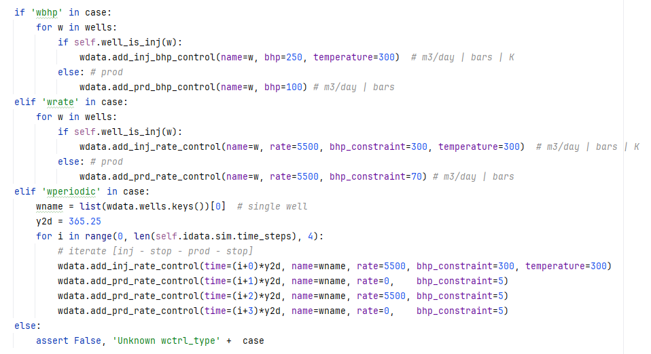
Well controls
Geothermal physics
BHP control
rate control
cyclic rate control (a thermal storage example)

Slide 15
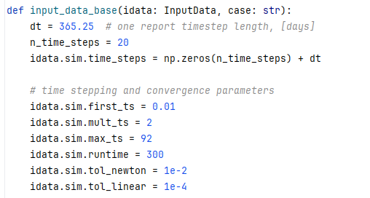
Simulation parameters
Time stepping and convergence parameters (case_base.py)
Log
redirect_darts_output(os.path.join(out_dir, 'run.log'))
Set number of CPU cores
https://open-darts.gitlab.io/open-DARTS/for_developers/configure_hardware.html

Slide 16
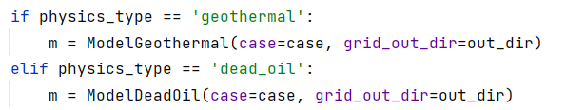

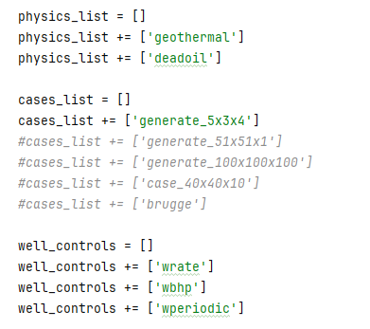
Running the simulation (main.py)
Create the model:
Run the simulation:
Choose cases to run:
physics
geometry and properties case
well control type

Slide 17
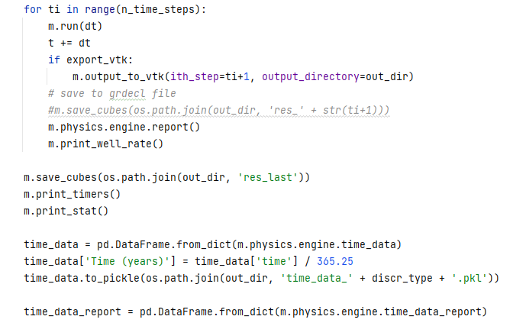
Well results (time_data)
Timestep loop
Add well result of the current timestep to the report
Contains all timesteps
Contains only report timesteps

