Slide 1
Image classification using Convolutional Neural Networks
IronHack AI Engineering Bootcamp – Jan 2026 Group 1
Bianca Radulescu, Ben Hunt, Rodrigo Torralba, Santiago Barón
1
Notes:
Done - Santi

Slide 2
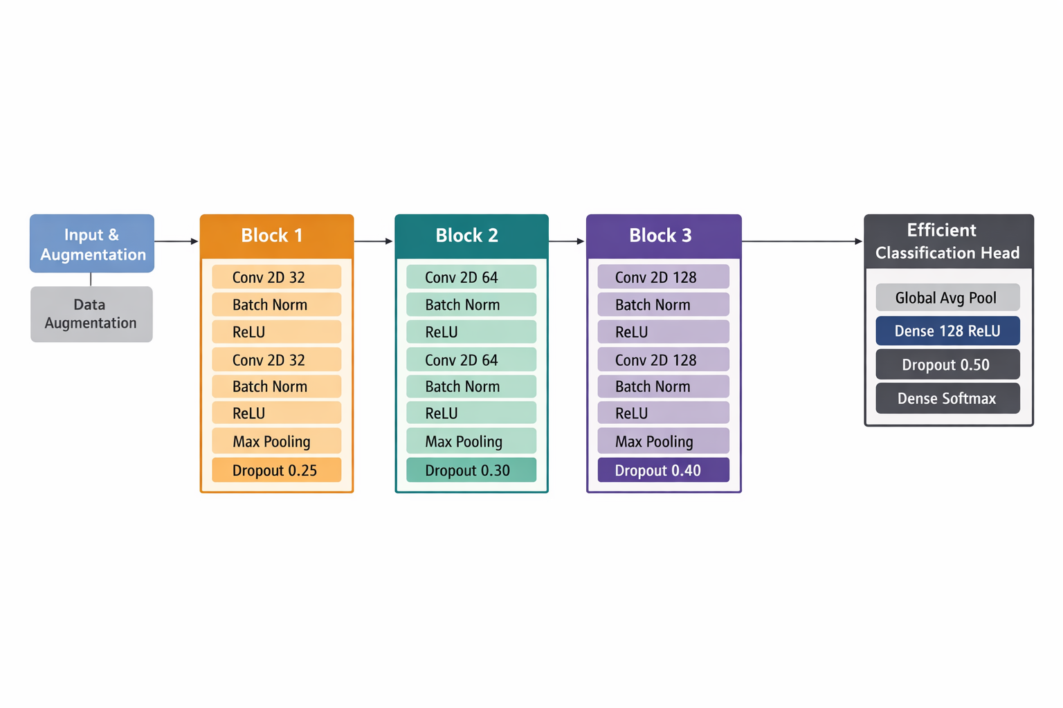
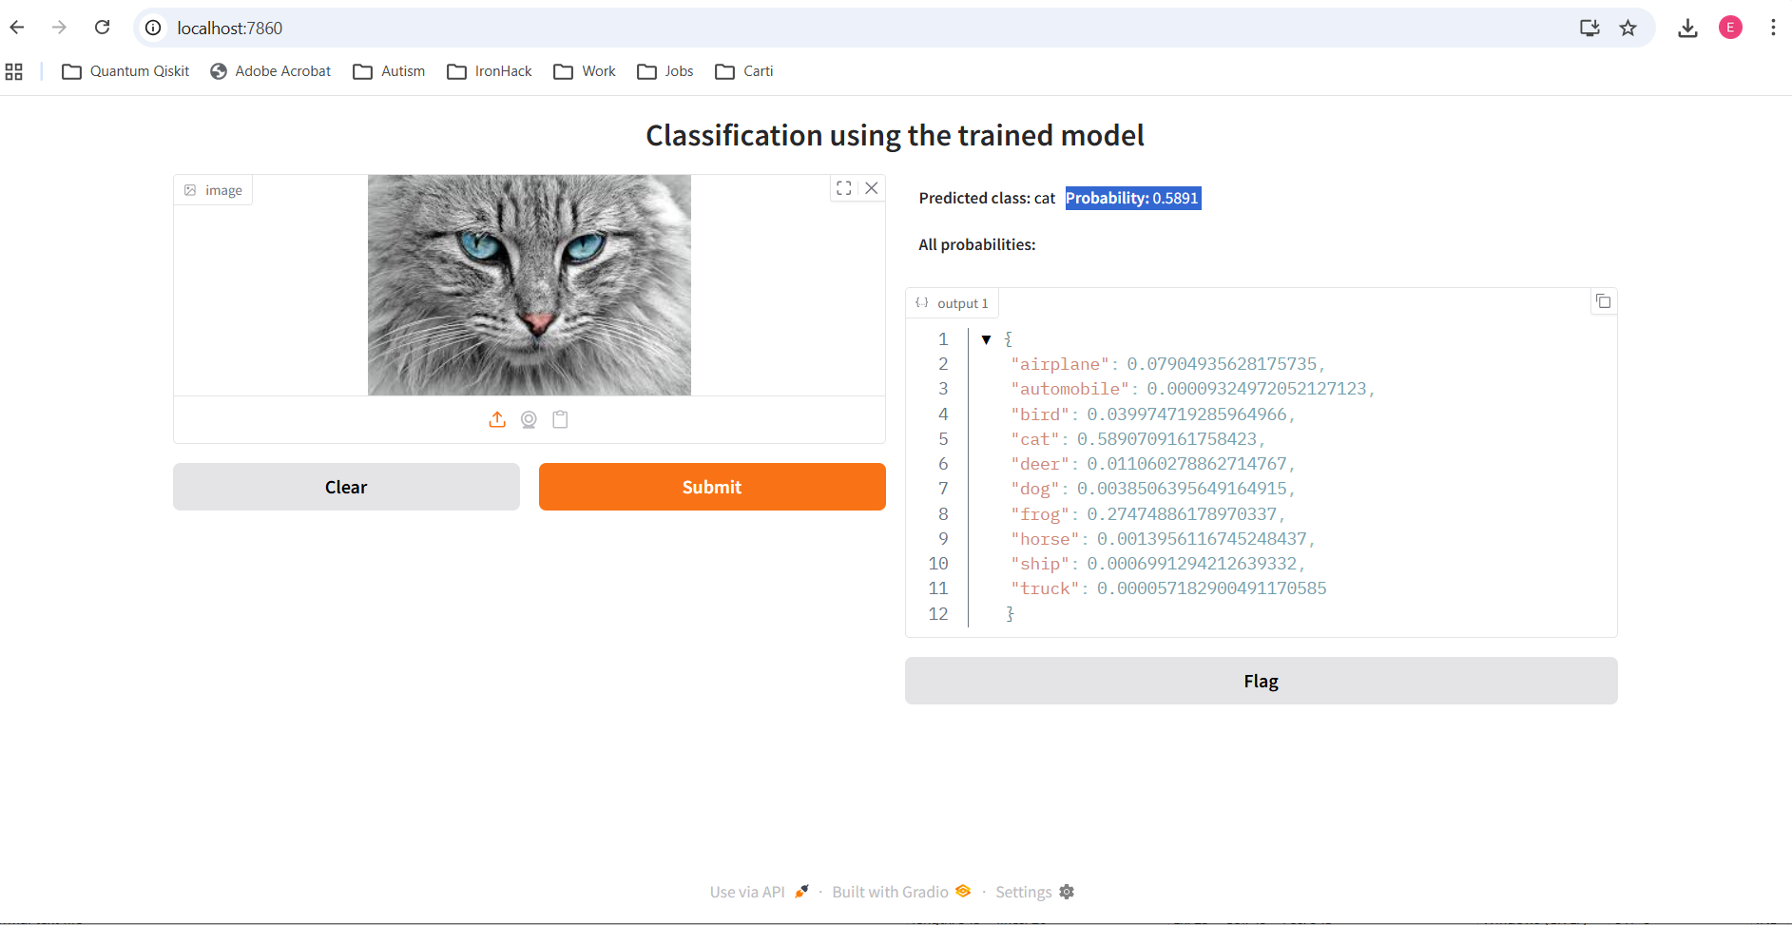
Executive Summary
VGG type architecture model
85% accuracy. 300k params. 0,5 loss.
Deployment
Transfer learning
Other architectures
2
Notes:
- Santi

Slide 3
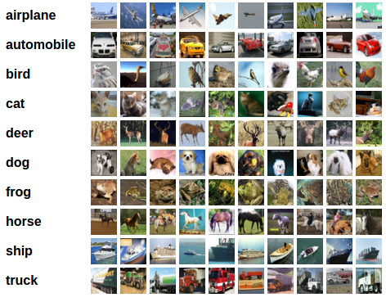
Dataset: CIFAR-10
60,000 color images (32×32)
10 balanced classes
50k training images, 10k test images
Link to dataset
3
Notes:
Done - Santi

Slide 4
Data Preprocessing
Normalization of pixel values
Train / validation / test split
One-hot encoding of labels
Data Augmentation
4
Notes:
Done - Santi

Slide 5
CNN Architecture – Design
VGG type architecture optimised for dataset
Hidden layers: Convolution → Batch normalization → Conv → BN → MaxPooling → Dropout that is: extract patterns → normalize → extract patterns → normalize → reduce size → avoid
Output layer:
GAP → Dense neurons → dropout → softmax
5
Notes:
Done - Bianca

Slide 6
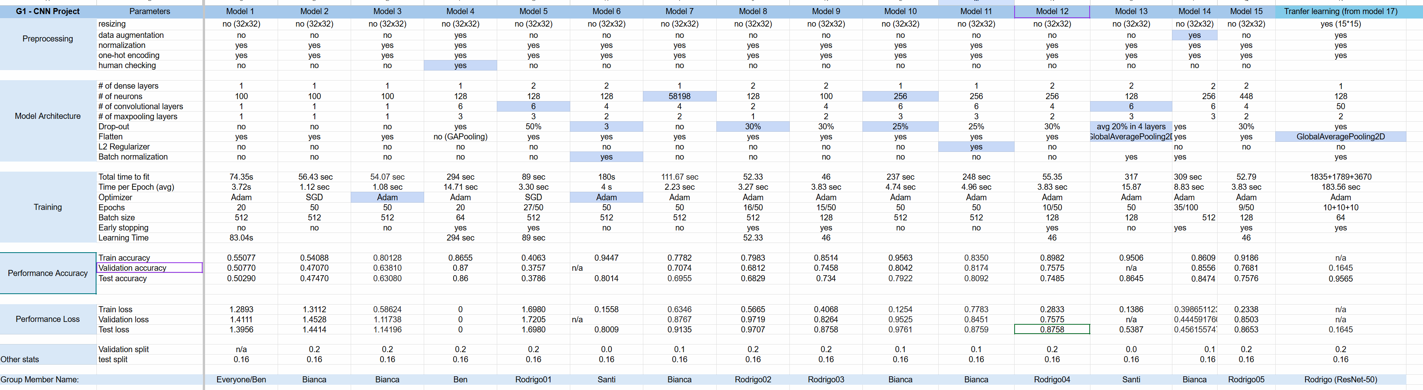
CNN Architecture – Evolution
Started with basic CNN (2 layers) – 50% accuracy
Tested Resnet arquitecture: not significant improvement
Increased depth and capacity: 85% accuracy
+ layers
+ tuning
6
Notes:
Done - Bianca

Slide 7
Optimization Techniques
Larger impact:
Layers/neurons
Adam optimizer, augmentation, General Average Pooling, BN, dropout.
Smaller impact:
L2 regularization, learning rate, early stopping, batch-size tuning
7
Notes:
Done - Rodrigo

Slide 8
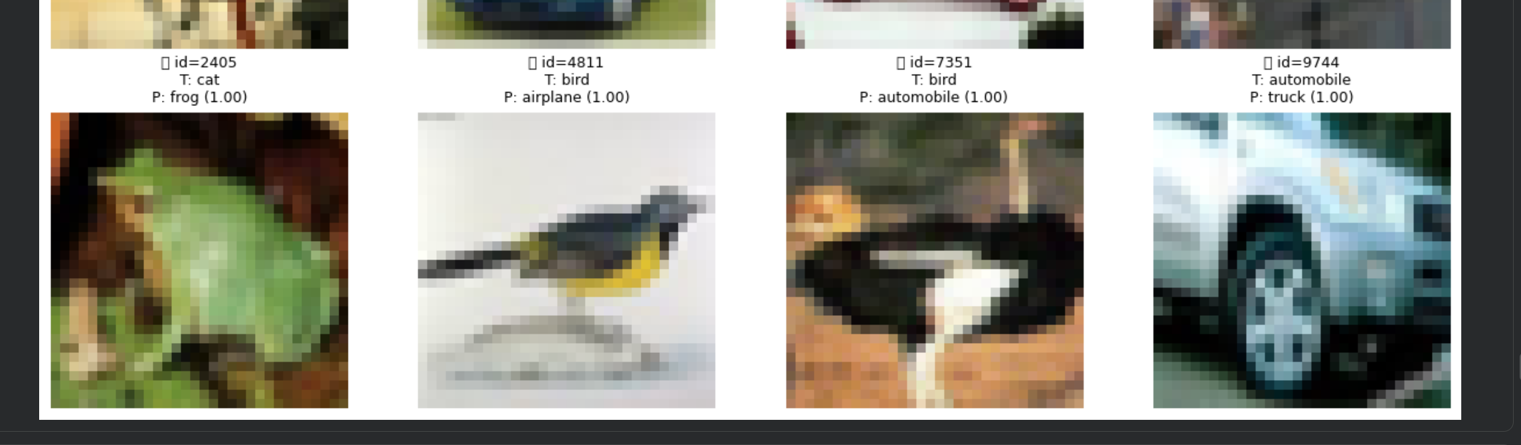
Evaluation Metrics
9
Notes:
Done - Ben

Slide 9
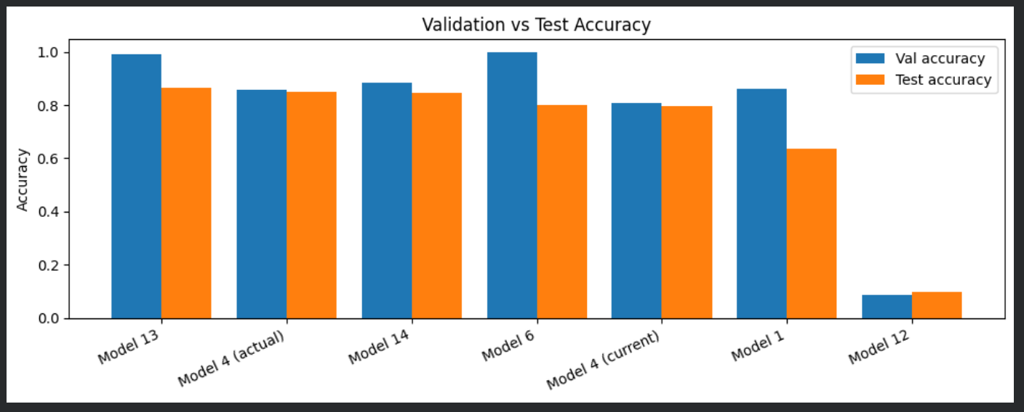
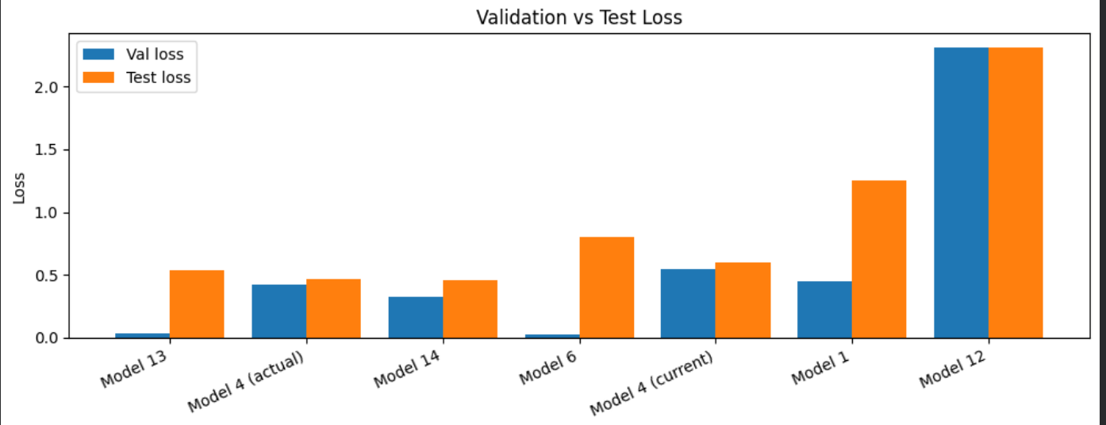
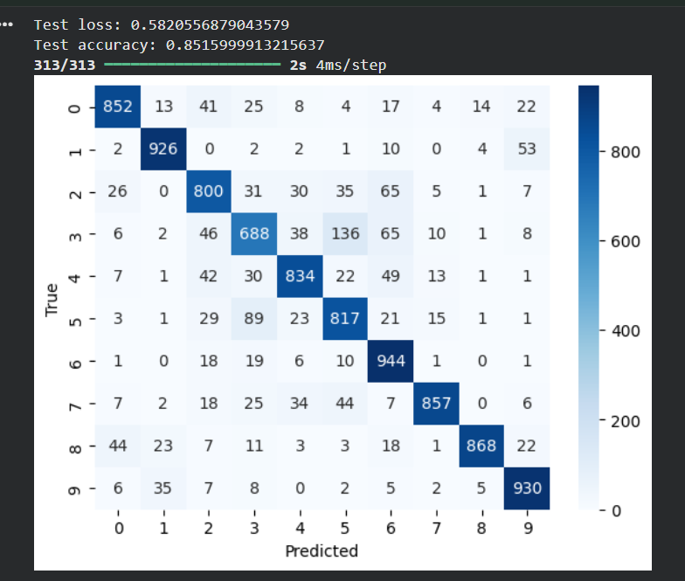
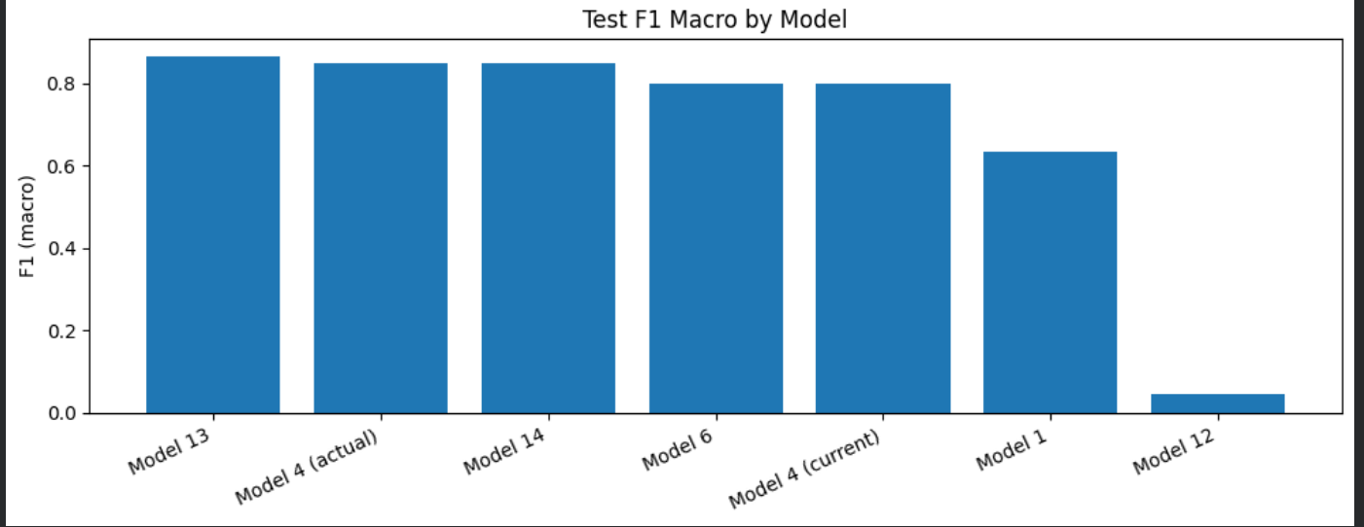
Evaluation Metrics
Accuracy, Loss, F1-score
Confusion matrix analysis
Training vs validation curves
9
Notes:
Done - Ben

Slide 10
Model Deployment
Interactive Gradio web app
User uploads image for prediction
Real-time interface
10
Notes:
Done - Bianca

Slide 11
Transfer Learning
Pretrained ResNet50 model from keras library
Preprocessing
Feature extractor
Compared performance vs custom CNN: 95% vs 85%
11
Notes:
Done - Rodrigo

Slide 12
Project Recap & Learnings
Different CNN architectures
Systematic tuning
Image handling and prediction by models
Contact with pre-trained models
First deployment : )
12
Notes:
Done - Rodrigo

