Slide 1
Oral/Comprehensive Exam and Thesis Proposal

Slide 2
The oral qualifying examination is an oral presentation with a written report that surveys the literature in the planned research area that a student may pursue. A few example papers, recommended by the PhD program committee will be posted and available to students for reference. The examining committee will be organized by the advisor if identified by the student, or by the program director if the advisor has not been chosen by the student. The examining committee consists of three faculty members from the host department.

Slide 3
Oral Exam
The topic of the exam will be determined by the student's advisor in consultation with the examining committee. Committee is 3 people.
Students having any sponsorship via the advisor's research funding or departmental teaching should pass the oral qualifying examination by the end of the first year after admission to the program. Other PhD students should pass the oral qualifying examination by the end of the second year after admission to the program. A student has one chance to take the oral exam.

Slide 4
Waivers
Waiver to the oral qualifying exam will be given if a student, as the first author, has one paper published or accepted for publication at a peer-reviewed international journal or technical conference with PUBLISHED selection rate <=40%. The request is initiated by the advisor.

Slide 5
For CS the written examination for the Computer Science focus area consists of four required topics: Computer Architecture, Operating Systems, Automata, and Algorithms.
For Security written examination consists of four distinct topics, Computer Communication, Fundamentals of Network & Computer Security, Applied Cryptography, and Homeland Security.
The examination takes place twice a year for all students in May and December.

Slide 6
A student can take the examination up to two times: Students only need to retake the failed topics in the subsequent attempt. Students having any sponsorship via the advisor's research funding or departmental teaching should pass all topics by the end of the second year after admission to the program. Other PhD students should pass all topics by the end of the third year after admission to the program

Slide 7
PH.D in CS Course waiver
Waiver to the written qualifying examination will be given if the student has passed the required courses (CS 5200, CS 5500, CS 5700 and CS 5720) of the four qualifying examination topics at UCCS with a cumulative GPA of 3.75 or above. The program committee will decide if the grade of a transferred class can be used. Courses cannot be retaken to increase the GPA in order to qualify for the waiver.

Slide 8
PHD in Security Course Waiver
Waiver to the written qualifying examination will be given if the student has passed the required courses (CS 5220, CS 5910, CS 5920 and CS 5950) of the four qualifying examination topics at UCCS with a cumulative GPA of 3.75 or better. The program committee will decide if the grade of a transferred class can be used. Courses may not be retaken in order to increase the GPA to qualify for the waiver.

Slide 9
Thesis Proposal /Comprehensive Examination The purpose of the comprehensive examination is to ensure that the student possesses the following:
Sufficient grasp of the fundamentals of the chosen dissertation area to begin research, normally achieved through a thorough study of the current literature on the topic
Ability to conduct innovative research
Ability to exchange ideas and information with members of the Advisory Committee

Slide 10
Timeline
Expected proposal done by end of year 3.
Max time for Ph.d. (without exceptions) 6 years. After that “course” start expiring and need grad school dean permission to continue.

Slide 11
PhD students cannot enroll in more than 24 credit hours of dissertation prior to passing the comprehensive exam. Comprehension of existing literature and course material pertinent to the dissertation research, as well as the reasonableness of the unknown or undeveloped concepts that the student proposes, will be assessed by the Advisory Committee. The responsibility of the Advisory Committee is to review the research proposal and the qualifications of the student to complete the research successfully. If the research and the approach are found to be significant and appropriate and the student is judged capable of completing the research, the Advisory Committee will approve the research direction.

Slide 12
Grad School: Must complete 15 credits after proposal is accepted.
If the Advisory Committee does not find the student ready to begin dissertation research, it must suggest further preparation by the student and plan on a subsequent taking of the comprehensive examination.
A passing grade in the examination is given if at least four of the five members of the public Committee including the student's advisor vote affirmatively.

Slide 13
What is in the proposal
Parts of a Proposal
Title
Abstract
Introduction
Background
Overall Research Theme
Research Question1
Research Question2
Research Question3
…
Bibliography
For Each Research Question:
Review of Literature
Significance/Implications
Preliminary work & Plan of Work
Possible Methodology
Plan for Result Validation
Anticipated Timeline

Slide 14
A Typical Process
Decide a general area of interest with your advisor
Initial literature review to narrow down and sharpen the problem definitions
For a Ph.D. thesis, usually multiple related problems under one broader theme, so find multiple problem
Write the problem statements
Justify potential innovation
Design methods

Slide 15
A Typical Process (continued)
Experimental Design (or Theoretical proof?)
Plan for validation/evaluation
Estimate a timeline
Having published papers adds significant credibility to your claims about ability to do research and that your problems are solveable.

Slide 16
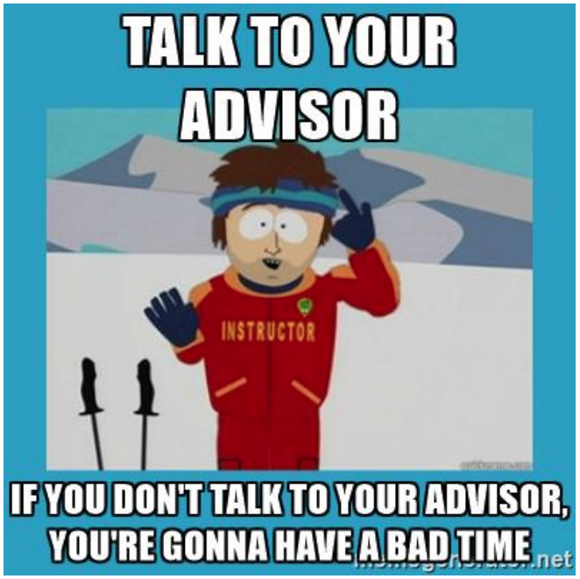
What problem to explore/propose

Slide 17
Thesis Timeline
Work with your advisor on the timeline.
Check important dates for submitting and defending dissertations.
Take various factors into consideration: IRB approval, travel; design, testing, and length of experiments; negotiation of entry into the study site; purchase of necessary equipment; drafting; redrafting).
Timeline is not always respected but writing it helps you to avoid potential pitfalls
Do a Gantt chart.

Slide 18
My “personal” advice/approach
Year 1: If you can, Go big try for Tier 1 level problems/papers. But either way try to publish something.
Year 2: Reassess where you are, go for Tier 2/3 to get 1-2 papers out (reworking paper from year1. Maybe new idea for Tier1).
Year 2 or 3, do thesis proposal & 1-2 more papers
Year 3 or 4, graduate. & 1-2 more papers

