Slide 1
CS 6000 Research Methods
Terrance E. Boult
El Pomar Prof. of Innovation and Security

Slide 2
The objectives of this course are for you to gain an understanding of :
Some basic CS publishing/development tools (LaTex, Git etc..)
How to effectively read CS research papers
How to effectively write a research paper
How to effectively present research papers
How to develop a thesis proposal

Slide 3
The objectives of this course are for you to gain an understanding of :
How to design an experiment and the statistical analysis of the resulting experimental data.
Basic usage of cloud computing for CS research.
and appreciation for and understanding of different subfields of CS and their approaches to CS research,

Slide 4
Course Ground Rules
Try to understand
Don’t be afraid to ask (email okay)
Don’t be afraid to comment
Be constructive
Be polite
Don’t be afraid to criticize (constructively!)
Be prepared & do the work on time

Slide 5
Grading
Writing assignments/Paper 30%
Oral Presentation 15%
Class participation and/or online discussion 15%
Weekly journal 20%,
Experimental Design Assignment 10%,
Cloud assignment 10%

Slide 6
In This Course
We will give you many research papers to read and hear many research talks
If the paper is published, free to discuss anywhere even online.
If the paper is unpublished (it has been submitted and is currently under review)
Treat it as confidential
Do not show it to anyone outside of this class
Be ready to put yourself in the mind of a reviewer, author, researcher.. as you’ll need to be each

Slide 7
First Assignment
Week 1 journal is to be done in latex, and you are to upload the pdf which will include a link to your git repo.
The document should have a title/author.
The first section should be 200-300 words on your goals for this course, what you hope to learn, which degree you are studying and something personal plus your photo as a figure. This same content should be in your canvas profile.
The second section should be about where to find your source code and your learning.
It should have hyperref/link to git repo (either public or shared with tboult on github or tboult on bitbucket) for the body of the latex.
Describe with whom you shared it and what tools you used. The body should discuss your learning from this week, problem/struggles you had and how you overcame them.
The third section should contain a 1-3 sentence description, plus citation, to each of five papers that are related to your research. It should reproduce at least 1 equation from at least 1 paper and discuss it.
The paper should end with a bibliography in IEEE format.

Slide 8
Role of Research
Should be about some problem that encourages enthusiasm (for you) and interest (for others)
Is often generated from the thought “what we’ve got now/from the past isn’t quite right/good enough – we can do better…”
Consists of work that leads to a meaningful contribution and evaluates that contribution
Generates, in some way, a better solution to the problem – it advances the state of the art
Needs to be shared and used to have an impact
Probably needs to be reviewed before most will consider using it.

Slide 9
What Is Research?
Merriam-Webster’s definition:
1 : careful or diligent search 2 : studious inquiry or examination; especially : investigation or experimentation aimed at the discovery and interpretation of facts, revision of accepted theories or laws in the light of new facts, or practical application of such new or revised theories or laws 3 : the collecting of information about a particular subject

Slide 10
What Is Research?
“A combination of investigation of past work and effort in the present that will help others in the future”
A set of opposites
Fun and frustration
Small steps and large insights
Building on others’ work and contributing your own work
Finding or developing something new that impacts the world….

Slide 11
What Isn’t Research
Playing with technology
Book reports
Programming project
Commercial product development
Doing what others have already done
However, each of these can be done as part of research.

Slide 12
What is fundamental research
The endless debate about fundamental research, basic research, applied research, finalized research…
A first and some say definitive answer : a study of something in pure form, with no application that leads to a result that has some scientific value as soon as it has been accepted by a scientific publication (a scientific committee)
A second answer : a result has some scientific value if it interests people and if it is novel (original) (and if it has some genericity)
A third and I say definitive answer : a result helps solve a problem and has some general scientific value cited by others, e.g. in an reviewed published paper.
The most difficult (and so the most interesting) problems have often been raised by applications, e.g. medical applications. Investigating these problems have gone through theoretical scientific developments.
My Bias: Fundamental research is that which help solve multiple-real world problems. Until then its just “speculative research.”

Slide 13
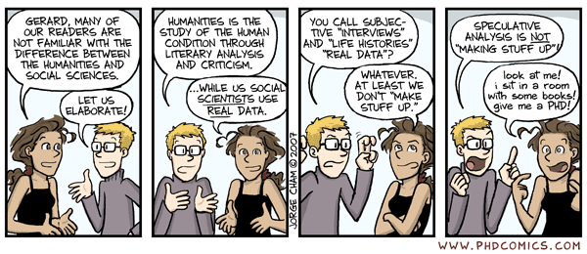
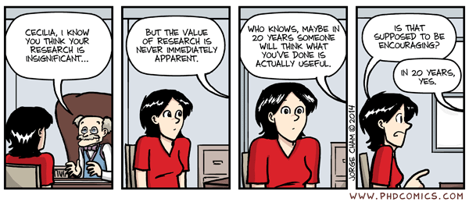

Slide 14
Who Does Research?
Graduate Students
Masters Degree (lower expected output)
Ph.D. Degree (higher expected output)
Researchers at universities
Post-Doctoral students
Faculty members
Researchers in industry
Research scientists
Many other technical workers
Undergraduate students

Slide 15
Who Does Research?
Individuals
Teams
Teams almost always make the process easier
Feedback from team members
Multiple-skill sets and division of labor
Each member can work to own strengths

Slide 16
Scope of Research
Varies by level of work
Ph.D. students – contribution expected at global/world level; e.g.
background investigation on all past work
make meaningful addition to world knowledge
MS/Undergraduate students – contribution can be at local to national to world level; e.g.
background investigation at university up to world level
make meaningful addition to university up to world level of knowledge
much ugrad research is to learn the process and get started down the path

Slide 17
What is Research?
Quantitative vs. Qualitative Research
Quantitative – use of mathematical models, software statistical, formulaic or numerical analysis to analyze results
Main approach: discovery, analysis; causal determination, prediction, generalization of findings
Results: “This solution is N% better”
Qualitative – not quantitative; use of non-numeric techniques to analyse results
Main approach: discovery; analogy; understanding, extrapolation to similar circumstances
Results: “This is a new problem and here is how to solve it

Slide 18
Pragmatic method & Mixed methods:
Generally problem driven
combines both quantitative and qualitative approaches, using right tool for a given task.
Advocacy/participatory research methods:
Predefined agenda, often focused on improving outcomes for a group of (marginalized) people.

Slide 19
Approaches to CS research
Attack a known problem, find/compare tools to solve it.
Formalize a new problem, then attack it and find/compare tools to solve it.
Build a new tool and test it on your own private data

Slide 20
Rest of Today’s Agenda
Some common tools for the course:
Latex
Zotero
Git

