Slide 1
CS 6000 Research Methods Publishing Venues, OA and Predatory Publishers
Terrance E. Boult
El Pomar Prof. of Innovation and Security

Slide 2
As a scientists/professor you are
a professional writer;
you get paid, in large part, to produce papers!

Slide 3
What is a scientific paper
A scientific paper is a written and published report describing original research results.
It must be the first publication of original research results,
In a form whereby peers of the author can repeat the experiments and test the conclusions, and
In a journal or other source document readily available within the scientific community

Slide 4
Definition of Scientific paper
An accepted original scientific publication containing scientific information to enable peers:
To assess observations
To repeat experiments
To evaluate intellectual processes
Must have an impact
Available to scientific community without restriction
Available for regular screening by one or more of the major recognized secondary services

Slide 5
THE FACETS OF AN ACADEMIC CAREER (US) in Research University

Slide 6
Remember what you put in the literature is your scientific legacy after all else is gone

Slide 7
ALWAYS LOOK FROM A DISTANCE
See your paper as the reviewer will see it – believe me the reviewer will not see it as the best thing since sliced bread even if you do!

Slide 8
Understand that the best scientists get rejected and/or have to make major revisions

Slide 9
Science (the journal)
The rejection rate is tough:
~3%
~4%
18%
75%

Slide 10
Choosing a Venue
Fit to your topic
Quality
Various “Tiers” of publications & Formal rating in some countries.
Acceptance Rate
Generally in the publication (message from chairs, etc). Top venues are often summarized in websites.
H5-Index in google or Journal Impact Factor
Timelines
Other dimensions of impact (e.g. OA, publisher etc).

Slide 11
Finding Venues
Google “top conferences in xyz” top journals in XYZ” (e.g. http://www.guide2research.com/topconf/)
Wikicfp.com
Make a calendar
Search to make sure you are a good fit.
Ask someone else to make sure you are a good fit.
Read some papers in the venue
Read what you can about their review process (more later on that).

Slide 12
Finding Venues
Most good venues do not allow double submission. Check before you submit!
Plan maybe submit
tier1->tier2->tier3
As your plan.. Or maybe
tier1->tier1->tier[23].
With most fields in CS, can do 2-3 conference rounds within a year, with mixed tiers.
Understand your commitment (e.g. reviewing if you submit)
Understand your costs and how you might reduce them, e.g. volunteer.

Slide 13
Primer on Open Access (OA)
OA simply means free-to-read.
OA is fully compatible with rigorous peer review.
OA does not necessarily mean author-pay (there are many models being tested).
OA journals can be low or high quality, just like subscription journals.

Slide 14
Can OA have Prestige?
PLOS One (Maybe the largest science journal in the world) – est. 8,000 articles
JIF= 4.351 (10th out of 76 gen. biology journals)
PLOS Biology
JIF=12.916 (8th out of 283 biochem journals)
Started in October 2003
CVPR, most cited CS publication has been IEEE+“open access’ since 2011 and seen substantial increases in citations.

Slide 15
OA – a flash in the pan?
Directory of Open Access Journals (DOAJ)
www.doaj.org
More than 10500 fully OA, peer reviewed journals with over1.9Million articles.
new titles per day
OA journal not the whole story
Most non-OA journals allow authors to deposit their articles in an IR/DR (e.g. arxiv)

Slide 16
SO WHAT?
We publish for prestige, but we also publish to be read & cited.
Some research that shows OA articles in good OA venues are cited 25-250% more than toll access (TA) articles?
Lawrence S (2001) Free online availability substantially increases a paper’s impact. Nature, 31 May 2001. http://www.nature.com/nature/debates/e-access/Articles/lawrence.html
Open Access Citation Advantage: An Annotated Bibliography – A. Ben Wagner, Issues in Science & Technology Librarianship, Winter 2010.
http://www.istl.org/10-winter/article2.html

Slide 17
The OA Advantage
As scholar, enlarge your audience/impact.
As reader, enjoy free online access to the literature.
As teacher, your students have free, liability-free access (fair use, course pack).
For all of us, moving away from an unsustainable journal publishing system.

Slide 18
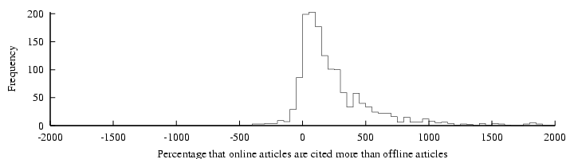
“Online or Invisible?” (Lawrence 2001)
“average of 336% more citations to online articles compared to offline articles published in the same venue”
Lawrence, S. (2001) Free online availability substantially increases a paper's impact Nature 411 (6837): 521.
http://www.neci.nec.com/~lawrence/papers/online-nature01/
Notes:
Lawrence’s study using articles in computer science, comparing articles ffrom the same venue (mostly refereed conference proceedings, which is the main form of publication in computer science) and showing that the ones that were self-archived had 300% more citations than the ones in the same venue that were not self-archived.

Slide 19
Research Impact
measures the size of a research contribution to further research (“publish or perish”)
generates further research funding
contributes to the research productivity and financial support of the researcher’s institution
advances the researcher’s career
promotes research progress
Notes:
Self explanatory: Describes the various aspects of research impact.

Slide 20
The author/institutional self-archived version is a supplement to -- not a substitute for -- the publisher’s official version
Link the self-archived author/institution supplement to the publisher’s official website
Pool and credit download counts for the self-archived supplement with downloads counts for the official published version
(All citation counts of course accrue to the official published version)

Slide 21
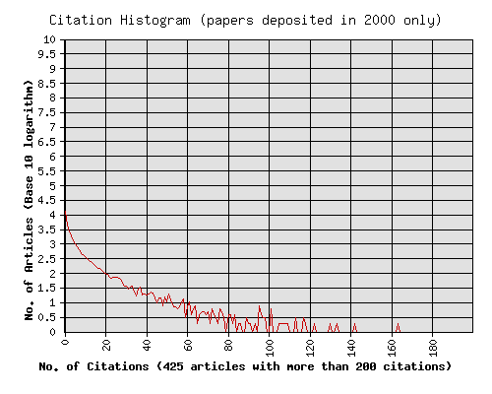
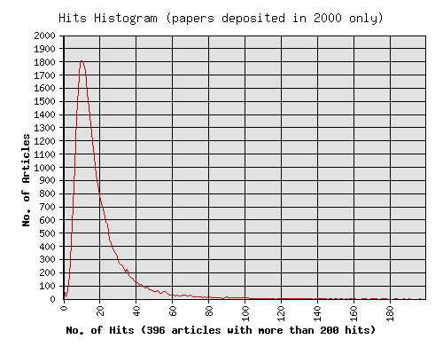
Usage Impact (downloads) is correlated with Citation Impact (Physics ArXiv: hep, astro, cond, quantum; math, comp) http://citebase.eprints.org/analysis/correlation.php downloads from first 6 months after publication predict citations 2 years after publicattion
(Quartiles Q1 (lo) - Q4 (hi))
All r=.27, n=219328
Q1 (lo) r=.26, n=54832
Q2 r=.18, n=54832
Q3 r=.28, n=54832
Q4 (hi) r=.34, n=54832
hep r=.33, n=74020
Q1 (lo) r=.23, n=18505
Q2 r=.23, n=18505
Q3 r=.30, n=18505
Q4 (hi) r=.50, n=18505
(correlation is highest for high-citation papers/authors)
Most papers are not cited at all
Average UK downloads per paper: 10
(UK site only: 18 mirror sites in all)
Notes:
The correlation in the access-impact cycle are also confirmed by the download/citation correlator: There is a strong positive correlation between the number of downloads a paper receives when it is self-archived and the number of citations it receives about 2 years later.
This correlation could be used in early-days evaluation and comparison of researchers and research.
The correlation between downloads and citations is greatest for the high-impact papers and authors.
Note how most papers are not cited at all (upper graph).
Other analyses show that when a paper is first self-archived (and there is an alerting service, as in the physics arxiv, there is a burst of downloads which subsides quickly -- except for papers that later turn out to be highly cited ones.
Those get donwloaded more often, and for a longer time after they first appear. Once the downloads generate citations, the citations generate more downloads.

Slide 22
Publishing models for scholarly journals
Traditional (subscription) model
Gold open access = free to reader, author pays a fee
Platinum open-access = free to author, free to reader
Delayed open access = subscription model but OA after some time
Green Open Access: Open-Access Self-Archiving (Traditional + Arxiv)
Slide adapted from Predatory Publishers are Poisoning Scholarly Communication by yJeffrey Beall UC Denver
Notes:
Slide adapted from
Predatory Publishers are Poisoning Scholarly Communication byJeffrey Beall
University of Colorado Denver
ORCID number 0000-0001-9012-5330

Slide 23
Some economic aspects of open access
The change from subscription-financed journals to author-financed journals has many negative, unanticipated effects
New business models focus on authors as revenue source
Conflict of interest: more papers accepted = more income
Not all subscription journals are good; not all OA journals are bad
Notes:
Alide adapted from
Predatory Publishers are Poisoning Scholarly Communication byJeffrey Beall
University of Colorado Denver
ORCID number 0000-0001-9012-5330

Slide 24
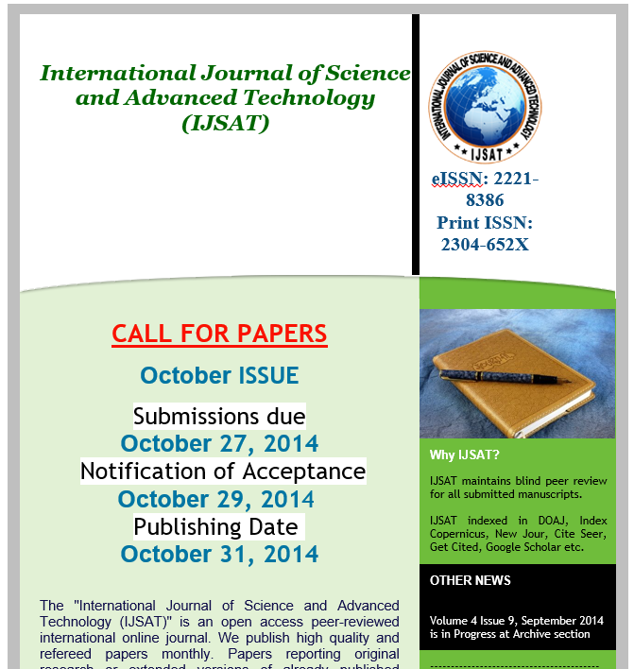
Predatory publishers
Predatory publishers (journals) are those that exploit the gold open-access model for their own profit
They take advantage of, exploit, and pander to scholarly authors
They pretend to be legitimate, copying established and respected journals' websites and practices
Many do a poor or fake peer review
While Beall address journals, There are also predatory conferences..
Notes:
Slide adapted from
Predatory Publishers are Poisoning Scholarly Communication byJeffrey Beall
University of Colorado Denver
ORCID number 0000-0001-9012-5330

Slide 25
Top Red Flags for Predatory Conferences
Email to you inviting you to apply, especially with your name
Not in google scholar under metrics
Unrealistic review timelines
Part of large multi-topic conference
No listing of program committee
Old topic with new conference.
Insufficient Contact Information
Unclear Author Fee structure
False Index Claims
No ISSN/ISBN

Slide 27
Breakdown of research cultures
Undoubtedly some have earned tenure and promotion through easy articles in predatory journals
The role of merit in academic advancement is disappearing
Never before has so much pseudo-science been published that looks like real science
Some academic databases are filled with junk science
Many researchers now expect cheap, easy, and fast publishing
Open access advocates are in denial about the problems OA has caused
It is possible for articles to be published open access yet still hidden
Notes:
Slide adapted from
Predatory Publishers are Poisoning Scholarly Communication byJeffrey Beall
University of Colorado Denver
ORCID number 0000-0001-9012-5330

Slide 28

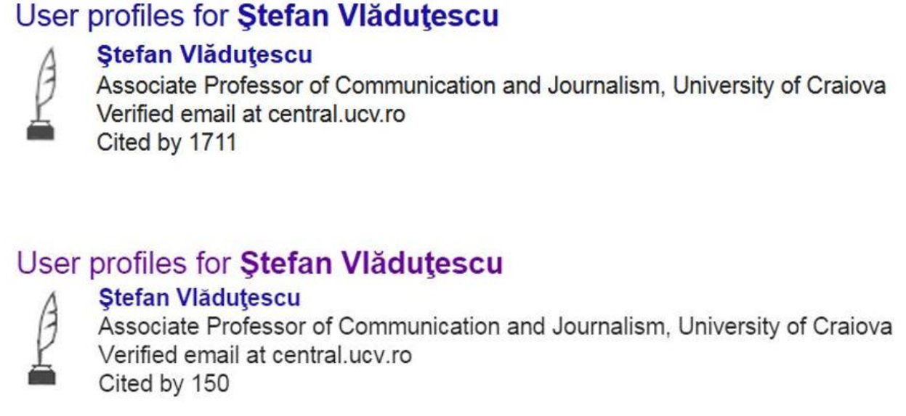
Impact on Scholarly metrics
Metrics can be somewhat gamed using predatory publishers
Alternative metrics (ISI) gamed too
Backlash against the impact factor
After a blog article by Beall brought up this case, google change scholar resulting in the drop.
Notes:
Slide adapted from
Predatory Publishers are Poisoning Scholarly Communication byJeffrey Beall
University of Colorado Denver
ORCID number 0000-0001-9012-5330

Slide 29
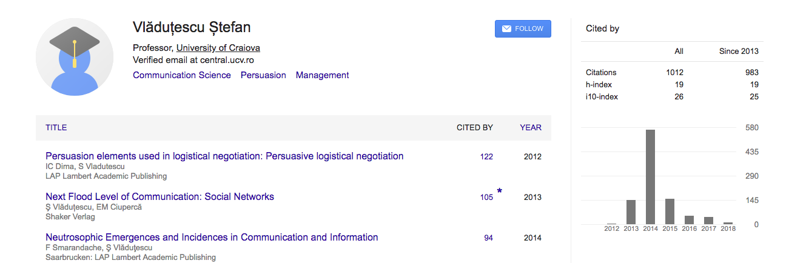
And people are are still playing their games But lawsuits & pressure on employers have reduced publicity
https://www.insidehighered.com/quicktakes/2015/01/21/scholar-accused-bogus-boost-google-rating
http://www.biochemia-medica.com/2017/27/273

Slide 30
How predatory publishers damage science
They've increased published research misconduct, such as plagiarism
The pseudo-science they publish gets indexed in Google Scholar and other academic indexes
They threaten demarcation, the division between science and pseudo-science, the cumulative nature of research
They feed bogus research to societal institutions that depend on authentic science
Entrepreneurs are using predatory publishers to make products appear efficacious
Notes:
Slide adapted from
Predatory Publishers are Poisoning Scholarly Communication byJeffrey Beall
University of Colorado Denver
ORCID number 0000-0001-9012-5330

Slide 31


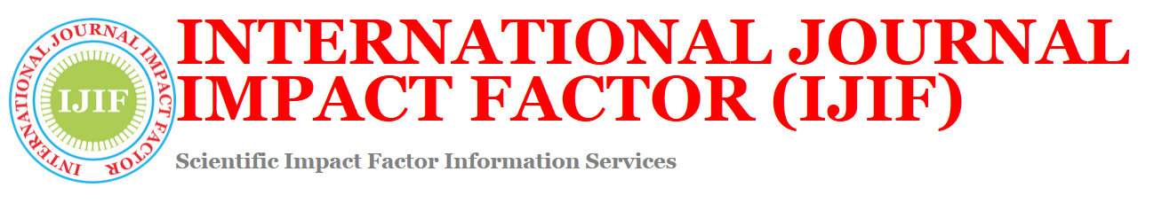

Fake Impact Factors
Companies make up and sell impact factors to open-access journal publishers
Many publish articles mistakenly believing that their work is in an reasonable impact factor journal
Predatory journals advertise their bogus impact factors in spam email and on their websites
Notes:
Slide adapted from
Predatory Publishers are Poisoning Scholarly Communication byJeffrey Beall
University of Colorado Denver
ORCID number 0000-0001-9012-5330

Slide 32
Resources on Predatory Pub.
https://libguides.gwumc.edu/PredatoryPublishin
https://www.councilscienceeditors.org/resource-library/editorial-policies/cse-policies/approved-by-the-cse-board-of-directors/predatory-deceptive-publishers-recommendations-caution/
https://libguides.usask.ca/predatorypublishers

Slide 33



Author services companies
Provide services such as copyediting, pre-publication peer-review, statistical, methodological review, research promotion
Most are not predatory but quality varies.
Advantages those with money, who submit polished manuscripts
The costs of scholarly publishing on the authors, favoring those with money (I say it has for a long time)
Notes:
Slide adapted from
Predatory Publishers are Poisoning Scholarly Communication byJeffrey Beall
University of Colorado Denver
ORCID number 0000-0001-9012-5330

