Slide 1
“HOW TO DEVELOP A SURVEY PAPER”
Based in part on examples/slides from
Dr. Manish Kumar Bajpai

Slide 2
Your Primary paper assignment this term
  Solo: Survey paper at 8-10 pages in length at least 50 references.
  Will turn in draft (4 weeks) + final paper (6 weeks)
  Everyone will be giving feedback on at least 3 other paper at some point. You will get feedback from others on each draft.
  Step 1) Get the lay of the land. For next week you are “search” for survey papers in your area and critically read least 3 survey papers, and build a topic map of where there are gaps.

Slide 3
WHAT MAKES A GOOD SURVEY?
Disucssion in class. Online Stop and think of 3 characteristics of a good survey and put that in your journal

Slide 4
WRITING SURVEY PAPERS
Selection of the topic for a good/impactful survey must satisfy the following requirements:
  The (sub) field is newly emerging.
  Popularity of the field will grow over time.
  A critical number of papers with new algorithms/approaches does exist (at least twenty to forty).
  The author(s) are enthusiastic about the particular topic.
  A survey paper does not exist.
  Presents a new/useful organization of the space

Slide 5
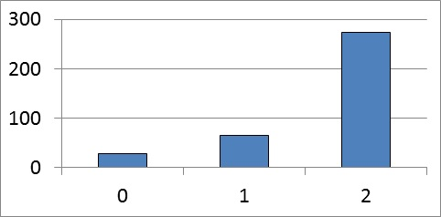
Figure : Impact of the existence of another survey paper.
Explanation: This figure gives a result which was absolutely unexpected.
The expectation was that existence of a survey would decrease citations of our survey,
but it happened absolutely the opposite. This means that the quality is more important
than the pre-existence of another survey paper on the same subject.
The paper with 2 preceded survey papers was the paper by Protic at al [Protic 1996].
The paper with one preceded survey was the paper by Tomasevic at al [Tomasevic1993].
The paper with no preceded survey was the paper by Jovanovic at al [Jovanovic1999].

Slide 6
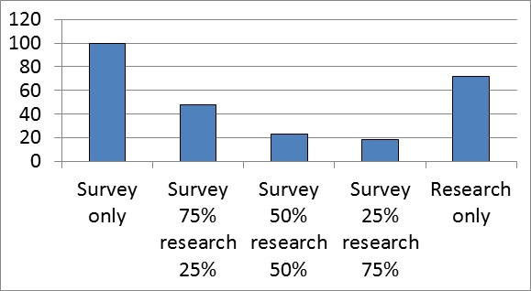
Figure : Survey papers versus research papers, what generates more citations? Explanation: Surveys generate more, unless an extraordinary research paper is generated in a popular field.

Slide 7
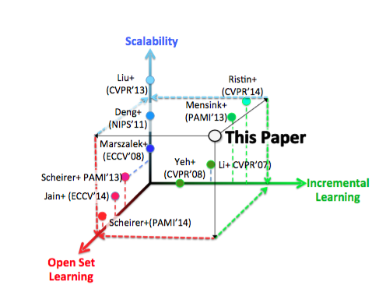
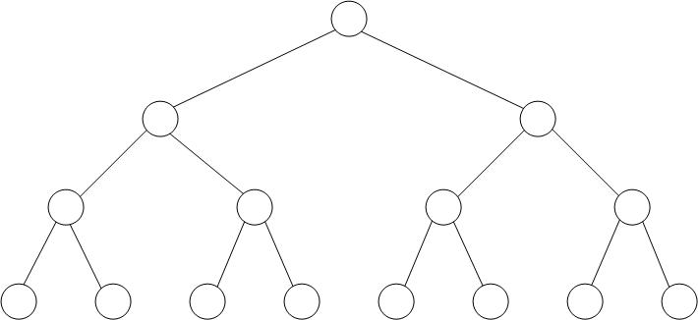
SURVEY PAPERS
With the binary (or n-ary) criteria, one can create either a tree-like classification or a cube-like classification,
With a tree-like classification, one can classify only the approaches that entirely belong to a specific class.
With a cube-like classification, one defines a space in which inner points include, to some extent, characteristics of all existing classes
What is useful, is to prepare a figure which includes the following:
  The classification criteria.
  The classification.
  Technical mnemonics.
  Symbolic mnemonics.
  The number of selected examples per class.
  The full list of references of selected examples.
  A vector of relevant characteristics.
FIGURE . A tree-like classification:
Classes are only at the leaves of the tree.

Slide 8
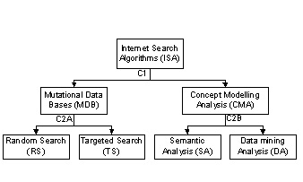
Figure . Classification of Internet Search Algorithms
Legend: C1 (criterion #1) = Retrieval-oriented vs Analysis-oriented
C2A (criterion #2, in the MDB path) = Random Search vs Targeted Search
C2B (criterion #2, in the CMA path) = Semantics-oriented vs Datamining-oriented

Slide 9
TRY MIND MAPPING SOFWARE
Coggle (Web) for beginners
Mindly (macOS, iOS, Android) for mobile mind mapping
Draw.io (Web, macOS, Linux, Windows, Chrome OS) for free mind mapping
iMindMap (macOS, Windows, iOS) for performing in-depth analysis on your mind map
MindMup (Web) for creating public mind maps
MindMeister (Web, iOS, Android, macOS, Windows) for collaborating on a mind map with a team
Scapple (macOS, Windows) for fluid, non-traditional mind mapping
SmartDraw (Web) for linear mind mapping
Stormboard (Web) for in-person mind mapping sessions
LucidChart (Web, iOS, Android) for turning your mind map into an organized flowchart

Slide 10
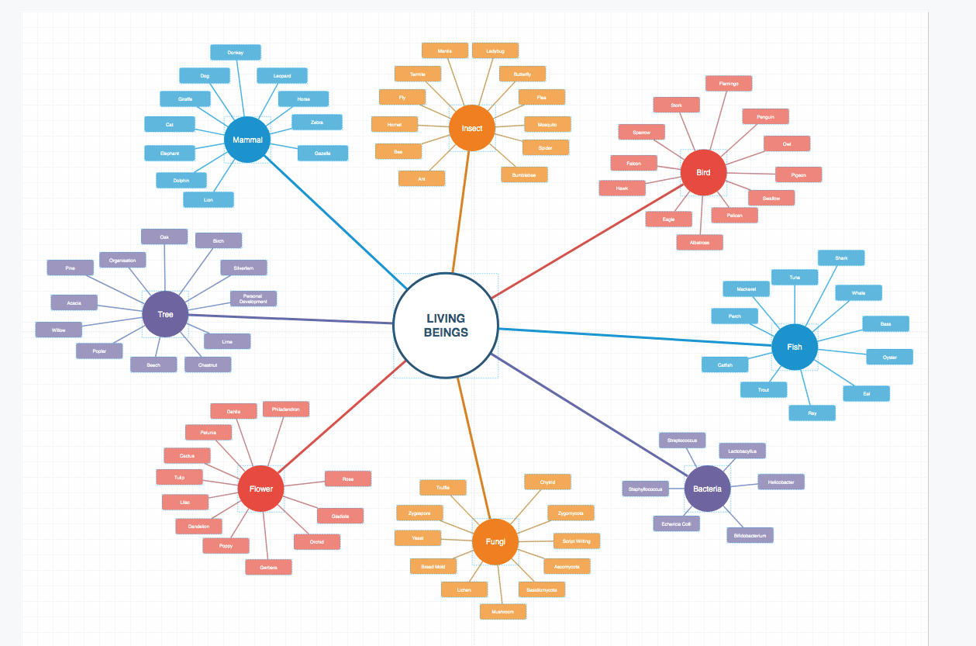

Slide 11
SURVEY PAPERS
When presenting each particular example, one can start with these 7 items:
  Seven Ws about the survey example (Who, What, When, Where, Why, for Whom, hoW).
  Essence (it can extremely difficult to give entire essence in only one sentence).
  Structure
  Some relevant details.
  Example (here one can call a figure that explains an example using a pseudo-code;
  ideally, the same application case should be used for all surveyed examples).
  Pros and cons.
  Author’s opinion of this example and its potentials.
  For short surveys, each template element is a sentence.
  For long surveys, each template element is a paragraph.
  For books, each template element can be a page, or more.

Slide 12
GOOD SURVEY PAPERS
The need to weave that into a story.
Good surveys are not just a summary.
  Must to compare and contrast the papers.
  Must tell a story, with a theme and goal.
  Should help organize ideas for others
  Need not be complete but should be through within its theme/story.

Slide 13
SURVEY PAPER
1) Read about the general subject, to warm up. Pick target journal and locate related surveys
2) Determine your proposed classification approach and select 40-80 papers, on various approaches from the open literature based on your classification ideas. Explain why the proposed classification represents a contribution to science.
3. For each example (covered by one or more papers),
write the main 7 ideas mentioned earlier in this paper.
Use these place with within the the chosen template/classification which sould enables easy comparison, and therefore represents a contribution to science.
Pick the “key” points of comparison among the papers, may try many more than the final paper..
5. For each key point of comparison, generate two figures (for example, one block scheme of the structure and one pseudo code presentation of the algorithm). Choose the presentation form which indicates the essence of the class that the example belongs to.
6. If the generated classification includes a class without examples (which is highly desirable, since that points to possible new research avenues), define the research strategy of interest for those who decide to take that avenue. Form a section with appropriate discussions.

Slide 14
7. Define the research strategy for those who decide to analyze the hybrid approaches (those consisting of elements of two different classes). Hybrid approaches can be either a symbiosis (the two solutions used interchangeably, as the conditions dictate), or a synergy (the two solutions combined into one). Discuss possible new solutions or both types (symbiosis and synergy). Discuss other possible avenues leading to new inventions
8. Add the preamble and the conclusion and form the final text of the paper. Generate ONE pearl of wisdom that sheds light on the essence of the paper, and increases the probability that the paper be referenced a lot.
9. Ask peers to review your paper, and edit edit edit .
10. Submit the paper to a journal.

