Slide 1
WRITING
CS6000
Prof. Boult

Slide 2
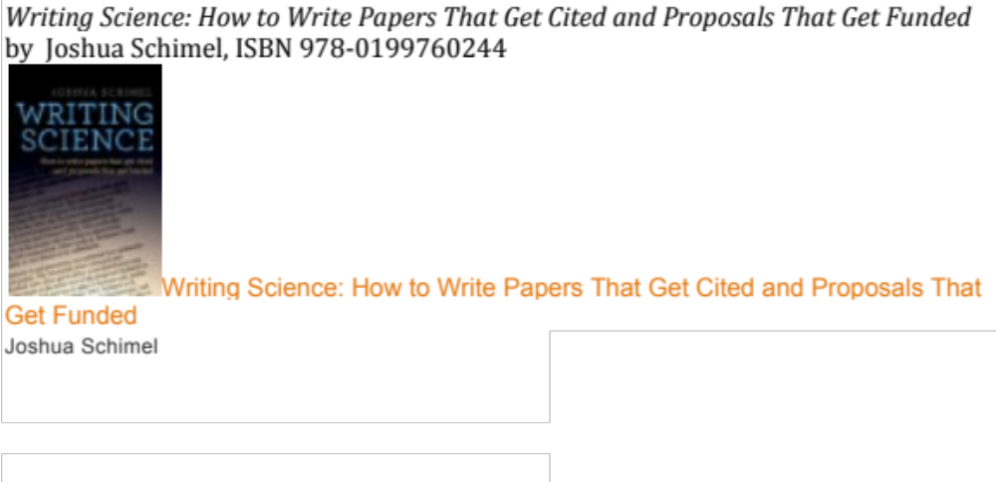
Suggested reading/books on writing
Watch his video: https://vimeo.com/17432903

Slide 3
The writing process
How to get started
A good process
why process != writing

Slide 4
GITOMERS 5.5 THINGS TO IMPROVE YOUR WRITING:
Just sit down and write something
Capture your though and ideas the second they occur.
Write it like you would say it (at least at first).
Edit to make sure your thoughts are simple and easy to understand ad complete.
Edit early, then often
5.5 Your writing for the reader AND yourself

Slide 5

Effective Writing: Process
All that you need to do is three things:
  Prewrite (about 25 percent of your time)
  Write (about 25 percent of your time)
  Rewrite (about 50 percent of your time)
  Have a good process, a timelines and tools
    GIT and Latex prefered
    Word (track changes, dropbox.. )

Slide 6
The biggest mistake you can make as a writer is waiting until its “ready”, let alone waiting for perfect. The rewriting process begins when you show your first draft to people and start getting feedback. Beethoven went through 70 drafts of his symphonies. As William Zinsser put it:
“Rewriting is where the game is won or lost; rewriting is the essence of writing.”

Slide 7
“Rewriting is the essence of writing well: it’s where the game is won or lost. The idea is hard to accept. We all have an emotional equity in our first draft; we can’t believe that it wasn’t born perfect. But the odds are close to 100% that it wasn’t. Most writers don’t initially say what they want to say, or say it as well as they could. The newly hatched sentence almost always has something wrong with it. It’s not clear. It’s not logical. It’s verbose. It’s klunky. It’s pretentious. It’s boring. It’s full of clutter. It’s full of clichés. It lacks rhythm. It can be read in several different ways. it doesn’t lead out of the previous sentence. It doesn’t…The point is that clear writing is the result of a lot of tinkering.

Slide 8
SHI..Y FIRST DRAFTS
or why I don’t recommend starting with an outline..
All first drafts are “bad”.. so might as well get one done so you can start making things better.
You should do your first draft, getting lots of stuff down on paper. Then you can review it to make an outline.
(Read http://richardcolby.net/writ2000/wp-content/uploads/2017/09/Bird-by-Bird-Anne-Lamott.pdf chapter on shitty drafts (I’ll

Slide 9
In Class EXERCISE
Don’t let words get in the way..
Seeing words slows down thinking and often makes one want to edit. You are to close your eyes and write/type, in your native language, about your own research idea. You are free to jump between ideas but must spend at least 30seconds on each idea.
I’ll tell you when to stop.
(If at home, do it while the video plays)

Slide 10
A BETTER WAY for many
Don’t write.. talk.. use a voice recorder or use your laptop to record your first draft.
Get an app that does “dictation” and talk to it.. It gets you even farther as much of the text is there. But DO NOT look at it as it types for you.
Ideal dictation software saves voices + text, but raw text is often good enough to prompt your memory.

Slide 11
Now look back and look for the storyline in it. You want a simple sticky story (we’ll define that latter)..
What is both novel and useful/interesting
Look for possible flows
What surprises can you find?
    If they cannot remember your work, they won’t accept/cite your work!

Slide 12
LISTEN TO YOUR INNER CHILD
At least for the first draft.. they are more playful, creative and full of ideas. Exactly what you want in the first draft.
See if you can think in pictures, shapes, characters.

Slide 13
FIRST EXERCISE, REDUX
Try it again but go with the inner child’s voice and tell a story..
I’ll tell you when to stop.

Slide 14
SECOND EXERCISE
Lose the words.
  The ideas from what you wrote, and sketch them in very crude figures.. see the figures, connect the concepts as a cartoon or comic book might. You can change the order to make it a more meaningful story.

