Slide 1
Introduction To GIT
Based in part on on slides from tboult Ling and others

Slide 2
Key Git Files/Directories
~/.gitconfig
.git
  In top level of repository
  Contains all objects, commits, configuration, for project
  .git/config has project specific configurations
.gitignore
  Stored in directory for ignoring

Slide 3
Git Advantages
Resilience
  No one repository has more data than any other
Speed
  Very fast operations compared to other VCS (source-safe, CVS and Subversion)
Space
  Compression can be done across repository not just per file
  Minimizes local size as well as push/pull data transfers
Simplicity
  Object model is very simple
Large userbase with robust tools

Slide 4
Some GIT Disadvantages
Definite learning curve, especially for those used to centralized systems
  Can sometimes seem overwhelming to learn
    Conceptual difference
    Huge amount of commends

Slide 5
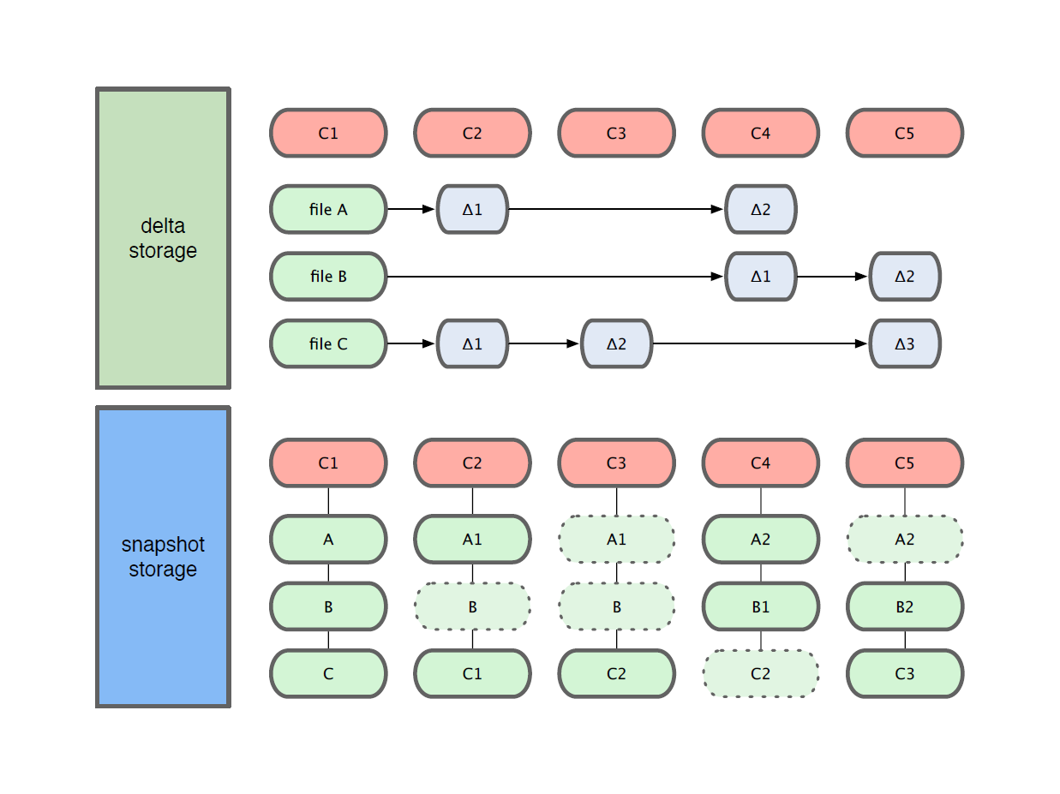
Getting Started
Git use snapshot storage (logical view– it does use deltas in packs)

Slide 6
Working With Git
echo “hello” >> hello.txt
git diff
  Shows changes we have made
git status
  Shows list of modified files
git add hello.txt
git diff
  No changes shown as diff compares to the index
git diff HEAD
  Now can see the changes in working version
git status
git commit -m ‘Second commit’

Slide 7
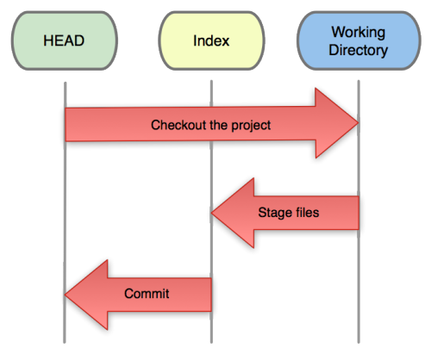
Getting Started
Three trees of Git
  The HEAD
    last commit snapshot, next parent
  Index
    Proposed next commit snapshot
  Working directory
    Sandbox

Slide 8
Getting Started
A basic workflow
  (Possible init or clone) Init a repo
  Edit files
  Stage the changes
  Review your changes
  Commit the changes

Slide 9
Getting Started
Init a repository
Git init
tboult:gittest-> git init
Initialized empty Git repository in /home/tboult/gitdemo/.git/
tboult:gittest-> ls -l .git/
total 32
drwxr-xr-x 2 tboult tboult 4096 2011-08-28 14:51 branches
-rw-r--r-- 1 tboult tboult 92 2011-08-28 14:51 config
-rw-r--r-- 1 tboult tboult 73 2011-08-28 14:51 description
-rw-r--r-- 1 tboult tboult 23 2011-08-28 14:51 HEAD
drwxr-xr-x 2 tboult tboult 4096 2011-08-28 14:51 hooks
drwxr-xr-x 2 tboult tboult 4096 2011-08-28 14:51 info
drwxr-xr-x 4 tboult tboult 4096 2011-08-28 14:51 objects
drwxr-xr-x 4 tboult tboult 4096 2011-08-28 14:51 refs

Slide 10
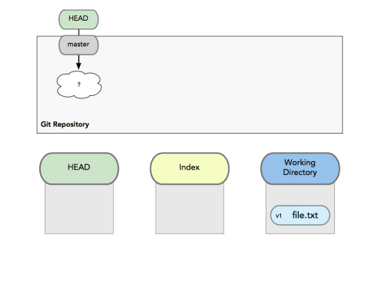
Getting Started
A basic workflow
  Edit files
  Stage the changes
  Review your changes
  Commit the changes
Use your favorite editor
E.g:
  Visual Studio
  Eclipse
  Vscode
  Atom
  Emacs
  VIM
  Sublime
  NotePad++
  https://help.github.com/articles/associating-text-editors-with-git/#platform-windows

Slide 11
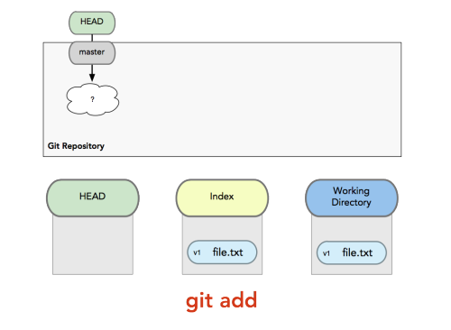
Getting Started
A basic workflow
  Edit files
  Stage the changes
  Review your changes
  Commit the changes
Git add filename
tboult:gittest->git init
Initialized empty Git repository in /Users/tboult/CS6000/gittest/.git/
tboult:gittest->echo "hello" > hello.txt
tboult:gittest->git status
On branch master
Initial commit
Untracked files:
(use "git add <file>..." to include in what will be committed)
hello.txt
nothing added to commit but untracked files present (use "git add" to track)
tboult:gittest->

Slide 12
Getting Started
A basic workflow
  Edit files
  Stage the changes
  Review your changes
  Commit the changes
Git status
tboult:gittest->git add hello.txt
tboult:gittest->git status
On branch master
Initial commit
Changes to be committed:
(use "git rm --cached <file>..." to unstage)
new file: hello.txt
tboult:gittest->

Slide 13
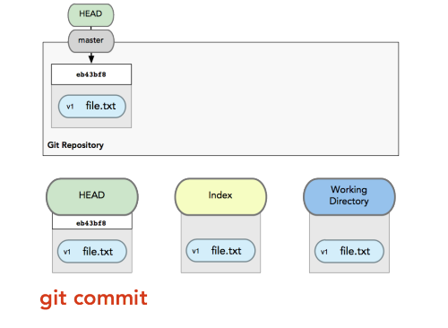
Getting Started
A basic workflow
  Edit files
  Stage the changes
  Review your changes
  Commit the changes
Git commit
tboult:gittest->git commit -am "demo message"
[master (root-commit) ff0f799] demo message
1 file changed, 1 insertion(+)
create mode 100644 hello.txt
tboult:gittest->

Slide 14
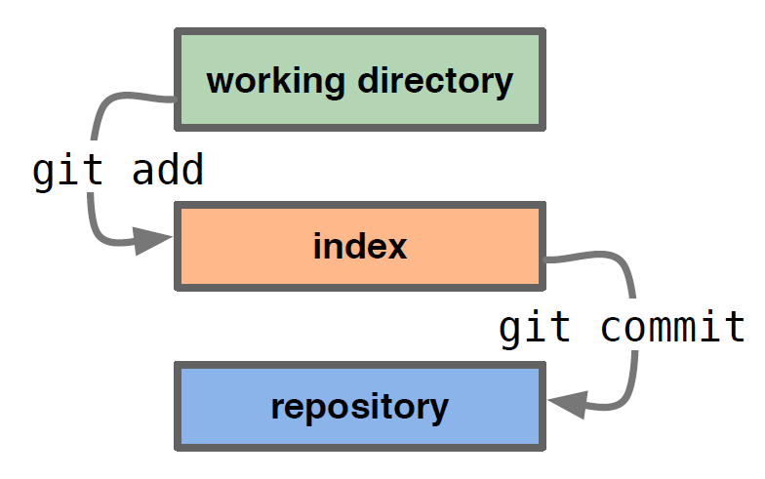
Getting Started
A basic workflow
  Edit files
  Stage the changes
  Review your changes
  Commit the changes

Slide 15
Getting Started
View changes
Git diff
  Show the difference between working directory and staged
Git diff --cached
  Show the difference between staged and the HEAD
View history
Git log
tboult:gittest->echo "hello2" > hello.txt
tboult:gittest->git commit -am "adding second line"
[master 03e952e] adding second line
1 file changed, 1 insertion(+), 1 deletion(-)
tboult:gittest->git log
WARNING: terminal is not fully functional
- (press RETURN)
commit 03e952e99190d4a4d2cad12504a5474921419daf
Author: Terry Boult <tboult@vast.uccs.edu>
Date: Sat Aug 18 12:53:33 2018 -0600
adding second line
commit ff0f799d1115ab1306dad78893fa1be3bee91af5
Author: Terry Boult <tboult@vast.uccs.edu>
Date: Sat Aug 18 12:52:22 2018 -0600
demo message
tboult:gittest->tboult:gittest->

Slide 16
Revert changes (Get back to a previous version)
  and branches
  Git checkout commit_hash
tboult:gittest->git checkout ff0f -b newbranch
Switched to a new branch 'newbranch'
tboult:gittest-
tboult:gittest->cat hello.txt
hello
tboult:gittest->echo "Branc lin" >>hello.txt
tboult:gittest->git commit -am "commit on branch"
[newbranch 5dfa020] commit on branch
1 file changed, 1 insertion(+)
tboult:gittest->cat hello.txt
hello
Branc lin
tboult:gittest->git checkout ff0f
Note: checking out 'ff0f'.
You are in 'detached HEAD' state. You can look around, make experimental
changes and commit them, and you can discard any commits you make in this
state without impacting any branches by performing another checkout.
If you want to create a new branch to retain commits you create, you may
do so (now or later) by using -b with the checkout command again. Example:
git checkout -b <new-branch-name>
HEAD is now at ff0f799... demo message
tboult:gittest->cat hello.txt
hello
tboult:gittest->git checkout 03e9
Previous HEAD position was ff0f799... demo message
HEAD is now at 03e952e... adding second line
tboult:gittest->cat hello.txt
hello2
tboult:gittest->

Slide 17
Undoing What is Done
git checkout
  Used to checkout a specific version/branch of the tree
git reset
  Moves the tree back to a certain specified version
  Use the --force to ignore working changes
git revert
  Reverts a commit
  Does not delete the commit object, just applies a patch
  Reverts can themselves be reverted!
Git never deletes a commit object
  It is very hard to shoot yourself in the foot!

Slide 18
Branching
Git branching is lightweight
  No massive copying a la CVS/Subversion
  Tools for helping merge branches and changes easily
You are ALWAYS on a branch
Branches can be local or remote
Key commands
  git branch
  git merge
  git cherry-pick
    Allows you to choose specific commits to apply
    You can edit the commits while cherry picking

Slide 19
Using Branches
git checkout -b branch
git checkout -b devel/branch
git branch
  Lists all local branches available
We can now make changes in one branch and propagate change using
  git merge
  git cherry-pick

Slide 20
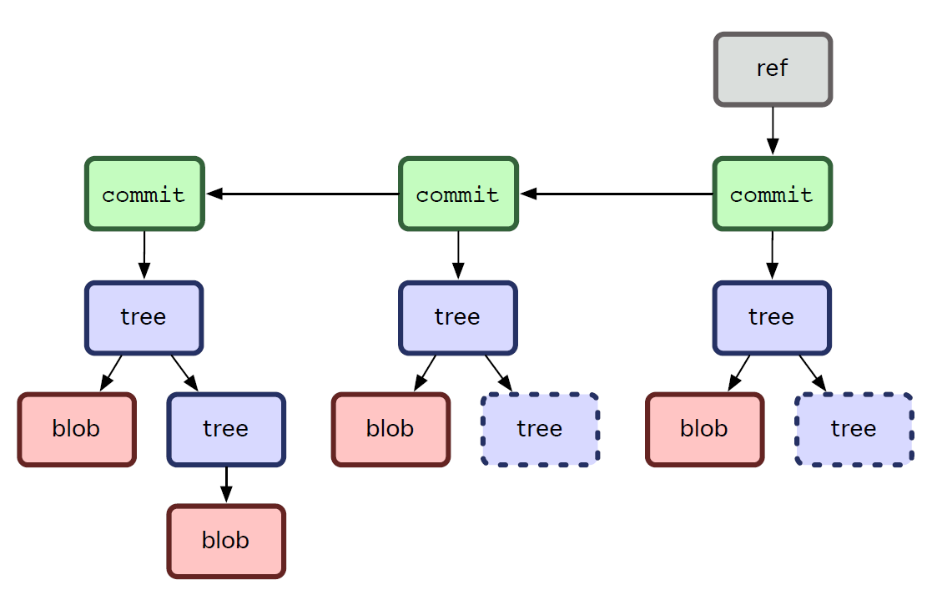
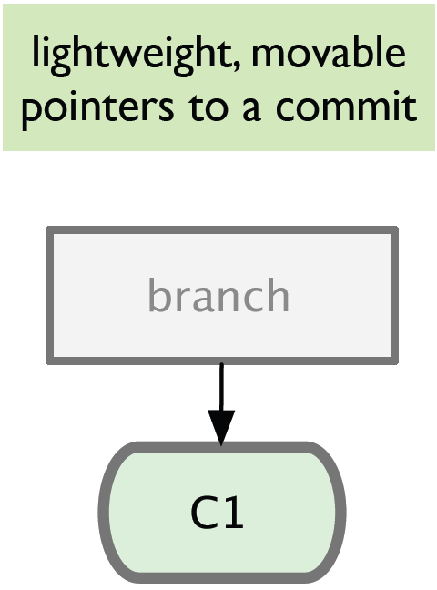
Branching
Git sees commit this way…
Branch annotates which commit we are working on

Slide 21
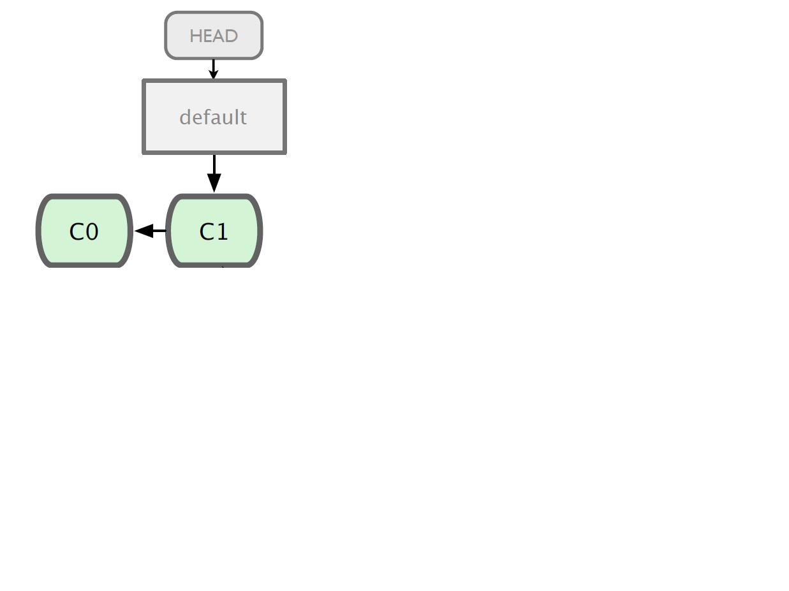
Branching

Slide 22
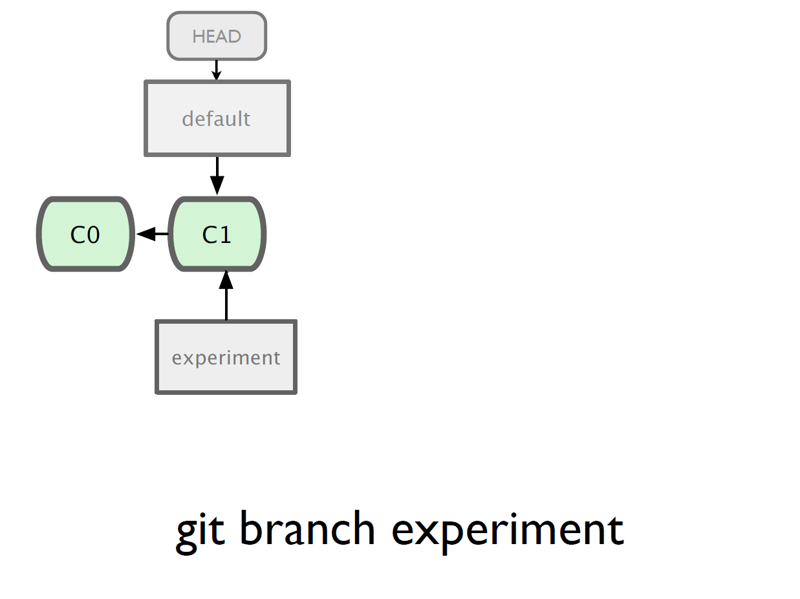

Slide 23
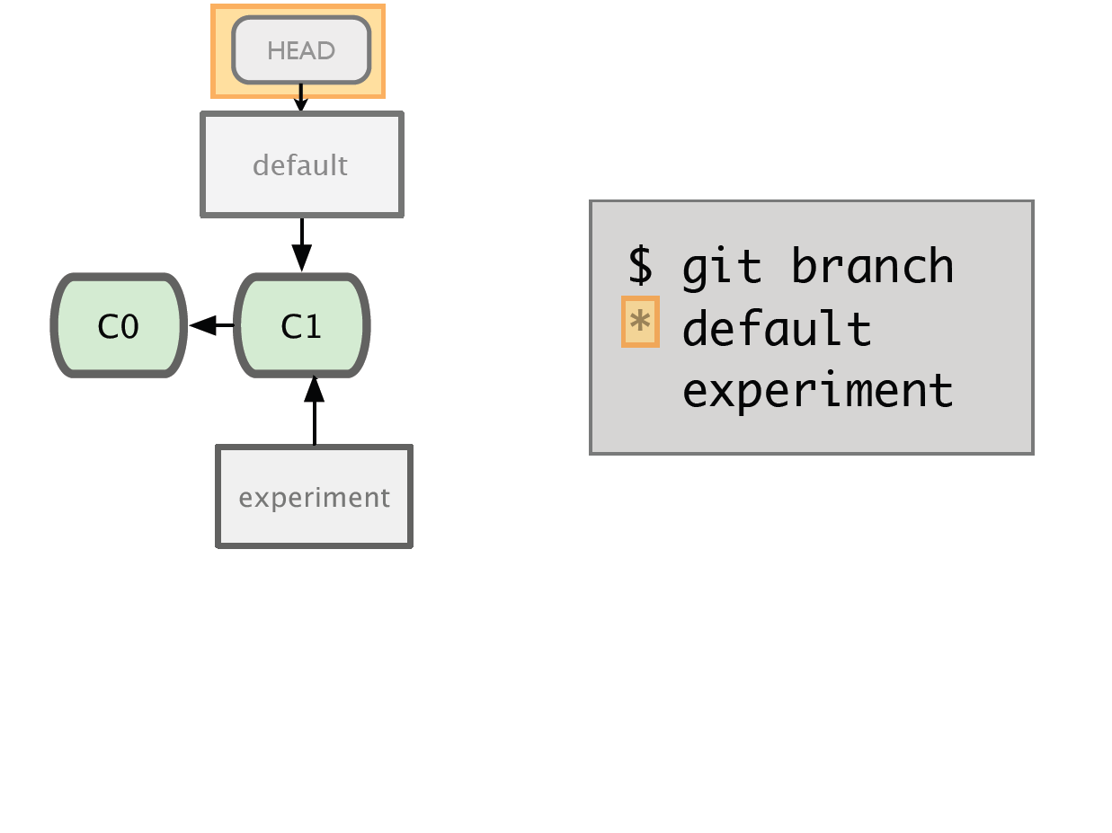

Slide 24
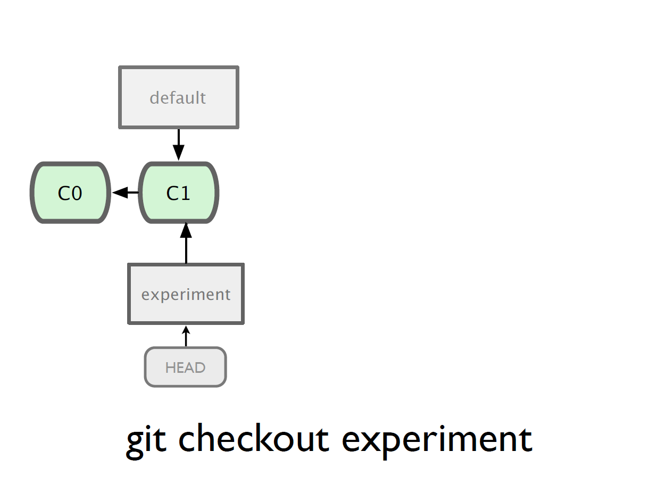

Slide 25
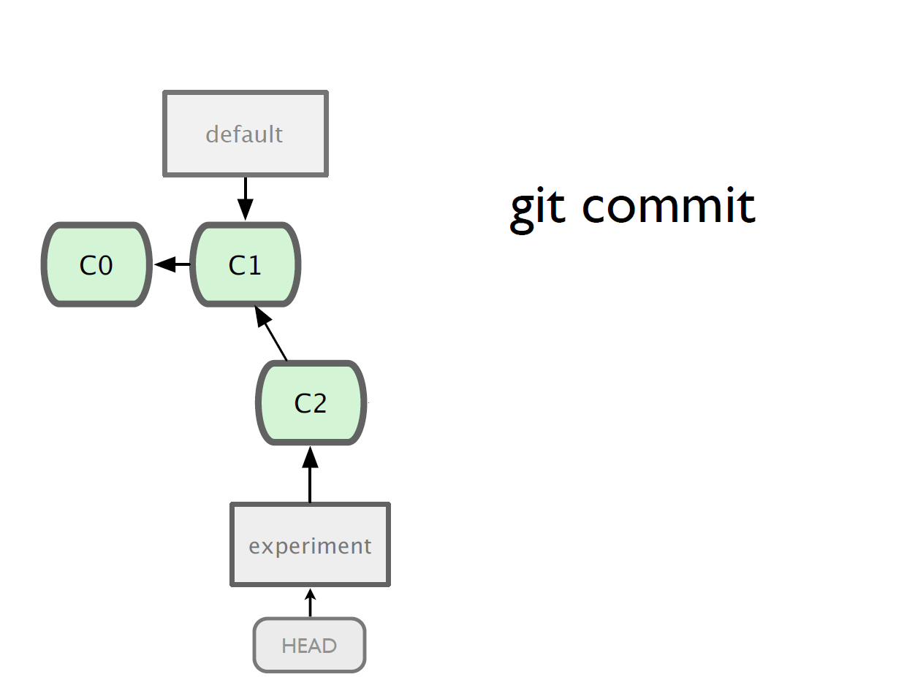

Slide 26
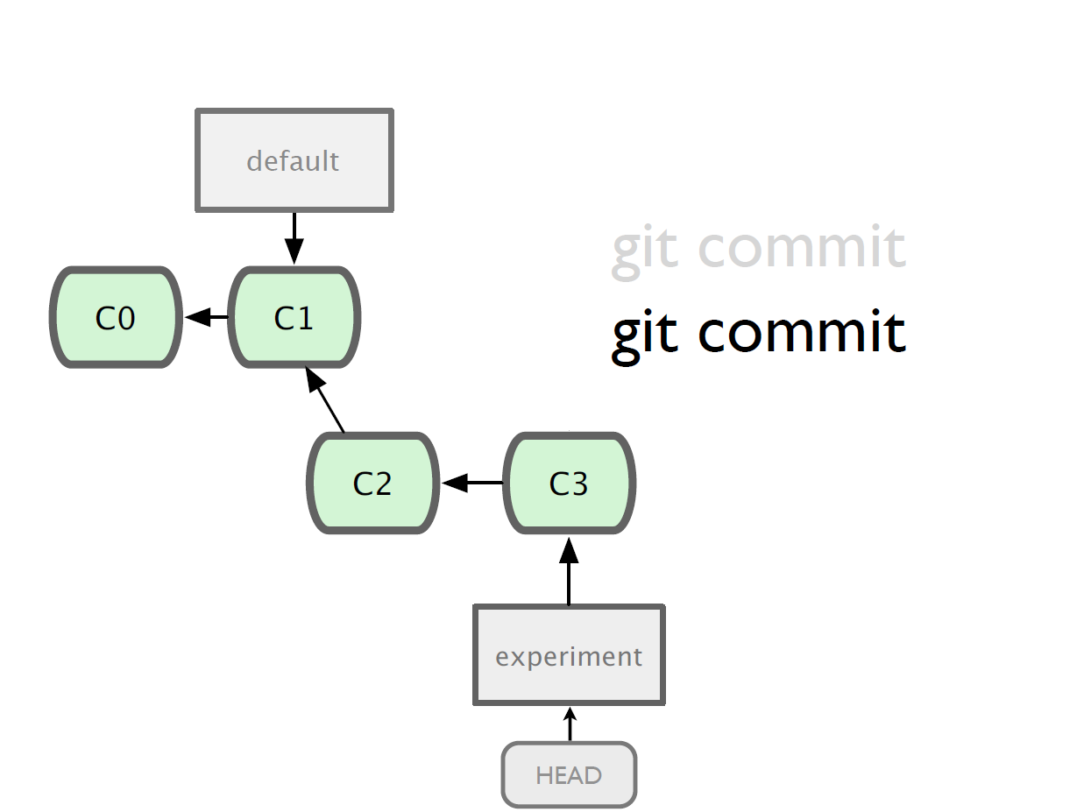

Slide 27
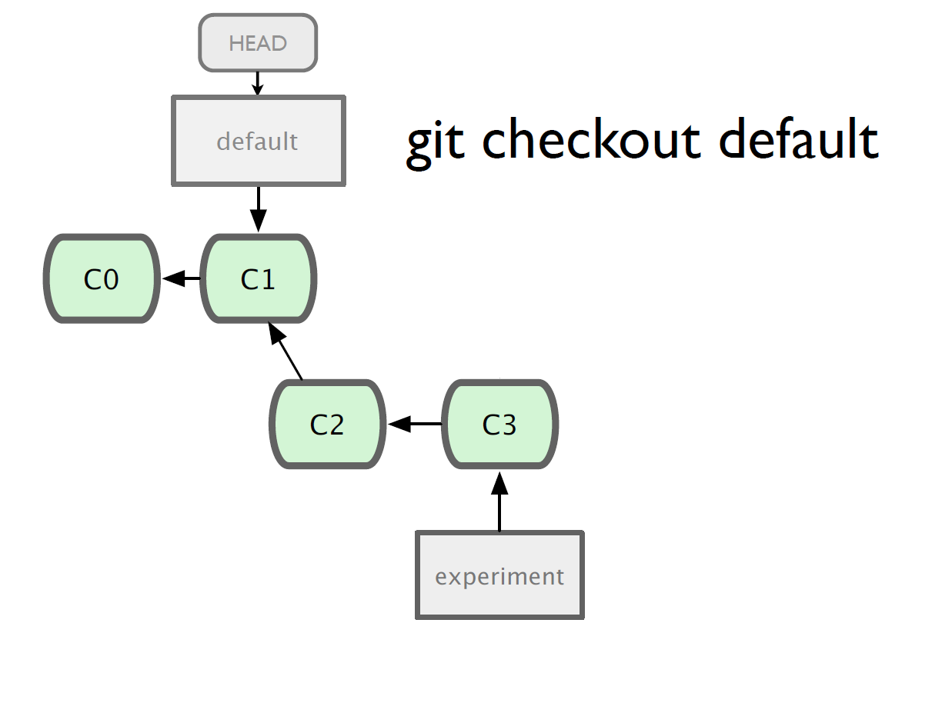

Slide 28
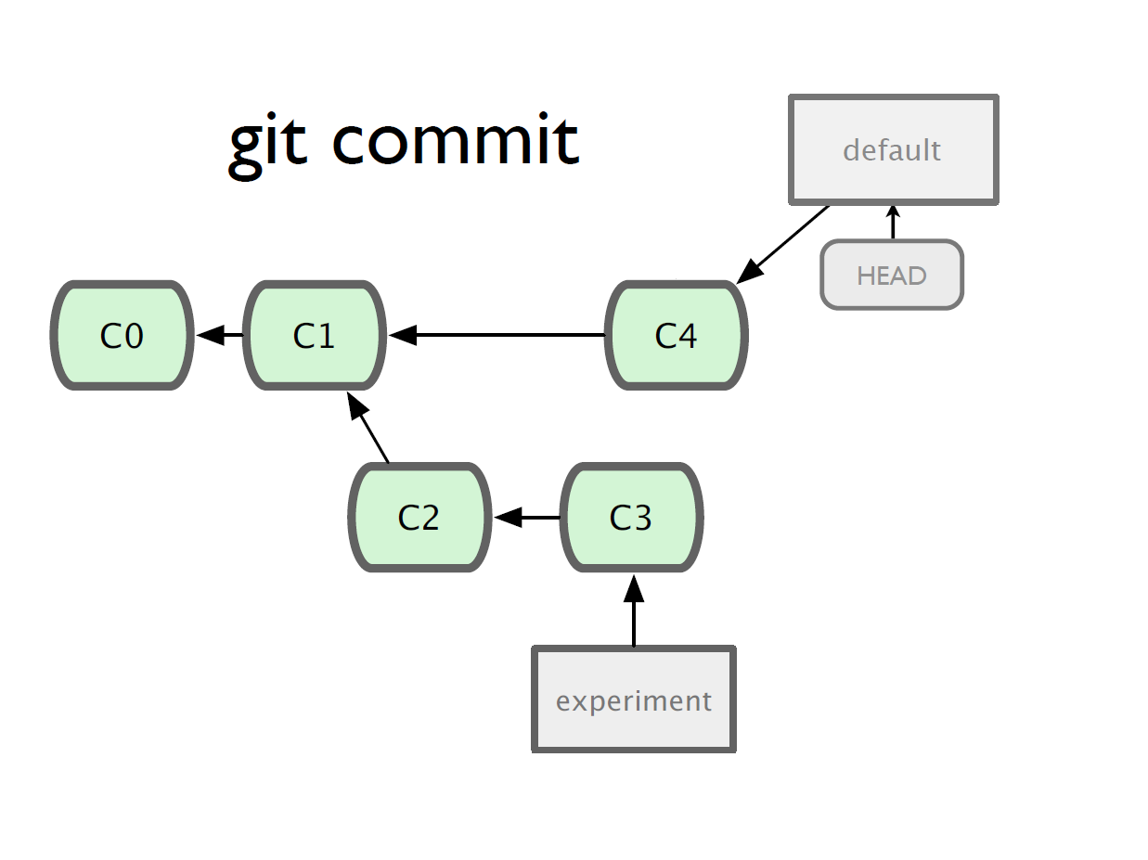

Slide 29
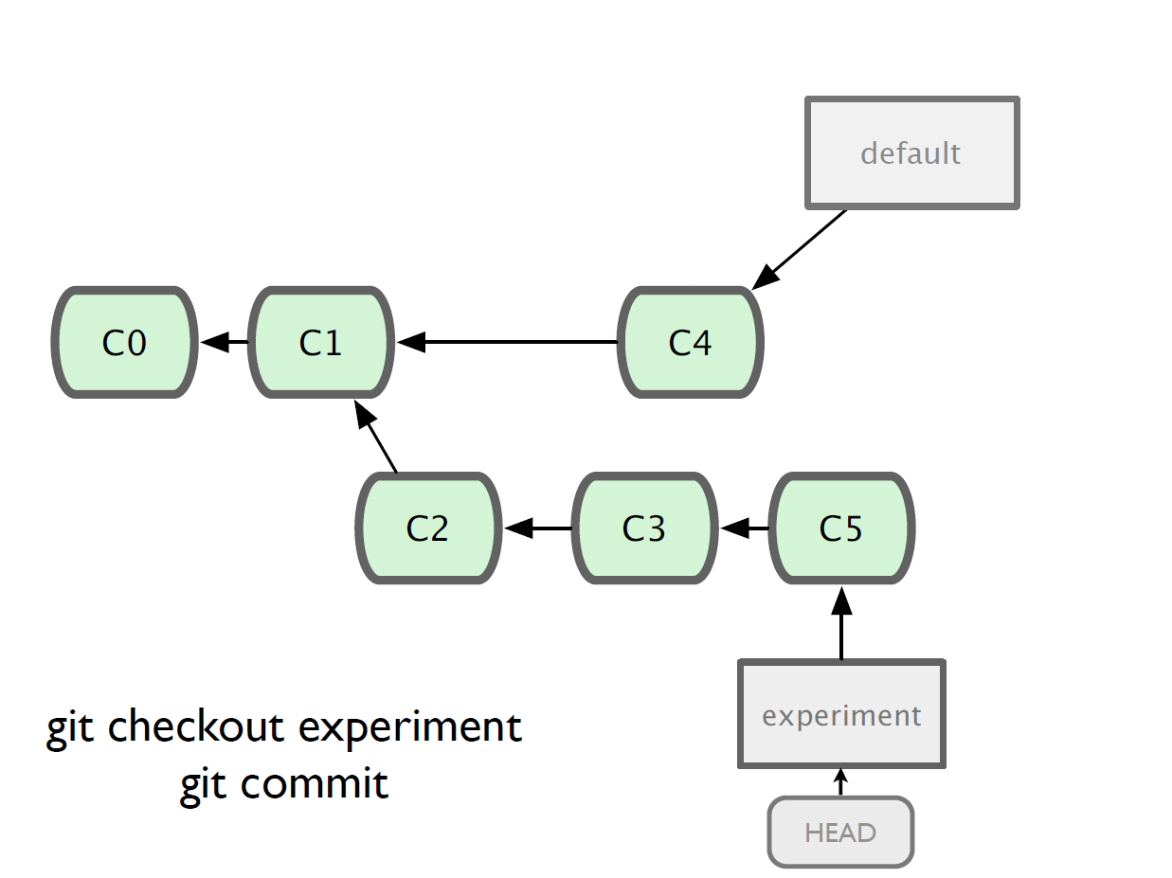

Slide 30
Merging
What do we do with this mess?
  Merge them

Slide 31
Merging
Steps to merge two branch
  Checkout the branch you want to merge onto
  Merge the branch you want to merge

Slide 32
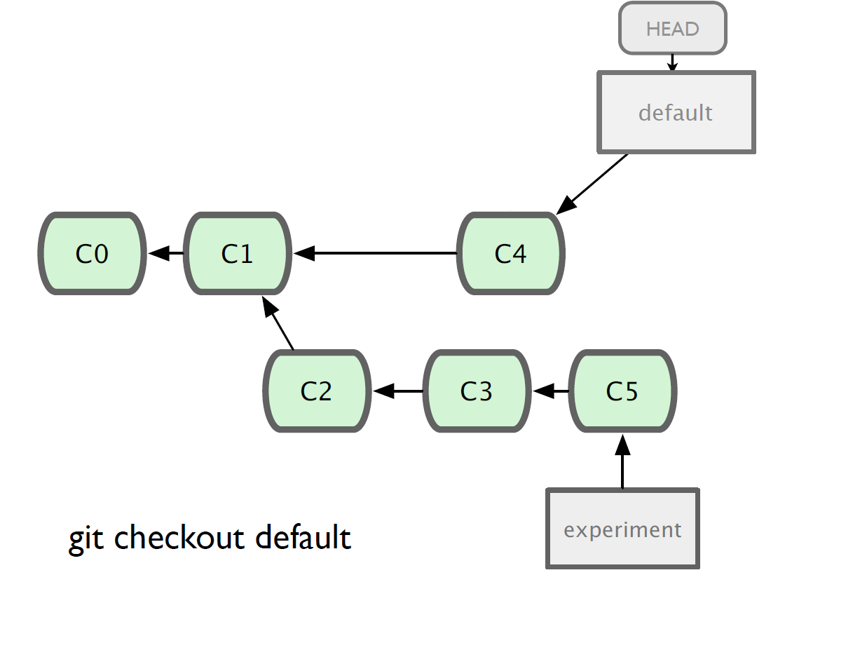

Slide 33
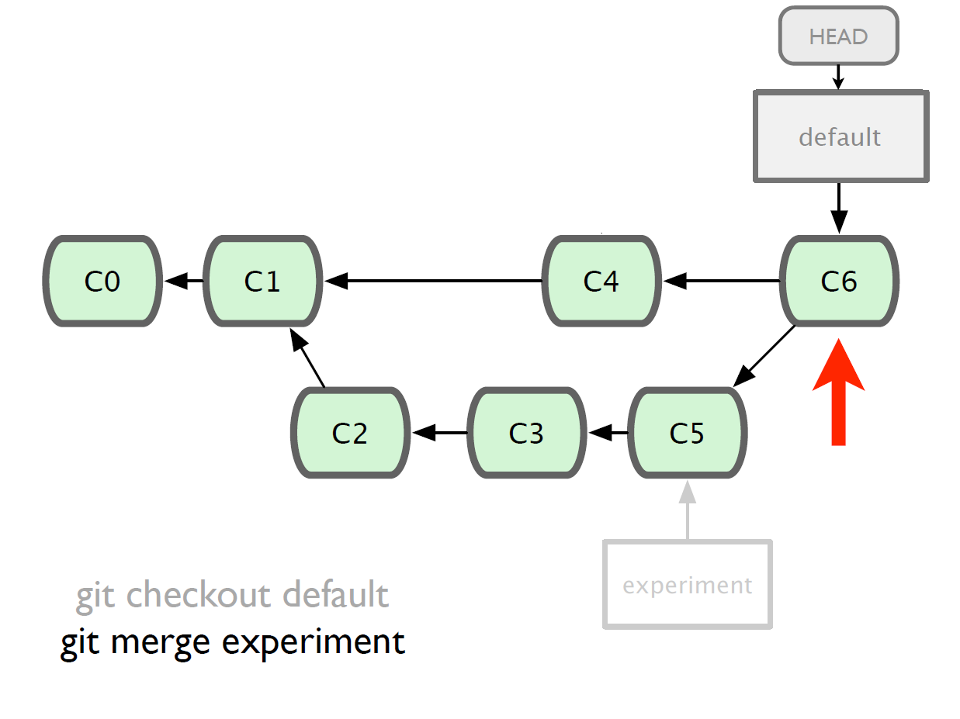

Slide 34
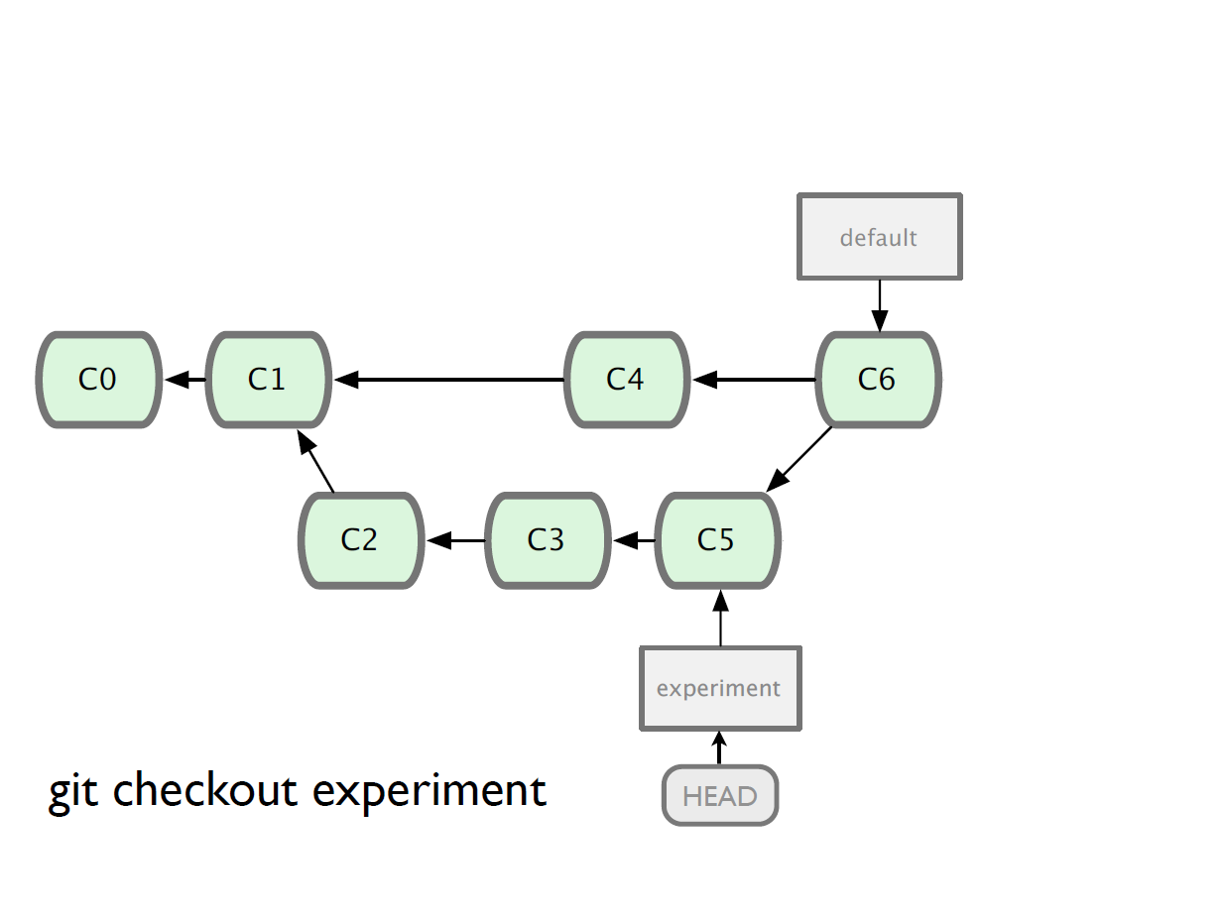

Slide 35
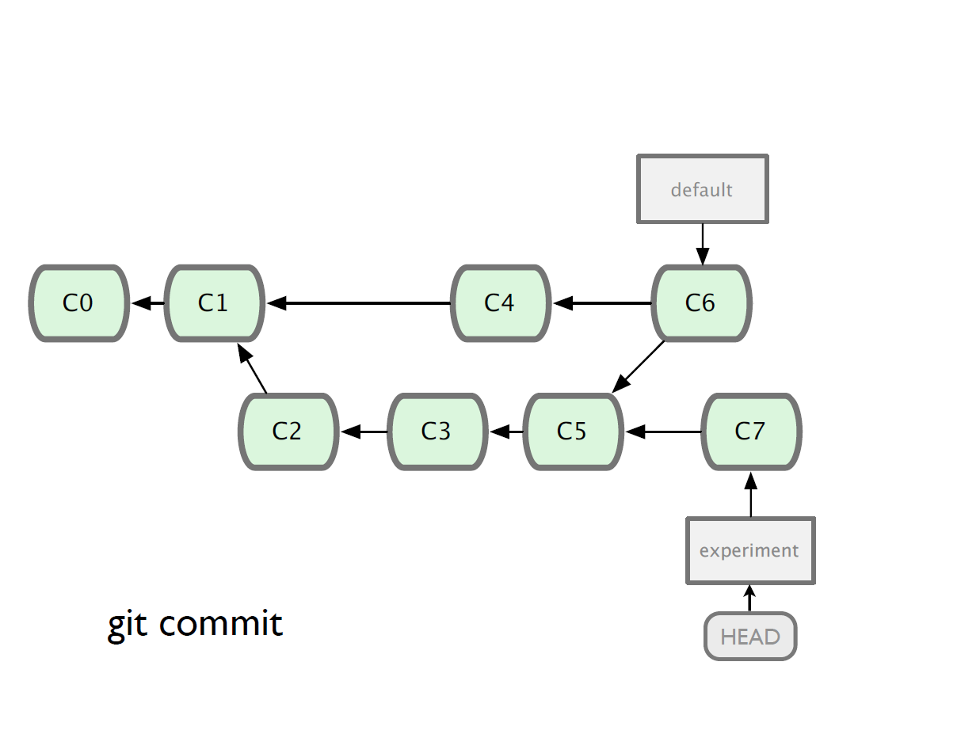

Slide 36
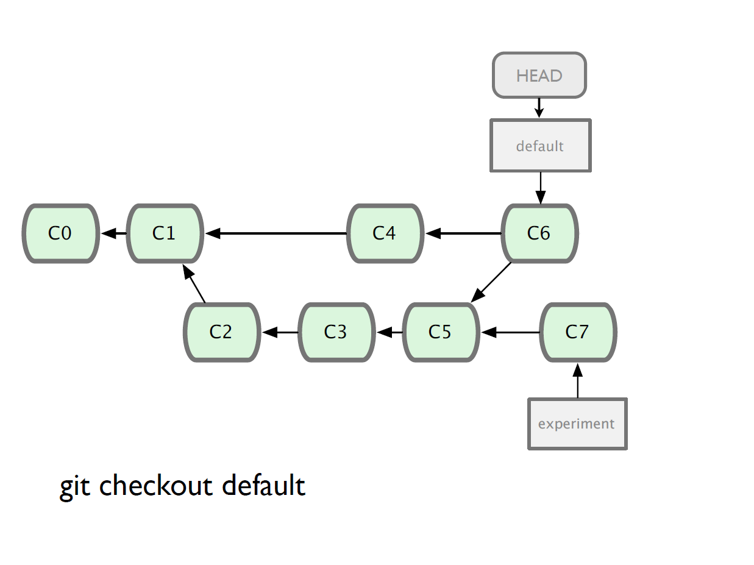

Slide 37
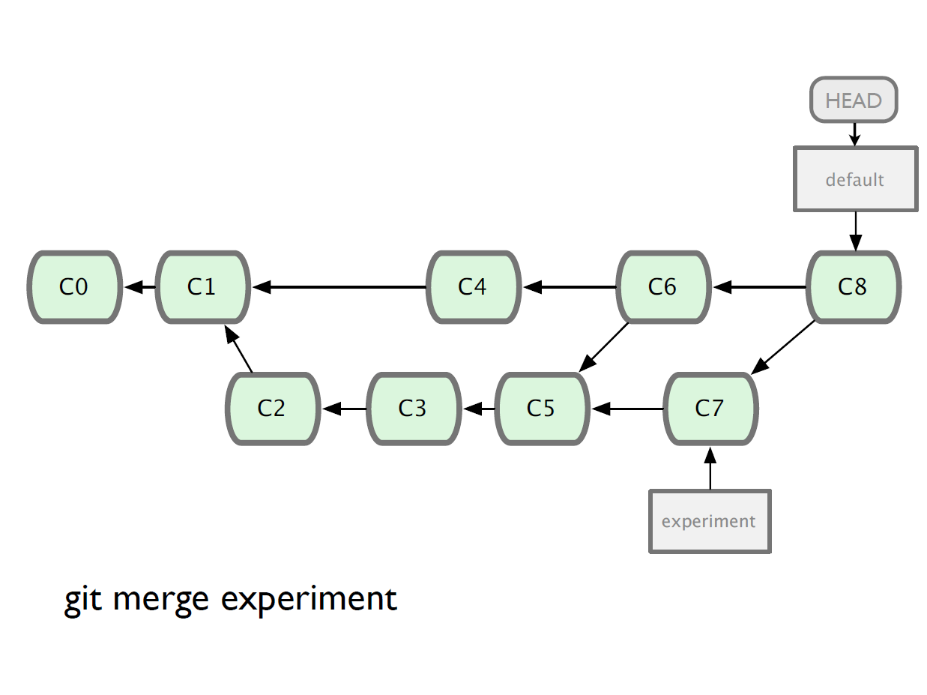

Slide 38
Branching and Merging
Why this is cool?
  Non-linear development
clone the code that is in production
create a branch for issue #53 (iss53)
work for 10 minutes
someone asks for a hotfix for issue #102
checkout ‘production’
create a branch (iss102)
fix the issue
checkout ‘production’, merge ‘iss102’
push ‘production’
checkout ‘iss53’ and keep working

Slide 39
Git and Tagging
Tags are just human readable shortcuts for hashes
Branches can be made from any commit
git tag <tag-name>

Slide 40
git submodule
Suppose your software has dependencies.
And that those dependencies are also held in git repositories.
You can add informations about them to your program.

Slide 41
git submodule
How to initialize it:
  git submodule add git://repo/path/to/project.git
    This creates a directory called ‘project’
  cd project; git checkout <version>
    Check out the exact version you wish to use
  git commit

Slide 42
git submodule
When cloning:
  git clone <main repo>
    As usual
  git submodule init
    Updates the submodules to the correct checkout version as set by the origin repository.
    This *will* require connectivity to the submodule repositories.

Slide 43
git submodule -- notes
Inside the submodules, you do not get a branch.
  I.e: commits in there are lost
Whenever you do a ‘git pull’ you should also do a ‘git submodule update’

Slide 44
Working with remote
Use git clone to replicate repository
Get changes with
  git fetch
  git pull (fetches and merges)
  Git commit –am “after merge”
Propagate changes with
  git push
Protocols
  Local filesystem (file://)
  SSH (ssh://)
  HTTP (http:// https://)
  Git protocol (git://)

Slide 45
Working with remote
Local filesystem
Pros
  Simple
  Support existing access control
  NFS enabled
Cons
  Public share is difficult to set up
  Slow on top of NFS

Slide 46
Working with remote
SSH
Pros
  Support authenticated write access
  Easy to set up as most system provide ssh toolsets
  Fast
    Compression before transfer
Cons
  No anonymous access
    Not even for read access

Slide 47
Working with remote
GIT
Pros
  Fastest protocal
  Allow public anonymous access
Cons
  Lack of authentication
  Difficult to set up
  Use port 9418
    Not standard port
    Can be blocked

Slide 48
Working with remote
HTTP/HTTPS
Pros
  Very easy to set up
  Unlikely to be blocked
    Using standard port
Cons
  Inefficient

Slide 49
Working with remote
One person project
  Local repo is enough
  No need to bother with remote
Small team project
  SSH write access for a few core developers
  GIT public read access

Slide 50
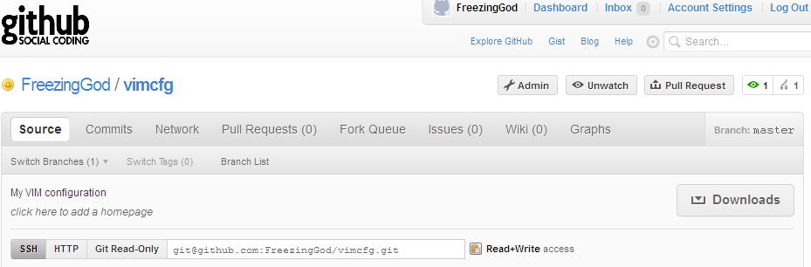
Working with remote
Use git remote add to add an remote repository
Git remote add origin git@github.com:FreezingGod/vimcfg.git
tboult@tboult-desktop:~/.vim_runtime$ git remote
origin

Slide 51
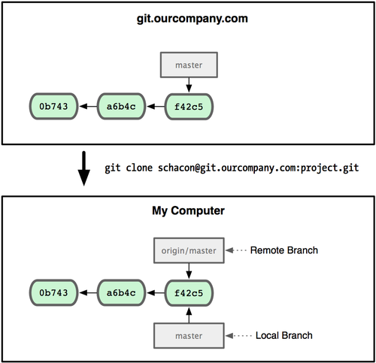
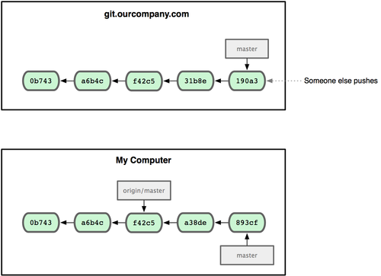
Working with remote
Remote branching
  Branch on remote are different from local branch

Slide 52
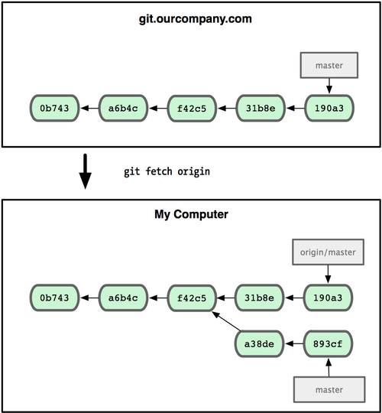
Working with remote
Remote branching
  Branch on remote are different from local branch
  Git fetch origin to get remote changes
  Git pull origin try to fetch reomte changes and merge it onto current branch

Slide 53
Cloning our Repository
git clone first-git-repo
  Now have a full git repository to work with
Changes are pushed back with git push
  Pushing changes WILL NOT change working copy on the repository being worked on
Branches can be based off of remote branches
  git branch --track new-branch remote/branch
Remote configuration information stored in .git/config
  Can have multiple remote backends!

Slide 54
Git for Software Versioning
Create convention to define default server
Developers clone from central server
Lots of tools for transmitting patches between developers
Being used for
  Linux (obviously)
  Ruby On Rails
  Check out http://github.com for a variety of hosted projects

Slide 55
Git for Backups
Example: Directory needs regular backups
  Could use rsync but unwieldy in size
Create Git repository for appropriate directory
  Regular local commits
  Regular push to backup location
  Get simple revision heistory

Slide 56
Git for Configuration Management
Example: Apache configurations
  Multiple environments (dev/test/production)
  Minor differences between environments
    IP Address
    Log levels
  Want to effectively move changes across environments
Great way to manage different “experiments” where different code versions/data are used/produced. With tags/branches its efficient and much better than commenting code in/out.

Slide 57
Git for Documents
Well matched for latex.
  Best if one-sentence-per-line
Well matched for multi-person editing
Authors/Editor clone from central server
Being used for
  Overleaf

Slide 58
Git Assignment For next week
Checkout out git repo from https://github.com/tboult/A3-CS6000F19
You are to make a new latex file, named after your last name. In that file copy some of your first assignment about your self, including photo, add the associated files to the repo. Then update Assignment3.tex file to \include your file. Make sure all latex compiles properly and shows your content. Then commit/push your changes.
After at least 2 other people have uploaded their files, you are to edit one of their files to ask them a question at the end of their file. You are to ask at least 2 people questions, and no one can be asked more than 2 questions. When someone asks you a question, you are to update your file to answer. If there are any merge conflicts, deal with them. If there are more than two questions in your file, revert it back to a point where they were only 2.

