Slide 1
Spring Boot Bibliography Management System
Keith Rodgers

Slide 2
Overview
Demo
Technologies used
Implementation of features

Slide 3
Demo
Implementation of a bibliography management system

Slide 4
Technology
Web application framework – Spring Boot
MVC
Database – MySQL
Deployment/Configuration – Maven

Slide 5
Features Overview
Add / Edit / Delete
Import
Export
Search
View IEEE formatted citation
Fetch records from IEEE api
Import records from IEEE api

Slide 6
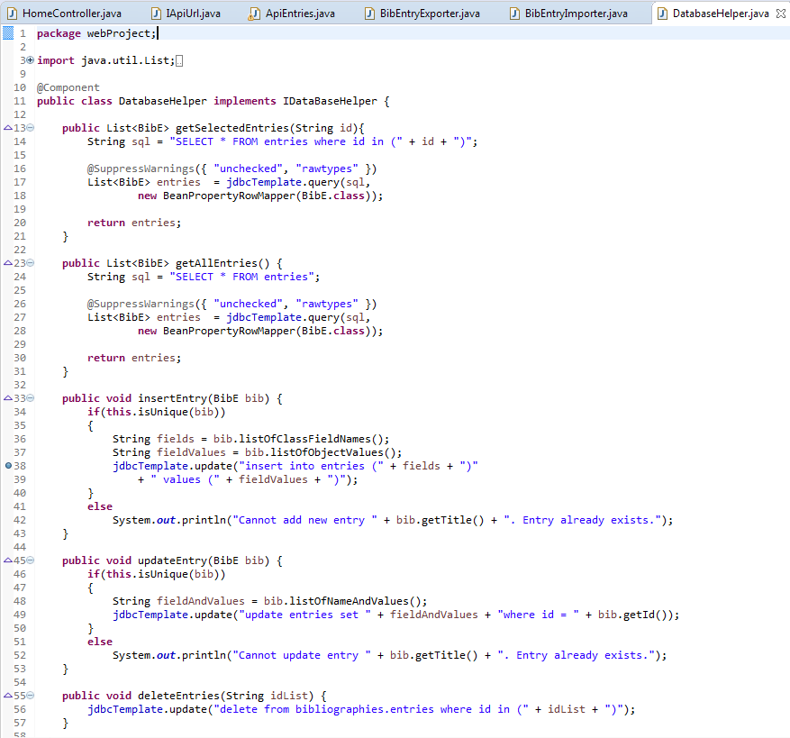
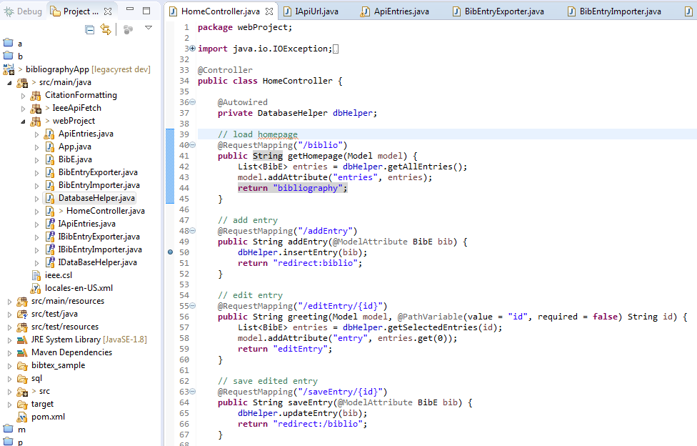
Add/Edit/Delete

Slide 7
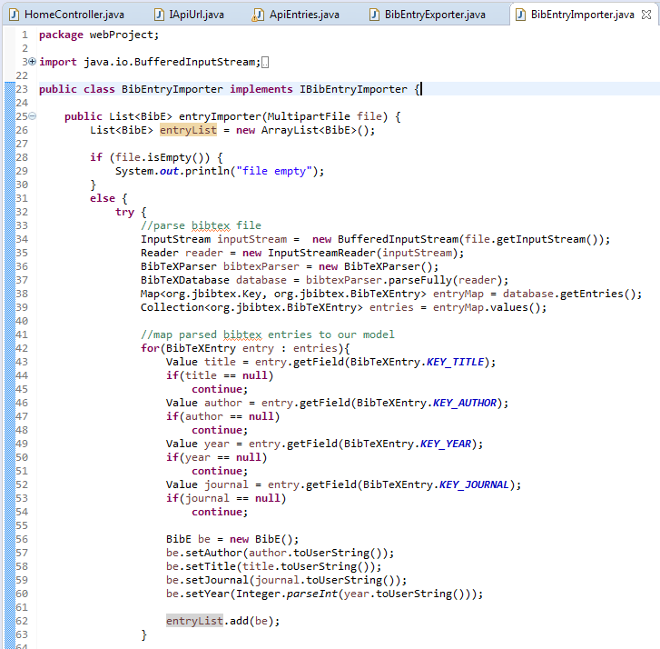
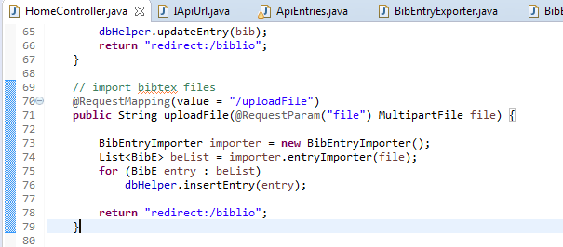
Import

Slide 8
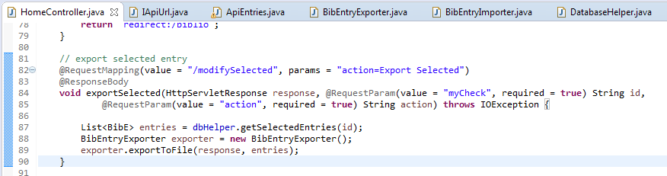
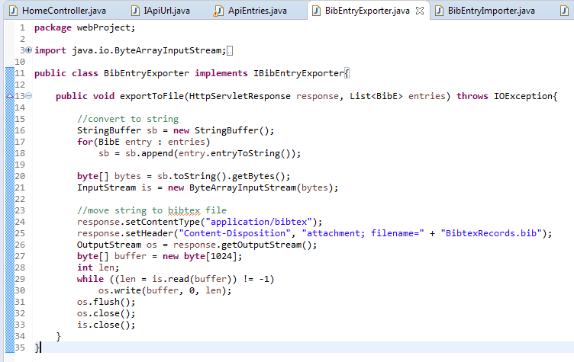
Export

Slide 9
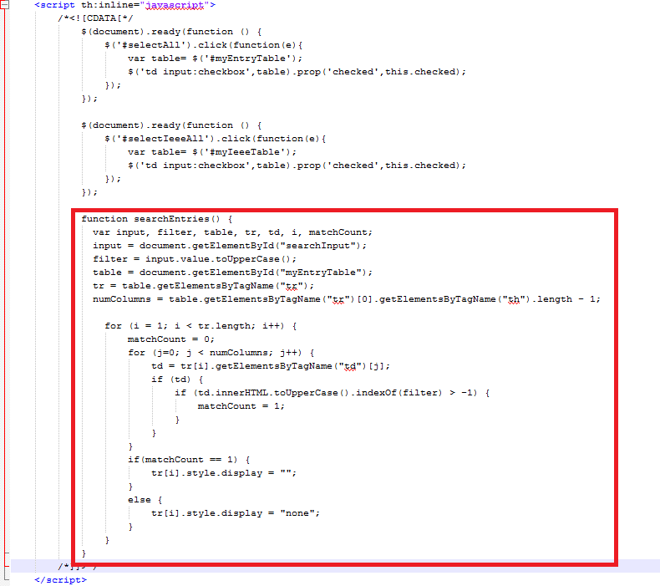
Search
Implemented in Javascript because doing in the browser was faster/easier/friendlier than making explicit calls to server

Slide 10
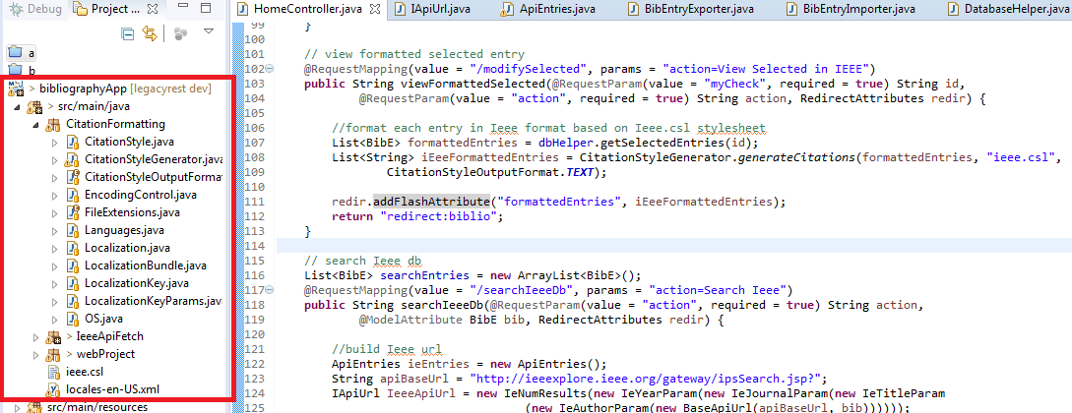
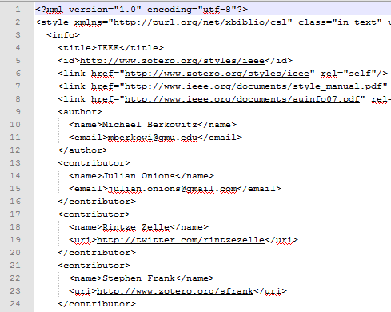
View records in IEEE citation format

Slide 11
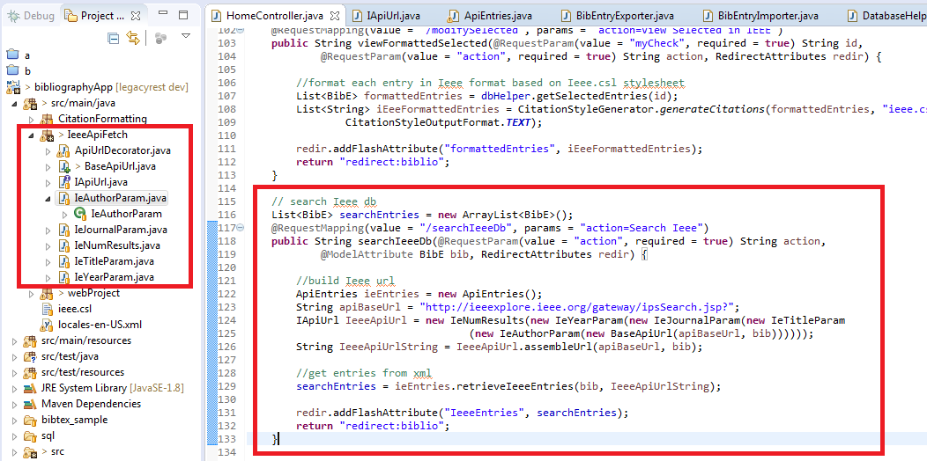
Fetch Records from IEEE Api
Decorator pattern for api url
Xml mapping to model

Slide 12
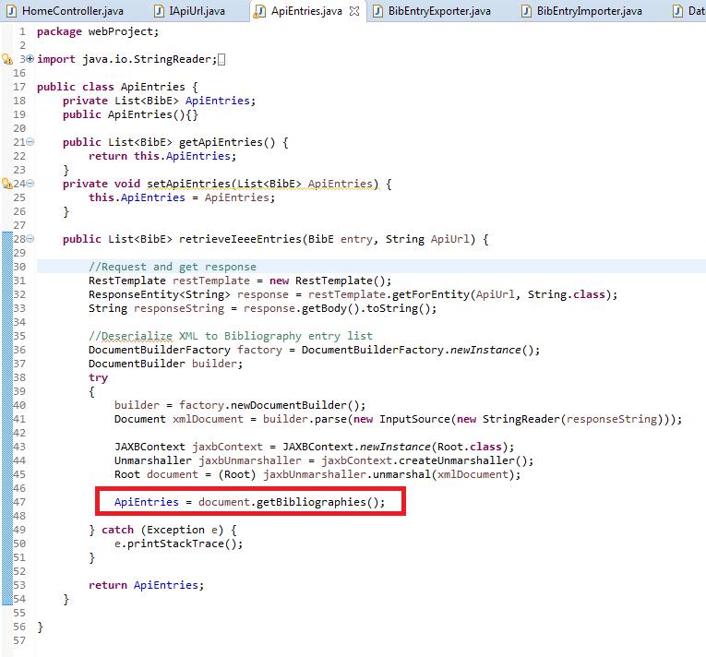
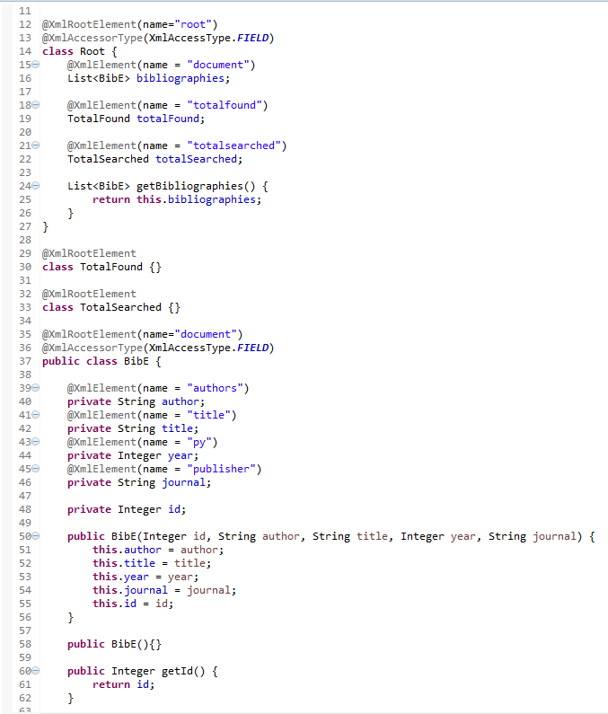
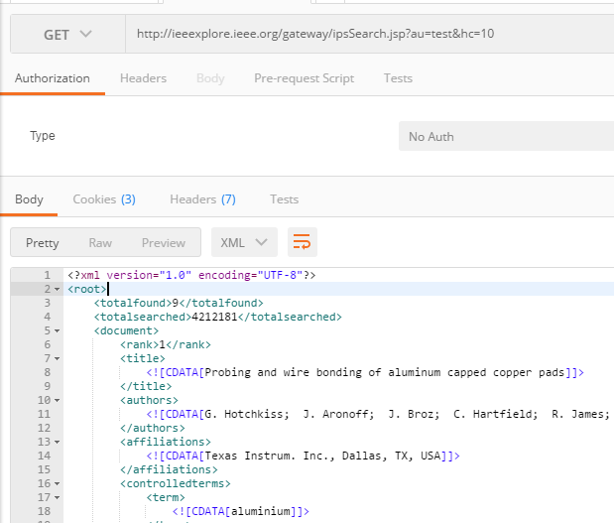
Map xml to model

Slide 13
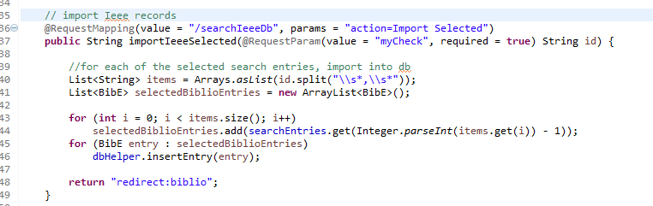
Import Records from IEEE Results

Slide 14
Questions?

