Slide 1
Rodgers VBA Challenge
Screen Shots from first Multi-Year Run
9/18/2020 4:30p

Slide 2
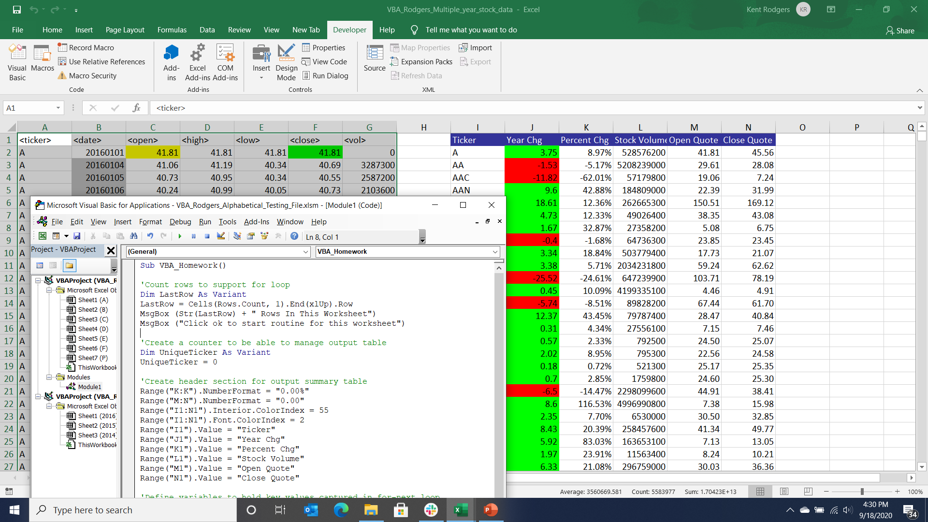

Slide 3
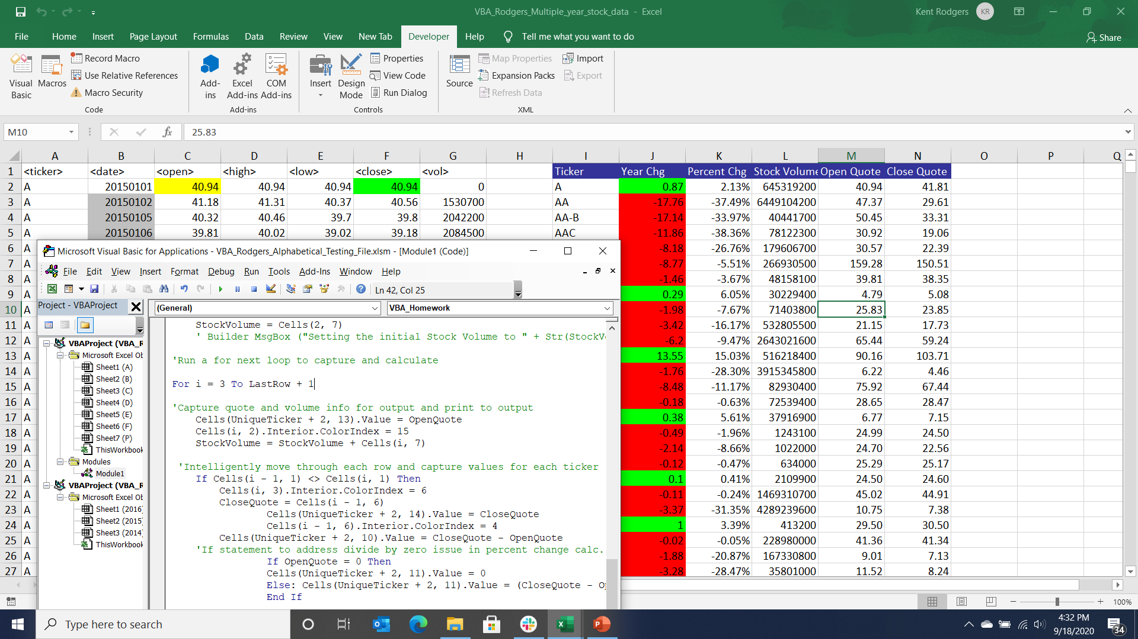

Slide 4
