Slide 1
ETL Project Anesthesia Compliance Management
Kent Rodgers
December 10, 2020

Slide 2
Project Overview

Slide 3
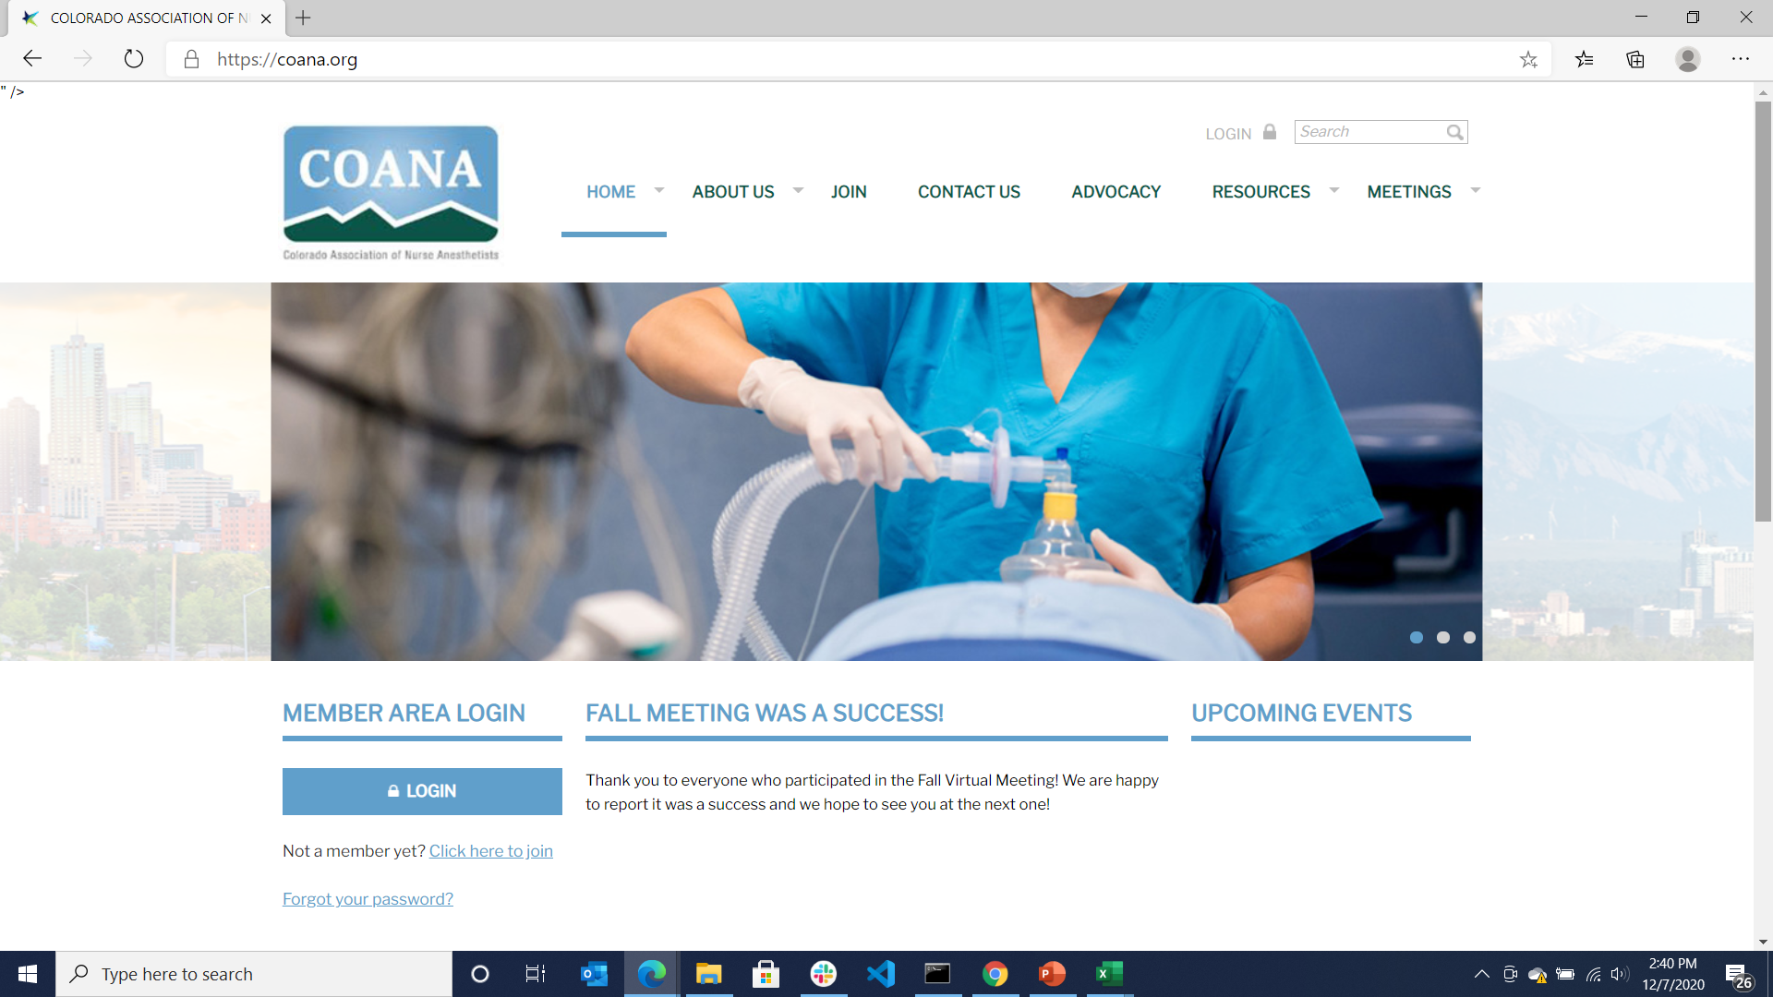
Colorado has 1252 actively licensed non-physician anesthesia clinicians in Colorado.
The primary purpose of a CRNA is to keep a patient comfortable and alive during a medical procedure. These professionals require extensive training and credentials to practice.
More than 85% are Certified Registered Nurse Anesthestists (CRNA’s)

Slide 4
Problem Statement
Managing Nurse Anesthetists licensing is complicated
… and if not done properly can be costly
A Nurse Anesthetist is an advanced practice nurse and must maintain two licenses concurrently a) Advanced anesthesia b) underlying RN
“Compact” licensing permits the two licenses to be issued from separate states which makes it harder to ensure compliance
It can be interpreted as fraud if a Nurse Anesthetist bills Medicare while either license is expired or out of compliance. This can result in refunds, fines, loss of license due to censure and contract breach

Slide 5
Original Project Proposal
Pull professional licensing data from Colorado.gov and create a reporting process to better manage expired and pending expiration licenses.
Extract
Ideally – utilize an API from the CO-DORA license listing that is updated daily.
Add fictitious employee file to align with the state licensing status (fabricated with publicly available info)
Add the state license expiration and license name information if needed form “Professional-Types” csv
Cleaning:
Narrow the dataset to the appropriate license types, i.e. separate anesthetists from the other professional types such as plumber or electrician.
Drop unnecessary information required to meet the license management process (simplify)
Determine if additional information is needed for the underlying RN license
Note: Out of state / compact license will not be included in dataset, missing RN license will be part of risk reporting later in project
Load
Load to a PGAdmin database with the idea that the data set might provide feeds to third-party credentialling software such as Apogee or scheduling software such as Qgenda.
See the value
Join the dataset with the states license type and reoccurring expiration data cycle dates
Join the dataset with a (fabricated) employee file based on license number and/or name
Produce a report of “at-risk clinical employees” whose licenses show a) expired or b) about to expire (w/in 30 days)
Ancillary, determine number of practicing CRNA and AA’s in state of Colorado … always wondered

Slide 6
Project Summary

Slide 7
Main Files

Slide 8
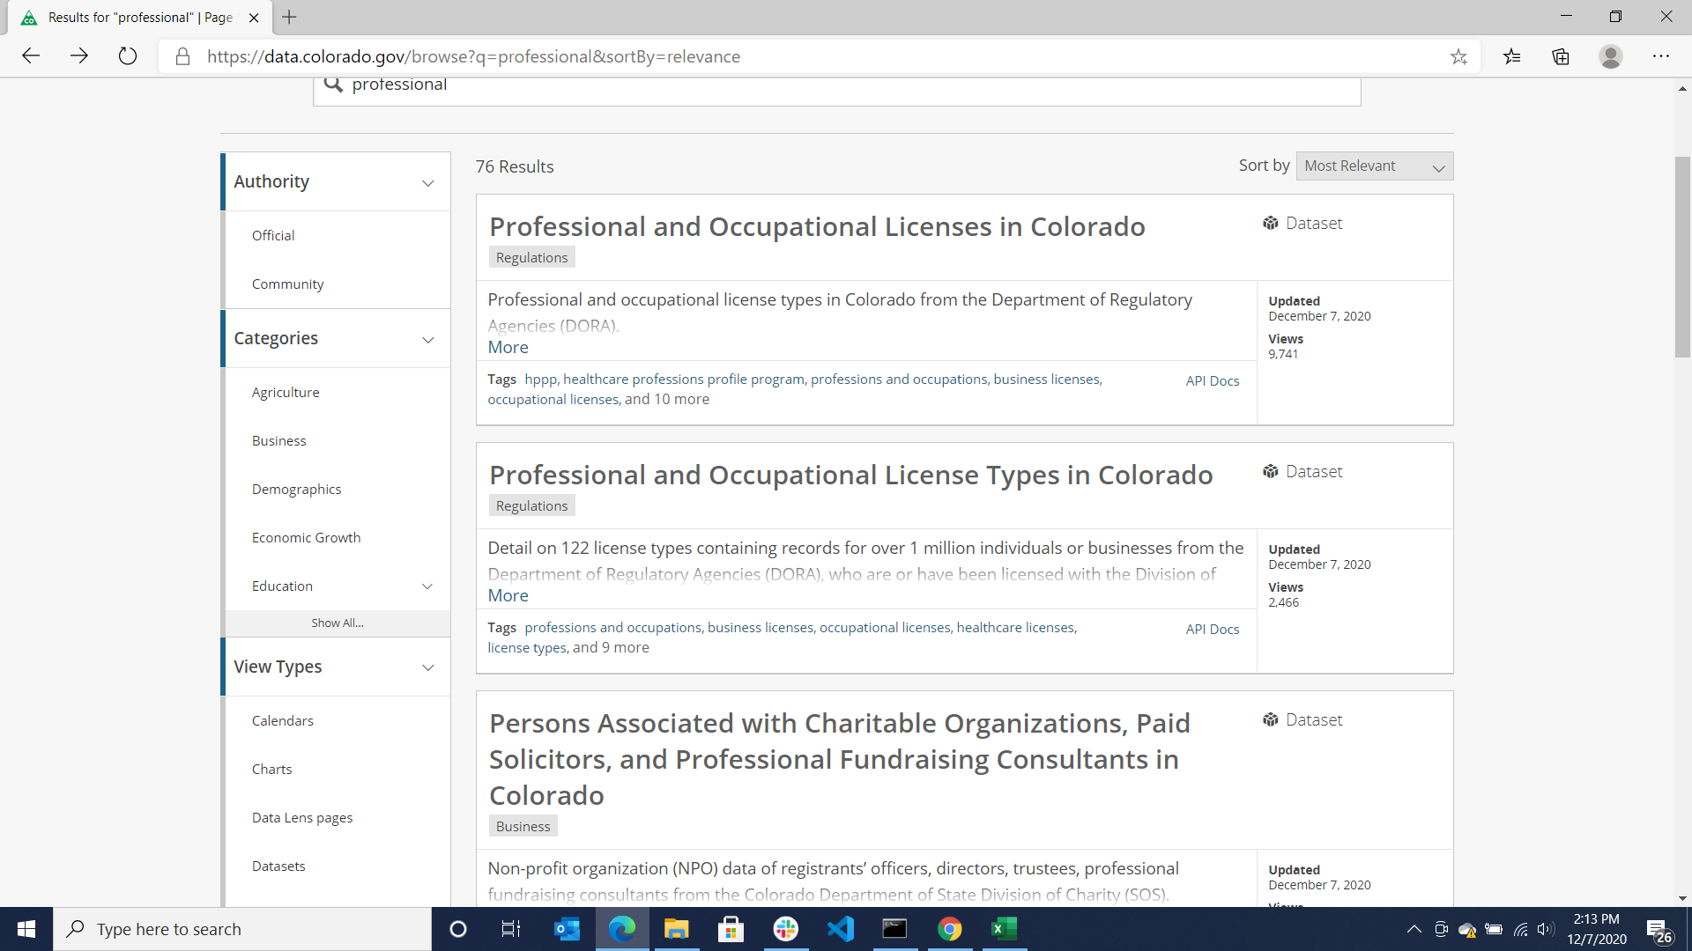

Slide 9
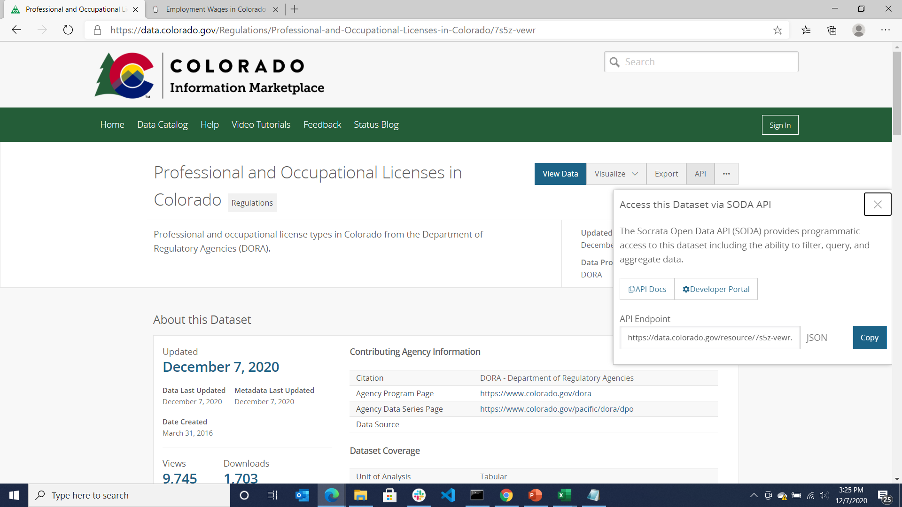

Slide 10
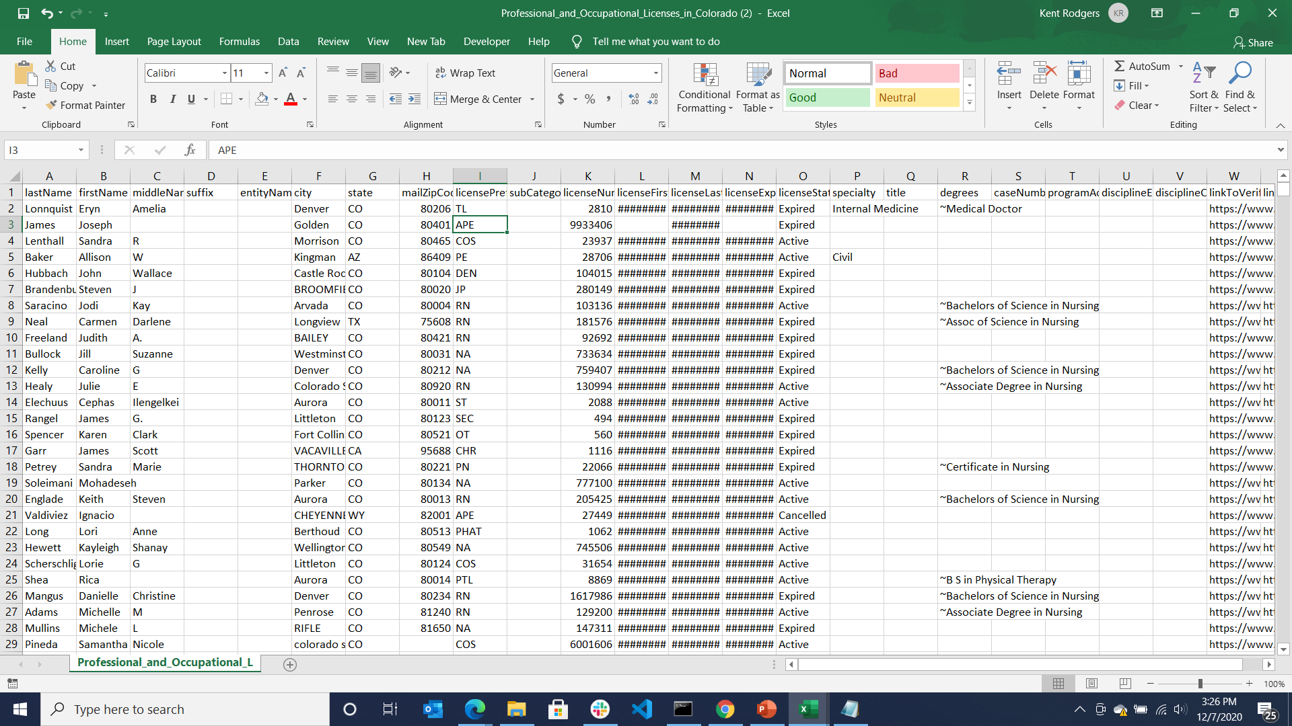
Main licensing file example

Slide 11
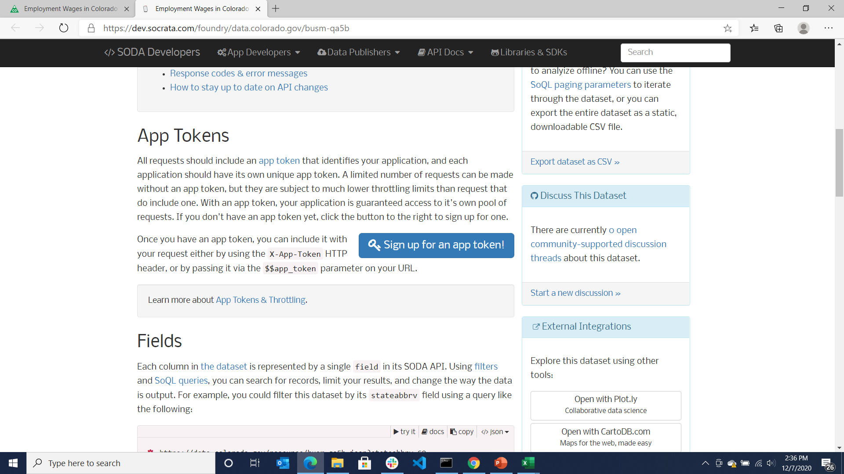
Path to getting an app token
May not need for project if we can secure a one-time file download

Slide 12
Ancillary File w/License Name & Renewal Cycle

Slide 14
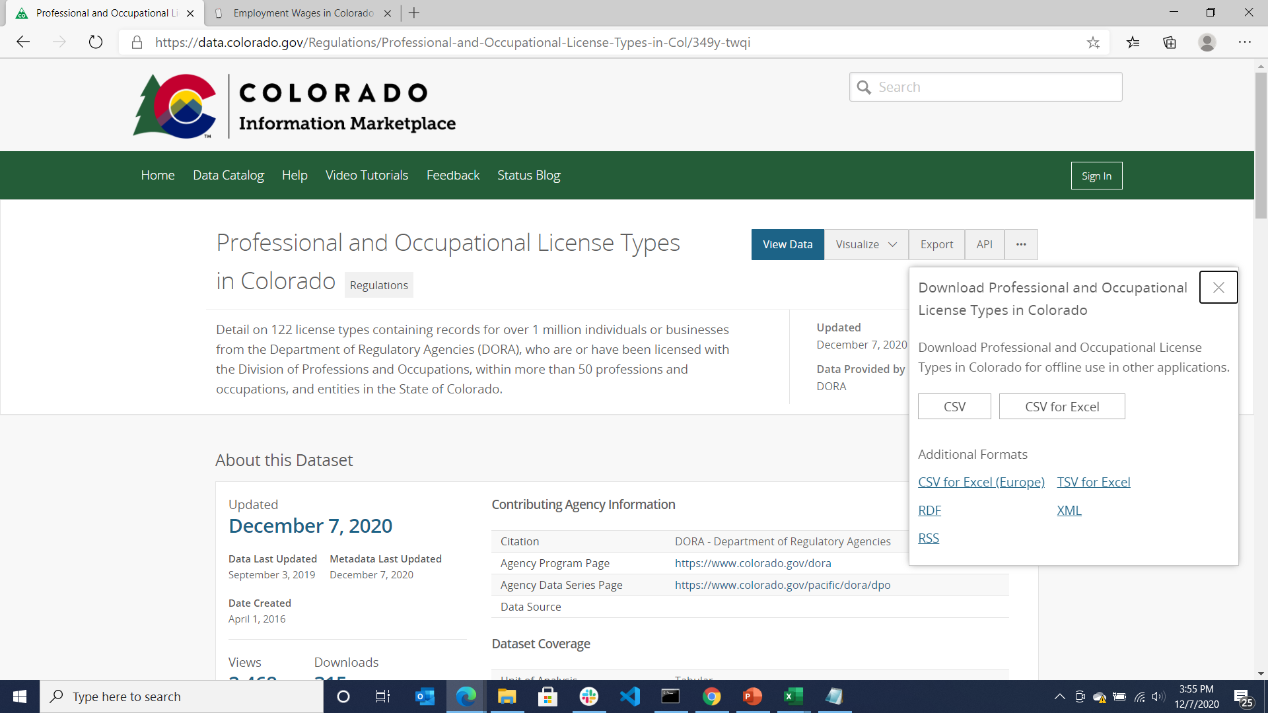

Slide 15
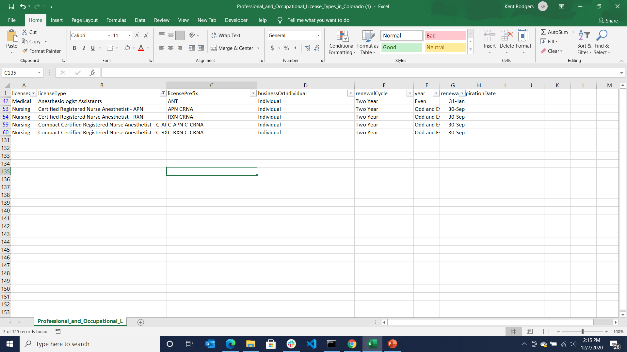

Slide 16
Ancillary File Fictitious Employee Roster

Slide 17
Fictitious employee roster will look something like this with 20-30 CRNA’s on the roster … names from public sources

Slide 18
Ancillary Resources Associate Websites (Out-of-scope but might use later)

Slide 20
