Slide 1
Matplotlib Challenge Pymacueticals
Kent Rodgers
October 18, 2020

Slide 2
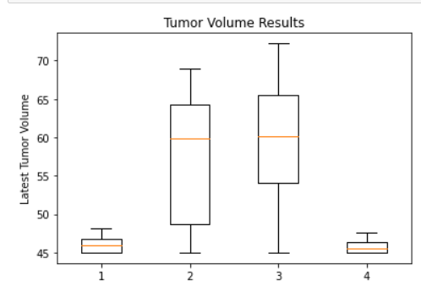
Tumor Volume Results In Key Drug Regimens
End Tumor volumes were significantly lower in the
Capomulin (1) and the Ramicane (4) drug regimens

Slide 3
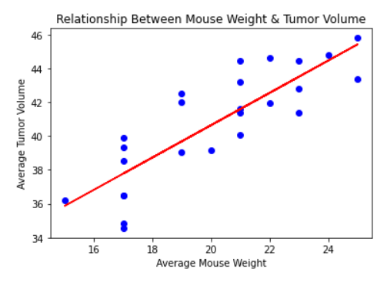
Weight & Tumor Volume Correlation
‘Weight and Tumor Volume are highly correlated
The correlation coefficient is 0.84

Slide 4
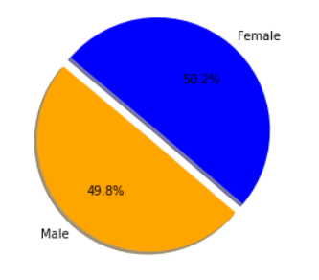
Mice Participants by Gender
The participants were equally distributed between male and female

Slide 5
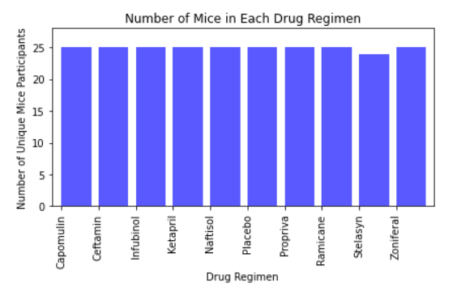
Mice Participants by Drug Regimen
Mice participants were evenly distributed between drug regimens with one exception
The participate and tumor volume data suggest two mice may have had their data combined

