Slide 1
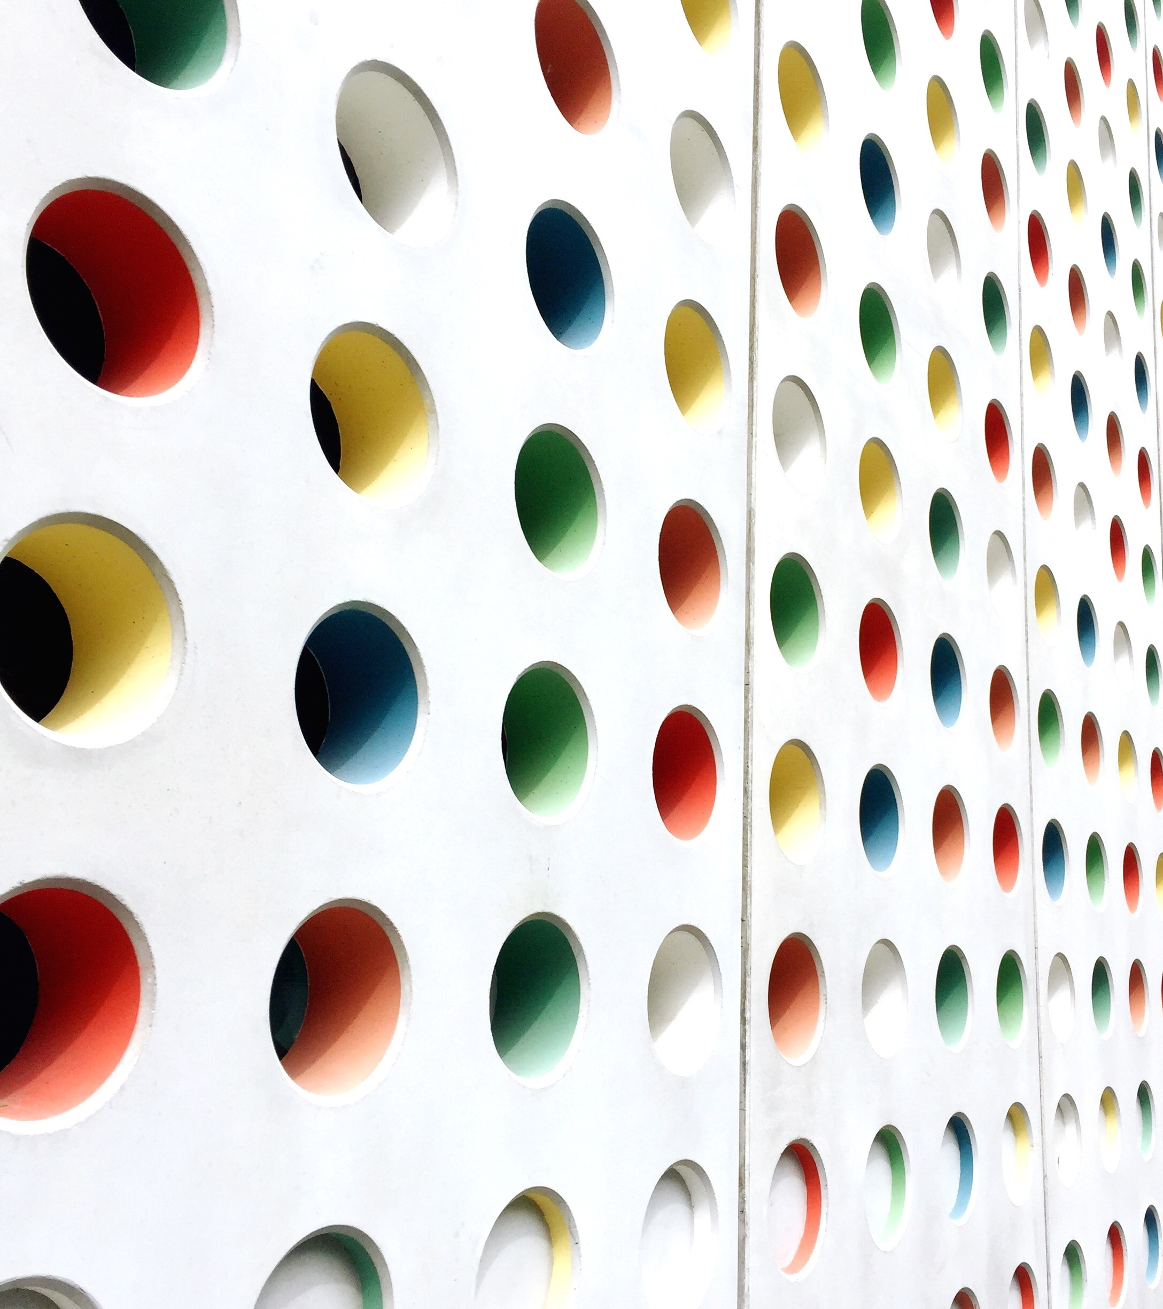
General Manager Presentation
Kent Rodgers
January 15, 2021

Slide 2
Prompt
Design an organization that will profitably achieve industry leading on-time delivery and client rating performance.
What would the team look like?
What is the background of each supervisor, and where will you recruit them from?
What is the reporting structure?
What roles operate across the whole region vs. only for the local market?
What are the KPIs you would use?
What meetings would your teams have and at what cadence?
What unique management insights would you bring to your team that would make them a model for how a market/region within the Veho organization should operate?

Slide 3
Organizational Structure
Region
Recruiting
& IC Performance
Assignment v. Role
Substation
Lead
Small Station
Supervisor
Medium Station
Mgr./Supr. +
(+5)
Other Markets
Up to 12 Rte Eq.
---
Inside Operations
Reports to nearby station
Up to 16 Rte Eq.
---
Inside Operations
Substation Oversight
Up to 60 Rte Eq.
---
Inside Operations
Substation Oversight
---
Dispatch hub or CX Host
2021 Copyright Kent Matthew Rodgers

Slide 4
Key Performance Indicator List & Role Map
5 to 7 Scorecard
Categories
20 to 25
Performance
Indicators
Narrowed to
5 to 7 Performance Metrics
for each role
Translate to Example Dashboard Next Page
2021 Copyright Kent Matthew Rodgers

Slide 5
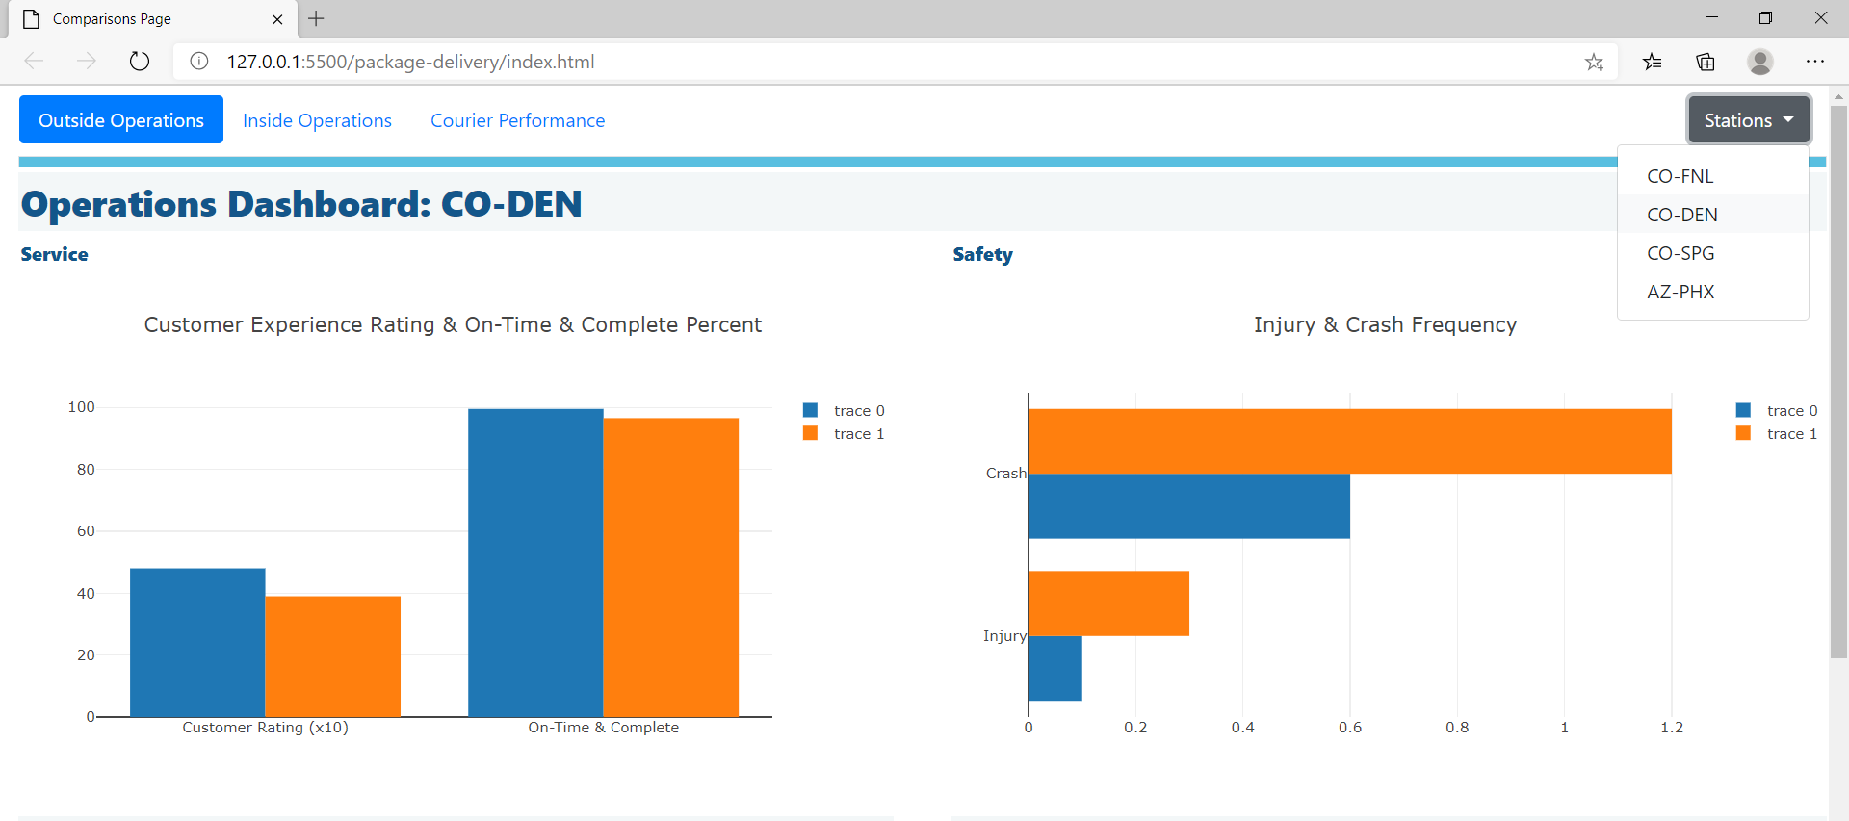
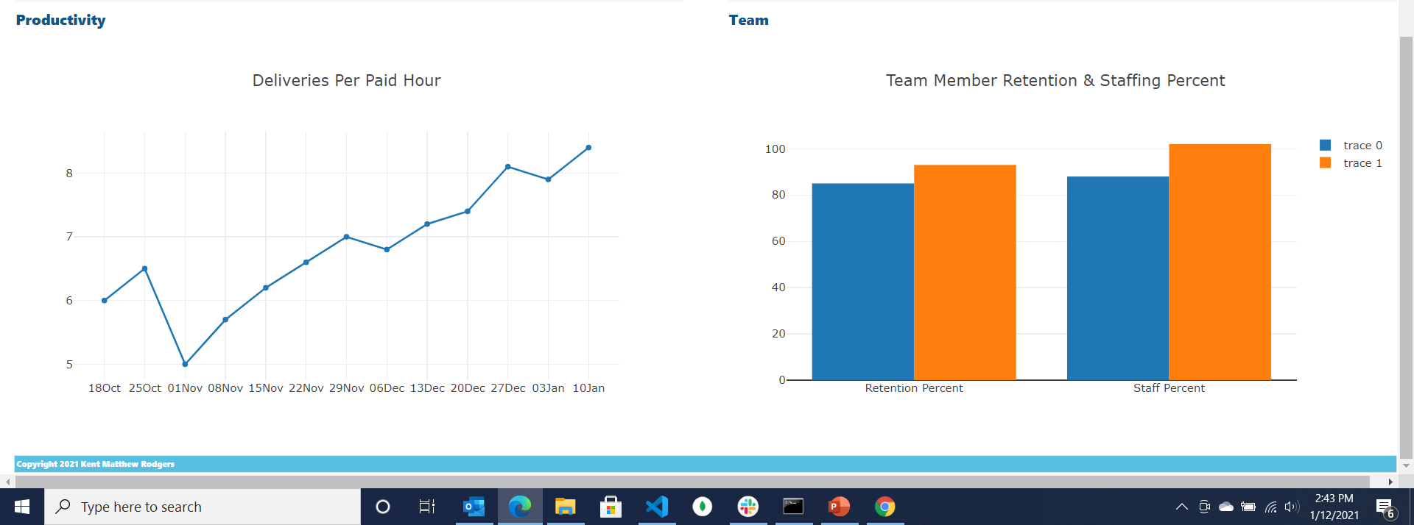
Dashboard Example
Scorecard => Daily Dashboard
2021 Copyright Kent Matthew Rodgers

Slide 6














Communication & Engagement Touchpoints A dozen team communication and engagement ‘events’ and an example frequency or schedule
Frontline
Team
One-One
Leader
2021 Copyright Kent Matthew Rodgers

Slide 7
Team Build-Out
2021 Copyright Kent Matthew Rodgers

Slide 8
Unique Insights …
Three time growth champion in field service and logistics
… anesthesia, physical and digital information governance, cash logistics
Inherited & turned around sour labor relationships … know to build & keep great relationships
Work hard on the right things … set priorities based on facts and sound strategy
Consistent and structured ‘stewardship’ fosters performance and builds leaders
‘Team’ is founded on trust, responsible candor (conflict), commitment, accountability & results(1)
1) Reference The Five Dysfunctions of a Team, Patrick Lencioni to provide proper credit here.
2021 Copyright Kent Matthew Rodgers

