Slide 1

General Manager Presentation
Kent Rodgers
January 15, 2021

Slide 2
Prompt
Design an organization that will profitably achieve industry leading on-time delivery and client rating performance.
What would the team look like?
What is the background of each supervisor, and where will you recruit them from?
What is the reporting structure?
What roles operate across the whole region vs. only for the local market?
What are the KPIs you would use?
What meetings would your teams have and at what cadence?
What unique management insights would you bring to your team that would make them a model for how a market/region within the Veho organization should operate?

Slide 3
Organizational Structure
Structure to support four key business processes in dynamic & growing markets
Region
Recruit & Train
Fractional
X-Small
Lead
Small
Supervisor
Medium
Manager.
Up to 7
Stations
Driver Success
Supervisor
<10 hour station window
---
<12 ground operations associates
<20 hour station window
---
< 24 ground operations associates
---
<= 2 leads
<20 hour station window
---
< 100 ground operations associates
---
<= 5 supr./leads
In-Route coordination
+ coaching
---
Approximately 1 associate for every 200 daily route hours
Receive
Sort
Launch
Deliver
Deliver
2021 Copyright Kent Matthew Rodgers

Slide 4
Key Performance Indicators & Performance Metrics by Role
5 to 7 Scorecard
Categories
20 to 25
Key
Performance
Indicators
(<= 40)
Targeting five performance metrics per role
Awareness built with daily dashboard
Example Dashboard Next Page
2021 Copyright Kent Matthew Rodgers

Slide 5
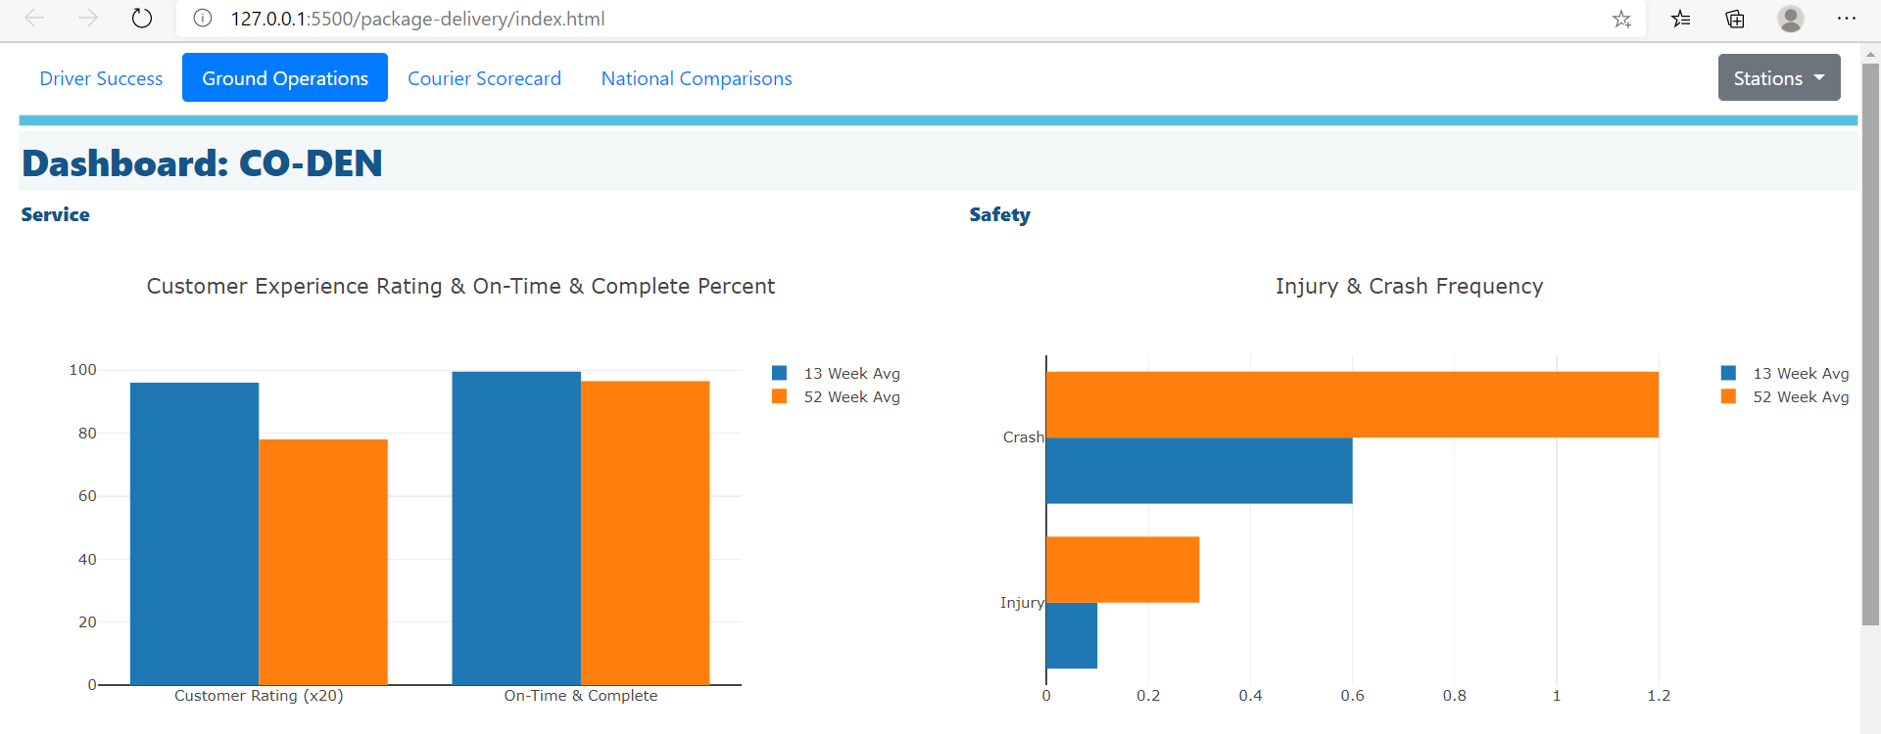
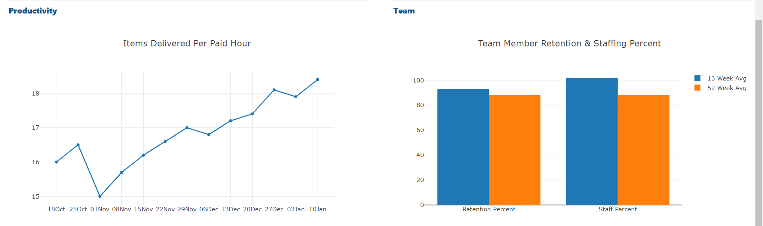
Dashboard Example
Metrics => Daily Dashboard
2021 Copyright Kent Matthew Rodgers

Slide 6














Team Communication & Engagement
A dozen+ ways to boost team engagement & performance
Frontline
Team
One-One
Leader
2021 Copyright Kent Matthew Rodgers

Slide 7
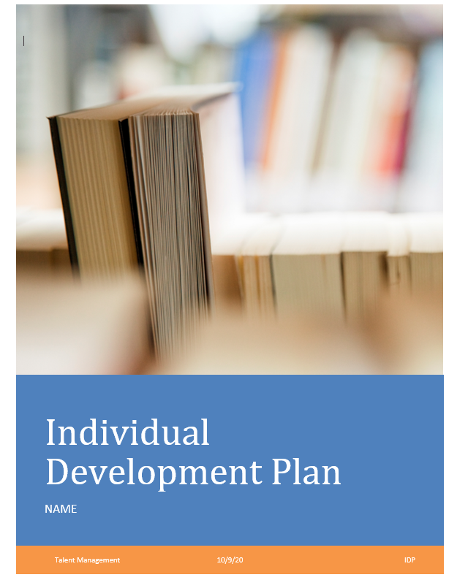
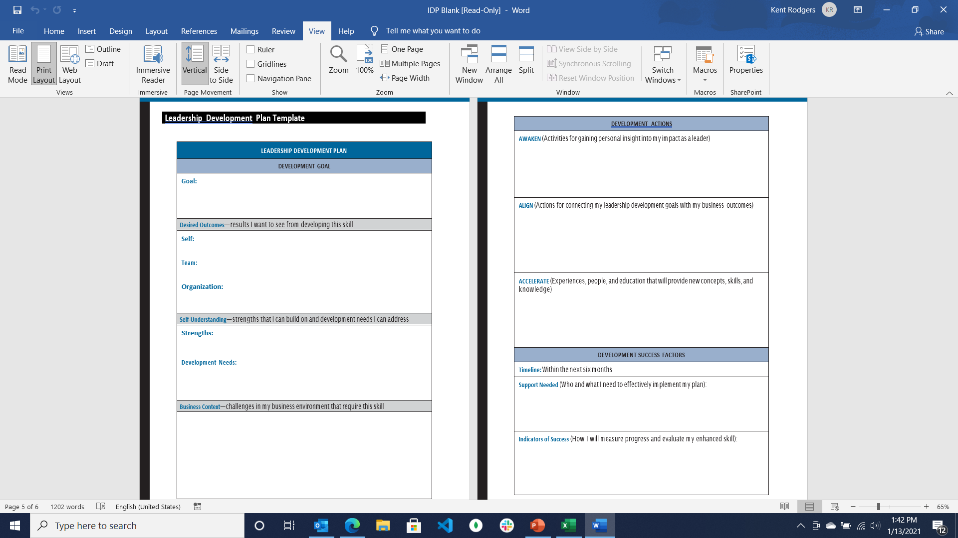
Talent Development & Growth
Individual development plan
Targeted training (examples below)
Team
Elements of a comprehensive talent development program
Change Leadership
Communication
2021 Copyright Kent Matthew Rodgers

Slide 8
Supervisor Background
Top 10 Competencies for a Ground Operations Supervisor
Must have:
2 years driver, warehouse, transportation or field services experience
2 years overseeing performance of others as hourly leader or salary supervisor
Note: Profile build on the Lominger, The Leadership Architect
2021 Copyright Kent Matthew Rodgers

Slide 9
Talent Acquisition
Where to find leaders …
From the current team
From the team’s network
Passive and targeted outside search
Collegiate development track / program
… Full-time recruiter at 60+/- active hourly hires. Fractional as starter or flex
2021 Copyright Kent Matthew Rodgers

Slide 10
Unique Insights to Compliment Team …
Three time growth champion in field service, station management and route logistics
… anesthesia, physical and digital information, cash
Know how to build and keep frontline, driver and client relationships
Focus on the right things … with data driven strategy and actions
Build leaders with stewardship in addition to development plans, training & coaching
‘Team’ is founded on trust, responsible candor (conflict), commitment, accountability & results(1)
Note: 1) Reference The Five Dysfunctions of a Team, Patrick Lencioni to provide proper credit here.
2021 Copyright Kent Matthew Rodgers

