Slide 1

General Manager Presentation
Kent Rodgers
January 15, 2021

Slide 2

Building Something Special!
Purpose
Clients
Tools
Culture
Talent
2021 Copyright Kent Matthew Rodgers

Slide 3
Key Building Blocks
Purpose
Mission
Design an organization that will profitably achieve industry leading on-time delivery and client rating performance.
What would the team look like?
What is the background of each supervisor, and where will you recruit them from?
What is the reporting structure?
What roles operate across the whole region vs. only for the local market?
What are the KPIs you would use?
What meetings would your teams have and at what cadence?
What unique management insights would you bring to your team that would make them a model for how a market/region within the Veho organization should operate?
Clients
Value
Relationships
Team
Process
Technology
Tools
Values
Behaviors
Alignment
Leadership
Culture
Development
Engagement
Focus
Organizational Structure
Team Roster
Talent
2021 Copyright Kent Matthew Rodgers

Slide 4
Pre-Wire the Org. Structure for Growth
Organize team’s for success in four key process areas with effective leadership to associate ratios
---
1:20 in simple form
Region
Recruit & Train
Fractional
X-Small
Lead
Small
Supervisor
Medium
Manager.
Up to 7
Stations
Driver Success
Supervisor
<10 hour station window
---
<12 ground operations associates
<20 hour station window
---
< 24 ground operations associates
---
<= 2 leads
<20 hour station window
---
< 100 ground operations associates
---
<= 5 supr./leads
In-Route coordination
+ coaching
---
Approximately 1 associate for every 200 daily route hours
Receive
Sort
Launch
Deliver
Deliver
2021 Copyright Kent Matthew Rodgers

Slide 5
Be Clear on How We Create Value
Establish focus and alignment with
5 to 7 role specific performance metrics
2021 Copyright Kent Matthew Rodgers

Slide 6
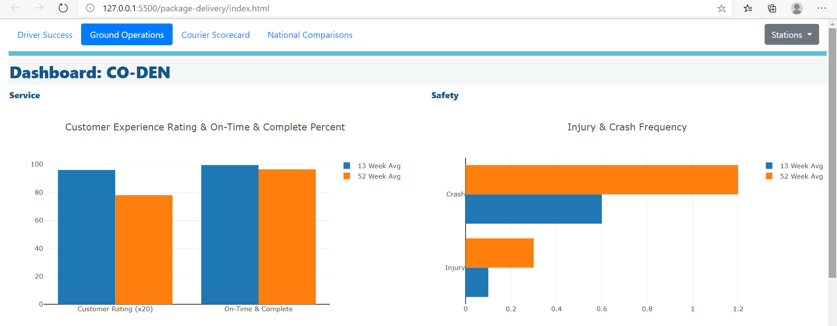
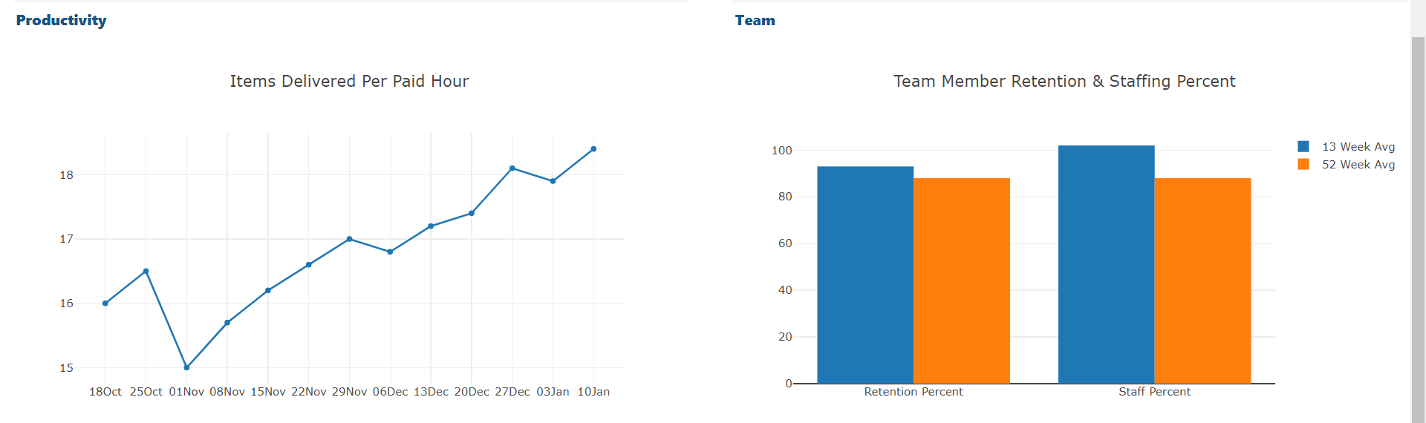
Achieve w/Performance Awareness & Candor
Create situational awareness through dashboards
& regular reviews
2021 Copyright Kent Matthew Rodgers

Slide 7














Build Engagement, Culture & Team
Build all-things culture with a comprehensive engagement, behavior and team building program
Frontline
Team
One-One
Leader
2021 Copyright Kent Matthew Rodgers

Slide 8
Talent Acquisition – Team Roster
Where to find leaders …
From the current team
From the team’s network
Passive and targeted outside search
Collegiate development track / program
… Full-time recruiter at 60+/- active hourly hires. Fractional as starter or flex
Robust and comprehensive recruiting process a high priority
2021 Copyright Kent Matthew Rodgers

Slide 9
Building the Team Roster
Hire both experience and demonstrated competency
---
Supervisor
Example Here
Must have:
2 years driver, warehouse, transportation or field services experience
2 years overseeing performance of others as hourly leader or salary supervisor
Note: Profile built using the Korn Ferry Leadership Architect tool
2021 Copyright Kent Matthew Rodgers

Slide 10
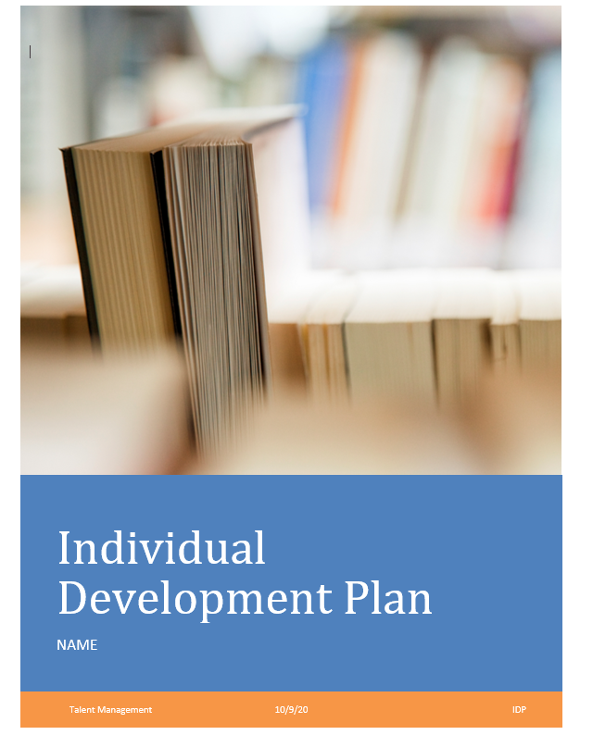
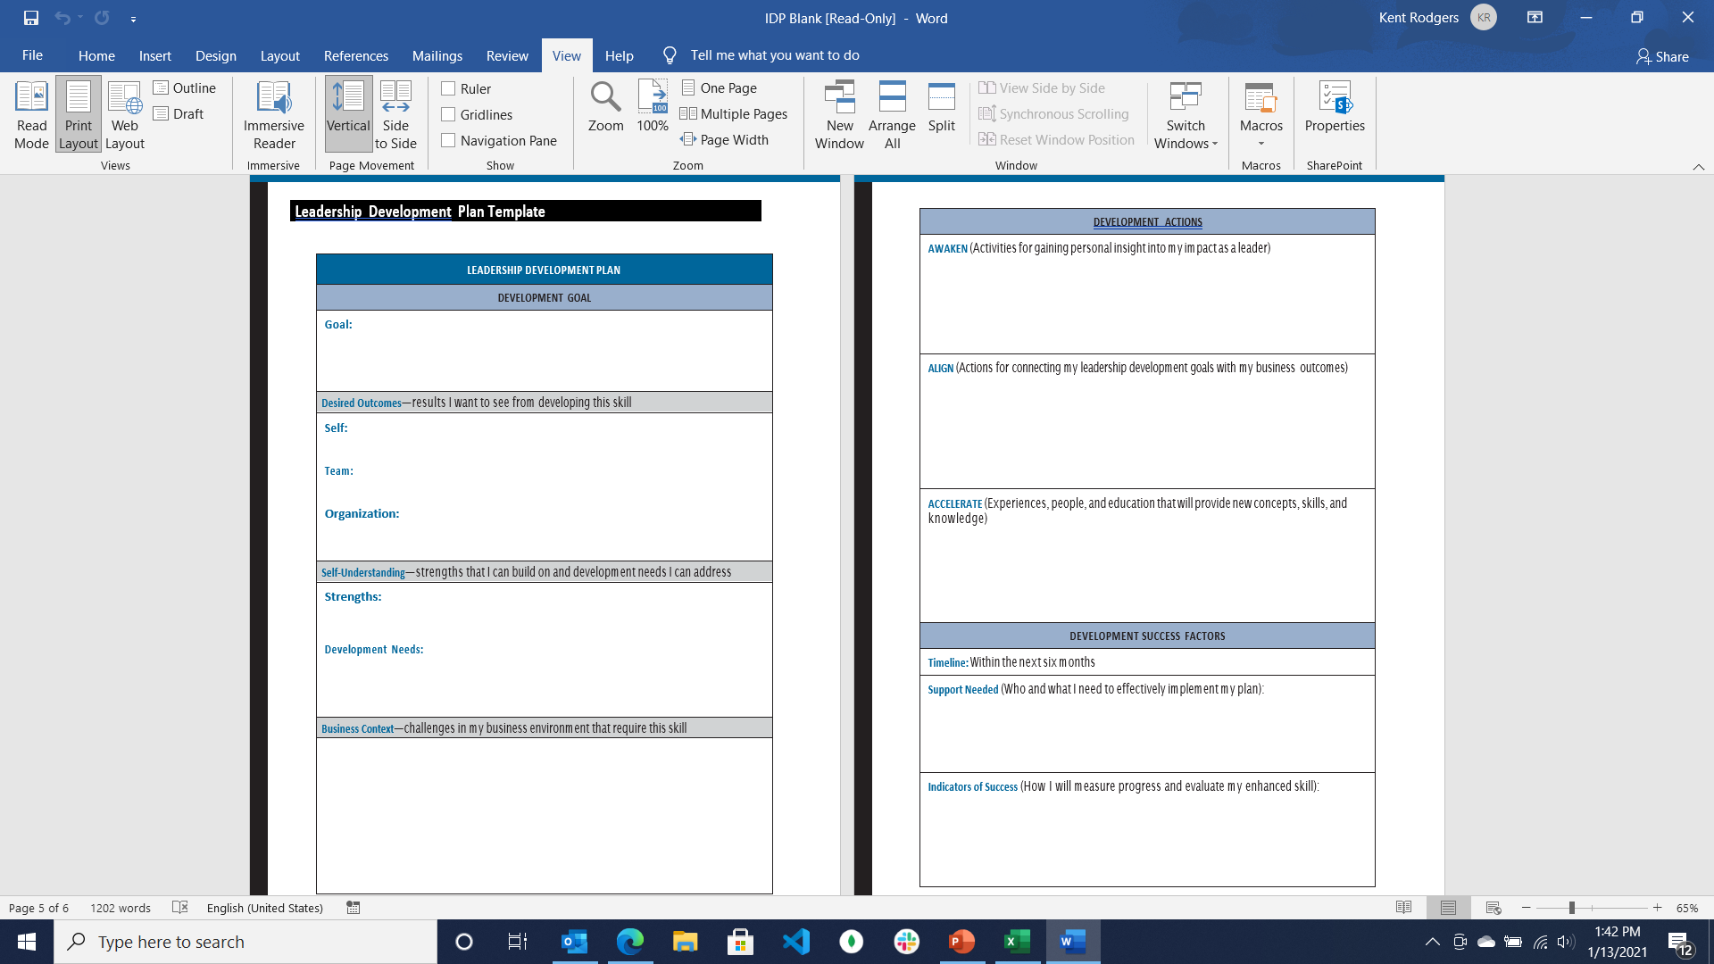
Talent Development
Individual development plan
Targeted training (examples below)
Team
Development plans and targeted training will pay-off in future speed and performance
Change Leadership
Communication
2021 Copyright Kent Matthew Rodgers

