Slide 1
Pandas-Challenge Heroes of Pymoli
Kent Rodgers
October 7, 2020

Slide 2
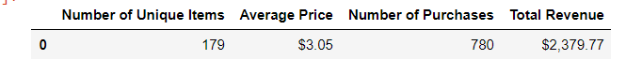
Purchase Analysis
‘Heroes’ sold 179 add-on items at an average price of $3.05 each

Slide 3
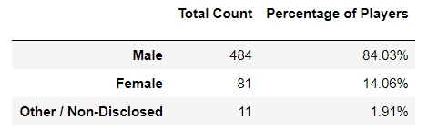
Gender Demographics
‘Heroes’ players are primarily males, 84% of known players identified at male

Slide 4
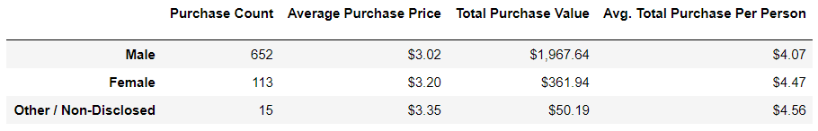
Purchasing Analysis – (Gender)
While the bulk of ‘Heroes’ add-on revenue is from males.,
Females and Other/Non-disclosed players spend more on average than males

Slide 5
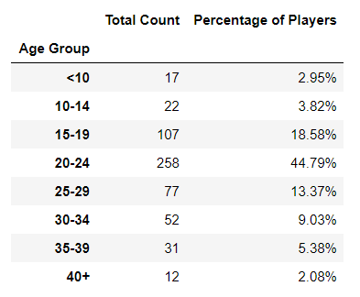
Age Demographics
The distribution of players by age is relatively normal and
centers around the 20 to 24 year old players

Slide 6
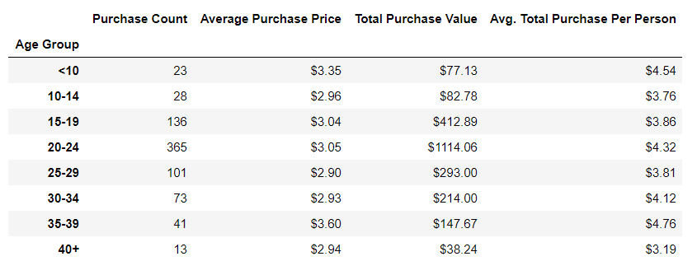
Purchase Analysis By Age
The 20 to 24 age players represent the largest total purchases as expected
The 20 to 24 age player also represent a higher than median purchase value at $4.32 per person

Slide 7
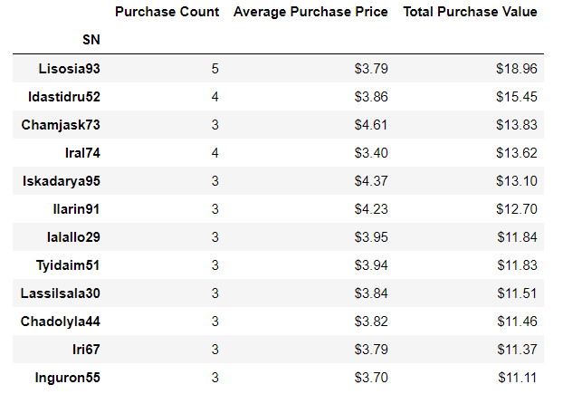
Top Spenders
Top five spenders are spending more than $13.00 each on add-ons

Slide 8
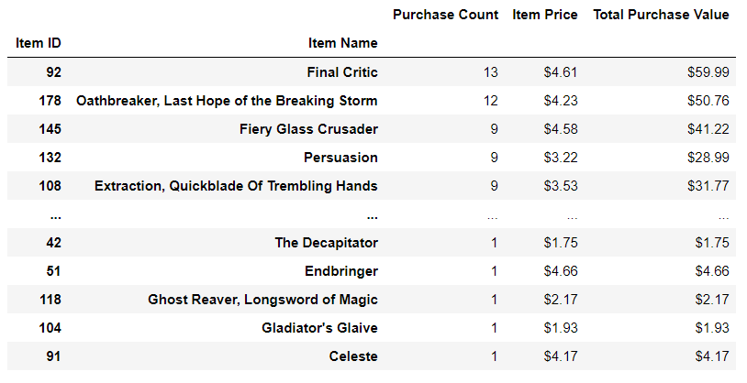
Most Popular Items
Final Critic, followed by Oathbreaker, are the most popular items

Slide 9
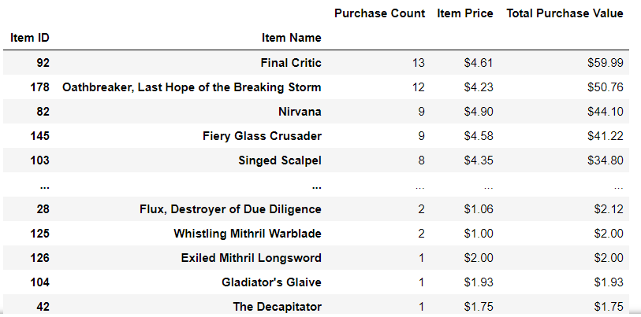
Most Profitable Items
Driven by volume, Final Critic, followed by Oathbreaker, are highest contributors to revenue.
And, may be the most profitable assuming production costs are the same between items

