Slide 1
Final Project Pitchbook
Kent Rodgers
3/1/2021

Slide 2
Hypothesis / Key Premises for Exploration
Hospitals operating in states that require Certificate-of-Need are more profitable than those in states with exceptions
CON creates a monopolistic environment
Rural hospitals are less profitable than Urban hospitals
Urban hospitals benefit from better revenue quality
Urban hospitals can operate more efficiently
Unprofitable hospitals are more efficient that profitable ones
Being unprofitable requires site to be more resourceful
The counter argument, sites are more profitable when more efficient
What is the impact of competition and/or over-building on profit?
May prove more challenge to measure, need source and append population at zip code level
Ultimately, where can the CEO go to get more profit $’s?
What drivers (features) truly predict or result in profitability?
What is driving revenue quality?
Which sites can be more efficient?
Which profitable sites are underperforming from an efficiency perspective?

Slide 3
Tasks & Deliverables
Extract (CSV)
Medicare Hospital Cost Reports as available from 2014 to 2017
Transform (Python)
Geo code (add latitude and longitude) based on address for mapping
Append Certificate-of-Need status based on hospital state
Append performance metrics, eg. profit %, revenue/expense per bed
Pre-process data for machine learning purposes (encode, scale, RFE, train/test)
Build a predictive model to estimate performance key metrics on non-reporting hospitals (Machine Learning, SciKitLearn, Python Matplotlib)
Build to an interactive dashboard and/or story (Tableau)
Three key performance metrics = profit, efficiency and revenue quality
Map and/or list interaction on key features from machine learning
Storyboard for a novice business leader to review and understand.

Slide 4
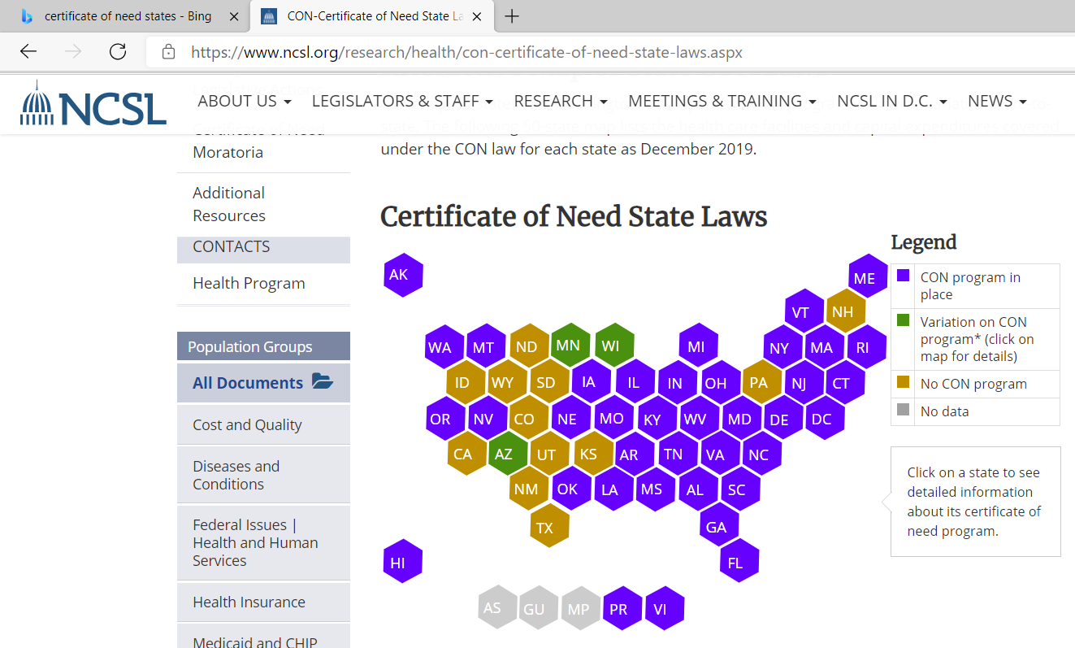
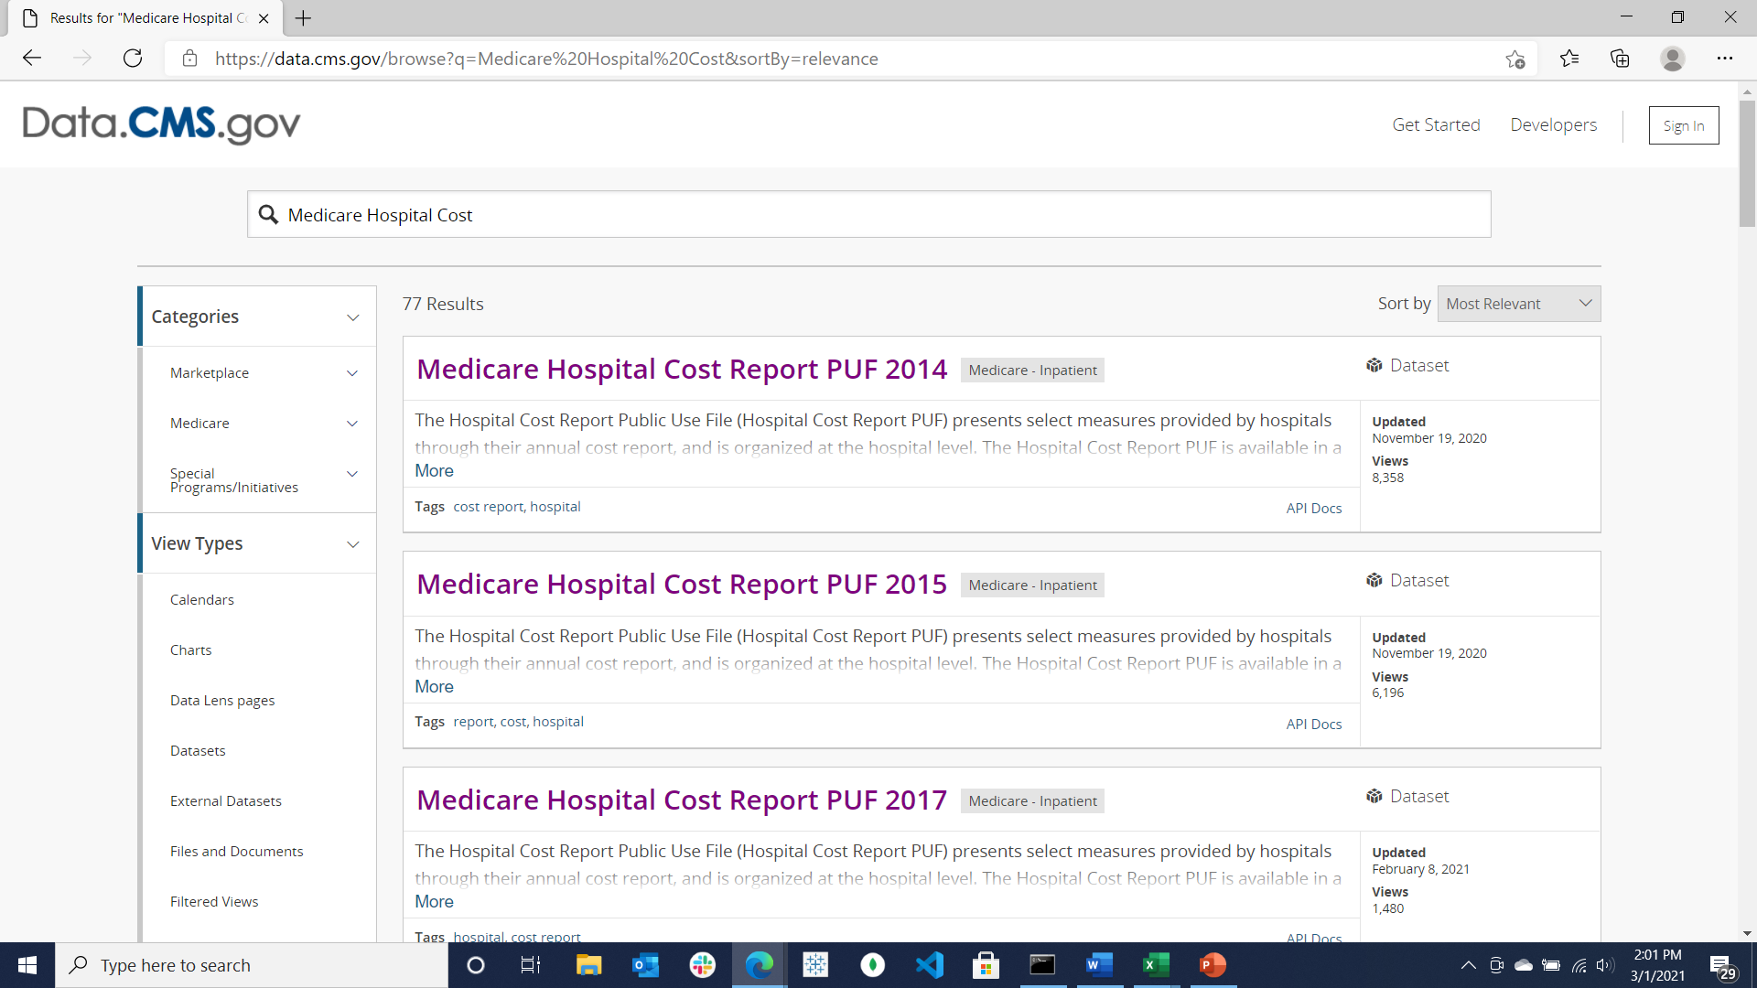
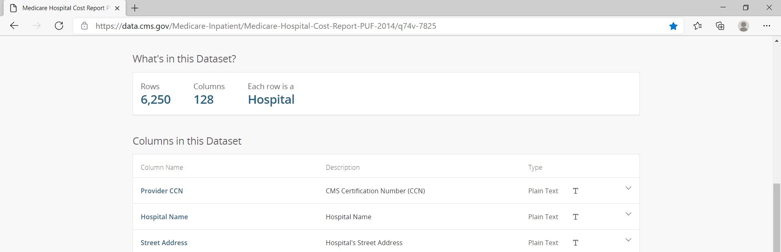
Data
Main Data Source = CMS
Additional Sources: CON, Geo-Code, Population
Centers for Medicare & Medicaid Services
data.cms.gov/browse?q=Medicare%20Hospital%20Cost&sortBy=relevance
Certificate-of-Need States
www.ncsl.org/research/health/con-certificate-of-need-state-laws.aspx

Slide 5
