Slide 1
Python API Challenge WeatherPy
Kent Rodgers
October 22, 2020

Slide 2
Project Overview
Created a random list of cities to evaluate
Explored the relationships between latitude and …
Maximum Temperature
Humidity
Wind Speed
Cloudiness
Initial results demonstrated need to re-evaluate on a northern and southern hemisphere basis
Net takeaways
Temperature is highly correlated to latitude
Humidity, Wind Speed and Cloudiness are not correlated to lattitude

Slide 3
Overall Results
North & South Hemispheres Combined

Slide 4
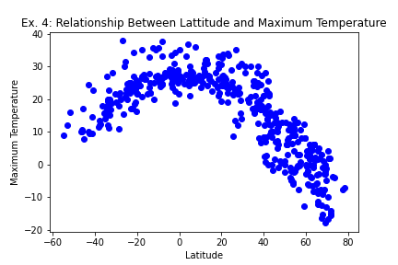
Relationship Between Latitude & Max Temp
Maximum Temperatures are lower the farther from the equator

Slide 5
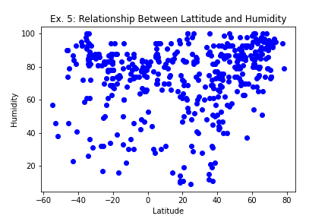
Relationship Between Latitude & Humidity
Latitude and humidity appear to be unrelated

Slide 6
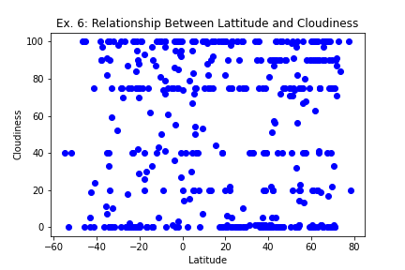
Relationship Between Latitude & Cloudiness
Latitude and cloudiness appear to be unrelated

Slide 7
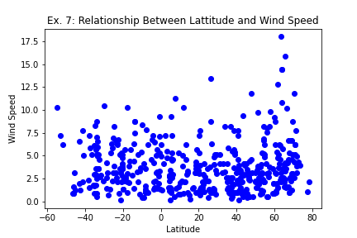
Relationship Between Latitude & Wind Speed
Latitude and wind speed appear to be unrelated

Slide 8
North/South Hemisphere Looks

Slide 9
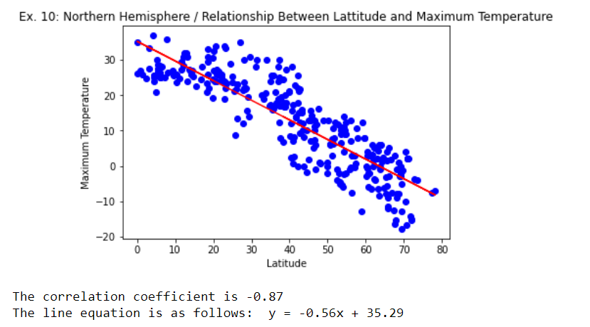
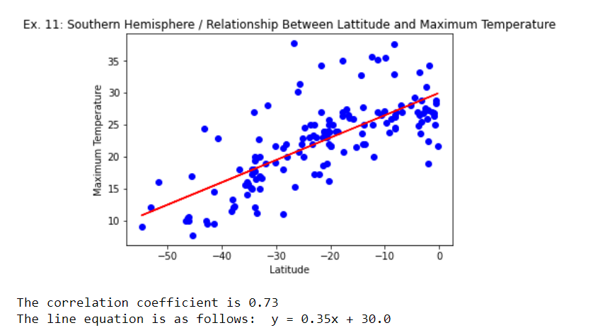
Relationship Between Latitude & Max Temp
Temperatures are cooler the farther a city is from the equator

Slide 10
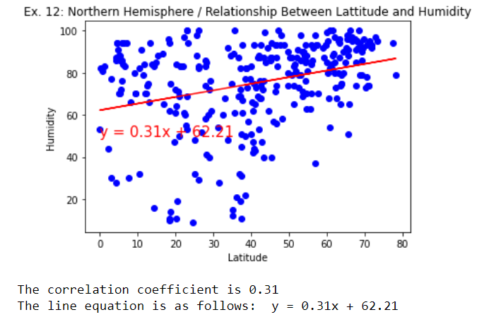
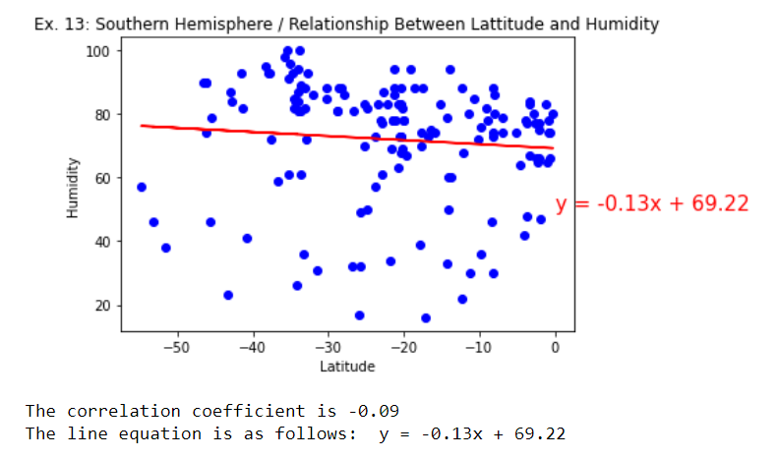
Relationship Between Latitude & Humidity
Latitude and humidity appear to be unrelated

Slide 11
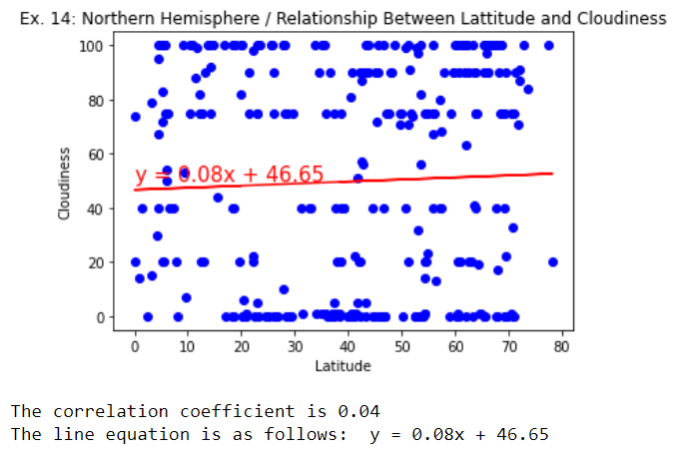
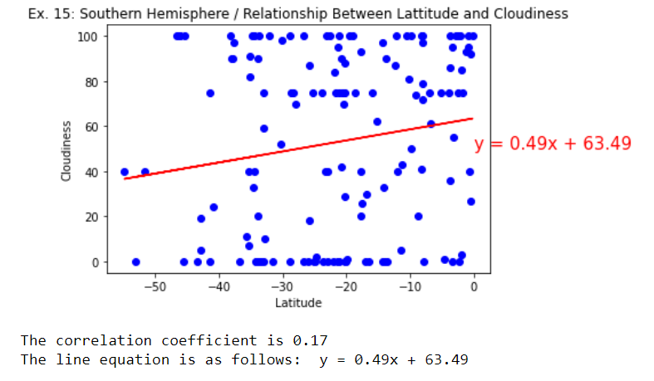
Relationship Between Latitude & Cloudiness
Latitude and cloudiness appear to be unrelated

Slide 12
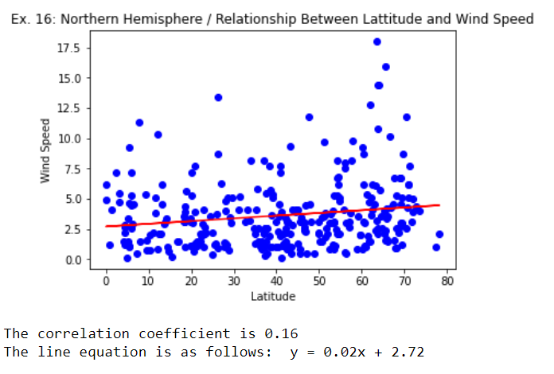
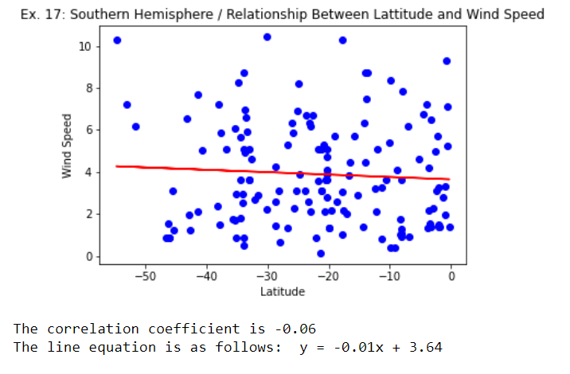
Relationship Between Latitude & Wind Speed
Latitude and wind speed appear to be unrelated

