Slide 1
Python API Challenge VacationPy
Kent Rodgers
October 22, 2020

Slide 2
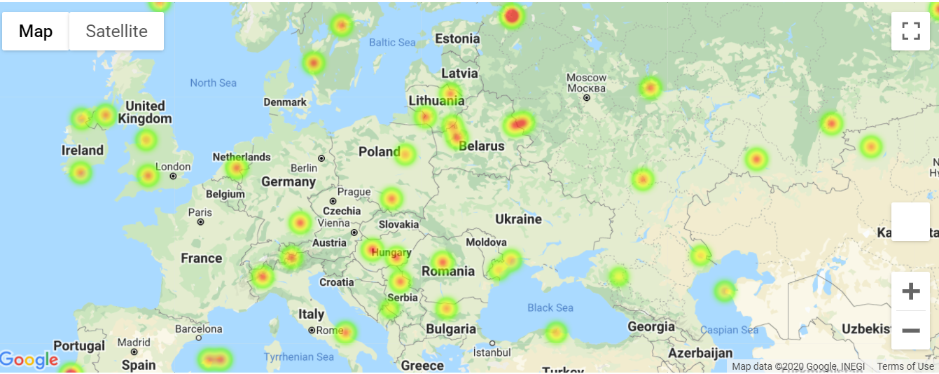
Representative Sample of Heat Mapping
… 461 of 500 random cities surveyed for project

Slide 3
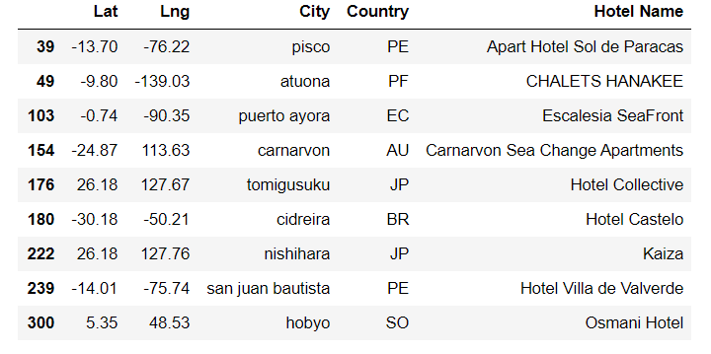
Representative Sample of Heat Mapping
9 cities in the survey held a temperature between 18 and 27 celcius
And a wind speed >8 miles and hour to support windsurfing & sailing

Slide 4
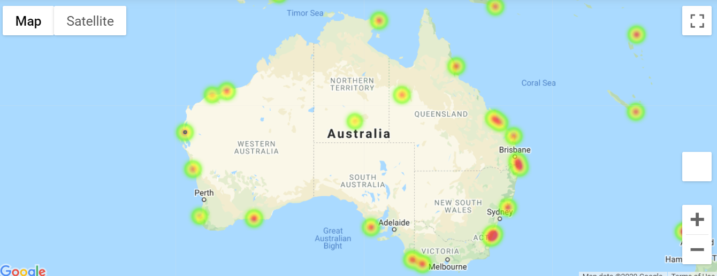
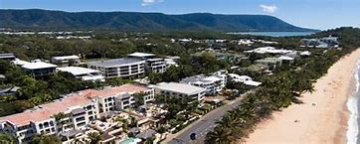
Heat and Hotel Mapping Combined
Camarvon
One location identified was Camarvon

