Slide 1
Project II – Initial Proposal
Kent Rodgers
1.20.2021

Slide 2
Tri-County Dining Dashboard

Slide 3
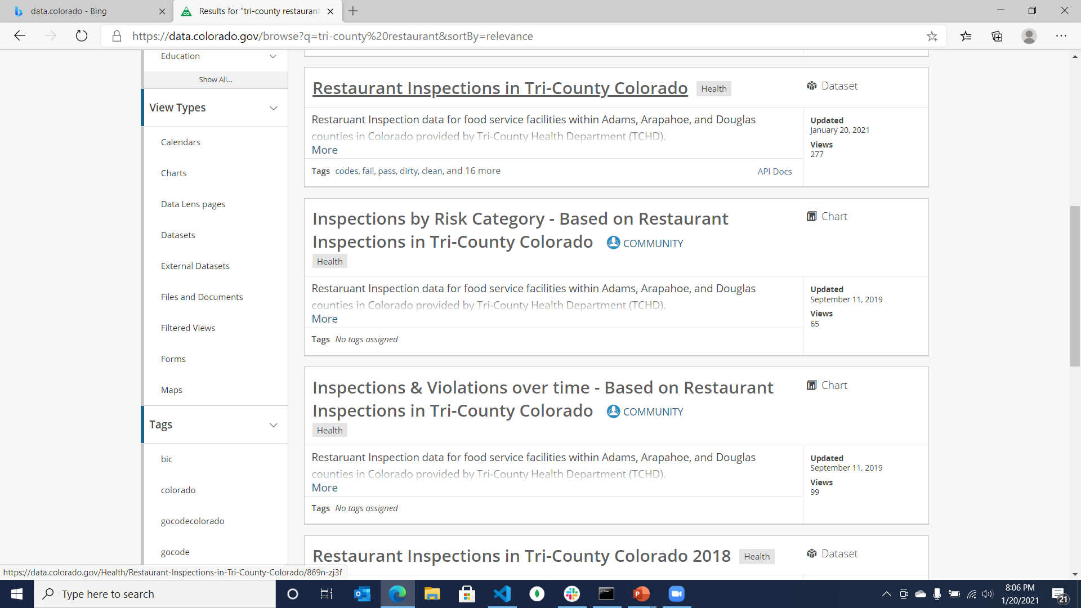
Data Source

Slide 4
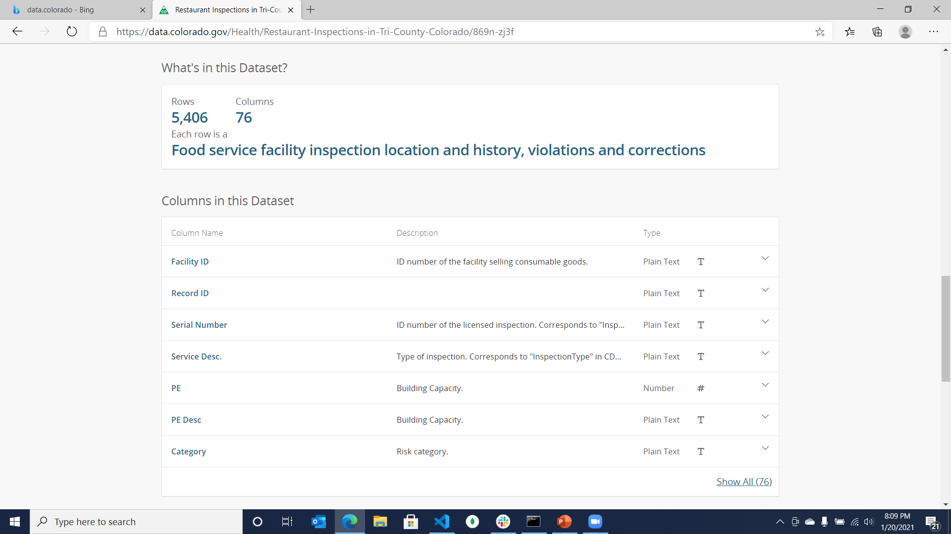
Data Summary

Slide 5
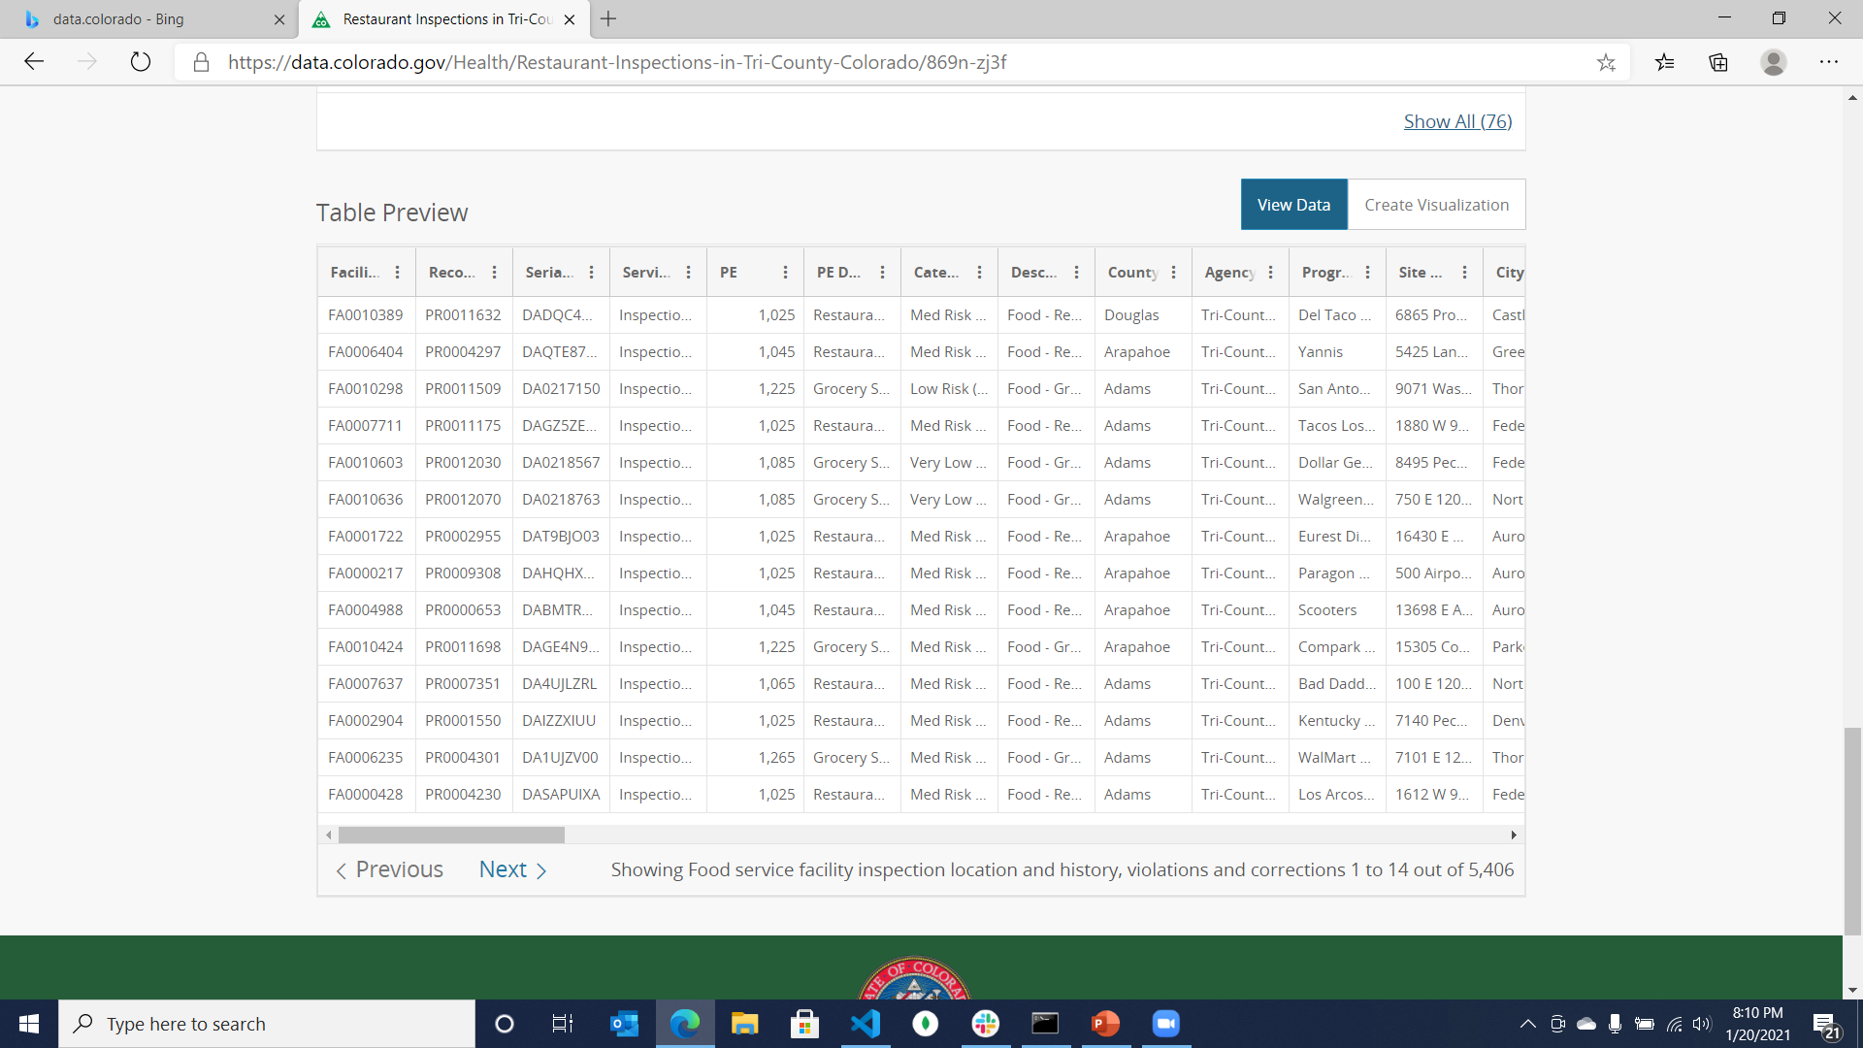
Data Table Preview

Slide 6
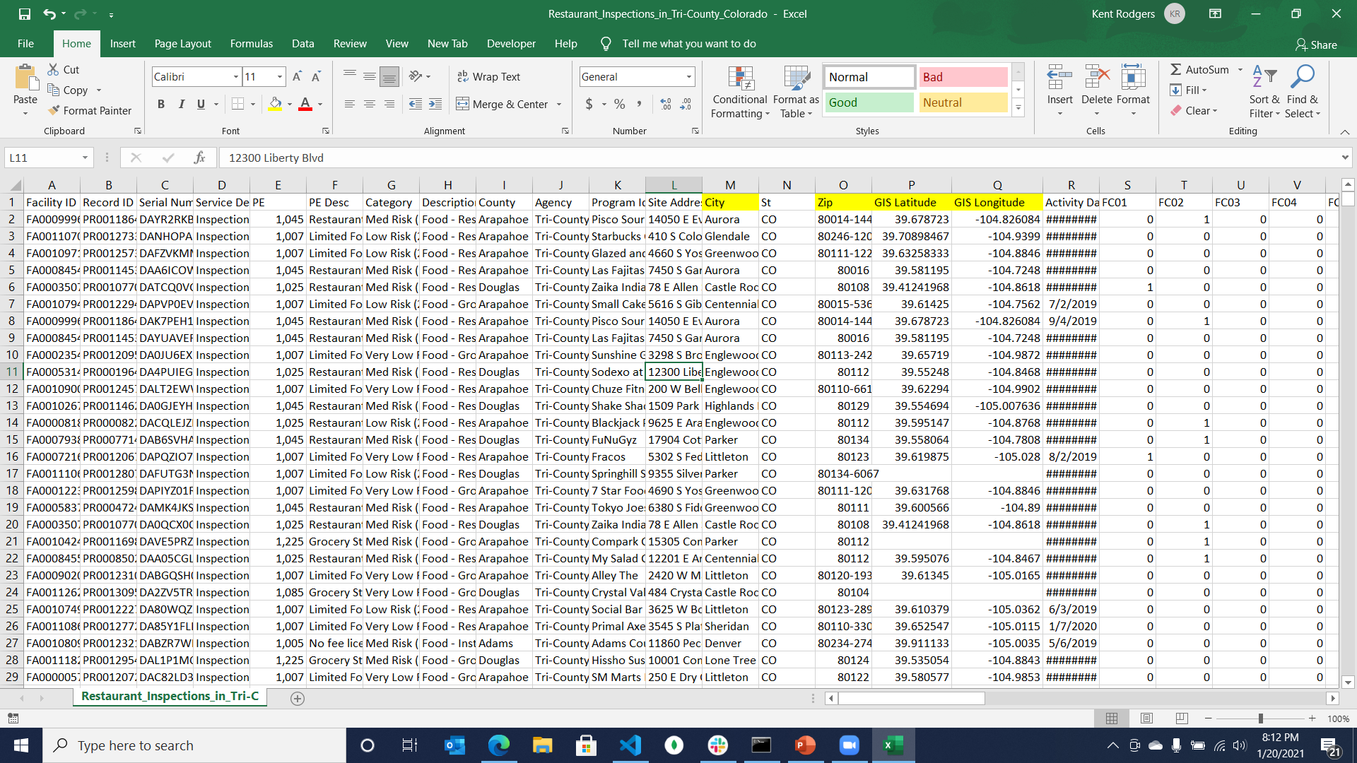
Data Download via CSV … not lat/lng

Slide 7
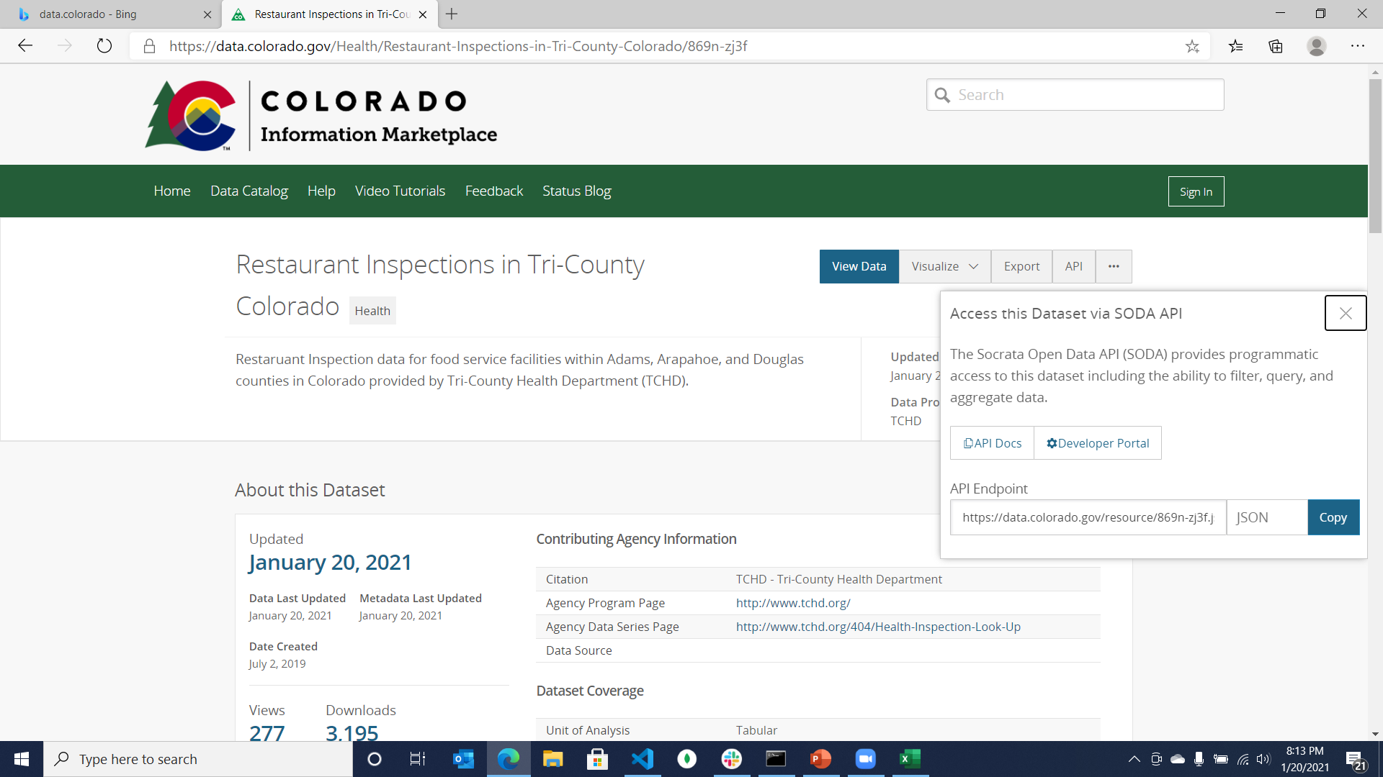
Data – API is available

Slide 8
Dashboard Concepts
Map …
Markers or
Colored Zip Codes
Quality / Top Exceptions
Histogram like bar chart
Narrow on zip code
Perhaps select exception codes
Quality / Top Offenders
Table with restaurant names
User can select
Find a good place
Perhaps map that permits user to narrow down restaurants based on quality score/exceptions, city and zipcode
Quality / Percent with x Exceptions
Bar or pie chart like experience

