Slide 1
SQL-Challenge Pewlett-Hackard
Kent Rodgers
November 10, 2020

Slide 2
Rodgers SQL-Challenge
ERD

Slide 3
ERD

Slide 4
Rodgers SQL-Challenge
Bonus Exhibits

Slide 5
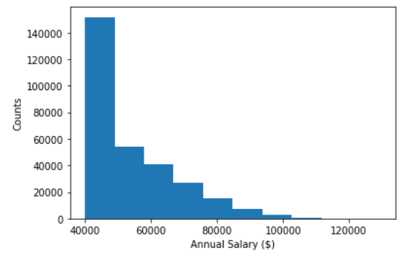
Create a histogram to visualize the most common salary ranges for employees.

Slide 6
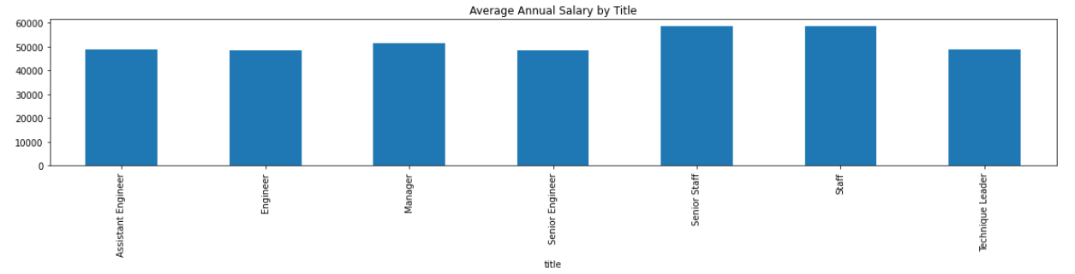
Create a bar chart of average salary by title

Slide 7
Rodgers SQL-Challenge
Data Analysis Examples

Slide 8
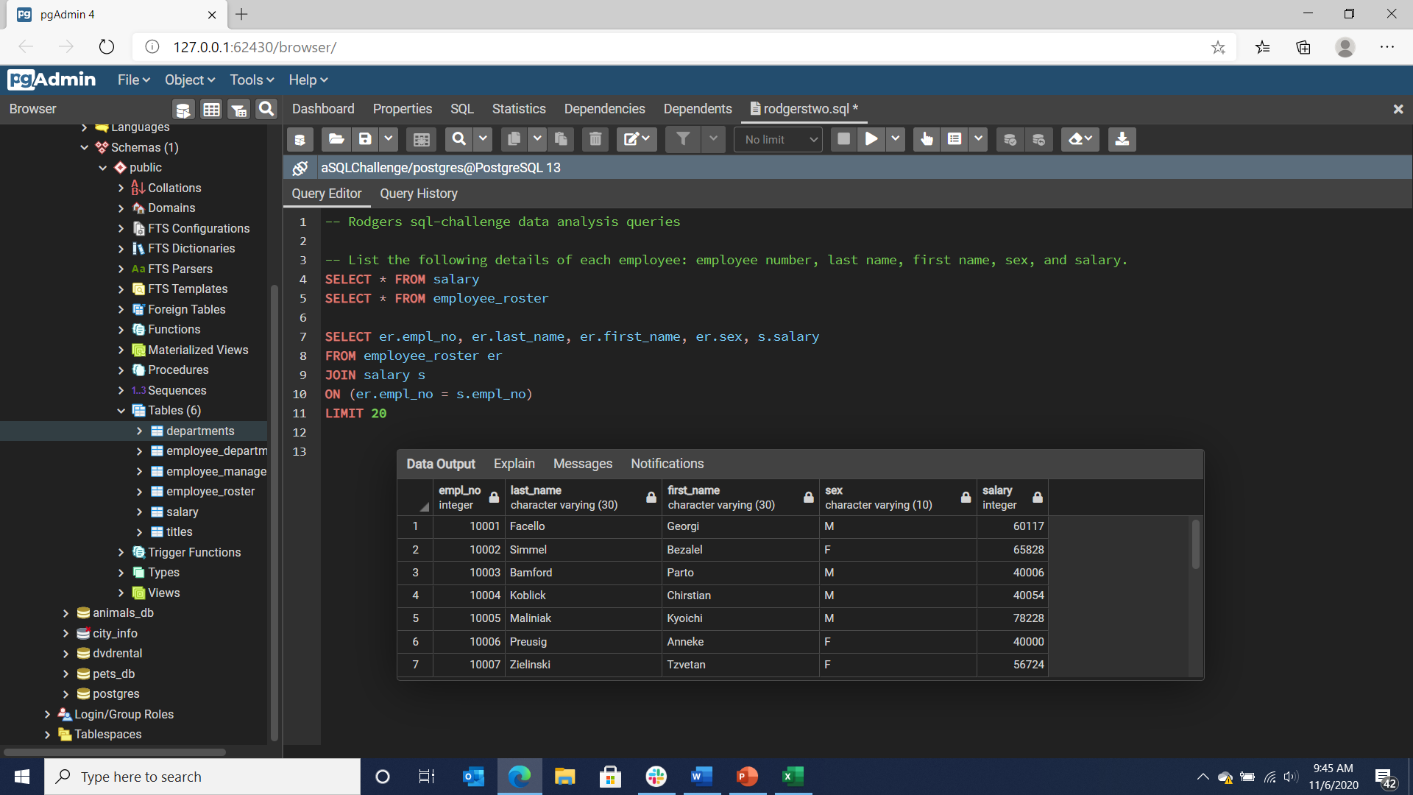
List the following details of each employee: employee number, last name, first name, sex, and salary.

Slide 9
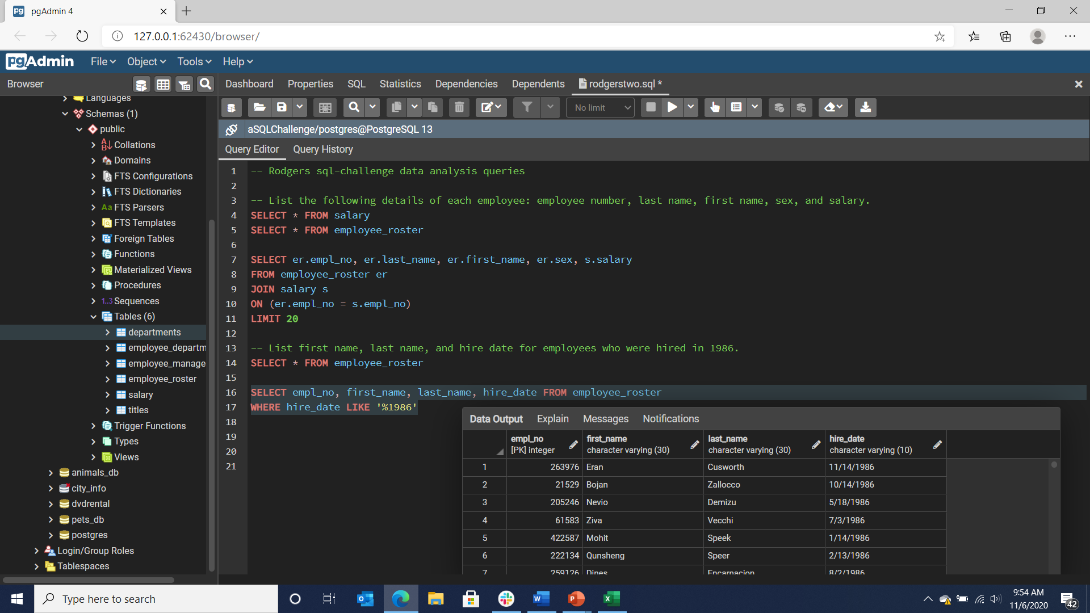
List first name, last name, and hire date for employees who were hired in 1986.

Slide 10
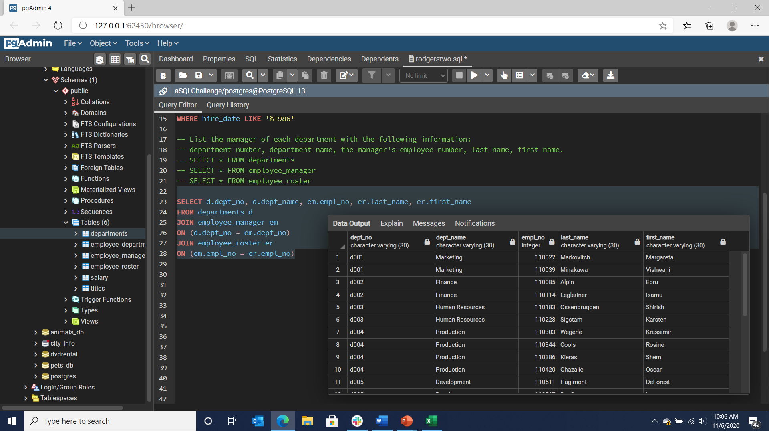
List the manager of each department with the following information: department number, department name, the manager's employee number, last name, first name.

Slide 11
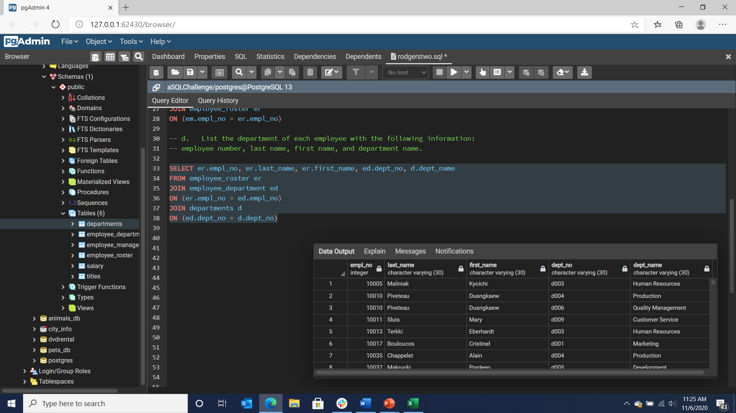
List the department of each employee with the following information: employee number, last name, first name, and department name.

Slide 12
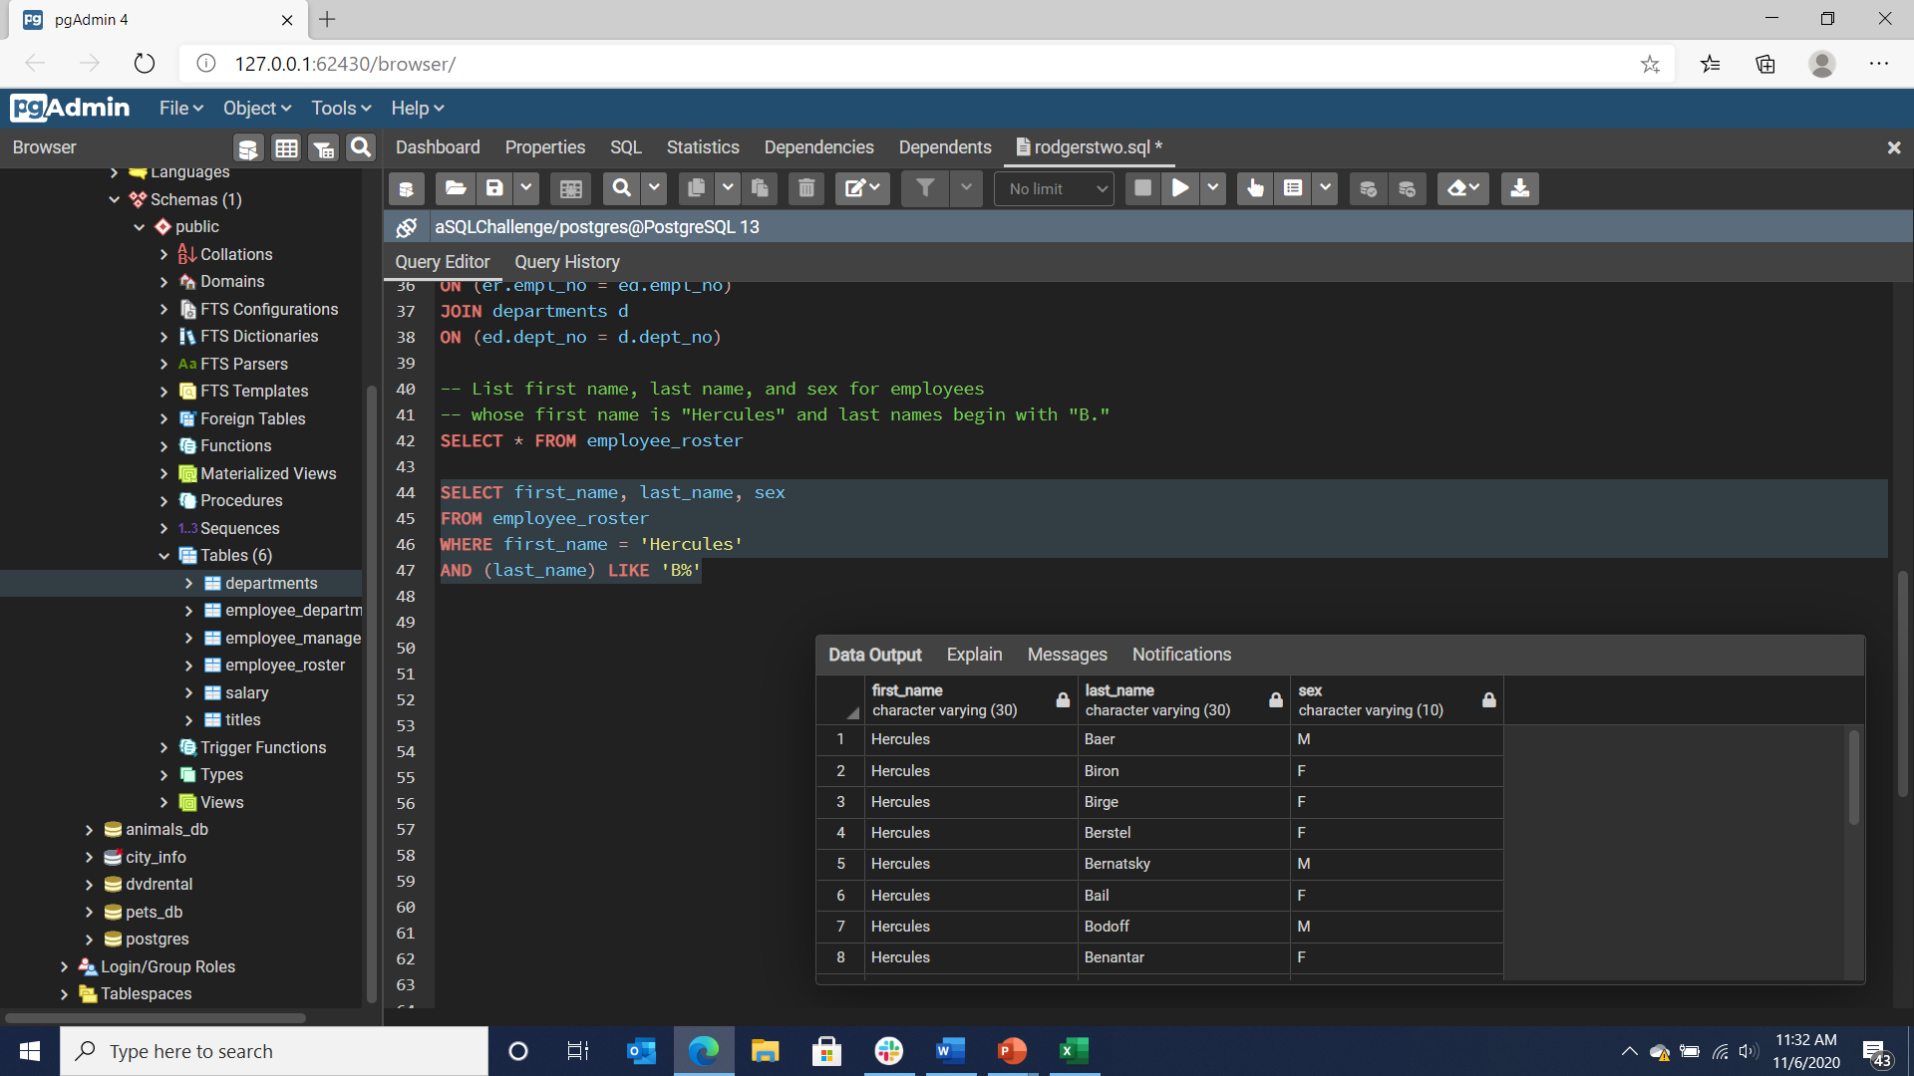
List first name, last name, and sex for employees whose first name is "Hercules" and last names begin with "B."

Slide 13
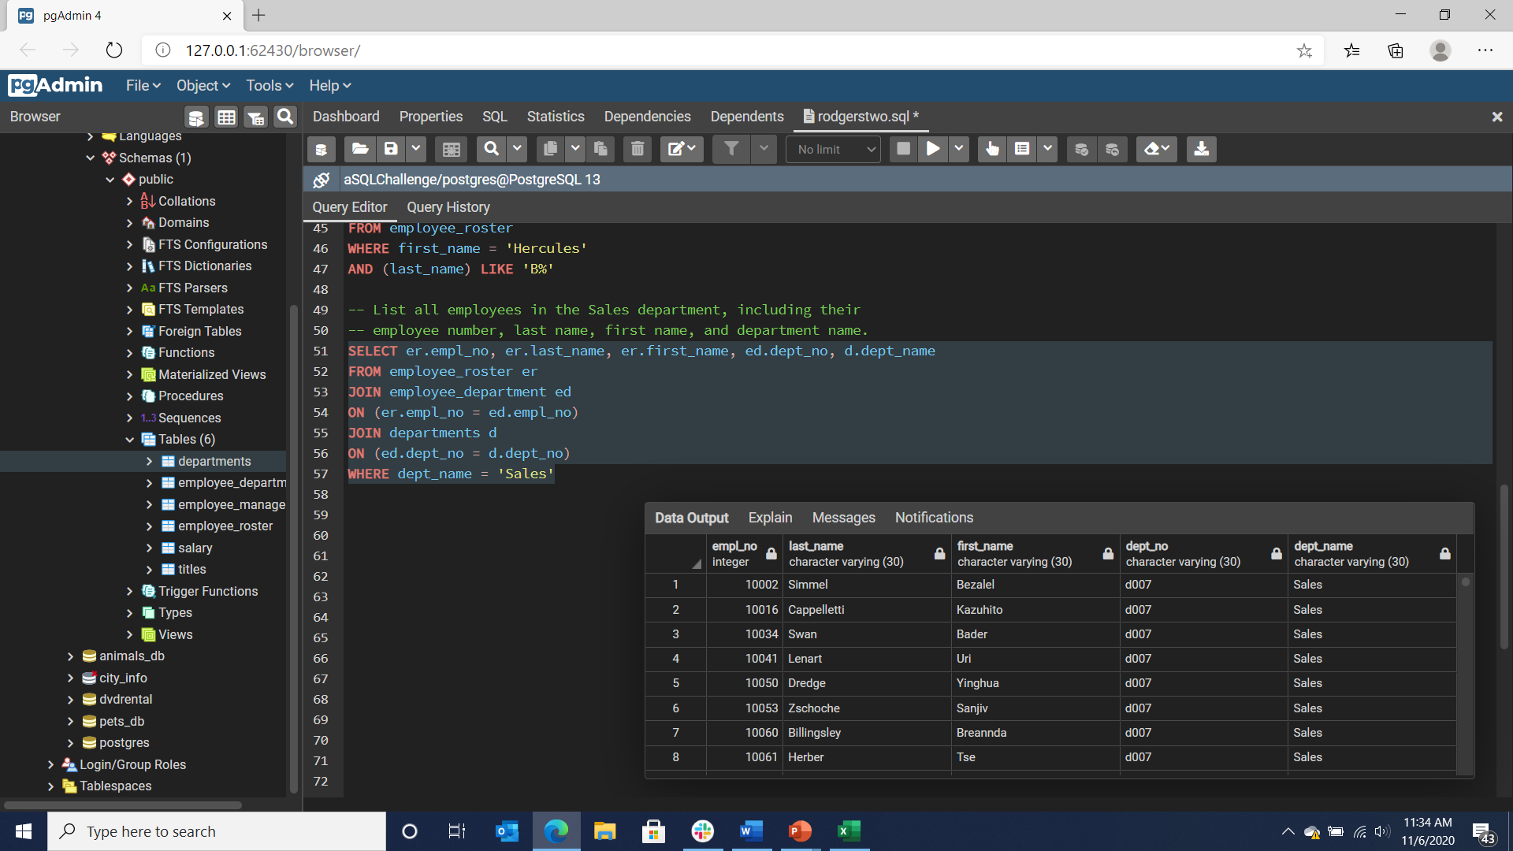
List all employees in the Sales department, including their employee number, last name, first name, and department name.

Slide 14
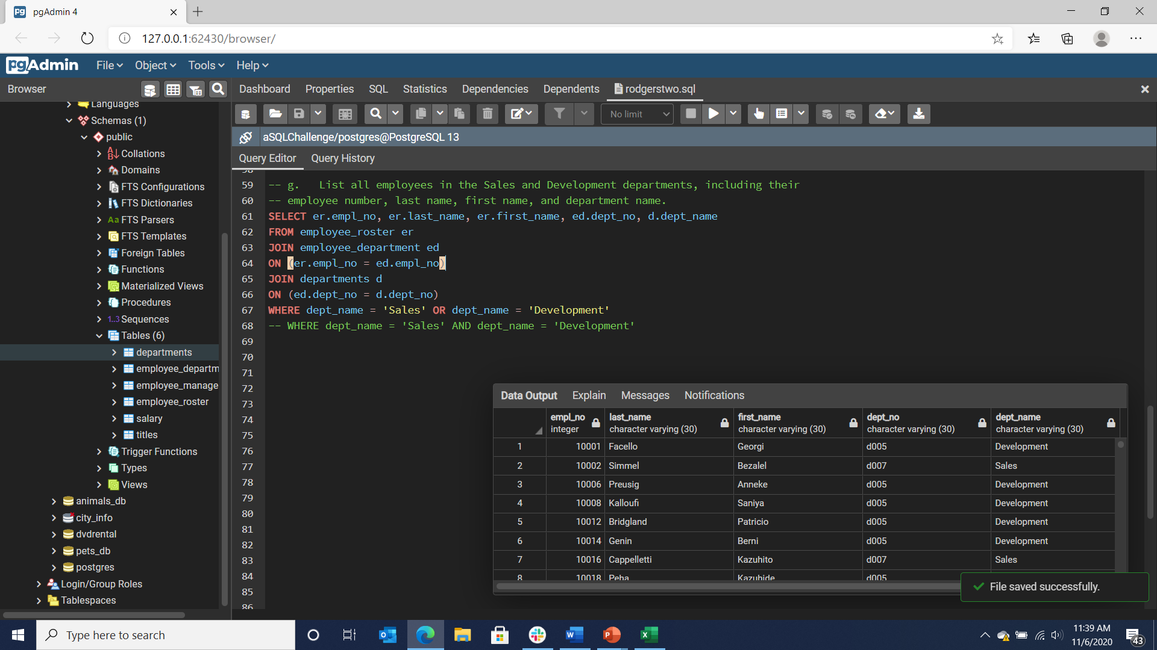
List all employees in the Sales and Development departments, including their employee number, last name, first name, and department name.

Slide 15
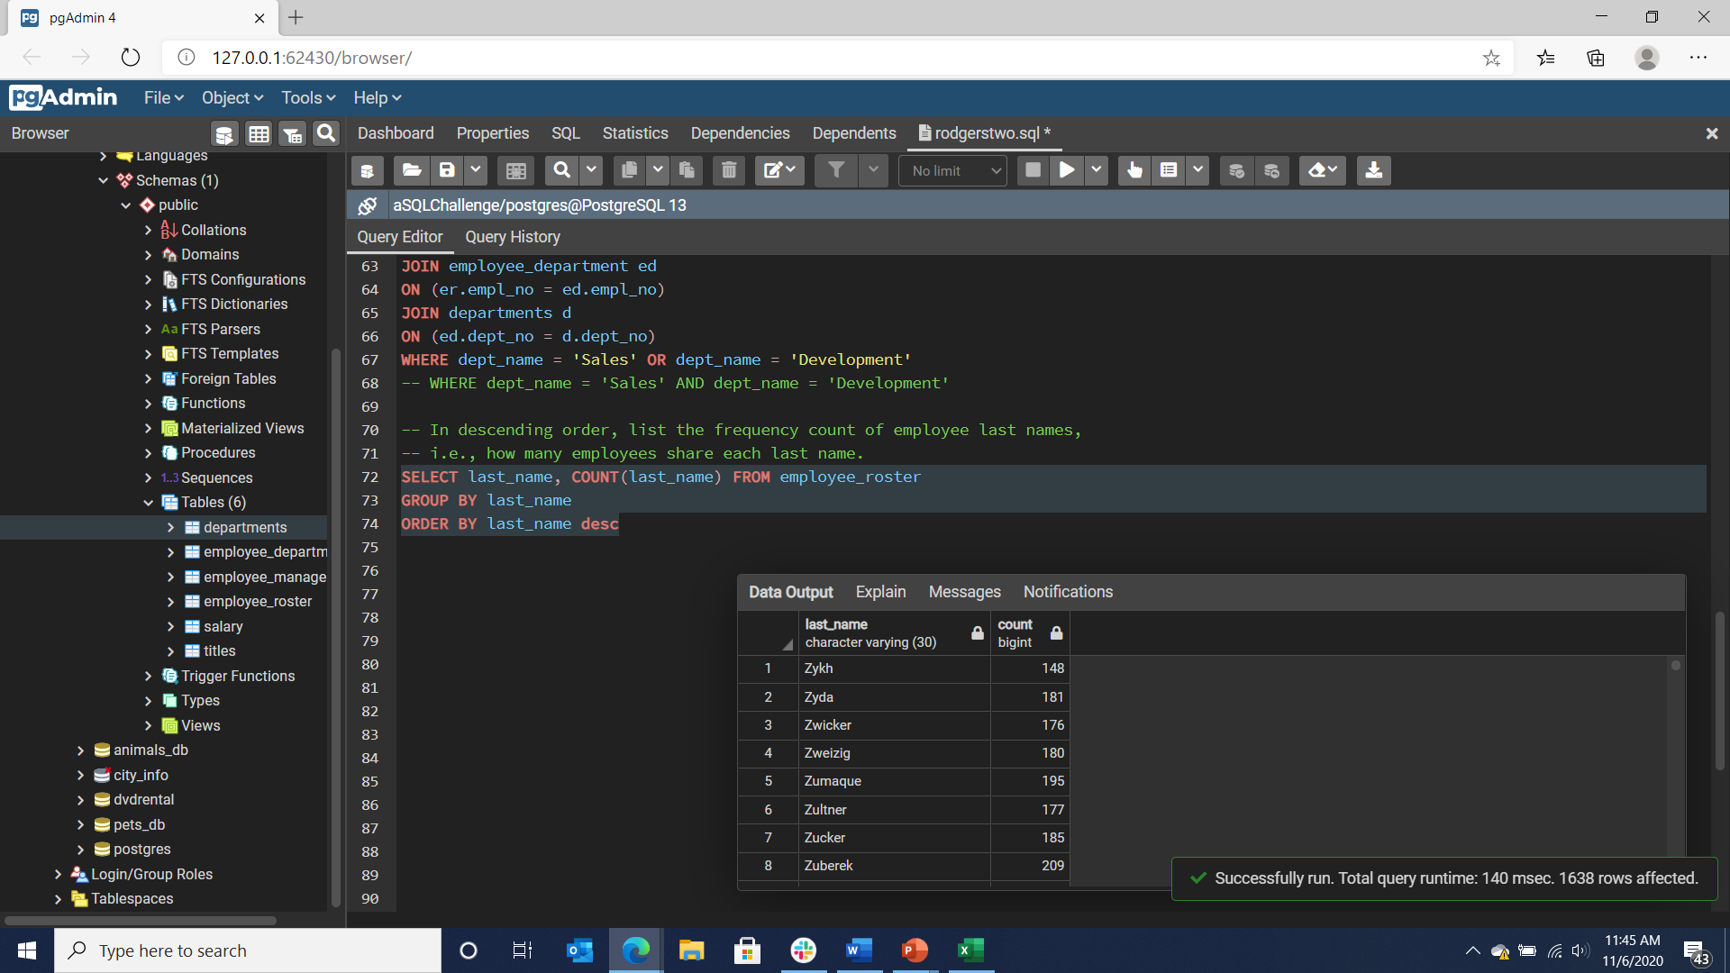
In descending order, list the frequency count of employee last names, i.e., how many employees share each last name.

