Slide 1
SQLAlchemy-Challenge Surfs Up!
Kent Rodgers
November 18, 2020

Slide 2
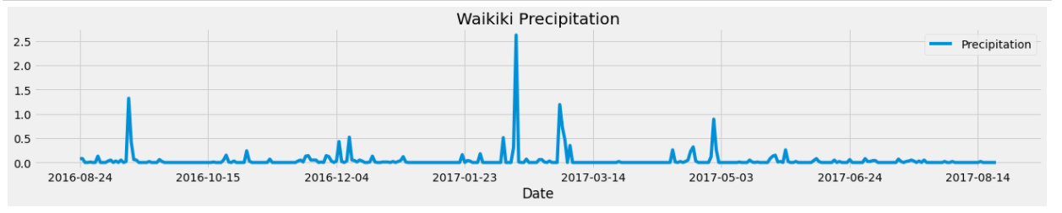
Waikiki Precipitation

Slide 3
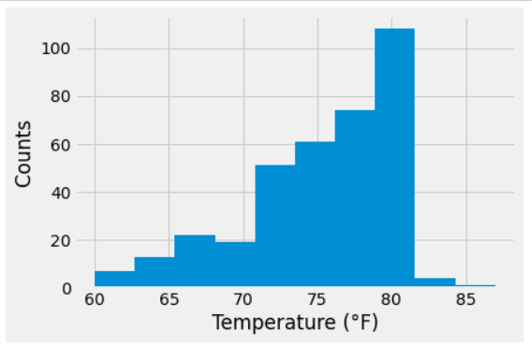
Waikiki Temperatures

Slide 4
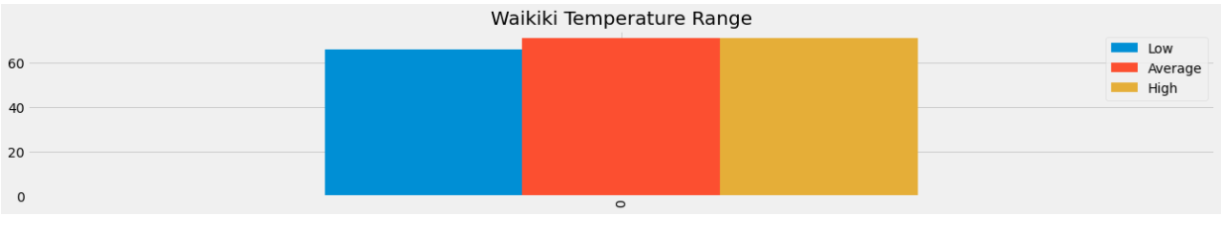
Waikiki Temperature Range - March

Slide 5
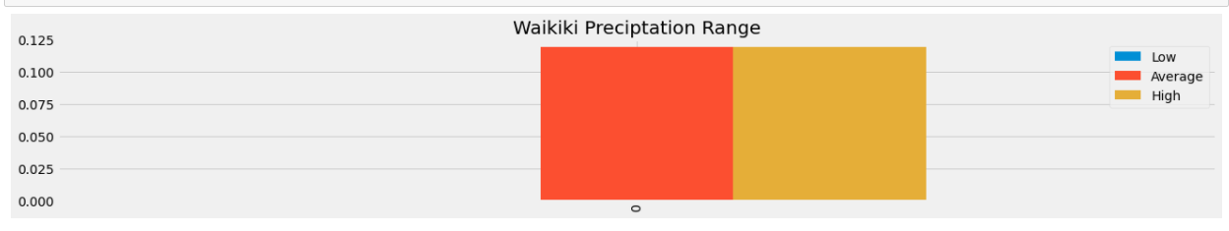
Waikiki Precipitation Range

Slide 6
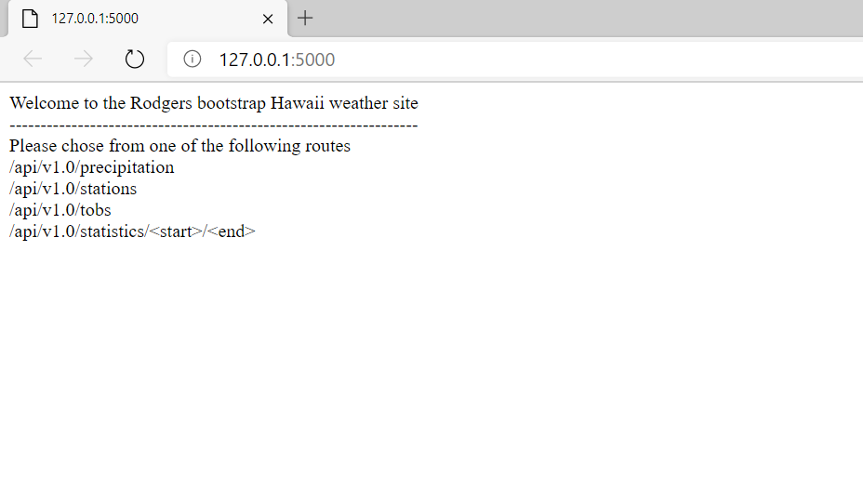
Home Page

Slide 7
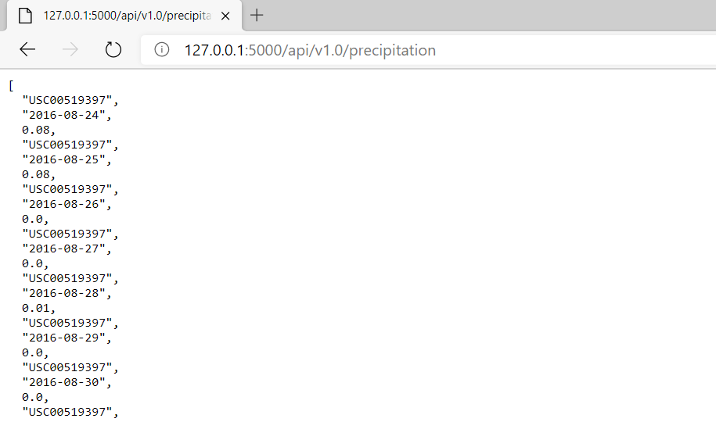
Precipitation Page

Slide 8
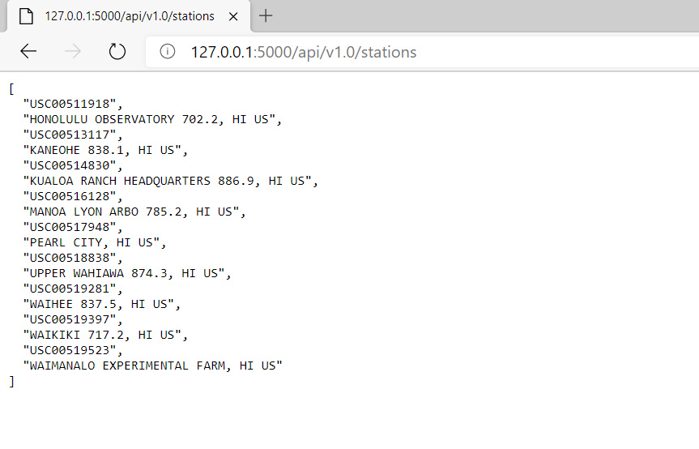
Stations Page

Slide 9

Temperatures Page

Slide 10
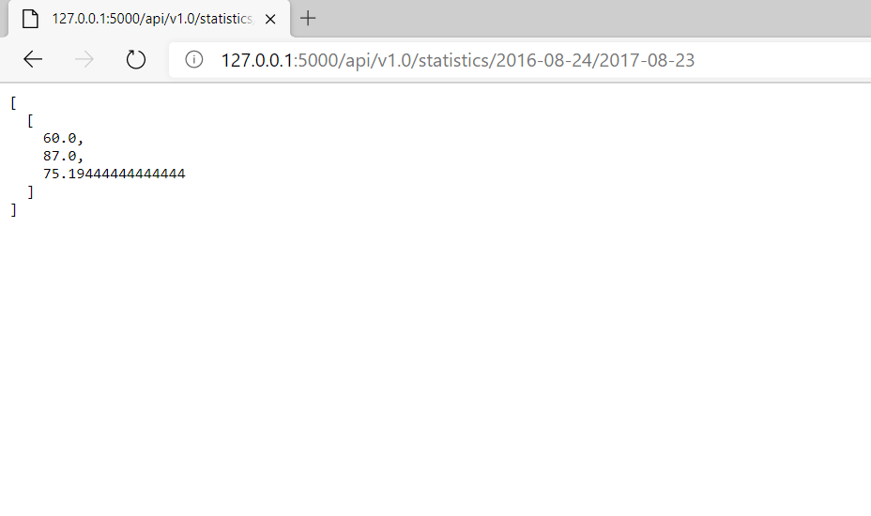
Statistics Page

