Slide 1
High Performance Computing (HPC) with Sun Grid Engine (SGE)
Oxford Biomedical Data Science Training Programme

Slide 2
Overview
Definitions
Batch system basics
SGE in particular
How to use SGE

Slide 3

Definitions
High Performance Computing (HPC)
Blurry concept, relative to historical context
Computational resources available vs required
Notes:
What is high performance computing --- all depends on your current state

Slide 4
Definitions
When do you need to use it?
Resources required > Resources on your PC
Notes:
If your desktop/laptop is struggling then go to HPC

Slide 5
Definitions
When do you need to use it?
Clear symptoms
If your code takes ages to finish
If your code freezes your computer
If your data does not fit into disk or memory

Slide 6

Definitions
Disclaimer
Using an HPC cluster comes with its own issues!
Notes:
A CLUSTER IS NOT LIKE USING YOUR OWN PC
- You need to describe to it your software/conda environment, where to find the pipeline code, which nodes you’d like, how much memory you require

Slide 7
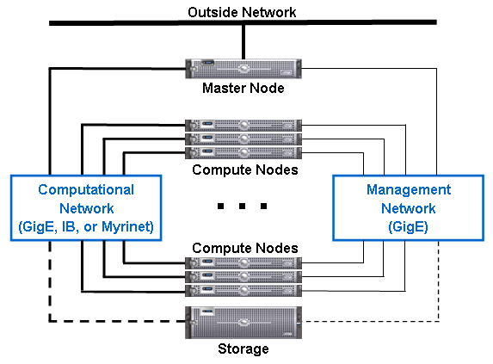
Definitions
How a typical HPC cluster is connected:
Notes:
Redhat 6 is licenced version (have to pay for it, but is supported and has patches/security updates) --- scientific linux is the open source free version of Redhat6
Log into cluster though a master node – this controls acess – need a password
- in cgat this is cgath1, cgath2
- cbrg = deva and klyn (we want to use klyn as it is generally less busy then deva)
- cgath1, cgath2 have redhat licences because we want upto date security on them
Compute node – have basic linux ditrubtion on them (scientific linux which is free – and no licence required)
- we use this free version because it’s internal and we are not worried about security attacks from outside
- compute nodes do not have any graphical interface on them – so can’t open up firefox etc – all software is stored on storage and cluster knowns to look here to run the programs
Storgage
- where all you data/software is
- this is the most expensive bit! Storage costs the most so use symlinks etc to keep data costs down
Management Network
- SGE communication
- specific master process communicating with slaves
Computational Network
- acess ilison

Slide 8
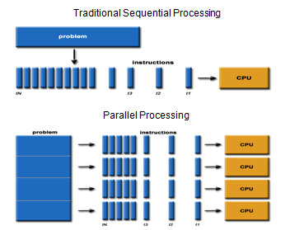
Definitions
Programming paradigms:
Sequential vs. Parallel vs. Distributed
Notes:
Sequential programming – tasks are executed one after an other --- takes longer
Sub problems
- each goes to a different CPU on the same box is parallel
- each going to a CPU on different boxes across network is distributed

Slide 9
Definitions
Amdahl’s law (1967)
Theoretical speed up for parallel programs
Assumptions:
Fraction F of your code perfectly parallelizable
Therefore, fraction 1-F of your code is sequential
There are no overheads for
Scheduling
Networking
Synchronisation
Notes:
This is from andreas
This is theoretical limit – does not account for networking or scheduling overheads

Slide 10
Definitions
Amdahl’s law
Time to run on N cores
Example: 4h program
Where 3h are parallelisable
Then F=75%. Assume N=3
Result is 0.5
Speed up
Example above
Speed up is 2 times faster
(1-0.75) + (0.75/3)
Notes:
(1-F) is the sequential bit of the program
Admals law gives you the fraction of the times for parallel versus if you ran it all sequentiall
Speed up equation just gives you the factor that the code has sped up by
N = number of CPUs
F = fraction of code that can parellise
N & F are the things you want to increase to cut the amount of time your code runs for

Slide 11
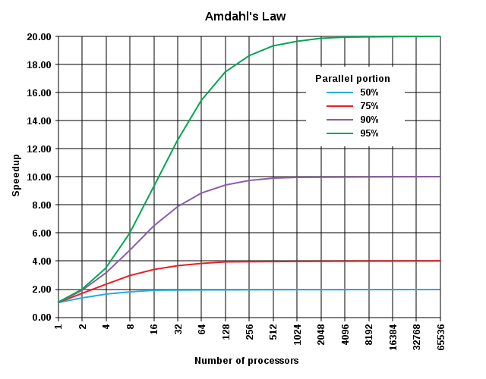
Definitions
Amdahl’s law
Notes:
However there are limits to how much the gains are – 95% of code is parellisable but it still reaches a limit of 20x speedup
Don’t get craxy with parellising code – even a little makes a big improvement after don’t get massive gains

Slide 12
Definitions
How much can I parallelise in practice?
It depends on the problem you are solving
e.g. by individual, by sample, etc.
Parallelising code can be complex
We think sequentially
Dependency among subtasks are difficult to debug
Worth it when time(subtask) >> time(overheads)
Notes:
Be aware if what you are sending to the cluster – if a process only takes 1second to finish then it is better to run it on your desktop – as will have delays from networking etc
- Some tasks are naturally parallisable, some are not

Slide 13
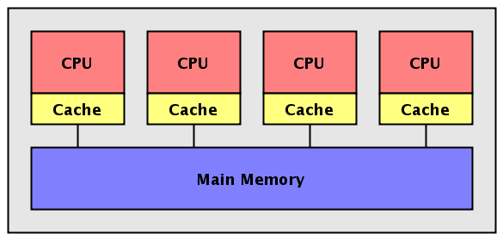
Definitions
Software frameworks
Shared-Memory Multi-Processing (e.g. OpenMP)
Notes:
Different software libraries can be used to parrallise code
Shared-Memory Multi-Processing – single box peocesses communicate through main memory

Slide 14
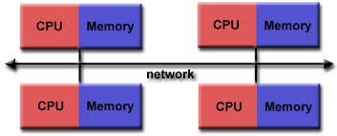
Definitions
Software frameworks
Message-Passing Interface (e.g. OpenMPI)
Notes:
Communicate with all processes through a network

Slide 15
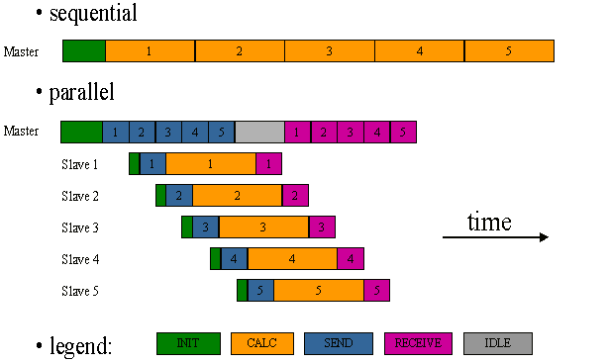
Definitions
Software frameworks
Master-Slave (e.g. pipeline.py)
Notes:
-Master-Slave = master process in charge of orchestrating things – create processes and send to cluster
- Sequential take a longer time then parallel – reduce time of run

Slide 16
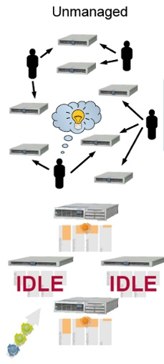
Batch systems
Why use a batch queue?
Manual management of cluster resources:
Notes:
With an unmanaged cluster – people need to actually talk together to discuss who is using what resources – Not as efficient
With a cluster management system like SGE you have a common queue, something works out what to send where, can have idle nodes turned off – more efficient

Slide 17
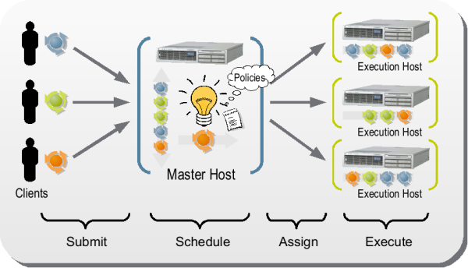
Batch systems
Why use a batch queue?
Automation simplifies and improves things:

Slide 18
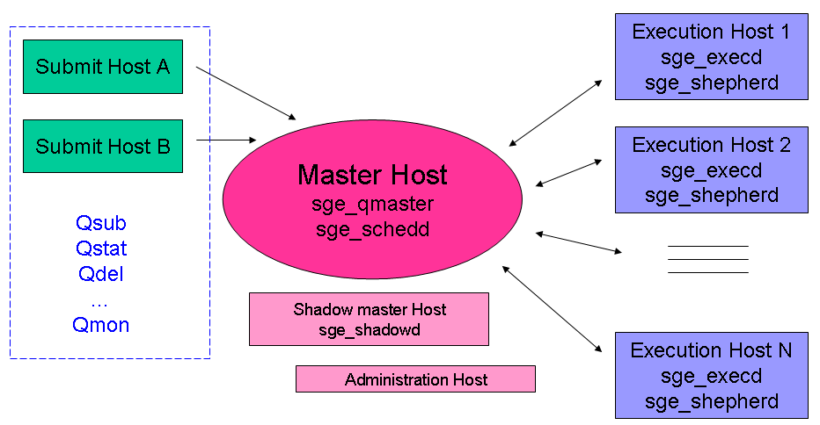
What is SGE
Sun Grid Engine: Architecture
Notes:
SGE = grid-computing computer cluster software system / batch-queuing system Grid Engine is typically used on a computer farm or high-performance computing (HPC) cluster and is responsible for accepting, scheduling, dispatching, and managing the remote and distributed execution of large numbers of standalone, parallel or interactive user jobs. It also manages and schedules the allocation of distributed resources such as processors, memory, disk space, and software licenses.
Software processes --- deamons/processes??? Look this up
SGE arichtecture is talked to through DRAMMA
Master Host = cgat022 – this schedules all the jobs
Shadow master host is cgatui → this is a backup for the master host incase it goes down for some reason
Administration host – a sepreate machine used incase want to configure the cluster for some reason
Execution host 1
sge_shepherd = Receive jobs, run properly and communicate this to master
http://www.oracle.com/technetwork/oem/host-server-mgmt/twp-gridengine-beginner-167116.pdf
At the center of the above diagram is the qmaster. The qmaster is the central component of an Oracle Grid Engine compute cluster, accepting incoming jobs from users, assigning jobs to resources, monitoring the overall cluster status, and processing administrative commands. The qmaster is a multi-threaded daemon that runs on a single host in the compute cluster. To reduce unplanned cluster downtime, one or more shadow masters may be running on additional nodes in the cluster. In the case that the qmaster or the host on which it is running fails, one of the shadow masters will promote the host on which it is running to the new qmaster node by locally starting a new qmaster daemon.
Each host in the cluster that is to execute jobs will host an execution daemon. The execution daemon receives jobs from the qmaster and executes them locally on its host. The capacity to execute a job is known as a job slot. The Oracle Grid Engine software does not place a limit on the number of job slots that an execution daemon can offer, but in most cases the number of job slots is determined by the number of CPU cores available at the execution host. When a job has completed, the execution daemon notifies the qmaster so that a new job can be scheduled to the now free job slot. At a fixed interval each execution daemon will send a report of its status to the qmaster. If the qmaster fails to receive several consecutive load reports from an execution daemon, the qmaster will mark that execution host and all its resources as no longer available and will remove it from the list of available job scheduling targets.
Jobs are sent to the qmaster in a variety of ways. DRMAA provides a programmatic interface for applications to submit, monitor, and control jobs. The Oracle Grid Engine software comes with C and JavaTM language DRMAA bindings, making it possible to use DRMAA from a wide range of applications. qmon is the Oracle Grid Engine graphical user interface. From qmon users and administrators can submit, monitor, and control jobs as well as manage all aspects of the cluster. qsub is a command-line utility for submitting batch, array, and parallel jobs. qsh, qrsh, qlogin,
4
and qtcsh are all command-line utilities for submitting various kinds of interactive jobs. For more information on these command-line utilities, see the Oracle Grid Engine 6.2 Administration Guide3.
The last component shown in the diagram is ARCo, the Accounting and Reporting Console. ARCo is a web-based tool for accessing Oracle Grid Engine accounting information automatically stored in an SQL database. Using ARCo, end users and administrators can create and run queries against the cluster's accounting data. Administrators can also pre-configure ARCo with common queries for their end users to run.

Slide 19
What is SGE
Job scheduling
Scheduler is triggered either by:
Periodically (used on our systems – 15s on CGAT, 30s on CBRG)
New job submitted
Job finished
Scheduler assesses the needs of all pending jobs against all available resources, considering:
Job priority
Cluster configuration and cluster load
Job requirements (CPU, RAM, I/O)
Execution hosts’ relative performance
After assessment:
Dispatch new jobs
Suspend running jobs
Notes:
This slide is introducing queue.
Scheduler processing can take a while; periodic means there’s always a ready answer.

Slide 20
How to use SGE
Get to know your jobs
Get to know your cluster
Submit jobs to the cluster
Monitor jobs
Cancel jobs

Slide 21
Get to know your jobs
Job profiling
Iterative process
Run first a smaller instance of your problem
Measure the computational resources: time and memory
Repeat the process with a bigger instance
Use profiling tools, e.g.:
Linux: use top to see your program in action
Linux: /usr/bin/time –o profile.out –v ./script.sh
Sun Grid Engine: qstat –j <job_id> | grep usage
Python:Davids’ talk on debugging/profiling tools
Notes:
Log into node to use top
Cgat core has /usr/bin/time –o profile.out –v ./script.sh

Slide 22
Exercise 1
Let’s log into the cluster
We’ll be typing the following commands as we speak
Notes:
Logging on to the cluster require cgat installation and drama api (See cbrg env bash rc on wiki)

Slide 23
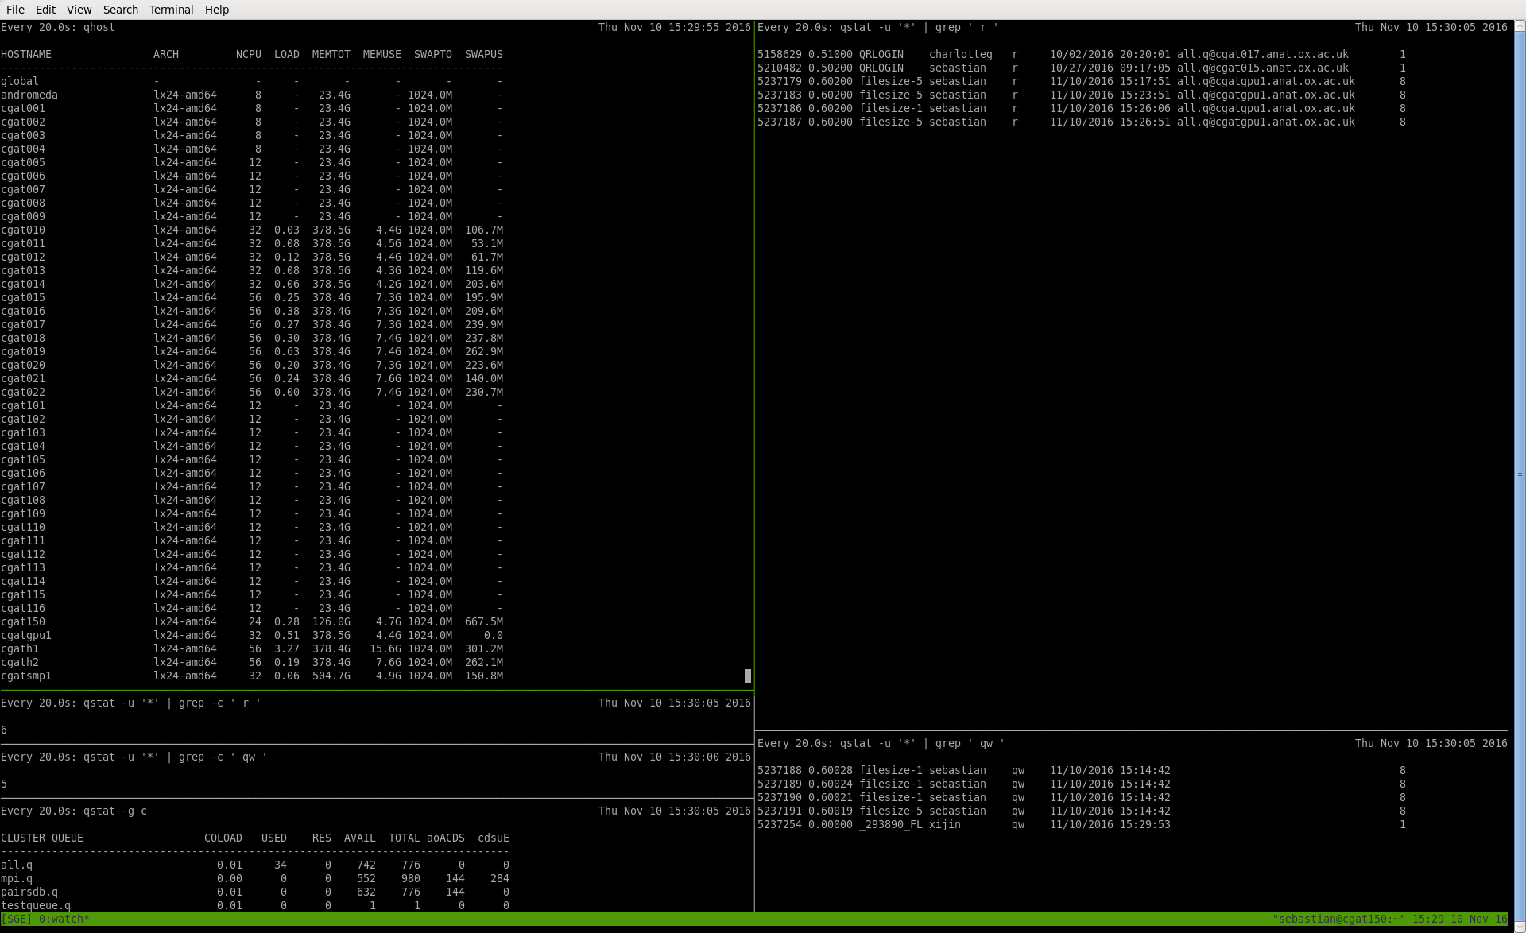
Get to know your cluster
Computational resources available – CGAT:
qhost
Notes:
Col 1 = node (HOSTNAME)
Col 2 = ARCH = architecture
Col 3 = NCPU = number of CPUs in total available on this node
Col4 = numberof processes running 0 = none, 3.27 = 3 processes – e.g. cgat150 will be full when 24 processes are running
Col 5 = Memory total on each node
Col 6 = Memory being used 7.6G = notjhong running/ empty node – this is the operating system
Col 7 & 8 = SWAP memory
- we just set this to 1024M as we don’t want to use swap memory
- swap memory is special part of file system that is only used if total memory is full
- it gives extra space but it uses the hard drive which is slower

Slide 24
Get to know your cluster
Computational resources available – CBRG:
qhost
cbrgbigmem01p lx26-amd64 40 0.00 1009.6G 10.6G 32.0G 0.0
cbrgbigmem02p lx26-amd64 40 16.43 1009.6G 223.5G 32.0G 43.6M
cbrgwn001p lx26-amd64 24 15.69 252.2G 171.4G 32.0G 27.2G
cbrgwn003p lx26-amd64 24 15.63 252.2G 170.1G 32.0G 38.6M
cbrgwn004p lx26-amd64 24 15.68 252.2G 170.1G 32.0G 28.7M
cbrgwn005p lx26-amd64 48 - 252.2G - 32.0G -
cbrgwn006p lx26-amd64 24 1.62 252.2G 12.1G 32.0G 26.9G
cbrgwn007p lx26-amd64 24 0.99 252.2G 6.9G 32.0G 48.2M
cbrgwn008p lx26-amd64 24 15.62 252.2G 170.1G 32.0G 86.3M
cbrgwn009p lx26-amd64 24 0.00 252.2G 2.2G 32.0G 24.3M
cbrgwn010p lx26-amd64 24 15.74 252.2G 170.2G 32.0G 21.9M
cbrgwn011p lx26-amd64 24 1.61 252.2G 4.8G 32.0G 3.9G
cbrgwn012p lx26-amd64 24 0.95 252.2G 14.6G 32.0G 31.9G
Notes:
Col 1 = node (HOSTNAME)
Col 2 = ARCH = architecture
Col 3 = NCPU = number of CPUs in total available on this node
Col4 = numberof processes running 0 = none, 3.27 = 3 processes – e.g. cgat150 will be full when 24 processes are running
Col 5 = Memory total on each node
Col 6 = Memory being used 7.6G = notjhong running/ empty node – this is the operating system
Col 7 & 8 = SWAP memory
- we just set this to 1024M as we don’t want to use swap memory
- swap memory is special part of file system that is only used if total memory is full
- it gives extra space but it uses the hard drive which is slower

Slide 25
Get to know your cluster
Host groups?
qconf –shgrpl # show all host groups
qconf –shgrp <@name> # show host group conf.
CGAT
CBRG
$ qconf -shgrpl
@allhosts
@mpihosts
$ qconf -shgrpl
no host group list defined
Notes:
The l in the command means list – enables you to see groups
qconf -shgrp @allhosts – lists all the nodes in the @all group
[-shgrpl] show host group list

Slide 26
Get to know your cluster
Type of queues?
qconf –sql # show list of queues
qconf –sq <queue-name> # show queue config.
CGAT
CBRG
$ qconf -sql
all.q
mpi.q
pairsdb.q
$ qconf -sql
batchq
bigmemq
blastq
local
testq
wholenodeq
In practice, we mostly use the defaults:
all.q or batchq
Notes:
CBRG queues
Batchq. == default – where everything goes
Bigmemq = 1 @ a time on large mem machines
Wholenodeq = scheduling hack 1 job at a time, use if want lots of CPU threads + deffinently need all the memory of a machine
Testq = EWAN system testing
LEGAGY – to be removed!
Blastq
local

Slide 27
Get to know your cluster
Parallel environments:
qconf -spl
dedicated
Allocation rule:
All jobs on the same execution host ($pe_slots)
make
Allocation rule:
Round robin
($round_robin)
mpi
Allocation rule:
Fill-up
($fill_up)
Notes:
The parallel environment you want depends on your tool – by default we use dedicated
dedicated. =1 want 10 cpus –all on same machine – useful for things like mappers which share information e.g. genomes across processes
- if the machine only has 8 cpus the job will not go to that machine it will go to a bigger one
Make = distribute jobs evenly across different machines
Mpi = fill up one machine before moving onto another
allocation_rule - this setting controls how job slots are assigned to hosts. It can have four possible values:
a number - if set to a number, Grid Engine will assign that many slots to the parallel job on each host until the assigned number of job slots is met. Setting this attribute to 1, for example, would mean that the job gets a single job slot on each host where it is assigned. Grid Engine will not assign the job more job slots than the number of assigned hosts multiplied by this attribute's value.
$fill_up - use all of the job slots on a given host before moving to the next host
$round_robin - select one slot from each host in a round-robin fashion until all job slots are assigned. This setting can result in more than one job slot per host.
$pe_slots - place all the job slots on a single machine. Grid Engine will only schedule such a job to a machine that can host the maximum number of slots requested by the job. (See below.)
control_slaves - this setting tells Grid Engine whether the parallel environment integration is "tight" or "loose". See your parallel environment's documentation for more details.
job_is_first_task - this setting tells Grid Engine whether the first task of the parallel job is actually a job task or whether it's just there to kick off the rest of the jobs. This setting is also determined by your parallel environment integration.
https://blogs.oracle.com/templedf/entry/configuring_a_new_parallel_environment

Slide 28
Get to know your cluster
Is the cluster empty or loaded?
qhost –j
qstat –f –u “*” (on CBRG this is just ‘qstat’)
queuename qtype resv/used/tot. load_avg arch states
---------------------------------------------------------------------------------
batchq@cbrgbigmem01p BIP 0/0/40 0.00 lx26-amd64 d
---------------------------------------------------------------------------------
batchq@cbrgbigmem02p BIP 0/3/40 2.30 lx26-amd64
1638175 0.55500 TyGER_star doconnor r 01/14/2019 12:10:17 1
1638182 0.55500 TyGER_star doconnor r 01/14/2019 12:10:32 1
1638191 0.55500 TyGER_star doconnor r 01/14/2019 12:10:52 1
---------------------------------------------------------------------------------
batchq@cbrgwn001p BIP 0/3/24 7.81 lx26-amd64
1326769 0.55500 QLOGIN rbeagrie dr 10/13/2018 01:28:23 1
1638181 0.55500 TyGER_star doconnor r 01/14/2019 12:10:32 1
1638190 0.55500 TyGER_star doconnor r 01/14/2019 12:10:47 1
---------------------------------------------------------------------------------
Notes:
Qstat – cbrg has a wrapper for qstat –f –u ‘*’
Listing is in the format queue@node – a queue can be down without the node being down.

Slide 29
End of exercise 1
Back to the slides!

Slide 30
Submit jobs to the cluster
Batch submission:
qsub [sge-options] <batch-prog> [prog-args]
e.g.: pipeline.py
Interactive sessions:
qrsh [sge-options] [commands]
Notes:
** Make sure they can open notebooks valisly on CBRG systems – should be able to use the same command as we have
Explain graphical/non-graphical difference between clusters.

Slide 31
Submit jobs to the cluster
Useful SGE options:
qsub –cwd # use current directory as working one
qsub –i <input.file> # redirect standard input
qsub –o <output.file> # redirect standard output
qsub –e <error.file> # redirect standard error
qsub –j y # redirect standard error to output
Notes:
When you submit jobs to cluster you need to give it certain things
Need to tell it the working directly otherwise will just use home directory by default!!
This is all generated at the top of the pipeline.py scripts

Slide 32
Submit jobs to the cluster
More useful options
qsub –p <priority> # lowest: -1024, highest: 1023
qsub –N <job-name> # change job name
qsub –M <email> -m e # email me when done
qsub –q <queue-name> # select specific queue
qsub –v name=value # export env variables
qsub –hold_jid <job-id> # start job after <job-id>
Notes:
We generally use qsub –p -10 as priority in pipeline.py as default
If using a long running job get it to email you when it finished
-qsub –v name=value = export environmental variables – in pipeline.py use –V to export everything from current shell (conda env etc)
If you send 1000 jobs SGE will penalize your priority – group ypu jobs into lots – wait for these to start after those have finishes
Nice -19 is used to run the pipeline – this is stating the priority of the master process

Slide 33
Submit jobs to the cluster
Define job requirements
Run time limit
qsub –l h_rt=1:30
Memory usage (per slot)
qsub –l mem_free=2G
Notes:
Memory values are specified in but for convenience the multipliers k(1000), K(1024), m, M, g and G can be appended.
Qsub –l h_rt=1:30 = kill process after 1hr and 30 mins – useful if you think the job is buggy and should have run in an hour
Qsub –l mem_free=2G = 1 slot if dedicated - 10 = 2x 10G on same machine

Slide 34
Submit jobs to the cluster
Define requirements for parallel jobs:
Shared-memory multi-processing:
qsub –pe dedicated <n-slots>
Message-passing interface:
qsub –pe mpi <n-slots>
Notes:
How to use parallel enviroments

Slide 35
Submit jobs to the cluster
Array jobs (qsub only)
qsub –t n[-m[:s]] <script.sh>
Exported environment variables:
SGE_TASK_ID
SGE_TASK_FIRST, SGE_TASK_LAST, SGE_TASK_STEPSIZE
Example
qsub -t 2-10:2 <script.sh>
SGE_TASK_ID=2, 4, 6, 8, 10
SGE_TASK_FIRST=2, SGE_TASK_LAST=10, SGE_TASK_STEPSIZE=2
Notes:
Array jobs -> useful for stochastic algorithms – e.g. you want to run the same code 100x with different seeds

Slide 36
Submit jobs to the cluster
Batch jobs: Better use a submission script
#!/bin/bash # The SGE batch system uses the current directory as working directory. # Both files (output.dat and error.dat) will be placed in the current # directory. The batch system assumes to find the executable in this directory. #$ -cwd # Redirect output stream to this file. #$ -o output.dat # Redirect error stream to this file. #$ -e error.dat # Send status information to this email address. #$ -M sebastian.lunavalero@imm.ox.ac.uk # Send an e-mail when the job is done. #$ -m e # For example an additional script file to be executed in the current # working directory. In such a case assure that script.sh has # execution rights (chmod +x script.sh). ./script.sh
qsub sge-job.sh
Notes:
Always best to write a script when submitting jobs to the cluster
- It always you to version control it and add comments!

Slide 37
Exercise 2
.bashrc ready?
ssh into head node
Notes:
use tmux!

Slide 38
Exercise 2
CGAT
CBRG
mkdir test-sge cd test-sge
cp /ifs/devel/system/sge-exercises/* .
# run a simple, serial job: qsub sge-serial.sh; qstat; cat serial.output
# select a specific execution host: qsub -l h=cgat022 sge-serial.sh; cat serial output # select a specific amount of RAM: qsub -l mem_free=2G sge-serial.sh # select 2 CPU cores (SGE slots): qsub -pe dedicated 2 sge-serial.sh # run a parallel job, with customised name: qsub -N myjob sge-parallel.sh
# run sge-serial.sh from Python
cat test-drmaa.py; python test-drmaa.py
mkdir test-sge cd test-sge
cp /t1-data/data/cgat/tutorials/sge-exercises/* .
# run a simple, serial job: qsub sge-serial.sh; qstat -u $USER; cat serial.output
# select a specific execution host: qsub -l h=cbrgwn015p sge-serial.sh; cat serial.output # select a specific amount of RAM: qsub -l mem_free=2G sge-serial.sh # select 2 CPU cores (SGE slots): qsub -pe dedicated 2 sge-serial.sh # run a parallel job, with customised name: qsub -N myjob sge-parallel.sh
# run sge-serial.sh from Python
cat test-drmaa.py; python test-drmaa.py
Notes:
This is a test script to run – the task is just a sleep
Copy scripts to working directory ( where are these scripts - in the training folder ??)
Py files – small python script using the drama api to talk to the cluster! Where are these?

Slide 39
Exercise 2
Let’s submit a different job to the cluster
Any examples from previous exercises?

Slide 40
Submit jobs to the cluster
Interactive sessions
Logging into a compute node via SGE:
qrsh [sge-options]
qrsh -q all.q -pe dedicated 4 -l mem_free=10G
Running small algorithms on the fly:
qrsh [sge-options] command [arguments]
qrsh -V -q all.q -l h=node01 python script.py --op1

Slide 41
Exercise 3
Let’s use qrsh in the cluster

Slide 42
Monitor your jobs
Once submitted:
qstat –u <user-name> # summary information
qstat –j <job-id> # detailed information
qstat –r # show requested resources
qstat –t # show array/parallel jobs
Log into the execution hosts with qrsh:
top # check CPU usage
free # check memory usage
df –h; du –sh your-folder/ # check disk usage
getquota # CRBG specific
Notes:
Log into the executing hosts with qrsh to profile the job
- Du = default linux command – CBRG has a getquota command to summarise for you

Slide 43
Cancel your jobs
Sometimes necessary...
qdel <job-id> # <job-id> displayed with qstat

Slide 44
DRMAA API
Distributed Resources Management Systems
http://www.drmaa.org ; Wikipedia
DRMAA is an standard API that focuses on:
Job submission, control, and monitoring
Pipeline.py uses DRMAA to talk to SGE
DRMAA-compliant DRMSs out there:
Sun Grid Engine (current DRMS in CGAT, CBRG)
SLURM (our next DRMS)
Others: LSF, PBS/Torque, etc.
Notes:
SGE belongs to a software family called Distributed Resources Management Systems.
They all allow you to make efficient use of a compute cluster.
DRMAA is an effort to make them all compatible!
API = application programme interface
With pandas you use an API – iuts just the same as that – a set of functions that allows you to do certain things
DRAMAA is a common package that works with many different schedulers (SLURM, SGE, Others)

Slide 45
DRMAA API
Rather than using directly SGE…
If you want your code/pipeline to be portable between HPC systems:
Use pipeline.py
Or the DRMAA API!
http://drmaa-python.readthedocs.io
Notes:
Pipeline.py works with SGE and Dramma already

Slide 46
Thanks!
Questions?

